Slide 1
ML Project Proposal House Price Prediction
Group 9:
XIA XICHENG, SHEN LI, LI FEIJIAO, WANGYIFAN, JIN WEIGUO

Slide 2

Project Description
Kaggle competition:
House Prices: Advanced Regression Techniques
Potential model to utilize:
Lasso, Ridge

Slide 3
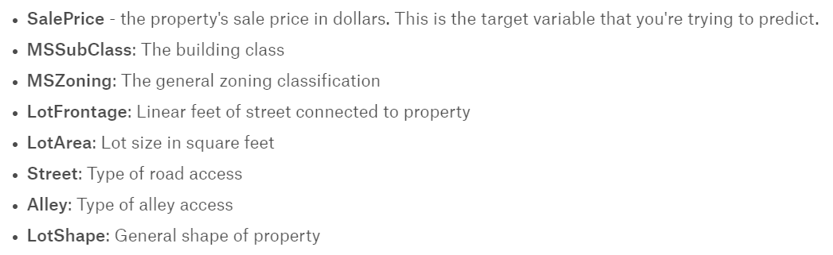
Data Structure
Training dataset: 1460 * 80 (incl explained variable)
Test dataset: 1459 * 79
Sample variables:

Slide 4
Methodology
Read those kernels
Data cleaning: cope with missing values and abnormal values(median filter, winsorize)
Single factor exploration: narrow our focus on plausibly important factors based on our intuition
Feature engineering: dummies, linear/non-linear transformations
Dimension reduction: PCA
Scale the data: normalization/standardization, max min scalar
Select models and parameters: Lasso/Ridge/SVR, cross-examination/regularization/penalization/learning- rate/iteration-times

Slide 5
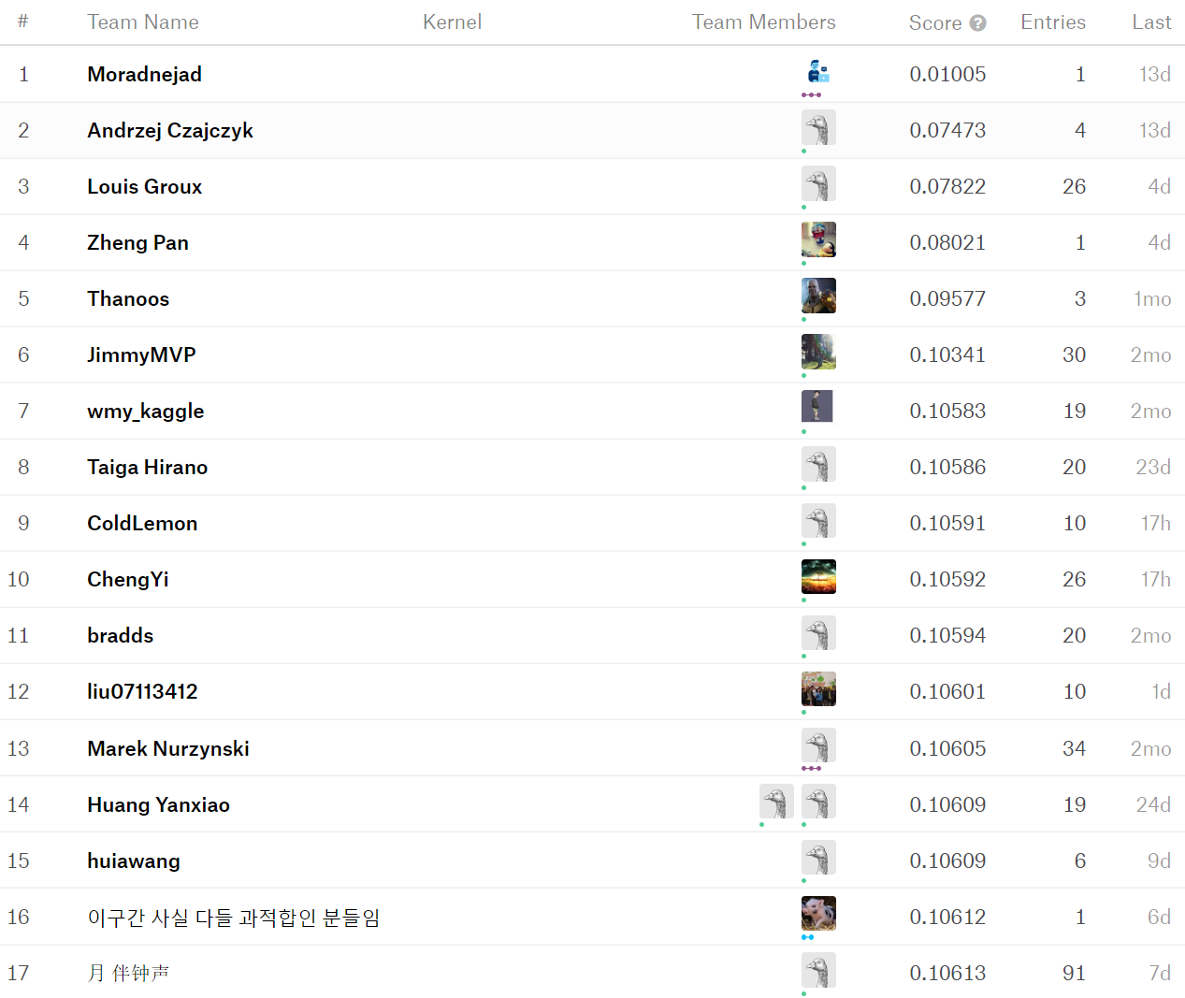
Performance Evaluation Criteria_Root Mean Squared Log Error

Slide 6
Our Target
Conservatively:
Ranking 3000, score of less than 0.15
Hopefully:
Ranking 2000, score of approx. 0.13

Slide 7
Thanks

