Slide 1
Consider a small library system with the following transactions:
1. Check out a copy of a book/ Return a copy of a book.
2. Add a copy of a book to/ Remove a copy of a book from the library.
3. Get the list of books by a particular author or in a particular subject area.
4. Find out the list of books currently checked out by a particular borrower.
5. Find out what borrower last checked out a particular copy of a book.
(uml in next page)

Slide 2
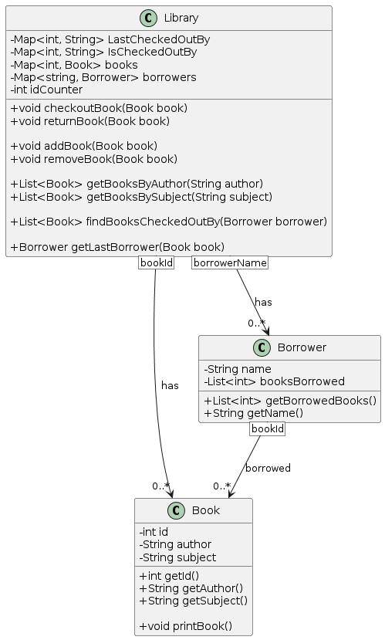
Consider a small library system with the following transactions:

Slide 3
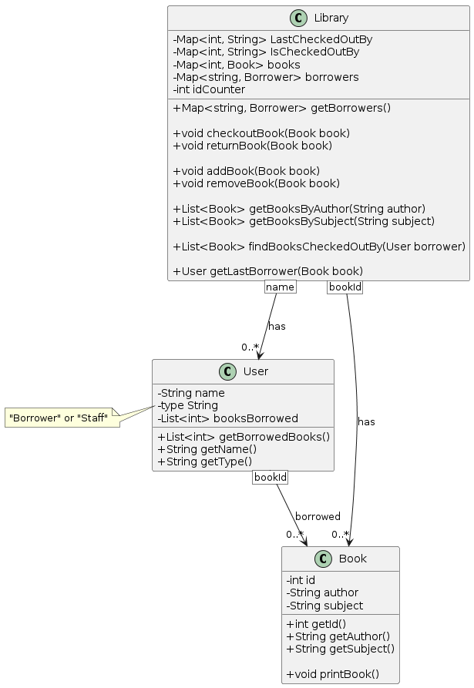
There are two types of users: staff users and ordinary borrowers.

Slide 4
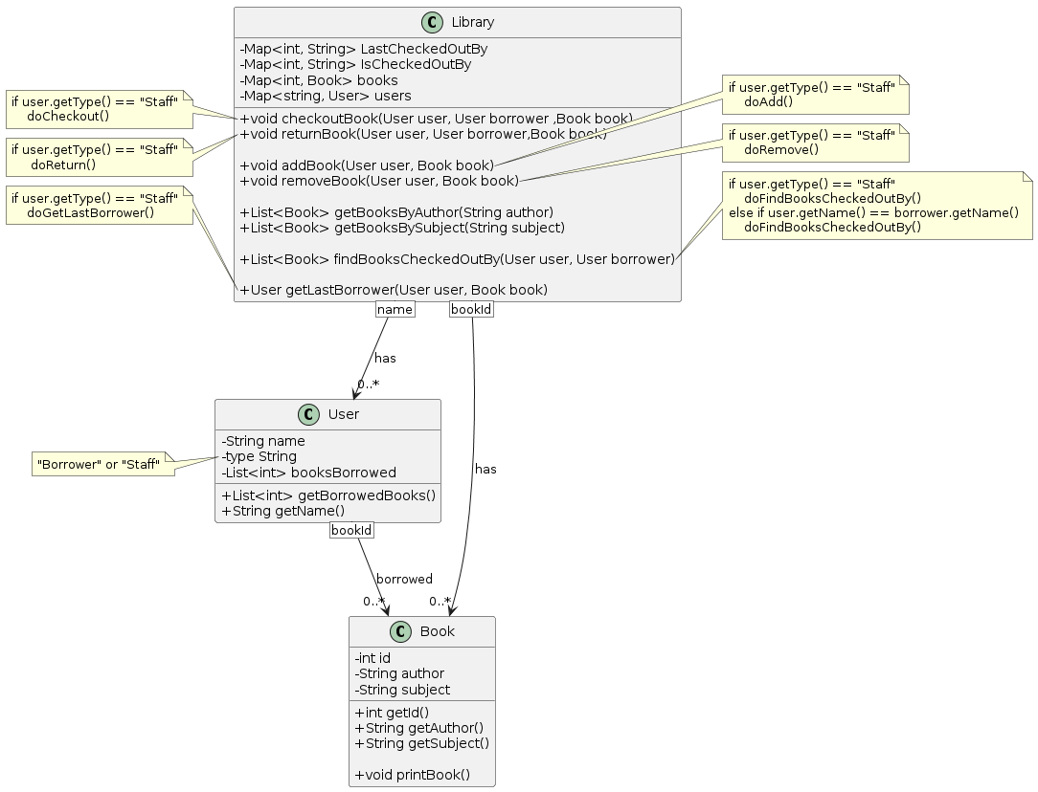
Transactions 1, 2, 4 and 5 are restricted to staff users, except that ordinary borrowers
can perform transaction 4 to find out the list of books currently borrowed by themselves.

Slide 5
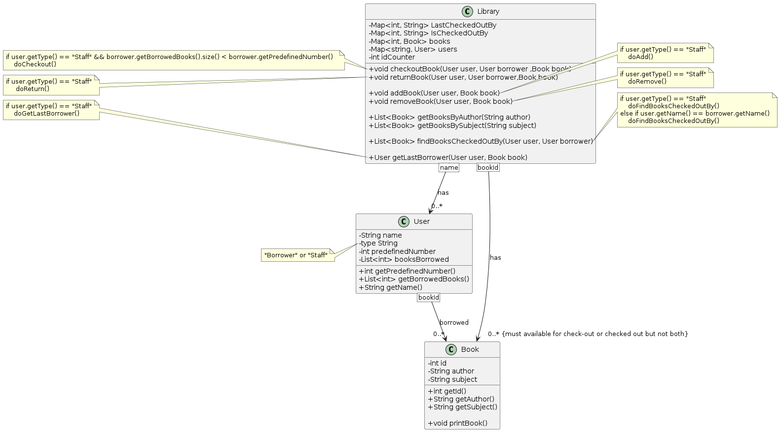
The system must also satisfy the following constraints:
1. All copies in the library must be available for check-out or checked out.
2. No copy of a book may be both available and checked out at the same time.
3. A borrower may not have more than a pre-defined number of books checked out at one time.

Slide 6
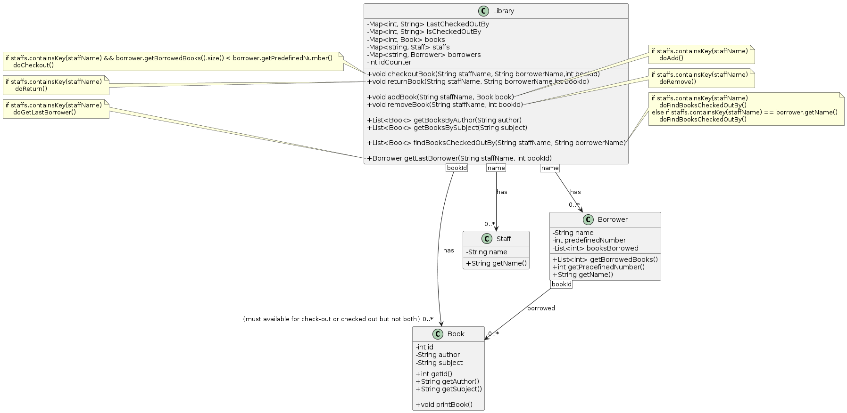
Refactor: encapsulate what Varies -> Staff, Borrower

Slide 7
Refactor: abstract common behavior -> No staff and Borrower are very different

Slide 8
Refactor: delegate to abstraction -> No

Slide 9
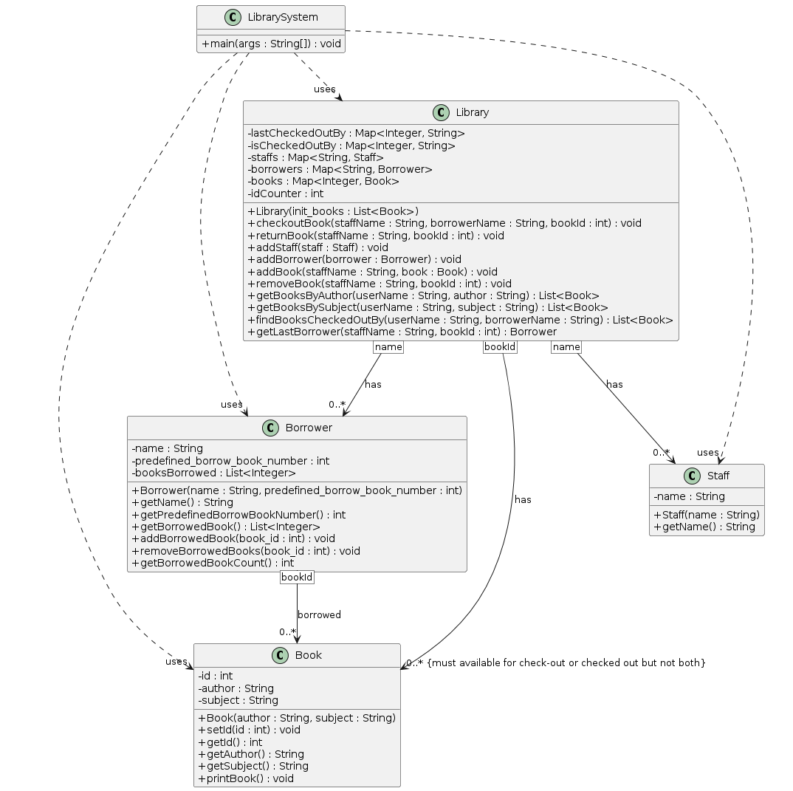
Refactor Final

