Slide 1
mqtt sagas

Slide 2
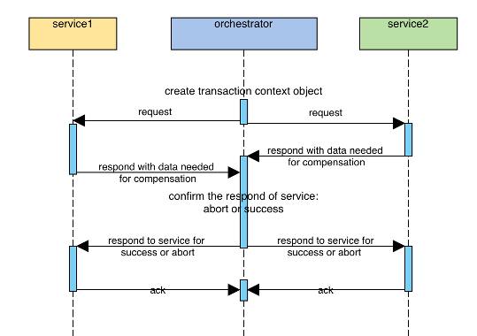
lock and no lock

Slide 3
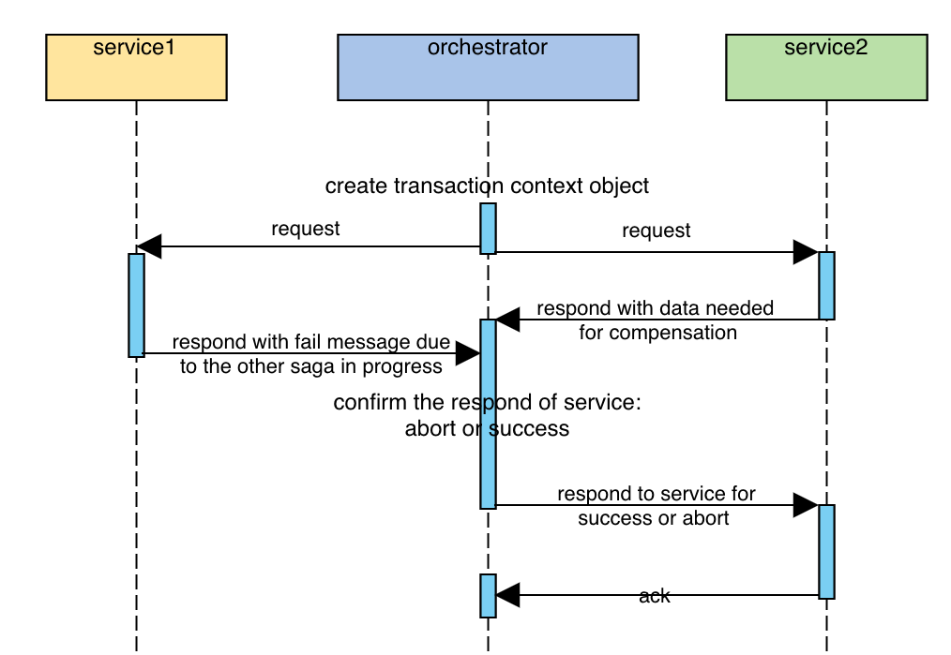
lock and no lock

Slide 4
lock and no lock
constructor(transactionId, transientIdList) {
this.transactionId = transactionId;
this.services = [
{
serviceId: 'service1',
state: 0, // -1 = fail, 1 = success
ack: false,
reject: false,
transientId: '',
compensate:[] // 補償操作
},
{
serviceId: 'service2',
state: 0,
ack: false, // -1 = fail, 1 = success
reject: false,
transientId: '',
compensate:[] // 補償操作
}
]

Slide 5
short circuit
constructor(transactionId, transientIdList) {
this.transactionId = transactionId;
this.services = [
{
serviceId: 'service1',
state: 0, // -1 = fail, 1 = success
ack: false,
fail: false,
reject: false,
transientId: '',
compensate:[] // 補償操作
},
{
serviceId: 'service2',
state: 0,
ack: false, // -1 = fail, 1 = success
fail: false,
reject: false,
transientId: '',
compensate:[] // 補償操作
}

Slide 6
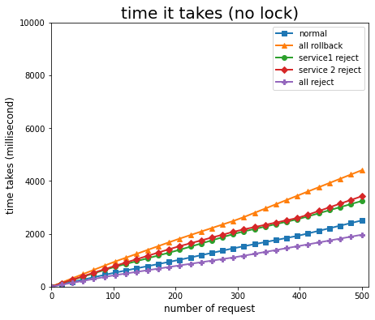
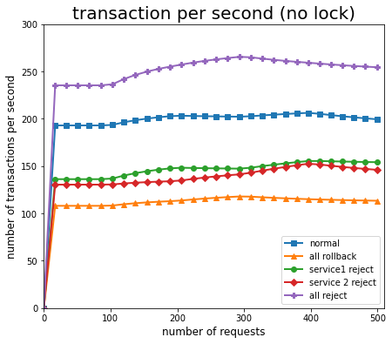
no lock experiment

Slide 7
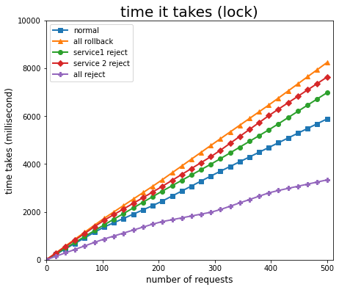
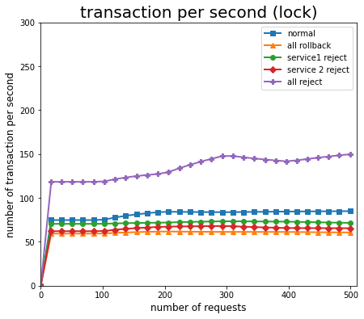
lock experiment

Slide 8
comparison

Slide 9
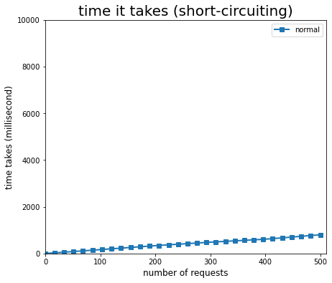
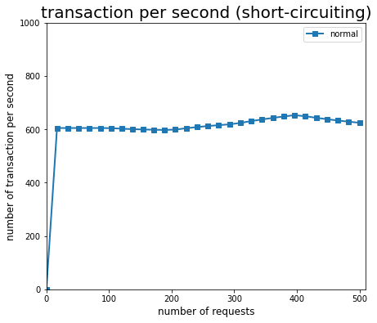
short circuit

Slide 10
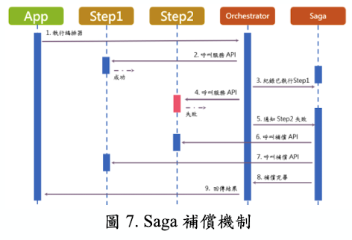
paper

Slide 11
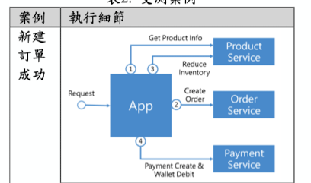
confirm ?

