Slide 1
Final Exam
Mark Louis Lim S12

Slide 2
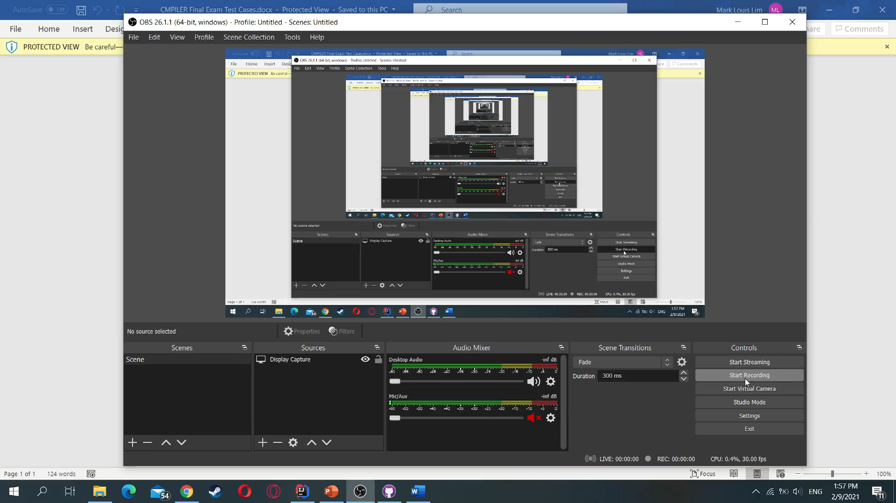
Video Sample

Slide 3

Lexical Analysis
Tokens are identified in a per-character basis
i.e. a b * would be identified as TERMINAL TERMINAL SYMBOL
The tokens are stored in a list
$ is added last to indicate the end of input

Slide 4
Syntax Analysis
expr: id union expr| LPAREN expr RPAREN symbol union expr| ‘’ ;
symbol: '*’ | '+’ | '?’ | ‘’ ;
union: 'U' |’’ ;
id: TERMINAL symbol | 'E’ ;
‘’ is epsilon
Grammar rules are stored in a 2D hashmap with the structure of <Key1, Key2, Value>
Hashmap is instantiated as follows:

Slide 5
Syntax Analysis (cont.)
K1 serves as the non-terminal of the grammar
K2 serves as the terminal of the grammar
Thus the rule is dependent on the case:
Given K1, and the current token is K2, execute this rule
If found return rule, else return null (which exits the parsing)

