Slide 1
Scanner Problem Set
Mark Louis Lim S12

Slide 2
Test Case #1

Slide 3
Test Case #2

Slide 4
Test Case #3

Slide 5

Token handling
Lines are read at a time with .readLine()
Split using the <whitespace> delimiter
Tokens with leading and trailing commas are removed with .replace(“,”)

Slide 6
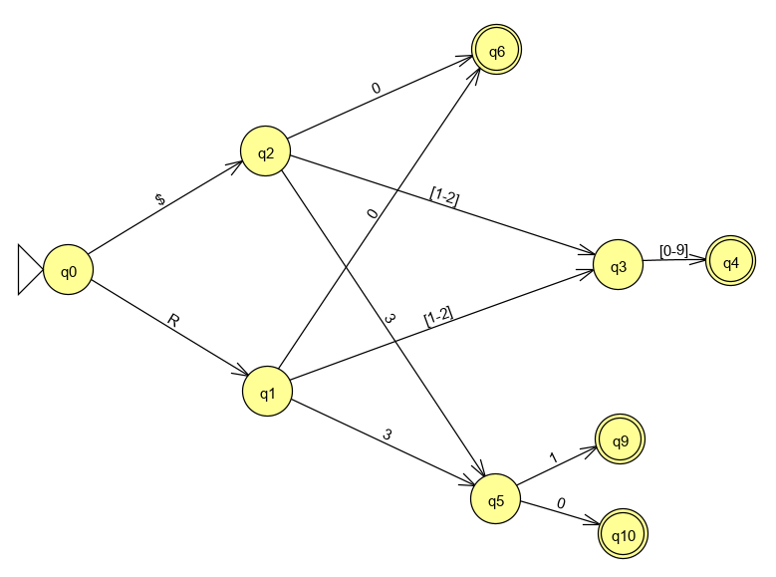
GPR DFA
Regex equivalent:
[R$]([0-9]|[12][0-9]|3[01])

Slide 7
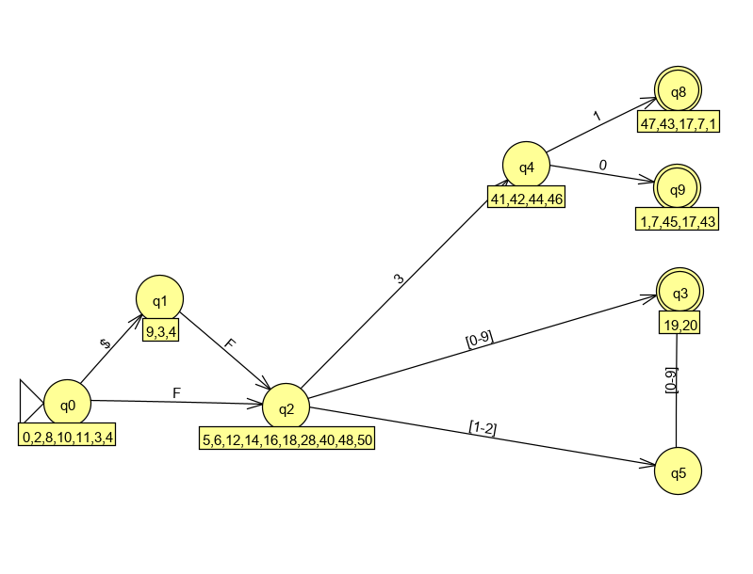
FPR DFA
Regex equivalent:
[$]?F([0-9]|[12][0-9]|3[01])\b

Slide 8
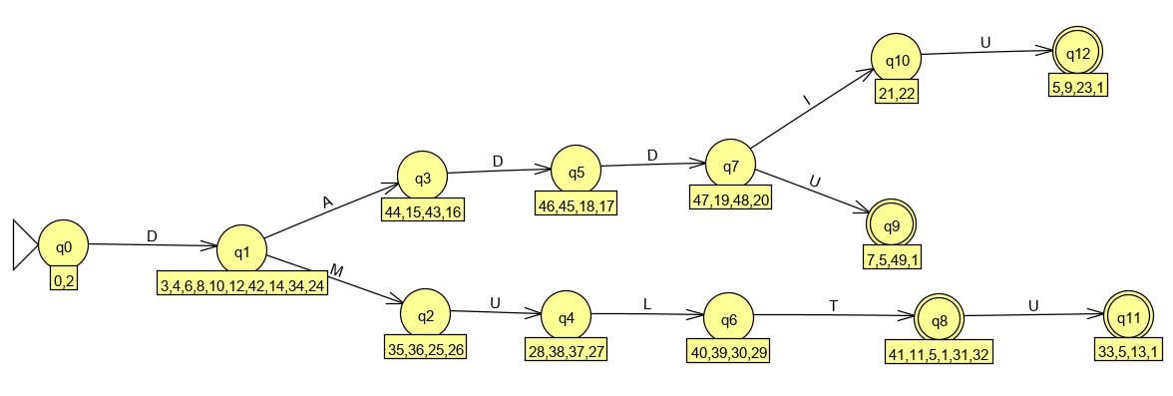
Keyword DFA
Regex equivalent:
D(ADDI?U|MULTU?)\b

Slide 9
Combined
GFA
$ | R
ε
S
$ | F
ε
A
NFA
D
ε
KEYWORD
This is what the code structure is meant to represent

Slide 10


Unknown Tokens
All unknown tokens are identified with ERROR token type
This does not include empty strings or newlines which return null

