Slide 1
generator
Input
Output
road (车道环境，BV位置)
trajectory (所有BV, pov的轨迹，可拟合为函数)
修正后的trajectory
疑问：修正的traj没考虑CAV，是否仍发生碰撞？
CAV task/controller (描述为特定位置的速度、方向)
discriminator
Input
Output
修正的trajectory
CAV task/controller
该环境是否为真实的碰撞环境
road
driving model
通过输入model检验新traj是否仍发生碰撞

Slide 2
generator
discriminator
Input
Output
Input
Output
road (车道环境)
模拟后状态
神经网络
是否真实 simulator的为真，generator的为假
随机向量
BV初始状态 (位置，速度，加速度，box，type…)
simu net
simu net是simulator的网络结构，训练simu net使其与simulator有相同output
simulator
Input
Output
Input
仿真直到发生碰撞或系统稳定
Output
road
神经网络
road
BV初始状态
模拟后状态
BV初始状态
模拟后状态
BV模型(IDM)
BV模型
AV模型(ACC)
AV模型
轨迹和速度
可以是生成的也可以是自己找的

Slide 3
road (length, lane num…)
BV’s initial state ((x,y), v, a, box, type…)
random
vector
&
BV’s model (IDM)
neutral
network
AV’s model (ACC)
generator
discriminator
simulator
(simu net)
simu net是simulator的网络结构，训练simu net使其与simulator有相同output
trajectory
is true?
trajectory
simulator--true
velocity
generator--false
velocity
training

Slide 4
road (length, lane num…)
BV’s initial state ((x,y), v, a, box, type…)
&
BV’s model (IDM)
AV’s model (ACC)
Simu-net is the network structure of the simulator. They will have a similar output after training.
generator
discriminator
simulator
(simu net)
trajectory
is true?
trajectory
simulator--true
velocity
generator--false
velocity
training

Slide 5
road (length, lane num…)
BV’s initial state ((x,y), v, a, box, type…)
BV’s control (IDM)
random
vector
generator
dynamics
(BV’s task)
BV’s final state
&
AV’s control (ACC)
Simu-net is the network structure of the simulator. They will have a similar output after training.
real
simulator
simu-net
discriminator
critical measurement
is true?
real
critical measurement
simulator--true
generator--false
training

Slide 6
training (obj: max CM)
road (length, lane num…)
Critical Measurement
Simu-net
training
(obj: min |CM-RCM|)
BV’s initial state ((x,y), v, a, box, type…)
random
vector
Generator
dynamics
(BV’s task)
BV’s final state
Real
Simulator
Real
Critical Measurement
input/output
&
AV’s Control (ACC)
neural network
BV’s control (IDM)
other process

Slide 7
road (length, lane num…)
AV&BV’s initial state ((x,y), v, a, box, type…)
random
vector
Critical Measurement
Generator
Simu-net
AV&BV’s task
AV&BV’s final state
&
input/output
AV’s Control (ACC)
dynamics
neural network
BV’s control (IDM)

Slide 8
training (obj: max CM)
Critical Measurement
Simu-net
road (length, lane num…)
AV&BV’s initial state
random
vector
training
(obj: min |CM-RCM|)
Generator
AV&BV’s task
AV&BV’s final state
input/output
&
Real
Critical Measurement
Real
Simulator
neural network
AV’s Control (ACC)
other process
BV’s control (IDM)

Slide 9
training (obj: max CM)
Critical Measurement
Simu-net
road (length, lane num…)
1 lane
MDP, RNN
TTC
AV&BV’s initial state
x, v0, v1, a0
random
vector
training
(obj: min |CM-RCM|)
Generator
AV&BV’s task
AV: following
BV: a0, t
MLP(sigmoid)
AV&BV’s final state
min_t {TTC_t}
input/output
&
Real
Critical Measurement
Real
Simulator
neural network
AV’s Control (ACC)
other process
BV’s control (IDM)

Slide 10
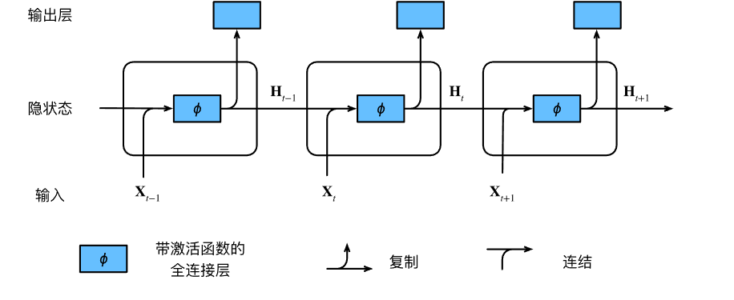
TTC
TTC
TTC
x, v_0, v_1
d, v_0, v_1
d, v_0, v_1
a_0
a_0
…
0

Slide 11
TTC
TTC
TTC
d, v_0, v_1
d, v_0, v_1
d, v_0, v_1
a_0
a_0
…
0
a_1
AV’s Control (ACC)

