Slide 1

Measurement of Functional Size Across Programming Languages: A Machine Learning Approach
Media Engineering and Technology Faculty
Student
Mark Mahrous
Supervisor
Dr. Milad Ghantous
Dr. Hassan Soubra
Bachelor thesis – Spring 2024

Slide 2
Outline
Introduction and background
Related work
Proposed design
Implementation
Results
Conclusion and possible enhancements

Slide 3
Introduction
Functional Size Measurement (FSM)
Measuring the amount of functionality a software provides to the users
By increasing the amount of functionality, the functional size increases.
Independent of the implementation.

Slide 4
Why FSM is Important
Cost Estimation: Helps in estimating the resources required for software development.
Benchmarking: Facilitates comparison of different software systems or projects.

Slide 5
Functional Size Measurement Methods
International Function Point Users Group (IFPUG)
Netherlands Software Measurement Association (NESMA)
Finland Software Measurement Association (FiSMA)
Common Software Measurement International Consortium (COSMIC)
COSMIC Method
Applicability across different software types
Standardized approach to FSM

Slide 6
COSMIC Method
Key Concepts of COSMIC
Functional User: An entity interacting with the software (e.g., a person, another system, or hardware).
Software Boundary: Between the software and its functional users.
Data Movements: The primary units of measurement in COSMIC, categorized into four types:

Slide 7
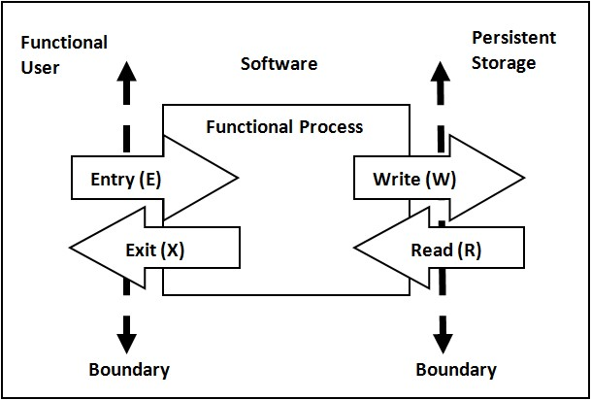
COSMIC Data Movements
Entry (E): Data entering the software from a functional user.
Exit (X): Data exiting the software to a functional user.
Read (R): Data read from persistent storage.
Write (W): Data written to persistent storage.

Slide 8
Measuring Functional Size Using COSMIC
Model the Functional Processes: Break down the software into functional processes, each representing a logical unit of functionality.
Identify Data Movements: For each functional process, identify all data movements (E, X, R, W).
Measure the Functional Size: Each identified data movement counts as one COSMIC Function Point (CFP).

Slide 9
Mapping Cosmic Data Movements to Arduino
Paper1: Functional Size Measurement for the Internet of Things (IoT).
Authors: Hassan Soubra and Alain Abran.
Entry: call functions via input pins (e.g., digital.read()).
Exit: call functions via output pins (e.g., lcd.print()).
Read: call EEPROM input function (e.g., EEPROM.read()).
Write: call EEPROM output function (e.g., EEPROM.Write()).

Slide 10
Mapping Cosmic Data Movements to Object Oriented Languages
Entry: get a user input (e.g., Scanner.nextInt()).
Exit: print or return any data (e.g., System.out.println()).
Read: read data from a file (e.g., reader.readLine()).
Write: write data to a file (e.g., writer.write(data)).

Slide 11
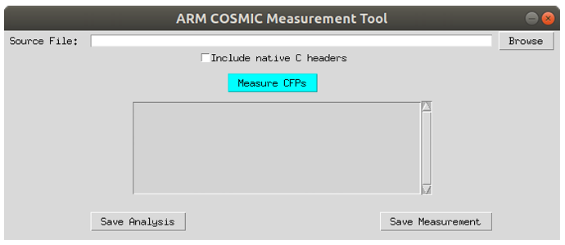
Related work
Paper2: COSMIC Functional Size of ARM Assembly Programs.
Authors: Hassan Soubra and Ahmed Darwish.
Automation prototype tool based on COSMIC ISO 19761 to measure the functional size of Assembly code.

Slide 12
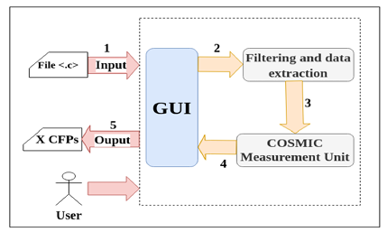
Related work
Paper3: Automated COSMIC Function Points Measurement for C Program Using Regular Expressions.
Authors: Moulla, Oumate, Mnkandla, Soubra, and Abran .
An automated FSM tool for the C programming language.

Slide 13
Related work
Problem: No General Tool Exist.
Goal: Introduce a General Tool.
Paper | Programming Language
Paper 1 | Arduino
Paper 2 | Assembly
Paper 3 | C

Slide 14
Proposed design
Gen-Cosmic
Measure Functional Size
Automated tool
General tool
Machine Learning Approach
Gen COSMIC
Code file
Size

Slide 15
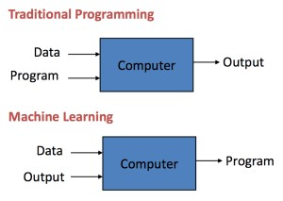
Machine Learning (ML)
Learn from data
Generalize to unseen data

Slide 16
Machine Learning (ML)
Data Collection
Dataset Generating
Data Preprocessing
Cleaning Data
Word Vectorizing
Data Splitting
>= 80% training set
<= 20% testing set
Model Training
Model Evaluation
Data Preprocessing
Data Splitting
Train
Test
Model Training
Model Evaluation

Slide 17
Implementation
Dataset
Consists of 1000 samples.
Each sample representing a single line of code with its corresponding classification (CFP or Not CFP).
Split into 90% training set and 10% testing set.

Slide 18
Data Preprocessing
Cleaning Data
Removing comments
Removing extra spaces
Word Vectorizing
Word Embeddings
Bag of Words

Slide 19
Machine Learning Models
Neural Network Model.
Decision Tree Model.
Logistic Regression Model.
Random Forest Classifier Model.

Slide 20
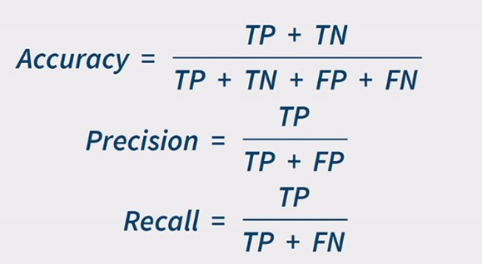
Model Training and Evaluation
Model is trained on training set
Model is evaluated using testing set
Performance Metrics
Accuracy
Precision
Recall
 | Predicted CFP | Predicted Not CFP
Actual CFP | TP | FN
Actual Not CFP | FP | TN

Slide 21
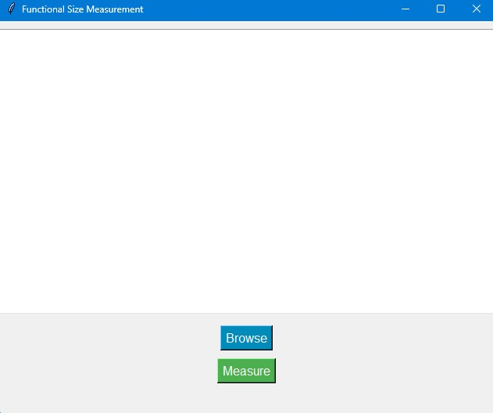
Functional Size Measurement of code snippets
Graphical User Interface (GUI)
Browse button
Measure button

Slide 22
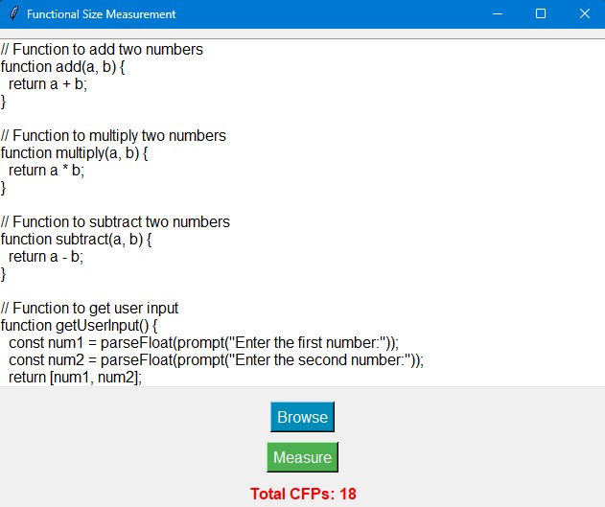
Functional Size Measurement of code snippets
initialize TotalCFP to 0
split The code into lines
while there are more lines
clean the current line
predict its classification
if classification is CFP
increment TotalCFP by 1
display TotalCFP

Slide 23
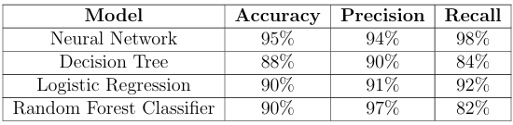
Results
Neural Network Model has the highest Accuracy and Recall
Random Forest Classsifier has the highest Precision

Slide 24
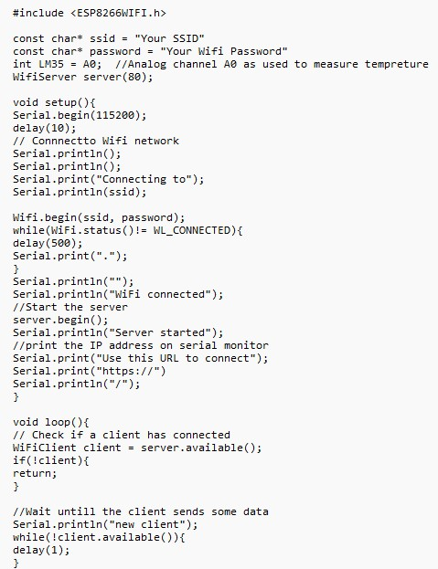
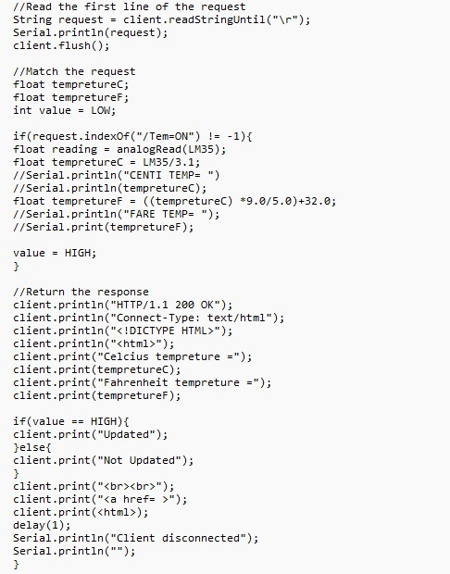
Functional Size Measurement of code snippets
Arduino Code
Manually measured: 46 CFPs
Automatically measured: 46 CFPs
Accuracy: 100%

Slide 25
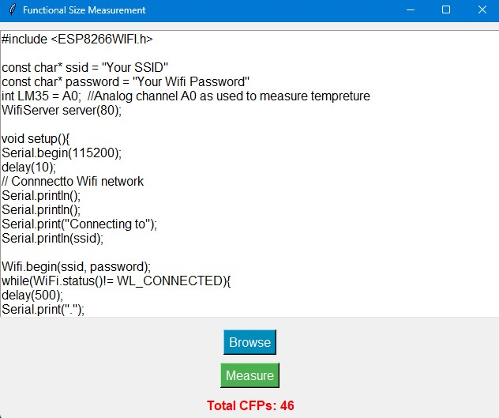
Functional Size Measurement of code snippets
Arduino Code
Manually measured: 46 CFPs
Automatically measured: 46 CFPs
Accuracy: 100%

Slide 26
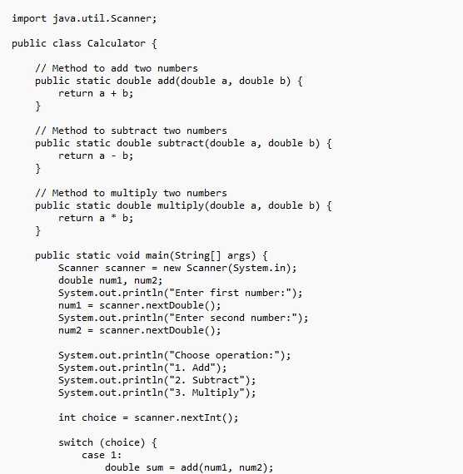
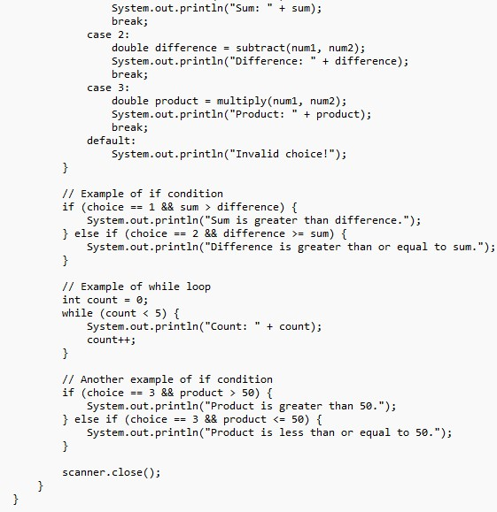
Functional Size Measurement of code snippets
Java Code
Manually measured: 26 CFPs
Automatically measured: 27 CFPs
Accuracy: 96%

Slide 27
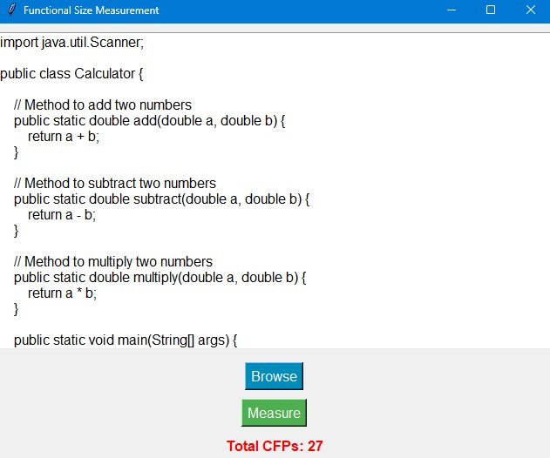
Functional Size Measurement of code snippets
Java Code
Manually measured: 26 CFPs
Automatically measured: 27 CFPs
Accuracy: 96%

Slide 28
Conclusion
Gen-Cosmic tool is implemented.
Machine Learning Models used.
Neural Network
Decision Tree
Logistic Regression
Random Forest Classifier
Neural Network Model has the highest performance.
Accuracy 95%
Precision 94%
Recall 98%
Measuring Functional Size of code snippets.
Arduino Code 100%
Java Code 96%

Slide 29
Possible Enhancements
Expansion of the dataset to enhance the tool’s generality and applicability.
Evaluation of alternative machine learning models, such as the Bert model, to enhance the performance and accuracy.
Exploration of alternative Word Vectorizing approaches, such as TF-IDF, to enhance the performance and accuracy.

Slide 30
References
https://cosmic-sizing.org/
H. Soubra, A. Abran, Functional size measurement for the internet of things (iot) an example using cosmic and the arduino open-source platform, 2017.
A. Darwish, H. Soubra, Cosmic functional size of ARM assembly programs, in: IWSM-Mensura, 2020.
D. Koulla Moulla, Oumate, E. Mnkandla, H. Soubra, A. Abran, Automated cosmic function points measurement for c program using regular expressions, in: Proceedings of the IWSM-Mensura, Izmir, Turkey, 2022.

Slide 31
Any Questions? Thank you

