Slide 1


CAPSTONE PROJECT DEFENSE | BACHELOR OF SCIENCE IN INFORMATION TECHNOLOGY
E-LEARNING PLATFORM FOR SNED PROGRAM
IN BIGAA ELEMENTARY SCHOOL
Group [No.] | College of Computing Studies
Pamantasan ng Cabuyao, City of Cabuyao, Laguna
RESEARCH TITLE:
E-Learning Platform for SNED Program in Bigaa Elementary School
RESEARCHERS:
Escarez, Kurt Ronel B.
Parao, Eliseo Evangelista Jr.
Onda, Kurby Dane B.
Quintana, Felipe A. Jr.
ADVISER:
[Adviser name]
Notes:
Greet the panel. Introduce the title, the group and each researcher, and the adviser. About 20 seconds.

Slide 2
RATIONALE
Why we conducted this research
Background
Problems at Bigaa ES
Research Gap
SNED learners need teaching that fits their needs
Teachers still rely on printed modules, handwritten records and face-to-face lessons
This makes it hard to track progress and prepare individual activities
Hard to organize resources and track progress
No individual pacing or alternative content formats
Parents lack simple instructions and visibility of their child's progress
Generic e-learning platforms lack key accessibility features
Examples: text-to-speech, speech-to-text, screen reader support, captions, high contrast, keyboard navigation
A platform built for SNED learners is needed
E-LEARNING PLATFORM FOR SNED PROGRAM
BIGAA ELEMENTARY SCHOOL
Notes:
Start with the background, then the problems we saw at Bigaa Elementary School, then the gap: generic platforms are not accessible enough for SNED learners. About 1 minute.

Slide 3
OBJECTIVES
What we set out to do
General objective: Develop and evaluate an AI-powered e-learning platform for the SNED Program in Bigaa Elementary School that is accessible, personalized and WCAG 2.2 compliant.
OBJECTIVE 1
OBJECTIVE 2
OBJECTIVE 3
Design
Develop
Evaluate
An accessible, user-friendly platform for delivering lessons
Managing activities and assessments
Strengthening teacher, student and parent communication
Tools for teachers to create and manage modules
Student access to lessons and assessments
Progress tracking for teachers
Timely updates for parents
Functionality
Usability
Accessibility
User satisfaction
E-LEARNING PLATFORM FOR SNED PROGRAM
BIGAA ELEMENTARY SCHOOL
Notes:
Read the general objective in your own words, then the three specific objectives. Tell the panel that the results later are presented objective by objective. About 40 seconds.

Slide 4
SCOPE AND LIMITATIONS
What the study covers, and where it stops
Scope
Limitations
SNED Program of Bigaa Elementary School only
Lesson delivery, learning materials, progress monitoring and communication
Modules: lessons, activities and assessments, progress tracking, dashboards, messaging
Stages: design, development, testing and evaluation
Evaluated on functionality, usability, accessibility and user satisfaction
Results cannot be generalized to other schools or programs
Needs a device and stable internet connection
No specialized assistive hardware, paid software or complex integration
A supplement to teachers, not a replacement
Assessed only during the research period, so no long-term effects
E-LEARNING PLATFORM FOR SNED PROGRAM
BIGAA ELEMENTARY SCHOOL
Notes:
Scope on the left, limitations on the right. Stress that it is one school, one program, and only the research period. About 45 seconds.

Slide 5
METHODOLOGY
Descriptive mixed-method research design
Two phases
Respondents by group (N = 62)
Pre-development (qualitative): survey questionnaire, direct observation, document analysis
Post-development (quantitative): 1-week User Acceptance Testing, then ISO/IEC 25010:2023 evaluation questionnaires
Statistics: content analysis for qualitative data; weighted mean with a five-point Likert scale for evaluation
Respondents: 62 purposely selected from Bigaa Elementary School, 100% retrieval
E-LEARNING PLATFORM FOR SNED PROGRAM
BIGAA ELEMENTARY SCHOOL
Notes:
Explain the two phases: we studied the problem first, then built and evaluated the system. Mention the 62 respondents and that the evaluation followed a one-week UAT. About 1 minute.

Slide 6
EVIDENCE OF METHODOLOGY
Agile Scrum: every sprint was carried out
SPRINT 0
SPRINT 1
SPRINT 2
SPRINT 3
Requirements
Login and foundation
Lessons and portal
Activities and assessments
Survey, observation, document analysis and interviews; user stories and product backlog
Account management, role-based login, React, Laravel and MySQL set up
Lesson upload and management; student learning portal
Create and assign activities; automatic grading; submission tracking
SPRINT 4
SPRINT 5
SPRINT 6
SCRUM EVENTS
Progress and communication
Accessibility and admin
Testing and UAT
Sprint planning
Daily scrum
Sprint review with stakeholders
Sprint retrospective
Progress dashboards and reports; low-performance flag; parent notifications
Text-to-speech, font size, high contrast, simple navigation; admin and backup
Unit, integration and system testing; 1-week UAT; ISO/IEC 25010 evaluation
E-LEARNING PLATFORM FOR SNED PROGRAM
BIGAA ELEMENTARY SCHOOL
Notes:
This slide is our proof that we followed Agile Scrum. Walk through the sprints quickly: requirements first, then login, lessons, assessments, progress and communication, accessibility, and finally testing and UAT. About 50 seconds.

Slide 7
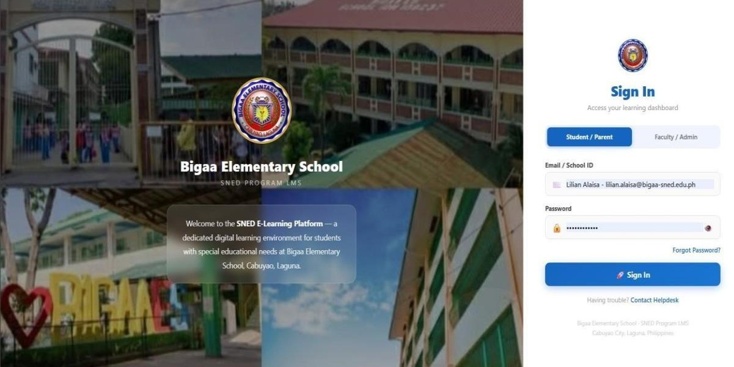
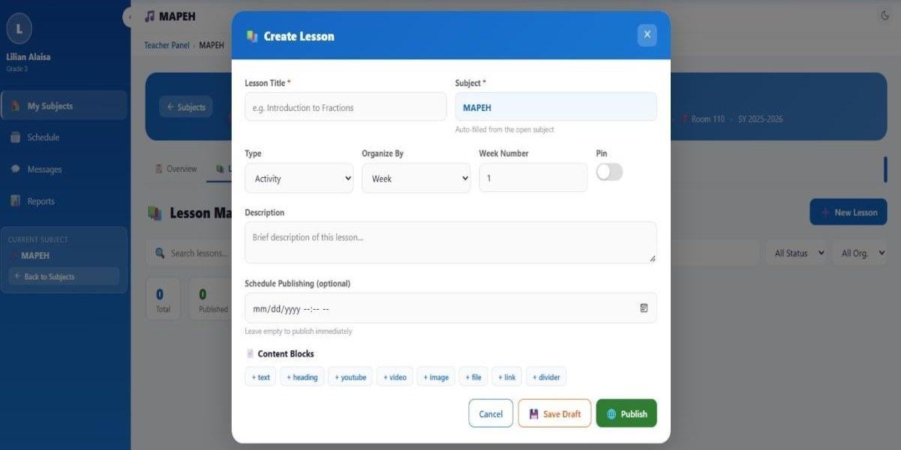
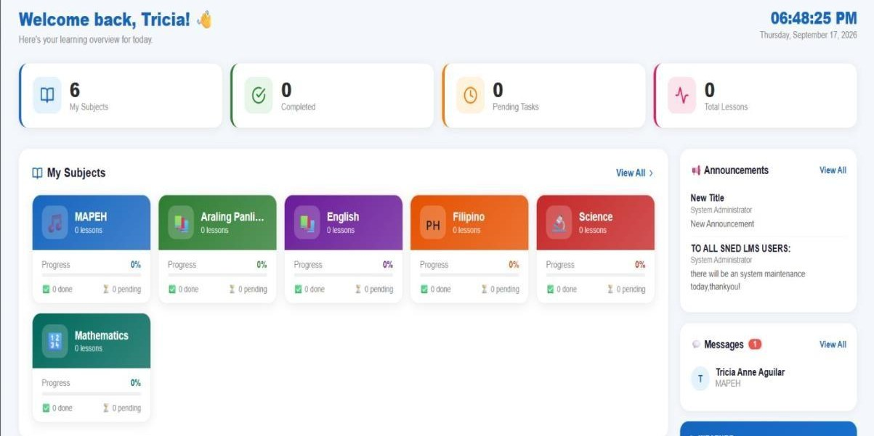
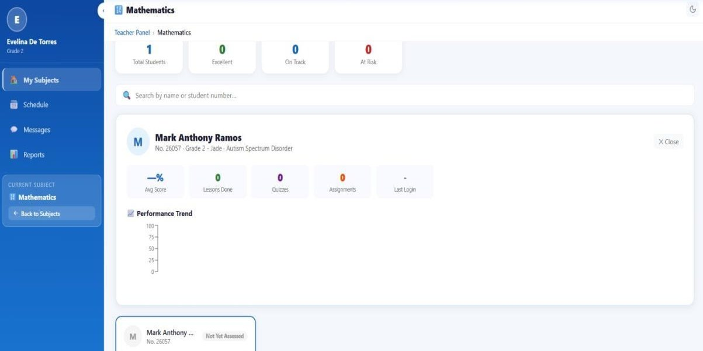
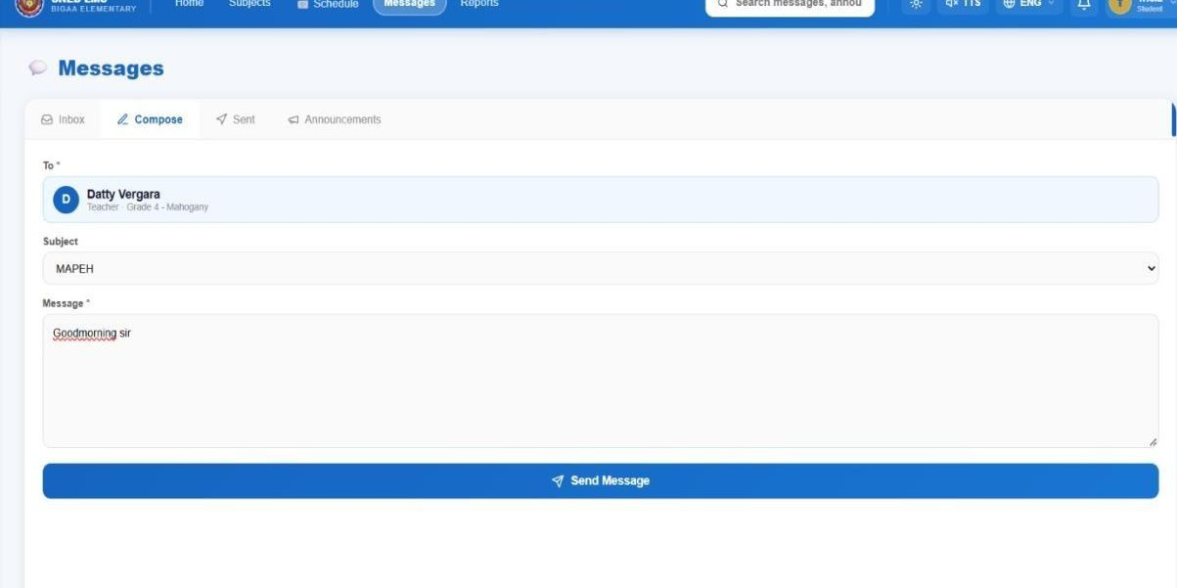
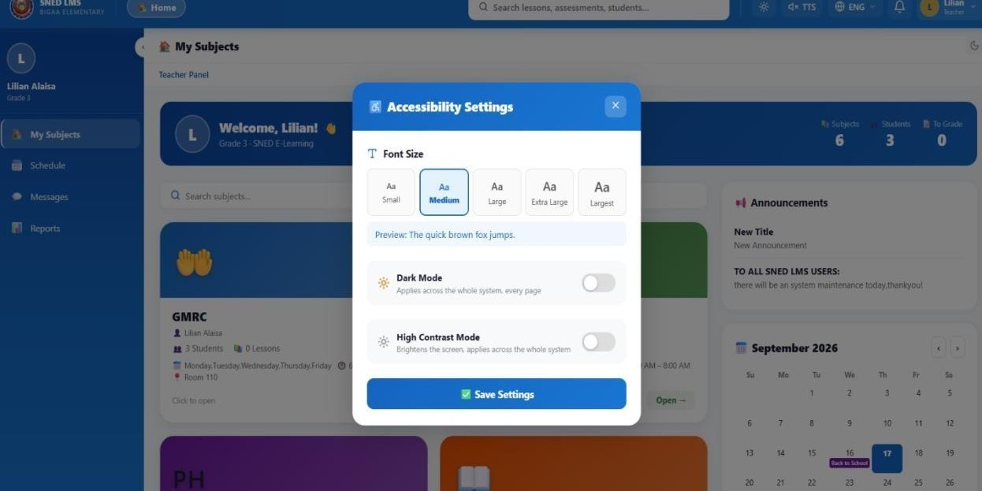
EVIDENCE OF METHODOLOGY
Working system outputs from the sprints
Sprint 1 | Login and authentication
Sprint 2 | Lesson upload
Sprint 2 | Student learning portal
Sprint 4 | Student progress tracking
Sprint 4 | Parent communication
Sprint 5 | Accessibility settings
E-LEARNING PLATFORM FOR SNED PROGRAM
BIGAA ELEMENTARY SCHOOL
Notes:
Point at two or three screens as examples: the login, the student portal and the accessibility settings. These are the actual outputs of the sprints. About 40 seconds.

Slide 8
OBJECTIVE 1 | RESULTS > DISCUSSION > CONCLUSION
Accessible, user-friendly platform designed
RESULTS
54 / 54
12 / 12
4.18
4.14
functions passed unit testing across 9 modules
integration scenarios passed
accessibility rating from students and guardians (Agree)
accessibility rating from teachers and school staff (Agree)
DISCUSSION
CONCLUSION
Minor defects, such as inconsistent validation messages, were fixed within each sprint. Adjustable text size and simple display scored 4.33 among students and guardians.
The platform was successfully designed to be accessible and user-friendly, and its modules worked both individually and as one system.
E-LEARNING PLATFORM FOR SNED PROGRAM
BIGAA ELEMENTARY SCHOOL
Notes:
Results first: every function passed unit testing and every integration scenario passed. Then accessibility ratings from both groups. Discussion: defects were fixed within the sprint, which is how Scrum works. Conclusion: Objective 1 was met. About 55 seconds.

Slide 9
OBJECTIVE 2 | RESULTS > DISCUSSION > CONCLUSION
System functionalities developed
RESULTS
Highest functionality items (weighted mean)
User registration and account management
Lesson upload and content management
Student learning portal
Activity and assessment management
Progress tracking and reporting
Parent communication and notification
Accessibility features management
System administration and user management
DISCUSSION
CONCLUSION
Functionality averaged 4.14 (Agree) among students and guardians and 4.27 (Strongly Agree) among teachers and staff.
The core functions for teachers, students and parents were successfully implemented and seen as reliable and effective.
E-LEARNING PLATFORM FOR SNED PROGRAM
BIGAA ELEMENTARY SCHOOL
Notes:
We built eight modules covering everything in Objective 2. The chart shows the highest-rated items: teachers can adjust accessibility settings (4.44) and get accurate reports (4.33); parents get timely notifications (4.20). Conclusion: Objective 2 was met. About 55 seconds.

Slide 10
OBJECTIVE 3 | RESULTS > DISCUSSION > CONCLUSION
Evaluation by students, guardians and teachers
RESULTS (weighted mean, five-point Likert scale)
4.19
Grand weighted mean (Agree)
4.25
Highest: user satisfaction (Strongly Agree)
DISCUSSION
CONCLUSION
Lowest items were device use (3.75, teachers) and slower internet (4.03, guardians). These point to device and connectivity limits, not core defects.
End users found the platform generally acceptable, with all ratings in the Agree to Strongly Agree range.
E-LEARNING PLATFORM FOR SNED PROGRAM
BIGAA ELEMENTARY SCHOOL
Notes:
Read the chart: guardians rated satisfaction highest (4.34), teachers rated functionality highest (4.27). Grand mean is 4.19, interpreted as Agree. The lowest items were about devices and slow internet, which are outside the core system. About 55 seconds.

Slide 11
OBJECTIVE 3 | RESULTS > DISCUSSION > CONCLUSION
Evaluation by IT experts (ISO/IEC 25010:2023)
RESULTS (n = 5, weighted mean)
4.10
4.20
Overall weighted mean (Agree)
Security and portability (Strongly Agree)
DISCUSSION
Experts rated every quality characteristic Agree or higher; function suitability was lowest at 3.95.
CONCLUSION
The platform is acceptable to users (4.19) and technically sound (4.10). The general objective was met.
E-LEARNING PLATFORM FOR SNED PROGRAM
BIGAA ELEMENTARY SCHOOL
Notes:
Independent IT experts rated eight quality characteristics. Security and portability were highest at 4.20; function suitability was lowest at 3.95. Together with the user ratings, the study met its general objective. About 45 seconds.

Slide 12
RECOMMENDATIONS
Based on what the results showed
FINDING
FINDING
FINDING
Slower internet rated lowest by guardians (4.03)
Device use rated lowest by teachers (3.75)
Teacher satisfaction was the lowest criterion (4.05)
RECOMMENDATION
RECOMMENDATION
RECOMMENDATION
Optimize the platform for slow connections
Improve the experience on tablets and mobile phones
Gather teacher feedback and add teacher training and support
FINDING
FINDING
Keep the platform as a supplement to teachers, not a replacement.
Function suitability was the lowest for IT experts (3.95)
Study covered one school and one research period
RECOMMENDATION
RECOMMENDATION
Keep refining features with further testing
Future studies: other schools and long-term learning effects
E-LEARNING PLATFORM FOR SNED PROGRAM
BIGAA ELEMENTARY SCHOOL
Notes:
Each recommendation comes from a specific finding. Slow internet and device use were the lowest items, teacher satisfaction was the lowest criterion, and function suitability was the lowest for the IT experts. The last one comes from our limitations. About 50 seconds.

Slide 13
THANK YOU
We welcome your questions and suggestions.
Escarez, Kurt Ronel B. | Onda, Kurby Dane B. | Parao, Eliseo Evangelista Jr. | Quintana, Felipe A. Jr.
E-LEARNING PLATFORM FOR SNED PROGRAM
BIGAA ELEMENTARY SCHOOL
Notes:
Thank the panel and invite questions. About 10 seconds.

