Slide 1


Slide 2

Beer Testing - An Exploratory Approach
Louise Perold
@lperold
louise.perold@houseoftest.co.za

Slide 3
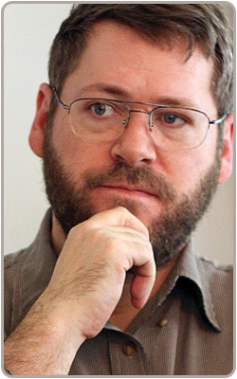
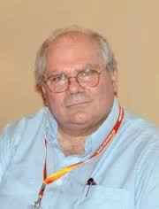

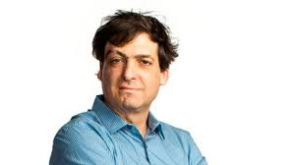


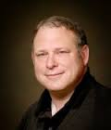
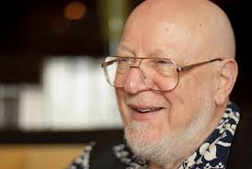

Slide 4
Exercise
Consider how your product might be used - What might be important quality criteria given that context?
What aspects of the product would you want to cover during testing and why?
What experiments would you run to uncover information about 1 and 2 – outline your test ideas

Slide 5
What is Quality?
“Quality is value to some person” (who matters)
Jerry Weinberg

Slide 6
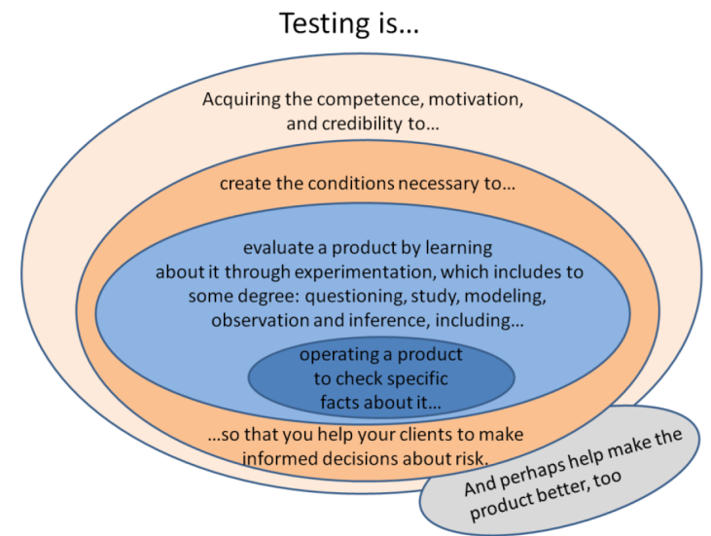
WHAT IS TESTING?

Slide 7
ORACLES AND HEURISTICS
A heuristic technique (/hjʉˈrɪstɨk/; Ancient Greek: Εὑρίσκω, "find" or "discover"), sometimes called simply a heuristic, is any approach to problem solving, learning, or discovery that employs a practical methodology not guaranteed to be optimal or perfect, but sufficient for the immediate goals. Where finding an optimal solution is impossible or impractical, heuristic methods can be used to speed up the process of finding a satisfactory solution. Heuristics can be mental shortcuts that ease the cognitive load of making a decision. Examples of this method include using a rule of thumb, an educated guess, an intuitive judgment, stereotyping, profiling, or common sense.
An oracle is a heuristic principle or mechanism by which someone recognizes a problem.

Slide 8
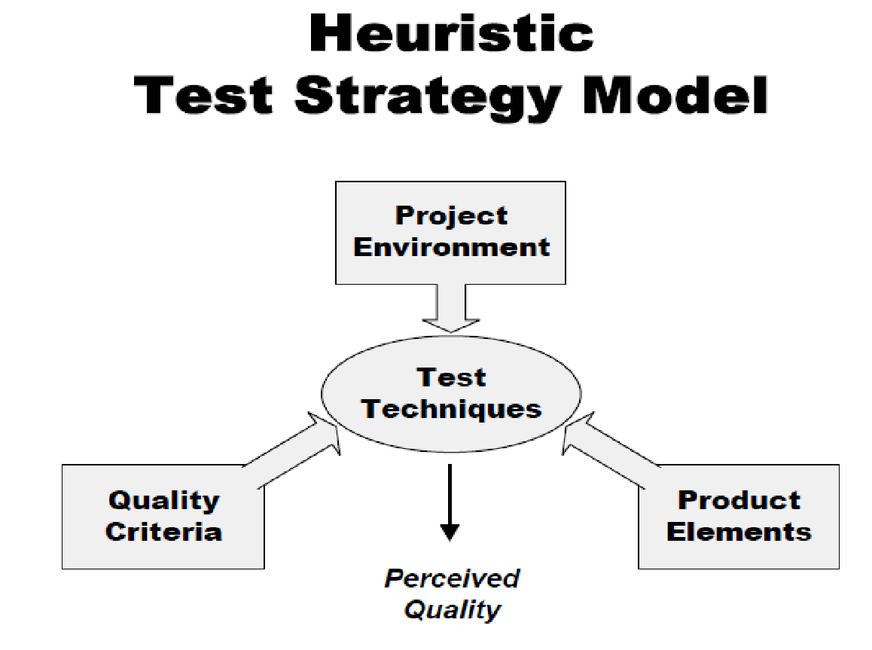
THE HEURISTIC TEST STRATEGY MODEL

Slide 9
SOME MNEMONICS
SFDIPOT - Product elements - Structure, Function, Data, Integrations, Platform, Operations, Time
CRUSSPIC STMPL – Quality criteria
Operational Criteria - CRUSSPIC Capability, Reliability, Usability, Security, Scalability, Performance, Installability, Compatibility
Development Criteria - STMPL Supportability, Testability, Maintainability, Portability, Localizability
CIDTESTD (Kid Tested) Project environment - Customers, Information, Developer elations, Team, Equipment & Tools, Schedule, Test Items, Deliverables
DUFFSSCRA (FDSFSCURA) – Test techniques - Domain, User, Function, Flow, Stress, Scenario, Claims, Risk, Automatic
HICCUPPSF – Oracles - History, Image, Comparable Product, Claims, User Expectations, Product, Purpose, Standards and Statutes, Familiar Problems

Slide 10
REFERENCES
http://www.developsense.com/resources/Oracles.pdf (Oracles)
http://www.satisfice.com/tools/htsm.pdf (Heuristic Test Strategy Model)
http://www.satisfice.com/blog/archives/1509 (Exploratory testing 3.0)
http://www.satisfice.com/rst.pdf (Rapid Sofware Testing)
http://www.qualityperspectives.ca/resources_mnemonics.html (Mnemonics list)
http://secretsofconsulting.blogspot.com/2012/09/agile-and-definition-of-quality.html (Jerry and Quality)

Slide 11
SHAMELESS PLUGS
Joburg Software Testers - http://www.meetup.com/Joburg-Software-Testers2/
Let’s Test SA 2016 - http://lets-test.com/

