Slide 1

Skateboard
Notes:
Present from Parents

Slide 2

Skateboard
Notes:
Become a famous skateboarder

Slide 3
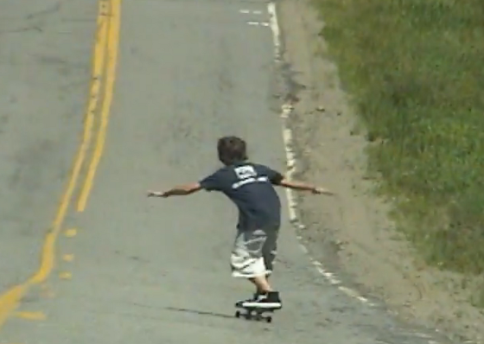
Skateboard
Notes:
10 seconds into the descent and 5 meters down the hill

Slide 4
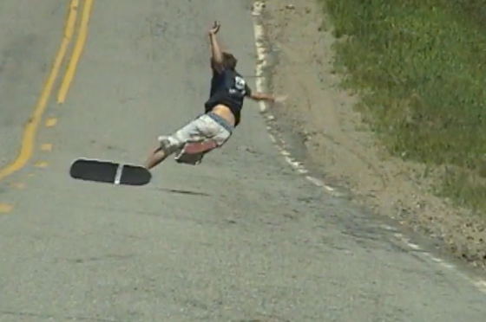
Skateboard
Notes:
World went into slow motion

Slide 5
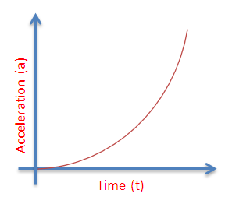
Notes:
Skateboarding & Software Development

Slide 6
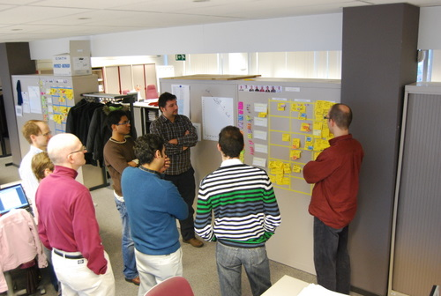

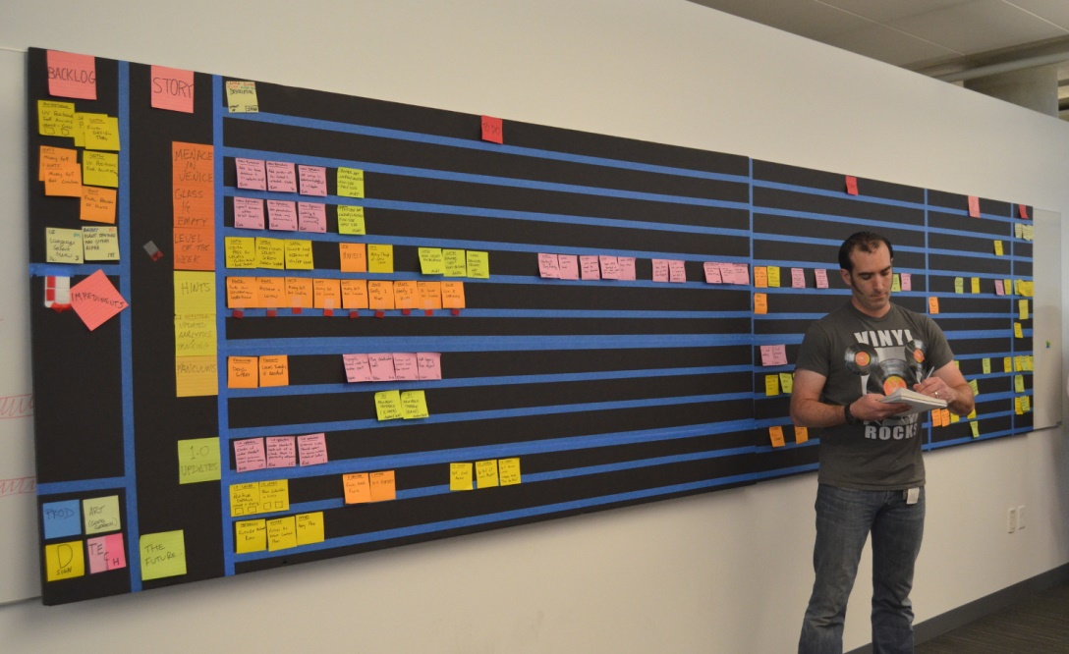
Notes:
Skateboarding & Software Development

Slide 7

Notes:
Skateboarding & Software Development

Slide 8
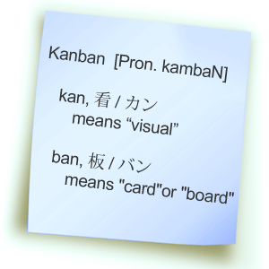
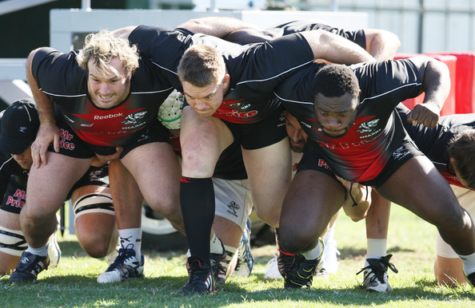

Slide 9


Slide 10
What are agile technical practices?

Slide 11
Test Driven Development, Continuous Integration Continuous Deployment Automated Acceptance Testing Pair Programming Mob Programming Feature Toggles

Slide 12


Slide 13
Structure, Interactions & Practices Linked

Slide 14
Create Slack

Slide 15
Prefer small regular intervals over large infrequent blocks

Slide 16
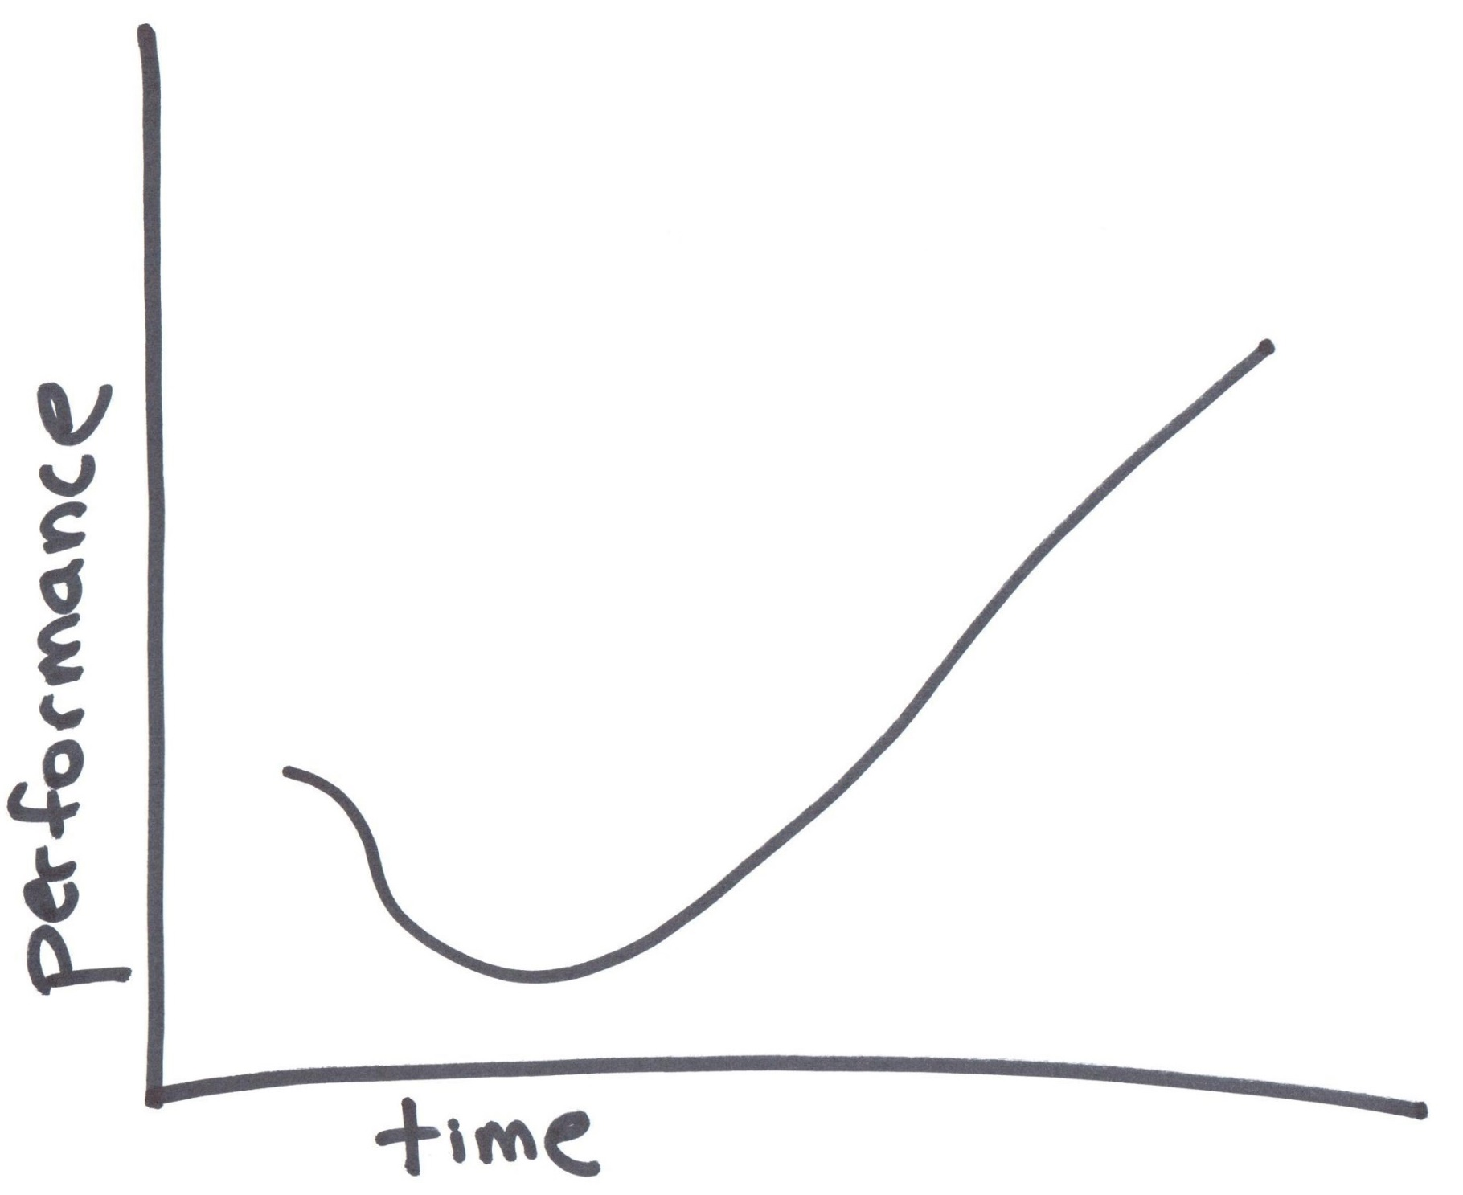
Notes:
Support the Dips

Slide 17

Notes:
We have deadlines!

Slide 18
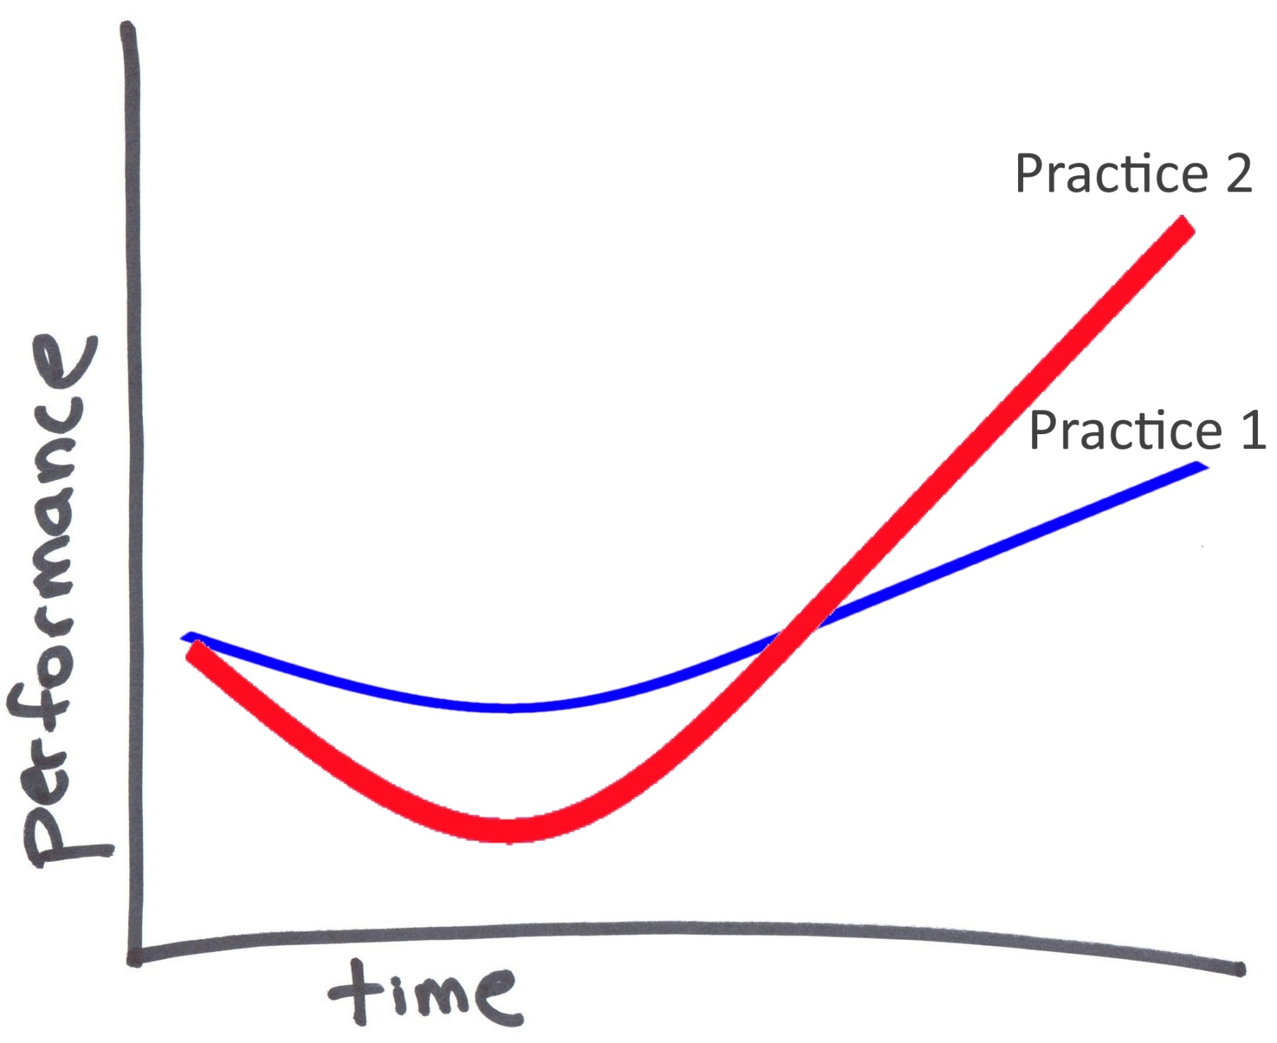

Slide 19
As a team: Identify where the bottlenecks are Identify practices that can help and their costs Pick an appropriate practice Learn and apply it

Slide 20


Slide 21
Effective use of Version Control

Slide 22
Do small little bits of work and merge or integrate frequently

Slide 23
Automate & Democratize the Build

Slide 24
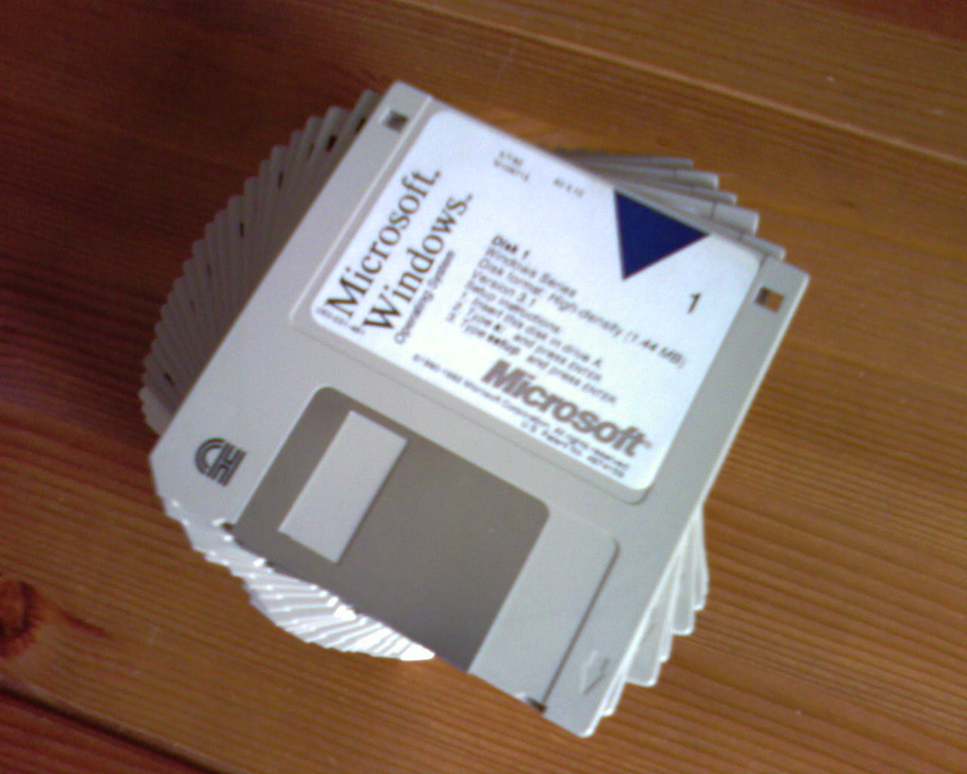

Slide 25


Slide 26


Slide 27


Slide 28


Slide 29


Slide 30
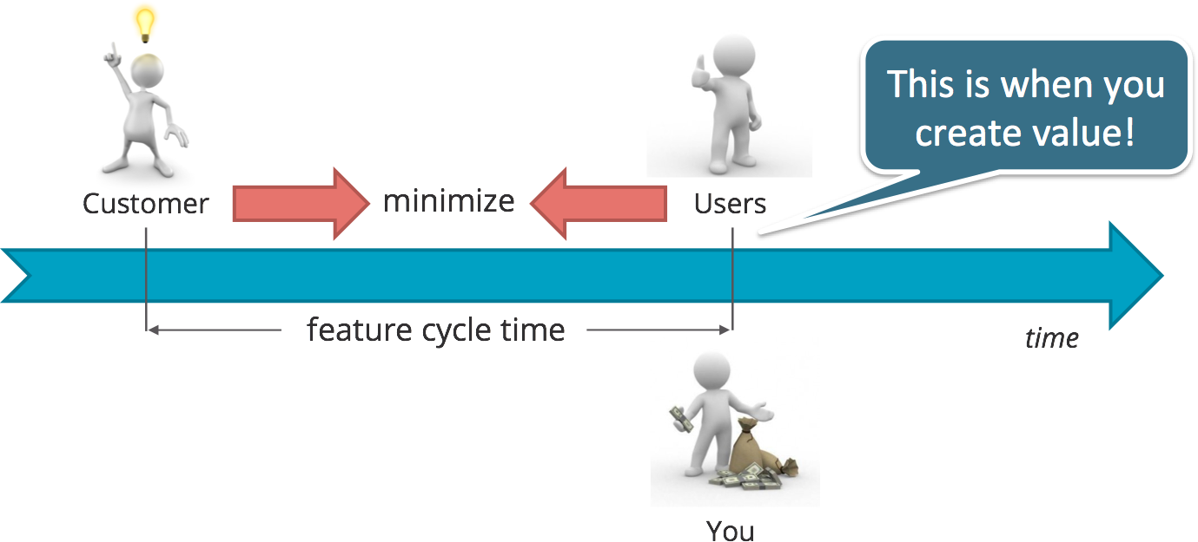

Slide 31
Continuous Integration Server

Slide 32
Common Code Style

Slide 33
Collaborative Coding

Slide 34
Test Driven Development & Automated Testing

Slide 35
Find your own pattern

Slide 36
Hope Story

