Slide 1

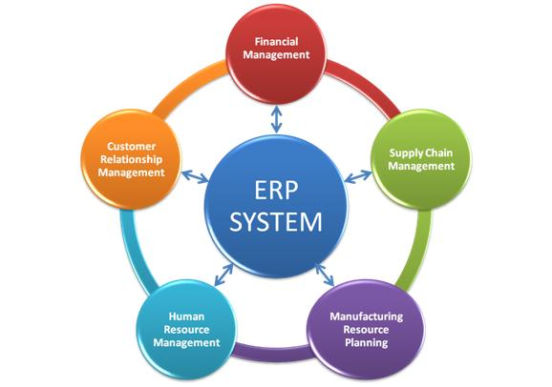




Data Queries & Data Mining
Business Analytics
MBA

Slide 2


Learning Objectives / Topics
Data Mining Intro
Relational Databases
Queries
Machine Learning SQL Application

Slide 3

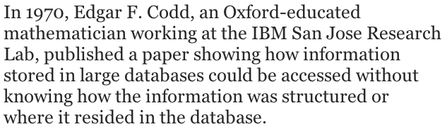








Relational Databases

Slide 4
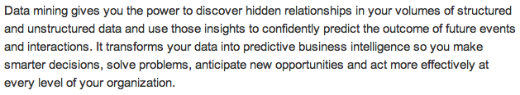
Data Mining
Source: ibm.com
Source: oracle.com
Data Visualization
Reports
Statistical Data Summarization and Analysis
PivotTables
Queries
And much, much more

Slide 5



Data Mining
https://www.bing.com/videos/search?q=IBM+Watson+data+mining+commercial&&view=detail&mid=DB41B1AEA4856FD34F3CDB41B1AEA4856FD34F3C&&FORM=VRDGAR
http://www.ispot.tv/ad/7HpN/ibm-and-twitter-how-data-can-build-a-smarter-business
https://youtu.be/A3JQCsM2qfA
https://youtu.be/uFwcyJRaAAI
https://youtu.be/FTQkTN9W6kg
https://youtu.be/x81hb8nT4yQ

Slide 6
Relational Databases
Store data in Tables, made up of rows (records) and columns (fields).
Every Table has a key field that uniquely identifies a row or record.
Tables are related to each other in one of three ways so information may be mined or gathered via Query.
The table relationships allow users to access the data in a fairly straight-forward manner. Tables made up of rows and columns that are intuitive and easy to understand.

Slide 7
Tables / Entities
Entity
person, place or thing in which data can be stored
a database table
CLIENT *ClientID ClientName ClientServices ClientCity ClientState ClientRevenue

Slide 8
Attributes
Attribute
describe the entity
columns in a table
fields

Slide 9
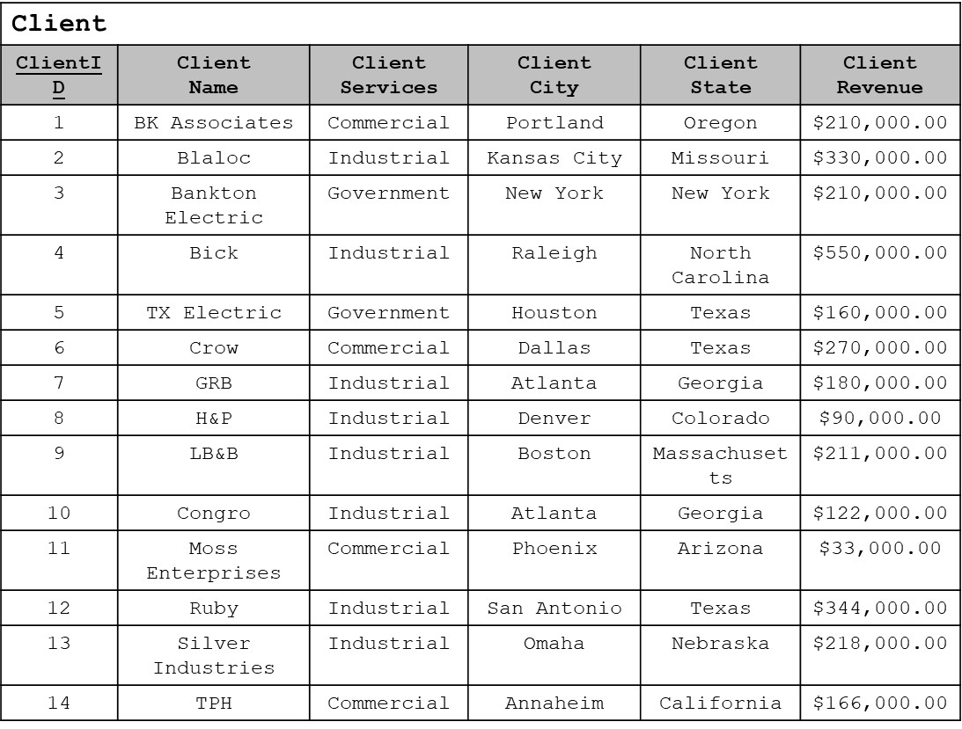
Records

Slide 10
Primary Key
Primary Key
uniquely identifies a record in a table
CLIENT *ClientID ClientName ClientServices ClientCity ClientState ClientRevenue

Slide 11
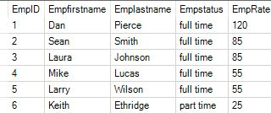
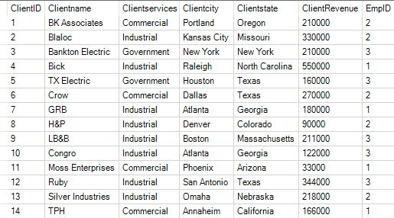
Relating Tables One-to-many 1:m relationship
Relational databases link several entities based on relationships that exist (based on modelling reality)
1:m relationship example: An Employee can serve as the project manager for many Clients, but a Client is only managed by one Employee

Slide 12
Connecting Tables
Entity name = Table name
Entity attribute = Table columns
1:m relationship
The two tables must be linked through a common column (key)
Primary Key in 1 side (Employee) is added as a Foreign key on the many side (Client)
Add a column to the Client table at the many end of a 1:m relationship (EmpID)
This key (EmpID) acts as a “bridge” between the two tables
Primary and Foreign keys should never be null (empty)

Slide 13
Employee and Client Tables, 1:m

Slide 14
Summary of SQL Syntax
SELECT attribute(s) FROM table;
WHERE to specify which records / cases desired from a table
SELECT ClientName, ClientRevenue from Client Where ClientRevenue >= 270000;
SELECT clientID, clientName, clientState FROM Client where clientState = 'Texas' or ClientState = 'Arizona';
SELECT clientID, clientName, clientState FROM Client where clientState in ('Texas', 'Arizona');
SELECT ClientServices, ClientName from Client where ClientServices <> 'Industrial';
SELECT ClientServices, ClientName from Client where ClientServices Not In ('Industrial');
ORDER BY attribute DESC
SELECT ClientName, ClientCity, ClientRevenue FROM Client where ClientRevenue > 180000 order by ClientRevenue desc;
COUNT, AVG, SUM, MIN, MAX (attribute)
SELECT Avg(ClientRevenue) as AverageRevenue FROM Client;
NOT / NOT LIKE
SELECT Clientname FROM Client Where ClientName Like 'B*';
SELECT Clientname FROM Client Where ClientName Not Like '*B*' and ClientName Not Like '*S*';
IN, =
SELECT clientID, clientName, clientState FROM Client where clientState IN('Texas', 'Arizona');
SELECT clientID, clientName, clientState FROM Client where clientState = 'Texas' or ClientState = 'Arizona';

Slide 15


Additional SQL Syntax
SELECT field1, function(field2), field3
FROM table1, table2
WHERE table1.linkfield=table2.linkfield, condition
AND condition
AND condition
GROUP BY field1, group by is needed with a function to “group” the records used in the function by the field specified
ORDER BY fieldn
HAVING, if used goes after GROUP BY, to count records.
HAVING Count(*)>1, counts records used in the function, displays those counts that are greater than 1.
Example
SELECT ClientName, SUM(Rev) AS Total Rev By Client
FROM Client, Transactions
WHERE Client.ClientId=Transactions.ClientId
GROUP BY ClientName

Slide 16
Querying Single Table
Display ClientName, ClientCity, ClientRevenue firms where revenues are greater than $180,000 in order of descending revenue. Where revenues are equivalent, list the Client firms in alphabetical order (based on their city).
SELECT ClientName, ClientCity, ClientRevenue FROM Client where ClientRevenue > 180000 order by ClientRevenue desc, ClientCity;

Slide 17
Querying Single Table
COUNT, AVG, SUM, MIN, and MAX
Find the average Client Revenue
SELECT Avg(ClientRevenue) as AverageRevenue FROM Client;
Display the Client name, state, and revenue (in thousands) for Client from Texas
SELECT ClientName, ClientState, ClientRevenue/1000 as ThousandDollars FROM Client Where ClientState = 'Texas';
AverageRevenue
$221,000.00
ClientName | ClientState | ThousandDollars
TX Electric | Texas | 160
Crow | Texas | 270
Ruby | Texas | 344

Slide 18
Querying Single Table
Subquery = A query within a query
Report all Client names and revenue for those firms with revenues that exceed the average revenue for the group as a whole.
SELECT ClientName, ClientRevenue From Client Where ClientRevenue > (SELECT AVG(ClientRevenue) From Client);
ClientName | ClientRevenue
Blaloc | $330,000.00
Bick | $550,000.00
Crow | $270,000.00
Ruby | $344,000.00

Slide 19
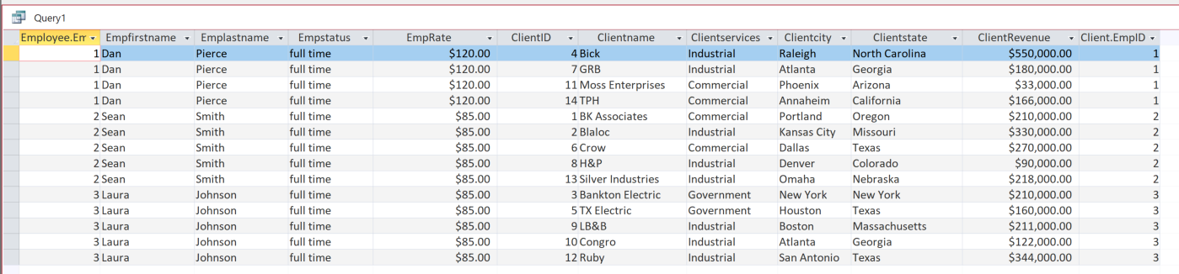
Selecting Specific Attributes, Two-Table Queries
SELECT *
FROM Employee, Client
WHERE Employee.EmpID = Client.EmpID;

Slide 20
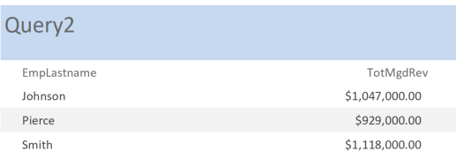
Querying both related or joined tables
Display Account Managers along with the total amount of revenue they manage.
SELECT EmpLastname, SUM(ClientRevenue) AS TotMgdRev
FROM Employee, Client
WHERE Employee.EmpID = Client.EmpID
GROUP BY EmpLastname;

Slide 21
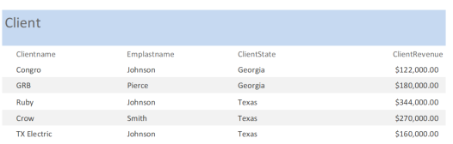
Querying both related or joined tables
Display Clients, their account manager, state, and revenue,
for only those clients in Texas and Georgia.
SELECT Clientname, Emplastname, ClientState, ClientRevenue
FROM Employee, Client
WHERE Employee.EmpID = Client.EmpID
And ClientState In ('Texas', 'Georgia')
ORDER BY ClientState;

Slide 22

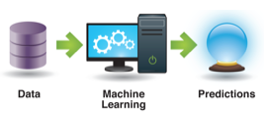
Machine Learning SQL Application EatItRDB
Implement 4 Queries or Decision Rules in SQL.
How many and which instances are incorrectly classified?

Slide 23
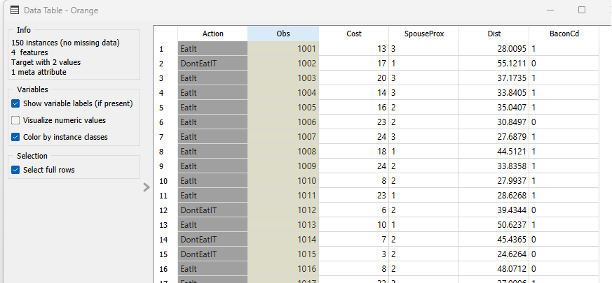
Machine Learning SQL EatIt, table & workflow

Slide 24
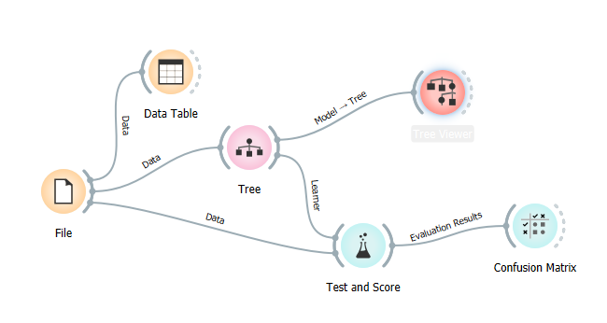
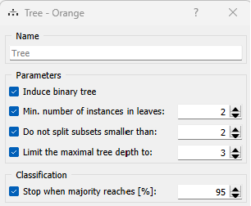
Machine Learning SQL EatIt, table & workflow

Slide 25
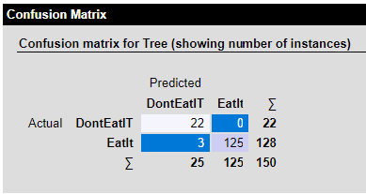
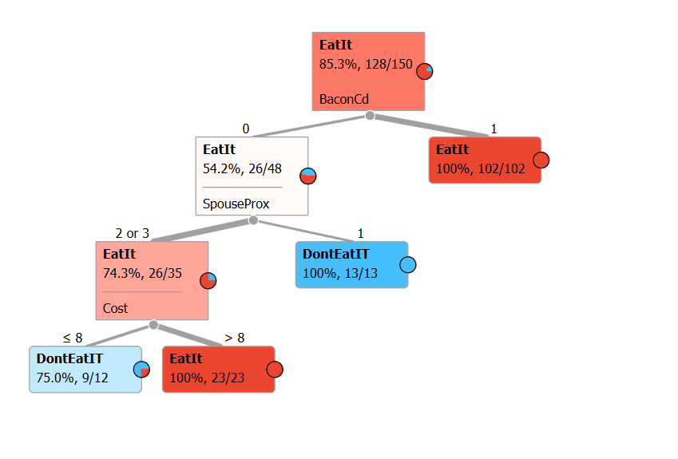
Machine Learning SQL EatIt, tree, SQL
SELECT *
FROM Data
WHERE BaconCd =0
AND SpouseProx In (2,3)
AND Cost <= 8;
Path 4
102 TP 0 FP
SELECT *
FROM Data
WHERE BaconCd =1;
Path 3 13 TN 0 FN
SELECT *
FROM Data
WHERE BaconCd =0
AND SpouseProx =1;
Path 1 9 TN 3 FN
Path 2 23 TP 0 FP
SELECT *
FROM Data
WHERE BaconCd =0
AND SpouseProx In (2,3)
AND Cost >8;

