Slide 1



TMCA
Business Analytics
Improving Business Decisions with Monte Carlo Analysis
Business Analytics for Managerial Decisions
Graduate Programs

Slide 2
Agenda / Topics
Monte Carlo Analysis Overview
Project Management Example
Supply Chain Example
Profit Example
Net Present Value Model
Nest Egg Model

Slide 3
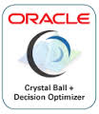



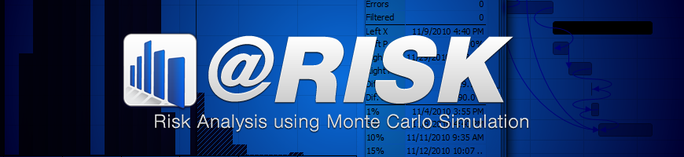
Monte Carlo Analysis
A popular business analytics methodology used to understand the impact uncertainty (or risk) may have on a business outcome of interest.
www.riskamp.com

Slide 4
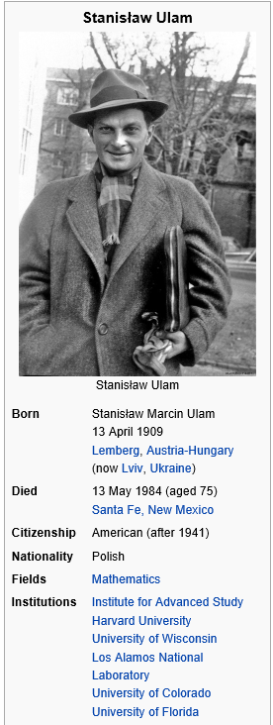

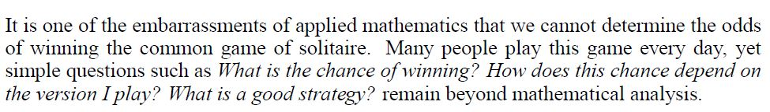
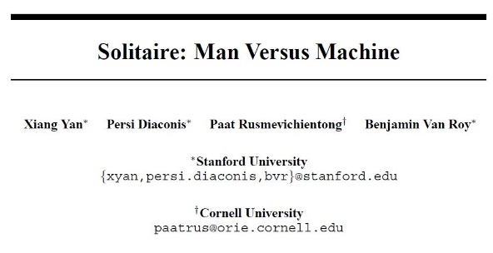
Monte Carlo Analysis
52!
80,658,175,170,943,900,000,000,000,000,000,000,000,000,000,000,000,000,000,000,000,000,000
500,000,000,000,000,000
Seconds since the Big Bang!
Yan, Xiang, Persi Diaconis, Paat Rusmevichientong, and Benjamin V. Roy. "Solitaire: Man versus machine." In Advances in Neural Information Processing Systems, pp. 1553-1560. 2005.

Slide 5
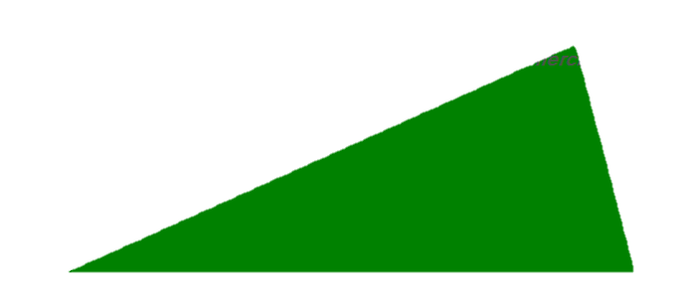
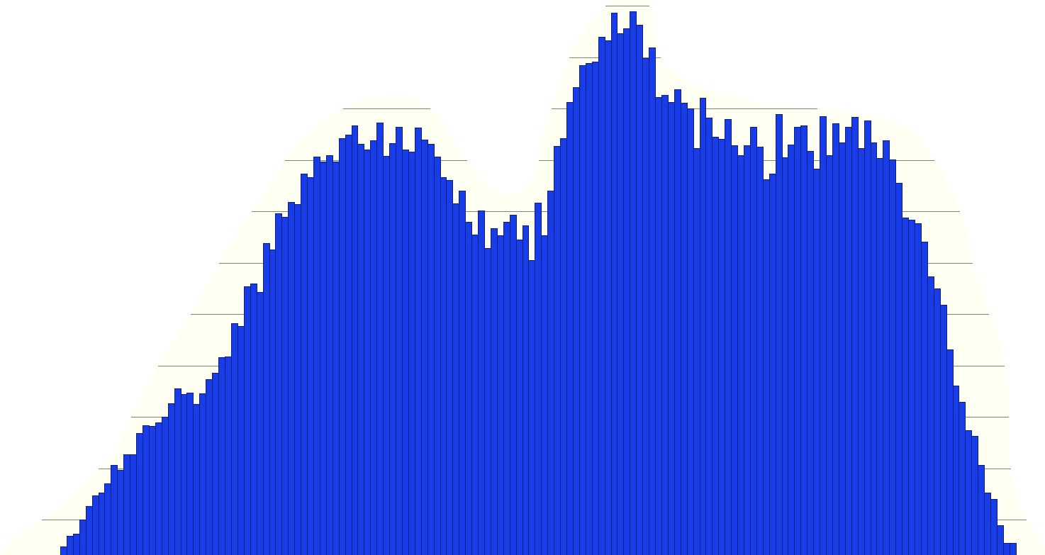

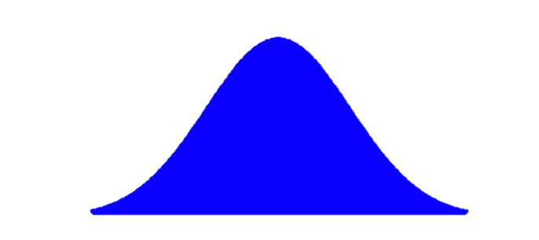
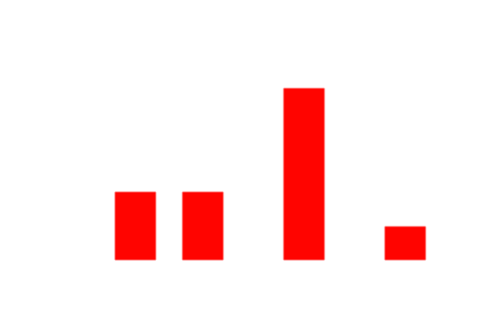
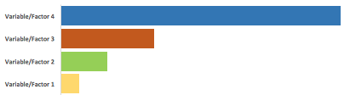
Monte Carlo Analysis

Slide 6
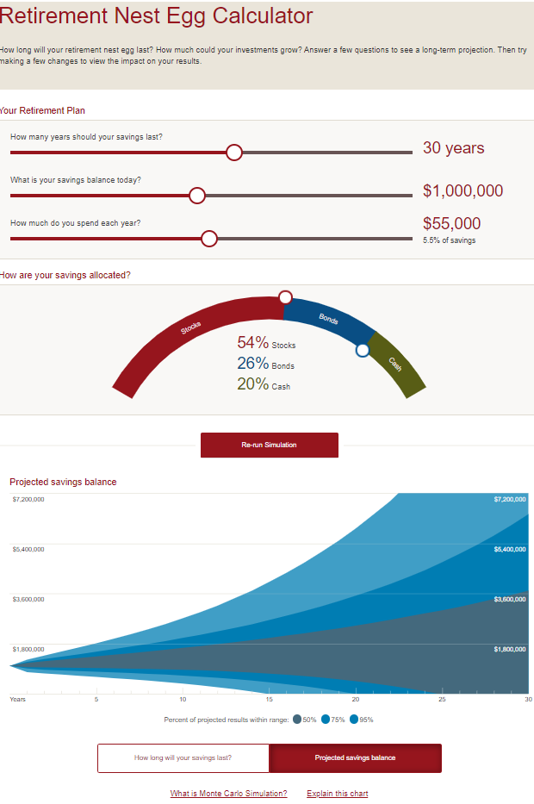

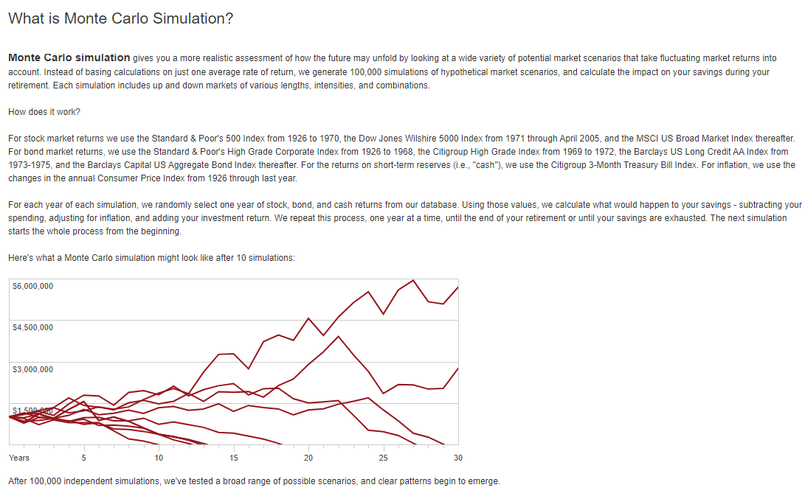
Monte Carlo Analysis
https://retirementplans.vanguard.com/VGApp/pe/pubeducation/calculators/RetirementNestEggCalc.jsf

Slide 7

Project Costs Example
An expert team provides the following cost estimates for a new project being envisioned.
Labor, somewhere between $800,000 and $1,000,000, all possibilities in between roughly the same likeliness.
Admin, best case $300,000, worst case $800,000, most likely around $700,000.
Materials around $250,000 with standard deviation of $40,000, bell-shaped based on similar prior projects.

Slide 8
Project Costs Example
What is your best estimate for the cost of this project? Why? Provide justification.
How likely is it that the administrative costs will come in under $1,700,000? Provide support.
How likely is it that the project will cost between $1,500,000 and $1,700,000? Provide justification.
Which cost is most impactful on the project total costs?

Slide 9
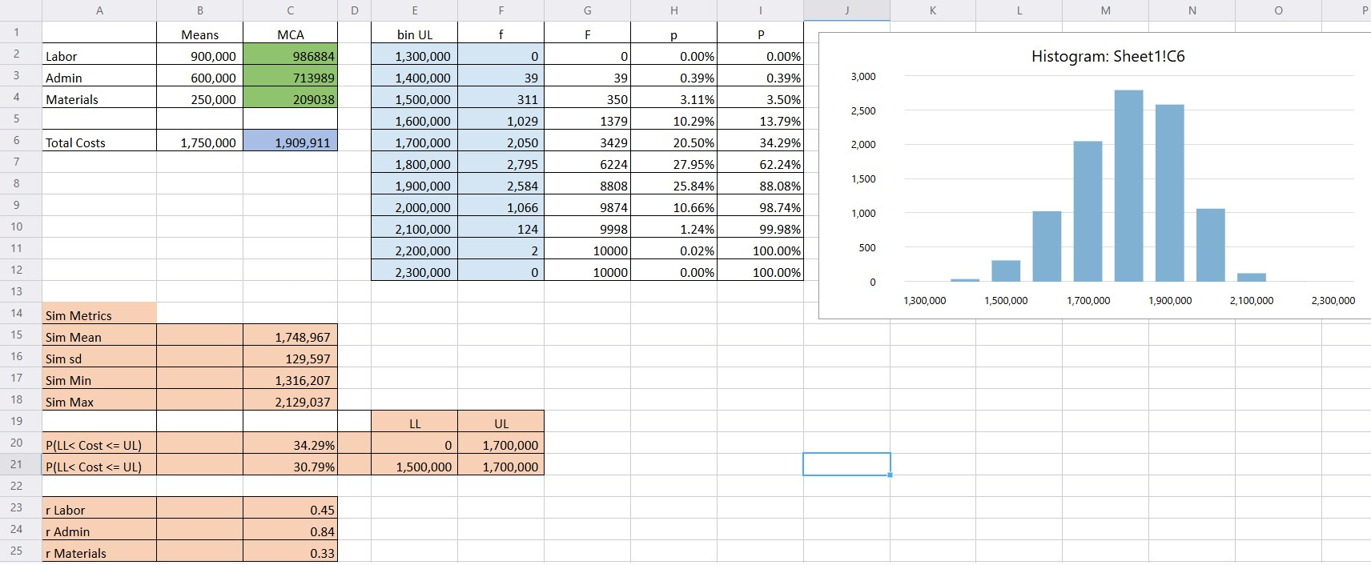
Project Costs Example
=SimulationMean($C$6)
=SimulationStandardDeviation($C$6)
=SimulationInterval($C$6, E20, F20)
=SimulationCorrelation(C2, $C$6)

Slide 10

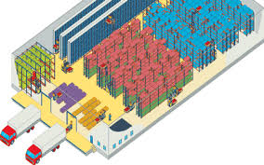

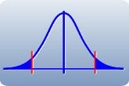
Supply Chain Example
Revenue per unit, somewhere between $100 and $160, all amounts approximately equally likely in this range.
Min $70/Unit, Max $130/Unit,
Most Likely $80/Unit
?UnitRevenue
?SupplyUnitCost
?Demand
Mean 300,000 units and SD 80,000 units
For next month:
What is our likely/mean net profit?
What is the likelihood we will have a positive net profit?
What uncertain factors are the most important and where we should focus?

Slide 11
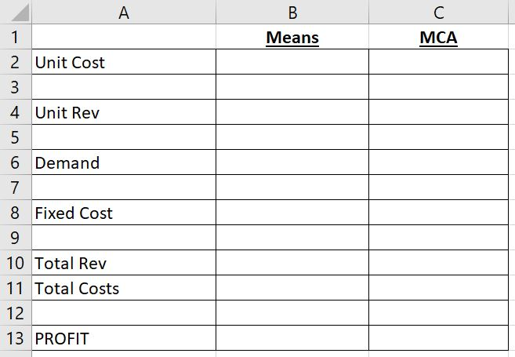
Profit Model Example
Can you use statistical/analytical means to determine the mean PROFIT? If so, what is it?
What does the distribution of potential profit look like?
What is the probability we will lose money (not be profitable)?
Which uncertain item is most impactful/correlated to profit?
How is the above impactfulness (sensitivity) determined
Unit Cost from our suppliers are projected to be somewhere between 80 and 130 with 90 dollars per unit most likely.
Marketing analysts state that the organization will be able to charge somewhere in the range of 95, 115, or 135 (min, most likely, max) dollars per unit, respectively.
Demand has been normally distributed (bell shaped) with a mean of 52,000 and standard deviation of 9,000 units.
Fixed costs are somewhere between 70,000 and 110,000 with all possibilities in between equally likely.
Base Model.

Slide 12
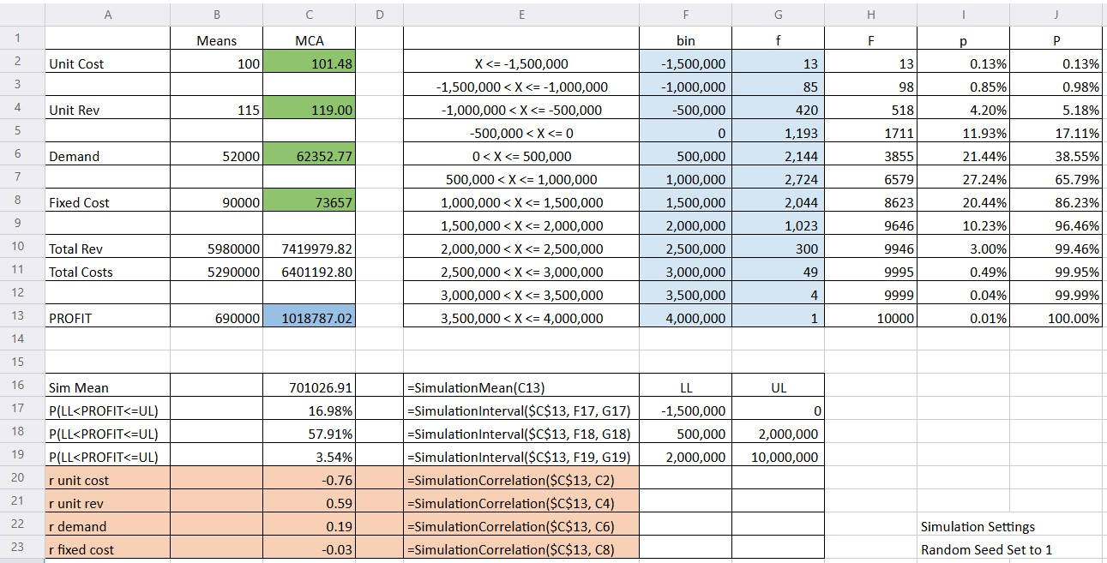
Profit Model Example

Slide 13
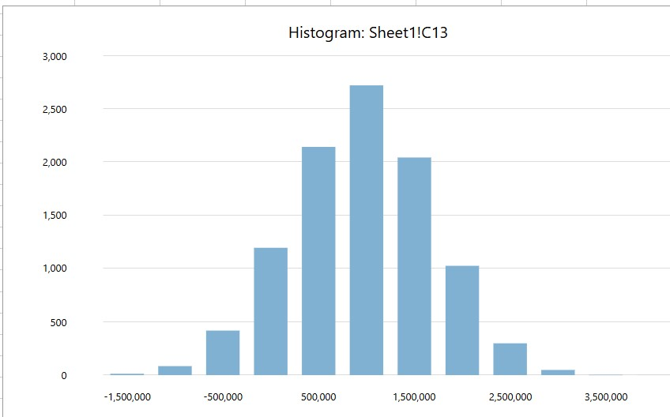
Profit Model Example

Slide 14
NPV Model
NPV Application. Build a 5-year NPV analysis for a new product introduction, with parameters specified below:
Yearly market growth rate is uncertain. Each year the market could decline by as much as 3% or grow as much as 9% will all possible growth rates in between equally likely.
The discount rate is uncertain and assumed to be normally distributed with a mean of 7% and a standard deviation of 1%.
Unit revenue, investment costs, and unit costs are fixed and certain.
First, determine the NPV using the grid below assuming no risk or uncertainty. Then, using the uncertainty/risk specified above:
Determine the probability the NPV will be negative.
Determine the probability the NPV will be more than $100,000.

Slide 15
Nest Egg Model
How much would $10,000 invested now in the stock market be worth after 20 years?
If returns were fixed at 0.08 or 8%?
If returns varied from year to year via a normal distribution with a mean of 0.08 (8%) and standard deviation of 0.35 (35%) based on a long-term historical analysis of annual returns in the stock market.

