Slide 1



WS01
Descriptive Statistics and
Basic Business Intelligence
Business Analytics

Slide 2
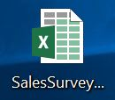
Application #1
Use Excel to generate descriptive statistics for the Age and Income attributes or variables.
At a managerial level, interpret important metrics from the descriptive statistics generated.
Use Excel or Tableau to construct histograms for Age and Income.
How would you describe the sample Age and Income data?
Use Excel to construct a cross tabulation comparing Gender and whether the subject made a purchase. Use counts of subjects in your cross-tab table.
Based on your cross tab, what percent of male subjects have not purchased the product?
Based on your cross tab, what percent of those who have purchased are female?
Construct a cross-tab table comparing Age ranges and whether or not the subject made a purchase. Use counts of subjects in your cross-tab table.
Prepare a short 1 paragraph analysis of your findings. Where might marketing efforts, best be focused for products of this nature?
Helpful link regarding cross tabulations:
https://www.youtube.com/watch?v=Uz7naxp8Taw

Slide 3
Application #2
In a dice game, depending on your roll you receive a certain amount of money (shown in the table) below.
If it costs $700 to play this game (one play), should you play? Please provide analysis and explanation.
If it costs $700 to play this game, should you play this game many, many (say 100) times? Please provide analysis and explanation.

Slide 4

Application #3
Use the file BikesF24.xlxs to answer the questions below. This is a real data set of daily bike rentals (stands like Ft. Worth city bikes but from across Europe). Cnt is the target. Only consider the three continuous predictors for this application problem.
You will perform a simple linear regression analysis in Orange Data Mining using a process where the data is split into training and validation data sets.
Which single predictor is best? Why? You will only use this predictor.
Develop a predictive analytics workflow to build the simple linear regression model. What is the model?
From your model, interpret the slope.
From your model, interpret the coefficient of determination.
How well does your model perform? Interpret the MAD metric on your validation or hold-out data set.
Score the 10 new data records. How many bikes does your model estimate will be rented on each of the new days?

Slide 5
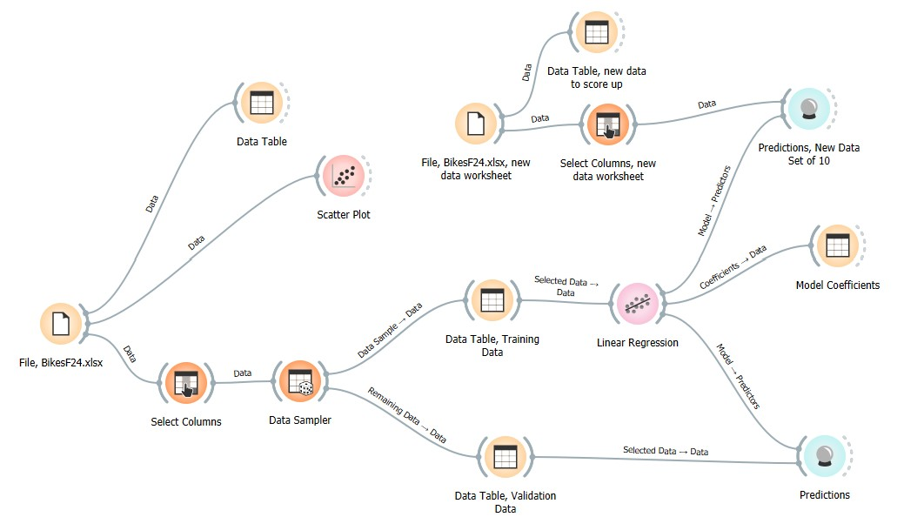
Application #3_hint

Slide 6
Application #4
A financial analyst believes a portfolio will return between 2 and 8 percent next year with all values in between equally likely. What is the probability the portfolio’s return will be between 3 and 5 percent?
Based on past Neeley history, an experienced analyst knows that undergraduate starting salaries follow a triangular distribution with $35,000, $50,000, and $80,000 being the min, most likely and max, respectively. σ = $9,354. The height of the triangle at $57,000 is 0.0000341. Selecting an individual graduate student at random, what is the probability her starting salary is at least $57,000?
A company has produced a new tractor tire that is estimated next quarter to have a mean demand of 8000 units with a standard deviation of 0f 2000 units, normally distributed. Unit tire revenue could be either $100, $150, $350, or $400 with probabilities of 0.20, 0.20, 0.50, and 0.10 respectively, depending on market conditions. Fixed infrastructure additions are estimated to cost somewhere between $500,000 and $900,000, with $800,000 being the most likely estimate. Variable costs are estimated to be between $60 and $90 per tire, all equally likely. Using analytical means as the base case, determine the mean quarterly profit or loss for the new tractor tire.
A company has determined the the distribution of customer demand is normal with mean of 750 and SD of 100 units per month. Determine the probability next month’s demand exceeds 850 units.

Slide 7


Application #5
Peachtree Logistics, Inc. acts as a broker that matches client needs with orders that are fulfilled by its base of suppliers Using the Peachtree logistics database on the course website develop SQL queries and provide the output for the following 6 questions. For each of the 6 queries, please provide the following:
a) SQL query text; b) query output.
a. Query 1:
Provide all information in the Supplier table for the three mostly highly rated suppliers according to cost effectiveness. Sort by the Cost Effectivenes rank (1=best to 5=worst).
b. Query 2:
Provide information for cases where an Employee manages a client which has revenues in excess of $250,000. Display the Employee Lastname, Client Name, and Client Revenue.
c. Query 3:
Find the Lastname(s) of employees who manage client with revenue greater than $400,000.
d. Query 4:
For all suppliers who have shipped to a client located in either Texas, New York, or Massachusetts. List the name of the supplier, the shipment date, client name, and client state.
e. Query 5:
Provide Supplier Name, Client Name, and Client Revenue for cases where Suppliers have shipped to those Clients that have above average revenue.
Hint: use a Subquery to compare vs the average
f. Query 6:
List the State and average Client Revenue for each state. Next, list the State and average Client Revenue for each state that has at least two clients based in it. List from reverse alphabetical order for the states.

Slide 8
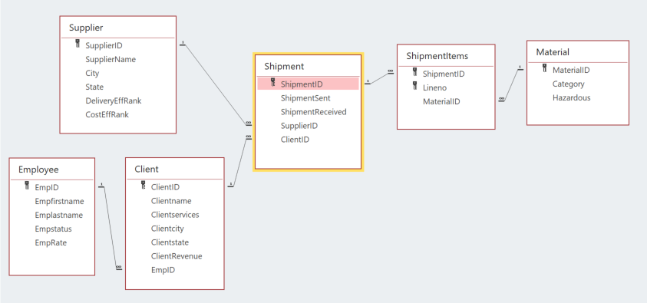

Application #5
SQL to link tables:
SELECT SupplierName, Clientname, ClientRevenue
From Supplier, Shipment, Client
Where Supplier.SupplierID=Shipment.SupplierID
and Client.ClientID=Shipment.ClientID
and ClientRevenue > (Select AVG(ClientRevenue) from Client);
Hint for #5

Slide 9

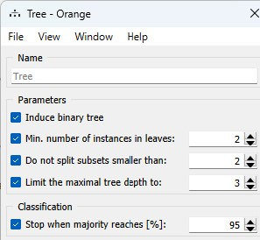
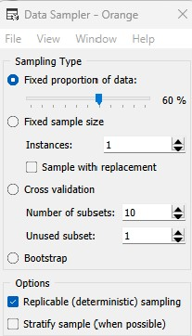
Application #6
Classification Tree. Data mining process, split data. EatIt.xlsx data set.
Build a classification tree with four terminal nodes (or leaves). Customize your tree by setting the parameters as shown below. 60/40 split, options Replicable using the Data Sampler.
Develop a confusion matrix for the validation data set. Interpret common confusion matrix metrics to evaluate the performance of the model. How many false positives? How many false negatives?
Using the validation data set, perform the SQL work that runs the model. For each terminal node in the tree, How many and which instances are correctly and incorrectly classified? Do these query results match your confusion matrix? They should.
Note: for this application #6, it is not necessary for you to use Orange Data Mining. You do not need to build the workflow, that is optional. You will need to use MS Access Desktop SQL for this application problem. You do need to understand the data mining output (tree and confusion matrix shown on the next slide.
Optional Orange Data Mining config information:

Slide 10
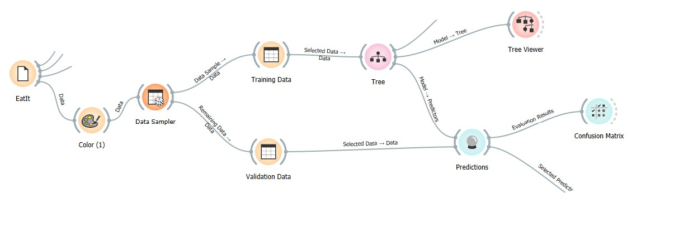
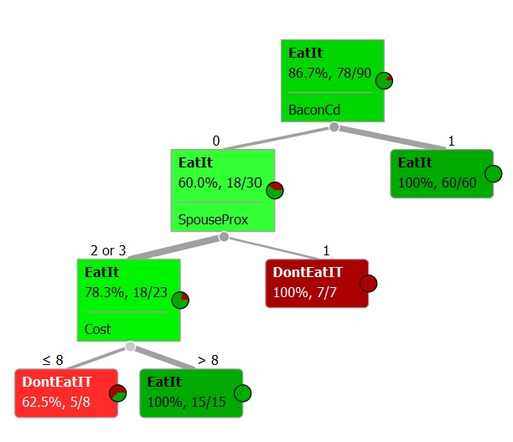
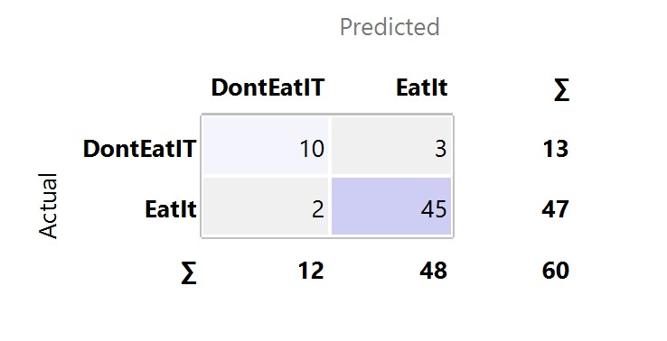
Application #6
Data Mining Output (below):
Training Data Set.
Data Mining Output (below):

Slide 11
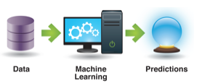
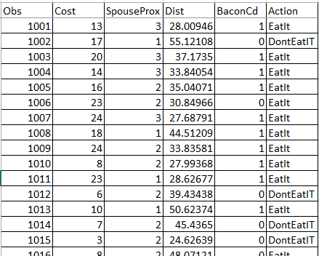
Application #6
Machine Learning SQL Application
Implement 4 Queries or Decision Rules in SQL (on the validation data set) based on the EatIt Decision Tree obtained from a Machine Learning Algorithm.
How many and which instances are correctly and incorrectly classified? Hints below!!
a. Had bacon in it and was eaten
SELECT *
FROM Data
WHERE ((BaconCd)=1);
b. Did not have bacon in it and the spouse was very nearby
SELECT *
FROM Data
WHERE (((BaconCd)=0) And ((SpouseProx)=1))
c. Did not have bacon in it and the spouse was not very nearby and the cost was less than or equal $8
SELECT *
FROM Data
WHERE BaconCd=0 And SpouseProx IN(2,3) And Cost<8.50;
d. Did not have bacon in it and the spouse was not very nearby and the cost was greater than $8
SELECT *
FROM Data
WHERE BaconCd=0 And SpouseProx IN(2,3) And Cost>=8.50;
Notes regarding the attributes: Cost, continuous SpouseProx, categorical, 1=very near, 2=medium distance, 3=very far away
Dist, continuous BaconCd, categorical, 1=yes, 2=no Action, categorical, target

Slide 12
SQL Basic Statement Organization
SELECT field1, function(field2), field3
FROM table1, table2
WHERE table1.linkfield=table2.linkfield, condition
AND condition
AND condition
GROUP BY field1, group by is needed with a function to “group” the records used in the function by the field specified
ORDER BY fieldn
HAVING, if used goes after GROUP BY, to count records.
HAVING Count(*)>1, counts records used in the function, displays those counts that are greater than 1.
Example
SELECT ClientName, SUM(Rev) AS Total Rev By Client
FROM Client, Transactions
WHERE Client.ClientId=Transactions.ClientId
GROUP BY ClientName

Slide 13


Application #7, TSLA, AAPL
Under Module 1 at our class site, click on the link YahooEquityBeta and run the Python code that pulls S&P 500 and TSLA data into a .csv file.
Using this data determine the Beta of the equity. Next, determine the correlation between Tesla and the S&P 500. Explain these metrics in business language as well as the difference between them.
Do the same for AAPL.

Slide 14

Application #8
According to several sources (such as; “Is it time for a reality check on rapid COVID test?” www.npr.org) the COVID-19 swab (at home) test is highly specific but not as sensitive. For the example data in file Swabtest.xls, determine the specificity and the sensitivity and explain these metrics in easy-to-understand language. Also, determine the overall accuracy.

Slide 15
Application #9 Tableau
For this assignment you will use the Excel spreadsheet Performance Lawn Equipment Database, NA (North America) Monthly Product Data Worksheet. We are interested in all the data, i.e. the two years 2012 and 2013. NA has two market size categories; Major Market and Small Market.
You are interested in finding out if total sales by product line is impacted by market size? Show results both as a table and as a chart. What type of chart did you use? Why? Which product lines are doing better in small markets vs. large markets?
Create a time-series (monthly) line chart of total sales for each product type (four types) on one chart.
How are the total sales related to total profit by product type? Which product type has the highest profit vs. highest sales?
You are interested in finding out more about business in California. Show the profit by Product type within Product line. Which product category is performing the poorest in California? Which specific products are contributing to this performance?
The Product manager responsible for mowers is interested in sales of mowers across all the states. Which state has the highest mower sales? Show it on a geo graph and a table. From the geo graph, can you identify the top 5 states for the highest mower sales?
Set up a hierarchy for Products:
Products
Product Type within Product Line, Product within Product Type
Using the Analysis tab, create a calculated field called ProfitIndex which is the Sum of Profit divided by the Sum of Budgeted Profit. According to this KPI, which products are performing poorly? What product line is performing poorly?

Slide 16
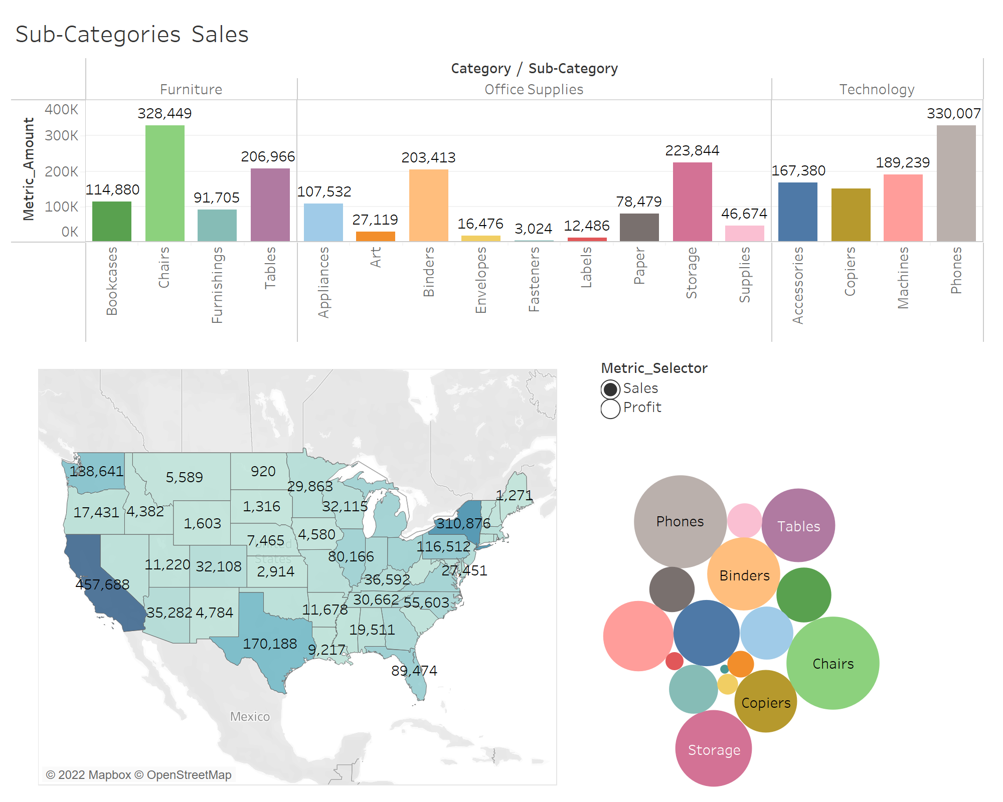
Application #10 Tableau, Dashboard
Use the Excel file Sample Superstore to build a dashboard.
In Texas, what were our total Sales for transactions involving Art?
What were our total profits in Texas and Oklahoma for Paper and Labels?

Slide 17
MCA – Application #11
A distribution organization is interested in analyzing potential profit possibilities for a new product they will soon be offering to their customer base.
The amount that can be charged depends on market conditions and based on the marketing team’s research and expertise, the team believes customers will pay somewhere between $100 and $130 for the item with $110 most likely.
During the initial offering period next month, the team also believes that the fewest the organization will be able to sell to the customer base is 2000 units. Most likely, next month 3000 will be sold, but the most optimistic forecast calls for 5000 to be sold.
From negotiations with various suppliers of the item, the purchasing team believes the per unit cost of the item will be somewhere between $70 and $110 per unit with all possible prices in between equally likely.
a. Using statistical means, determine the mean profit (or loss) for the item next month.
b. What is the likelihood the item will not be profitable for the organization next month?
c. Which factors in the next month profit analysis are uncertain? Which factor is most important for this item’s success? If management needed to focus on one uncertain item, which should it be?

Slide 18
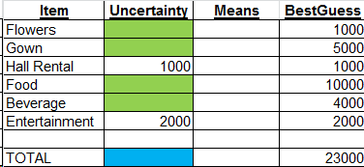
MCA – Application #12
Linda plans to get married in June. Her and her parents have been saving for years and have put aside $25,000 for the wedding. Frank, the wedding planner, tells the family that the estimates come out to $23,000. Linda, having understood her college business analytics course thoroughly, is concerned, however, about the variability of the costs. The florist keeps talking about the seasonality of certain flowers, shipping costs, size of arrangements, etc. and can’t quite nail down a firm estimate. “Beverage” cost estimates are always a challenge.
In addition, the gown may or may not require additional fittings and alterations, and while most of the RSVP’s have come in, Linda worries that some folks might not show up, while some family members might bring along uninvited guests. What’s a future bride and her family to do?
Linda first develops a spreadsheet listing of the line item expenses for her wedding (See Table 1). Frank’s $23,000 total estimate was based on his best guess for each expense item. However, Linda knows that some of the expenses are fixed (hall rental, entertainment) and some are variable (gown, flowers, food and beverages). Linda’s next step is to gather data on the costs associated with each item. She asks the florist for the raw data (cost for flowers) associated with the last 100 weddings of this size that he has done at this particular church. From this data set Linda obtains descriptive statistics for the Flower cost data (Linda’sWeddingStudent.xls) and develops a histogram. Based on this analysis Linda uses a common distribution to model this uncertain cost.
Using her knowledge of analytics, Linda uses Monte Carlo Analysis with Frontline Analytic Solver to create an input assumption for the variability of the cost of Flowers.
Table 1

Slide 19
MCA – Application #12
The estimate for her gown is that the price will likely be $5,000.00; if the gown fits perfectly, the cost may be as little as $4,500.00 (optimistic estimate), but if there are substantial alterations, the gown could cost as much as $5,500.00 (pessimistic estimate). All costs in between are also possible. Using her knowledge of analytics, Linda uses Monte Carlo Analysis to create an input assumption for the variability of the costs associated with her gown.
Linda has invited 125 people to the wedding, but either more or less than 125 could attend. Linda knows that if fewer than 125 people show up (her low estimate), her food costs will be $8,800 minimum. If more than 125 people show up (her high estimate), her food costs could be as high as $11,200. Total food costs anywhere between her high and low estimates are also possible.
Estimating “beverage” costs is more difficult. An analysis of prior history of “beverage” costs at this institution with approximately 125 guests, showed that these costs ranged from $3000 to $6000, with about $5000 most likely.
The spreadsheet now contains the same items as a static, or deterministic, model (Flowers, Gown, Hall Rental, Food, Beverage, Entertainment), but Linda adds variable estimates for Flowers, Gown, Food and Beverages based on her analysis of the variability of those costs. This gives her a much more sophisticated, probabilistic cost model that will provide a realistic assessment of a great many total cost scenarios that will lead to good cost expectations for her and her parents.
At this point, the Monte Carlo Analysis model has all of the information needed for simulating outcomes (forecast/results values). Linda choses to simulate 2,000 trial runs; in other words, for each “run”, Monte Carlo Analysis randomly selects one value from the distribution for each input variable and sums all 6 input variables to arrive at an output (TOTAL/results) value. When performed 2,000 times, the result is a range of output estimates representing a range of forecast total cost values.
Provide an analysis of potential total wedding costs using the Monte Carlo method. What is your total cost estimate using statistical means? How does this cost compare to the Mean total costs associated with the 2000 Monte Carlo Trials in your analysis. Estimate the likelihood of costs exceeding 25,000. According to the Monte Carlo analysis what are the minimum and maximum total wedding costs? To keep total costs as low as possible, which item(s) should receive the most attention? Is the $25,000 the family has set aside enough? Will Linda be happy? What are the (very) basic ideas of a deterministic versus a probabilistic or stochastic analysis?

Slide 20
MCA – Application #13
How much might $500,000 be worth in 10 years given the following:
- Current stock allocation, $250,000, 8% annual return
- Current bond allocation, $125,000, 4% annual return
- Current cash allocation, $125,000, 2% annual return
For the base case, assume annual returns as shown above.
Now let’s incorporate some risk and uncertainty, based on historical analysis.
Stock returns have a mean of 8% normally distributed with a standard deviation of 20%.
Bond returns could be as low as -5%, as high as 12%, or most likely 6% in any given year.
Returns on cash could be any where between 1% and 3% with all possibilities equally likely.
Describe the distribution of what the original balance could be worth in 5 years.
Could the original balance be worth less than $500,000?
What is the likelihood the original balance will be more than $700,000?

Slide 21
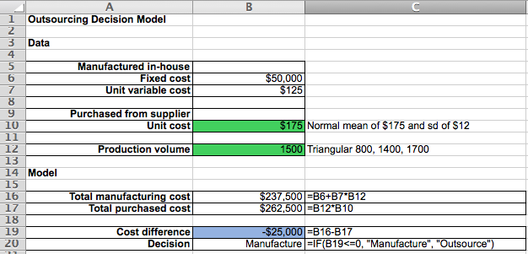
MCA – Application #14
Use the RiskAmp Platform to simulate an Outsourcing Decision Model (below) under the assumptions that the production volume will be triangular with a minimum of 800, maximum of 1,700, and most likely value of 1,400; and that the unit supplier cost is normally distributed with a mean of $ 175 and a standard deviation of $ 12. Find the probability that outsourcing will result in the best decision.

Slide 22
Application #15
In television’s early years, most commercials were 60 seconds long. Now, however, commercials can be any length. The objective of commercials remains the same – to have as many viewers as possible remember the product or service in a favorable way and eventually buy it. In an experiment to determine how the length of a commercial is related to people’s memory of it, 60 randomly selected people were asked to watch a one-hour program. In the middle of the show, a commercial commercial appeared. The content of the commercial was essentially the same, but the length varied. After the show, each person was given a test (max score was 30 points, 30-point scale) to measure how much they remembered regarding the product. The data was recorded in the TVCommercials.xlsx spreadsheet. Use all the data (no split).
Use Tableau to create an appropriate visualization of the data.
Determine the correlation coefficient and interpret in managerial language.
Determine the sample slope and interpret in managerial language.
Does it appear that commercial length is useful in estimating how much content will be remembered? Why?
Your organization is considering a 20 second commercial, how well do you think a viewer will remember it? Explain.
What would be the incremental value of purchasing a 40 second commercial versus the original 20 second commercial considered?

Slide 23
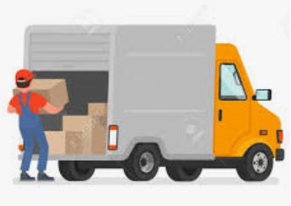
Application #16
The Excel file contains delivery data on 300 deliveries for a small fulfillment organization. The data set includes three predictors and one target (time in hours). Two predictors are continuous; miles and number of deliveries for an assignment. One predictor is categorical; whether there is highway congestion (a “1” means yes there was congested highway involved in the assignment and a “0” means there was not). Use Orange Data mining.
Use the common data mining approach with a 60/40, training/validation split.
Run the regression analysis in Orange Data Mining.
Interpret the coefficient of determination (multiple R-squared) for the training (or model building) data set.
Develop and interpret the MAD/E metric using the validation data set.
Interpret the model coefficients.
What is the model predicted delivery time for validation record Assignment ID #104? What was the model error?
Build a simple spreadsheet that demonstrates the interpretation.
Develop a spreadsheet that provides estimated delivery times for some new, example deliveries of your choosing, or those in the new worksheet; N1, N2, N3, N4.
TruckDrivingTimes.xls Excel File

Slide 24
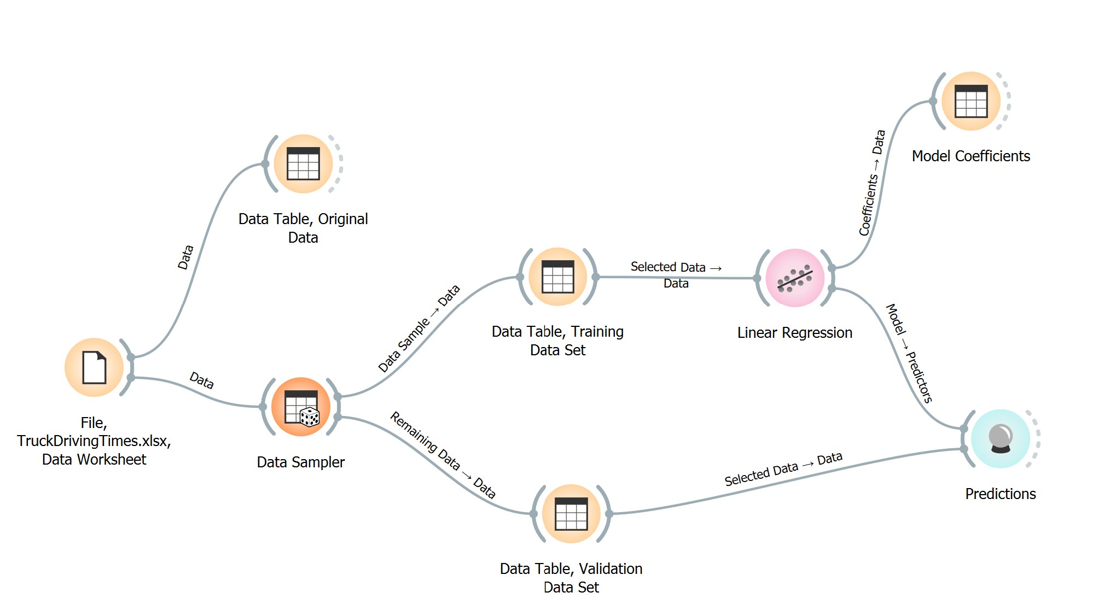
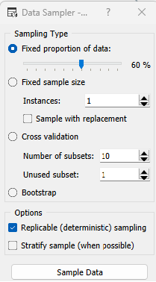
WS01 – Application #16

Slide 25
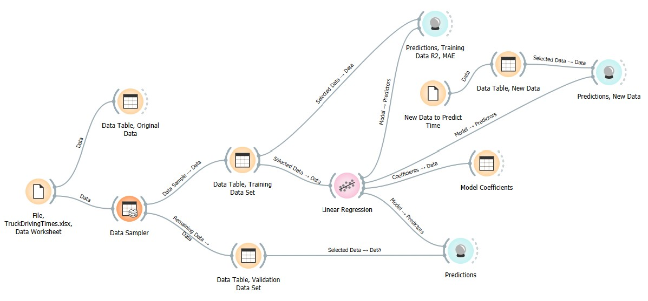
WS01 – Application #16_hints

