Slide 1
Mark Ritchie
2nd Year Computer Science and Software Engineering
Project Discussion
2D Structural Analysis
Circuit Logic Software
CSC Calculator (Aside)
Web-Server (Microsoft Project CS335)

Slide 2
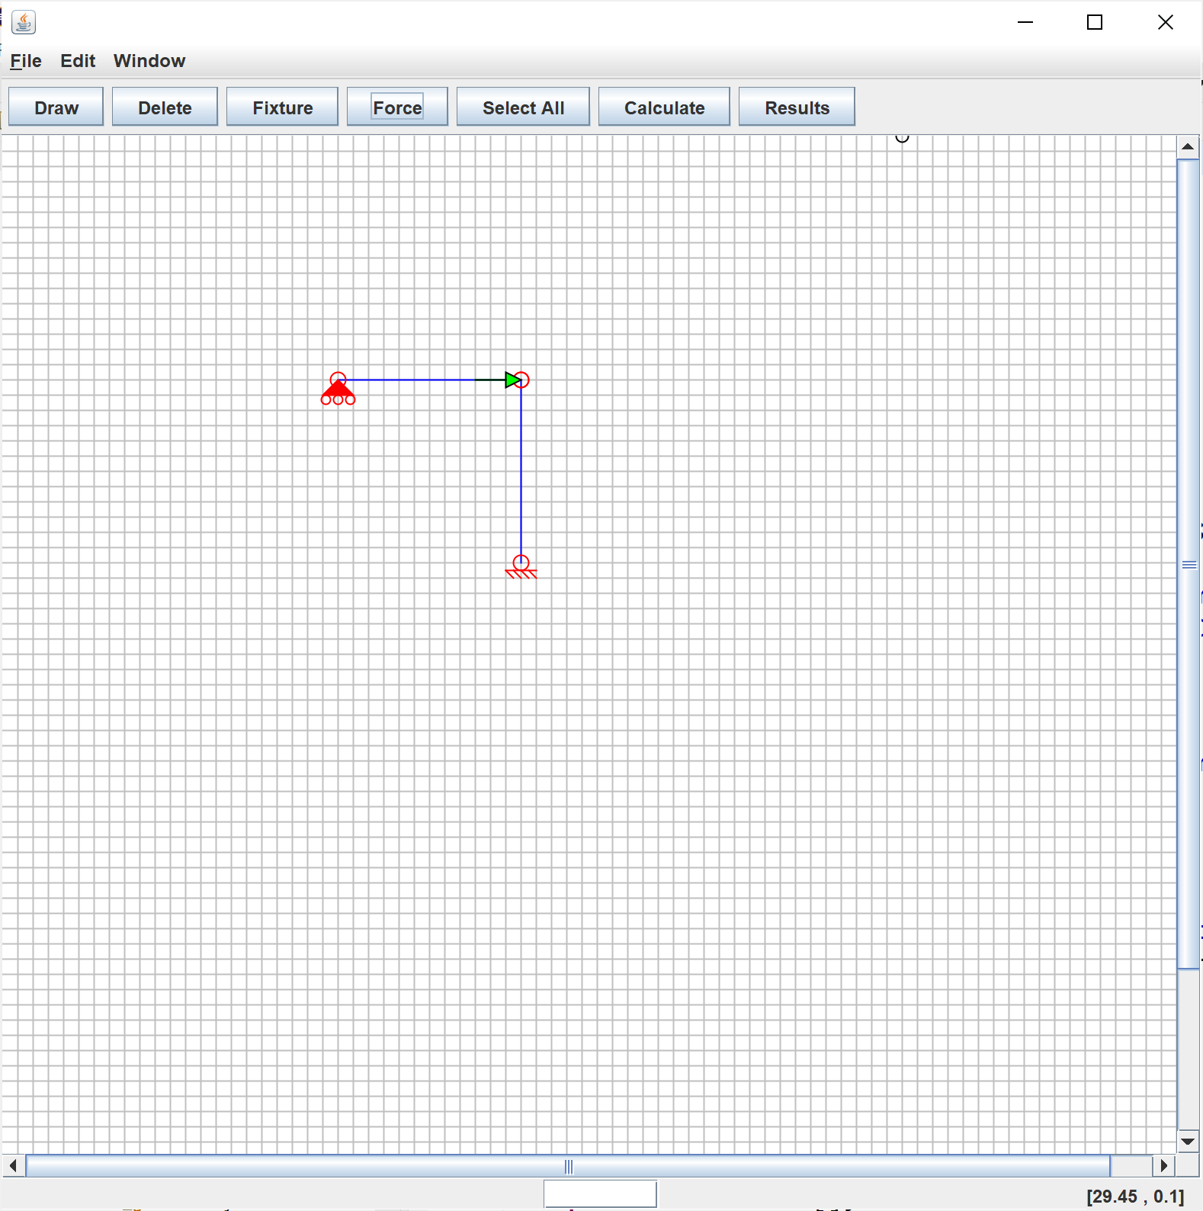
2D Structural Analysis: Overview
What is it?
Draw Nodes and Members
Apply Boundary Conditions
Apply Forces
Calculate Results
Displacement
Reactions
Shear Diagram
Bending Diagram
Eclipse, Java, Java Swing

Slide 3
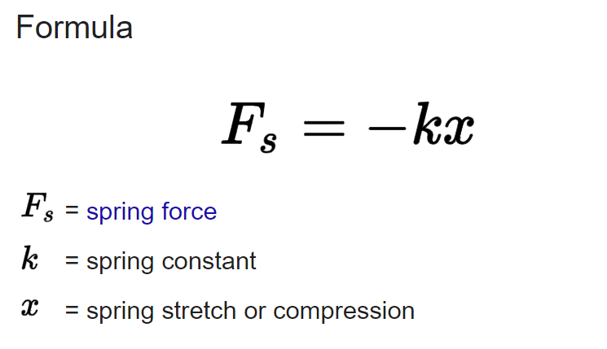
2D Structural Analysis: Direct Stiffness Method*
Solve system of linear equations governed by Hooke’s Law

Slide 4
2D Structural Analysis: Direct Stiffness Method More Specifically
F is the forces applied to the nodes and members (the structure)
k is a constant governed by the material properties and shape
x is the displacement of the structure
We input F and k by drawing the structure and we solve for x!

Slide 5
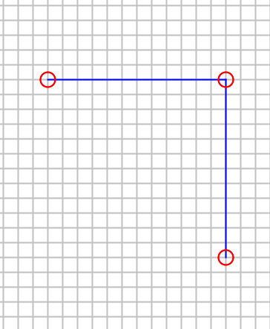
2D Structural Analysis: Drawing the Structure
Node | x(m) | y(m)
1 | 0 | 0
2 | 6 | 0
3 | 6 | -6
N1
N2
E1
Element | A(m2) | E(GPA) | I(m4) | dx | dy | L | cos*theta | sin*theta
1 | 600.0E-06 | 200.0E+09 | 60.0E-06 | 6 | 0 | 6 | 1 | 0
2 | 600.0E-06 | 200.0E+09 | 60.0E-06 | 0 | -6 | 6 | 0 | -1
E2
N3

Slide 6
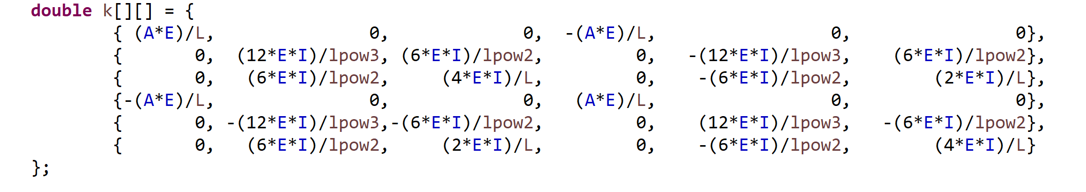
2D Structural Analysis: Each Member has a k Matrix
N1
N2
M1
M2
N3
A is the cross-sectional area (m^2)
E is Youngs modulus (GPa). How easy a material stretch's and deforms.
I is second moment of area (m^4). Resistance to moving on its own axis. Due to shape of cross-section

Slide 7
2D Structural Analysis: Each Member has a local k Matrix
Member 1
Member 2
N1
N2
M1
M2
N3

Slide 8
2D Structural Analysis: Each Member has a k local Matrix
We need to add K1 to K2 to create a global matrix!
But they aren’t in the same co-ordinate system!
We apply the beta matrix to both!
This transforms each member from local co-ordinate system to global.
N1
N2
M1
M2
N3

Slide 9
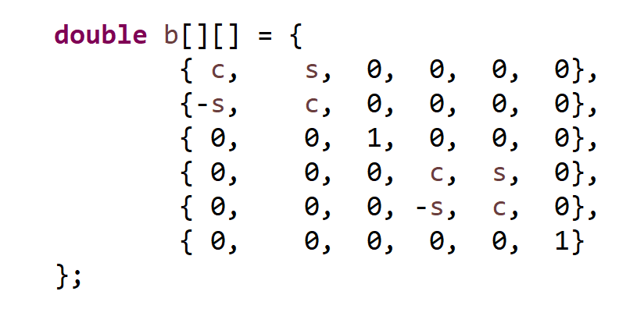
2D Structural Analysis: Each Member has a beta Matrix

Slide 10
2D Structural Analysis: Each Member has a beta Matrix
Member 1 beta
Member 2 beta

Slide 11
2D Structural Analysis: Each Member has a k prime Matrix
Member 1 beta
Member 2 beta

Slide 12
2D Structural Analysis: Create a global Matrix
N1
x y r
N2
x y r
N3
x y r
N1
N2
M1
M2
+
N3

Slide 13
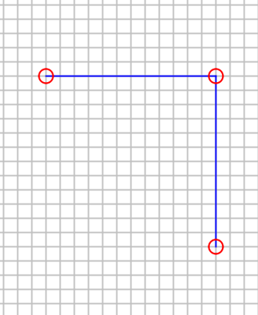
2D Structural Analysis: Create a global Matrix
=

Slide 14
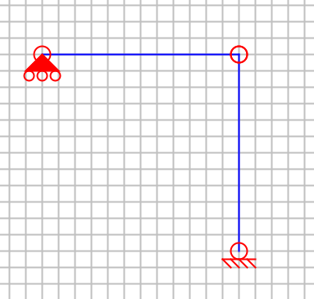
2D Structural Analysis: Apply Boundary Conditions
Fixed : No movement! (x,y,r)
Pinned: Only rotation (x,y,r)
Sliding: Rotation and either x or y movement
Free(Default): Move in x and y. Rotate in r

Slide 15
2D Structural Analysis: Apply Boundary Conditions
We remove dofs based on boundary conditions

Slide 16
2D Structural Analysis: Reduced global stiffness matrix
K=

Slide 17
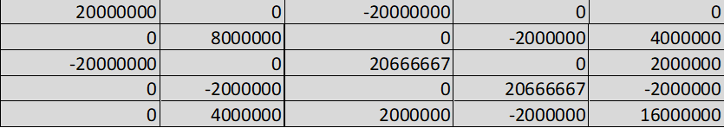
2D Structural Analysis: Direct Stiffness Method More Specifically
F is the forces applied to the nodes and members (the structure)
k is a constant governed by the material properties and shape
x is the displacement of the structure
F= x

Slide 18

2D Structural Analysis: Applying the Forces
We only have node forces
N1
N2
N3

Slide 19
2D Structural Analysis: Reduced Force
We only have node forces

Slide 20
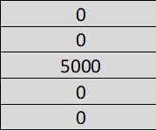
2D Structural Analysis: Direct Stiffness Method More Specifically
F is the forces applied to the nodes and members (the structure)
k is a constant governed by the material properties and shape
x is the displacement of the structure
= x

Slide 21
2D Structural Analysis: Displacement
x=

Slide 22
2D Structural Analysis: Displacement
These displacements cause additional reaction forces!
We “blow-up” the displacement matrix to the same dof as the global matrix

Slide 23
2D Structural Analysis: Displacement
9 by 9
5 by 1
9 by 1

Slide 24
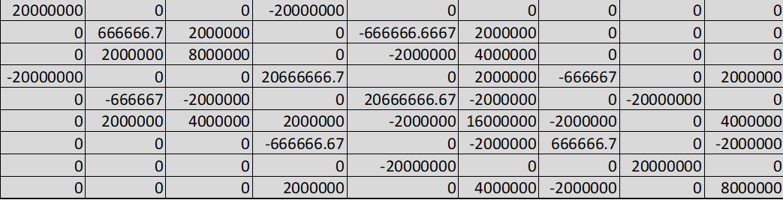
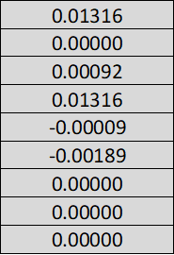
2D Structural Analysis: Reactions
R=
*

Slide 25
2D Structural Analysis: Reactions
R=

Slide 26
Reference
https://ichbinharsh.medium.com/basics-of-finite-element-method-direct-stiffness-method-part-1-2676f3ee062a

Slide 27
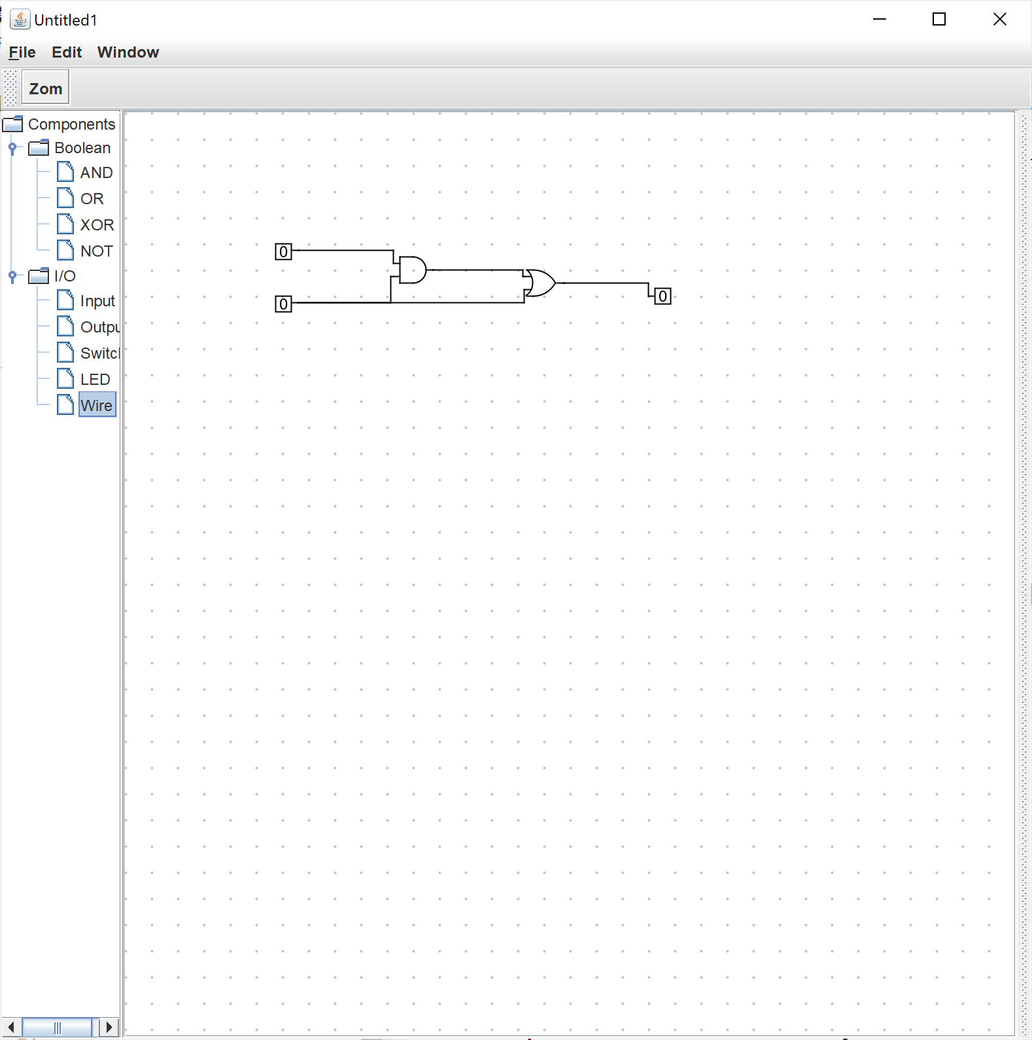
Circuit Logic Software

Slide 28
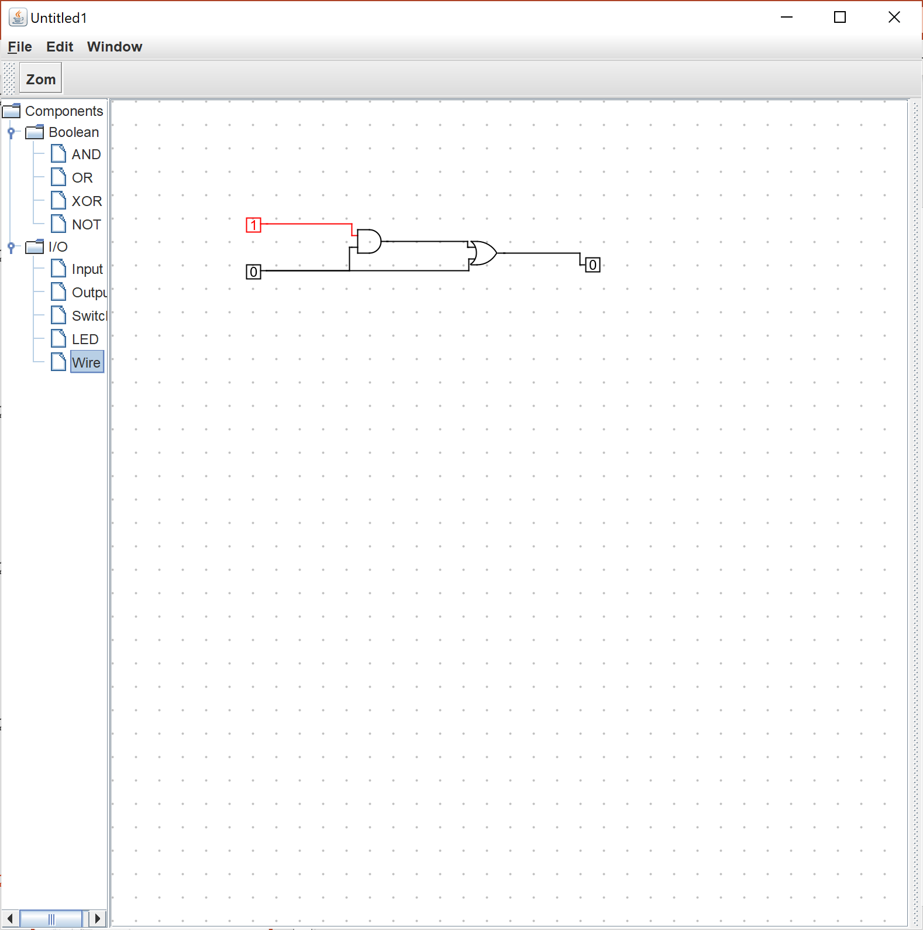
Circuit Logic Software

Slide 29
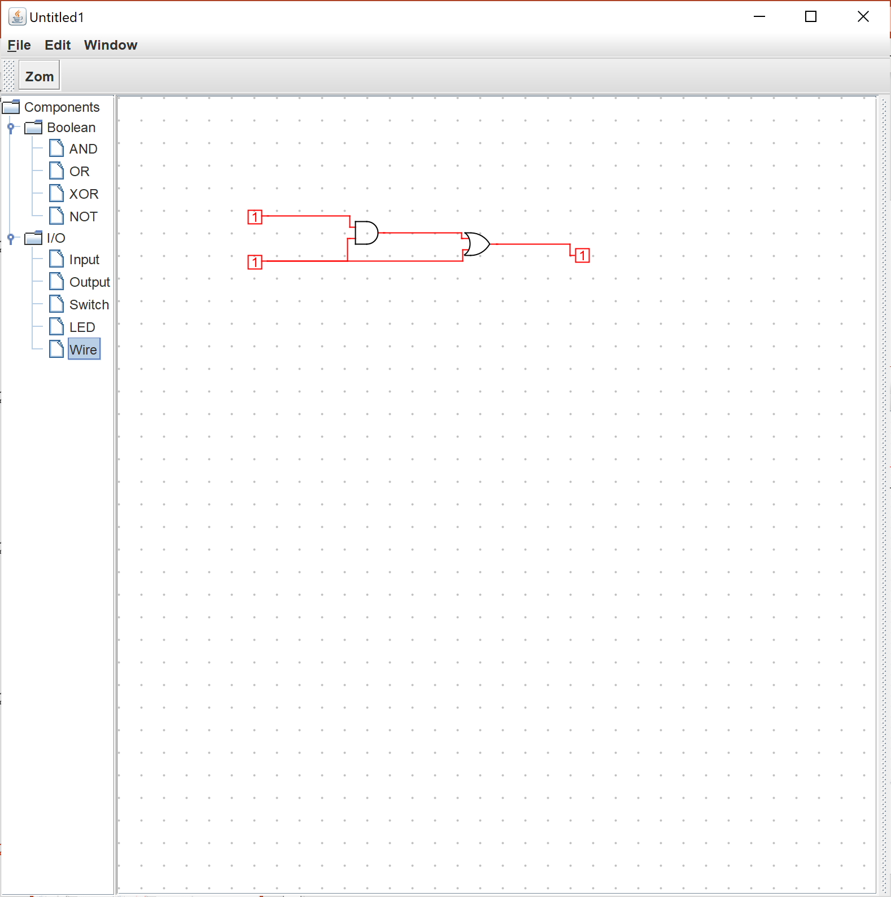
Circuit Logic Software

Slide 30
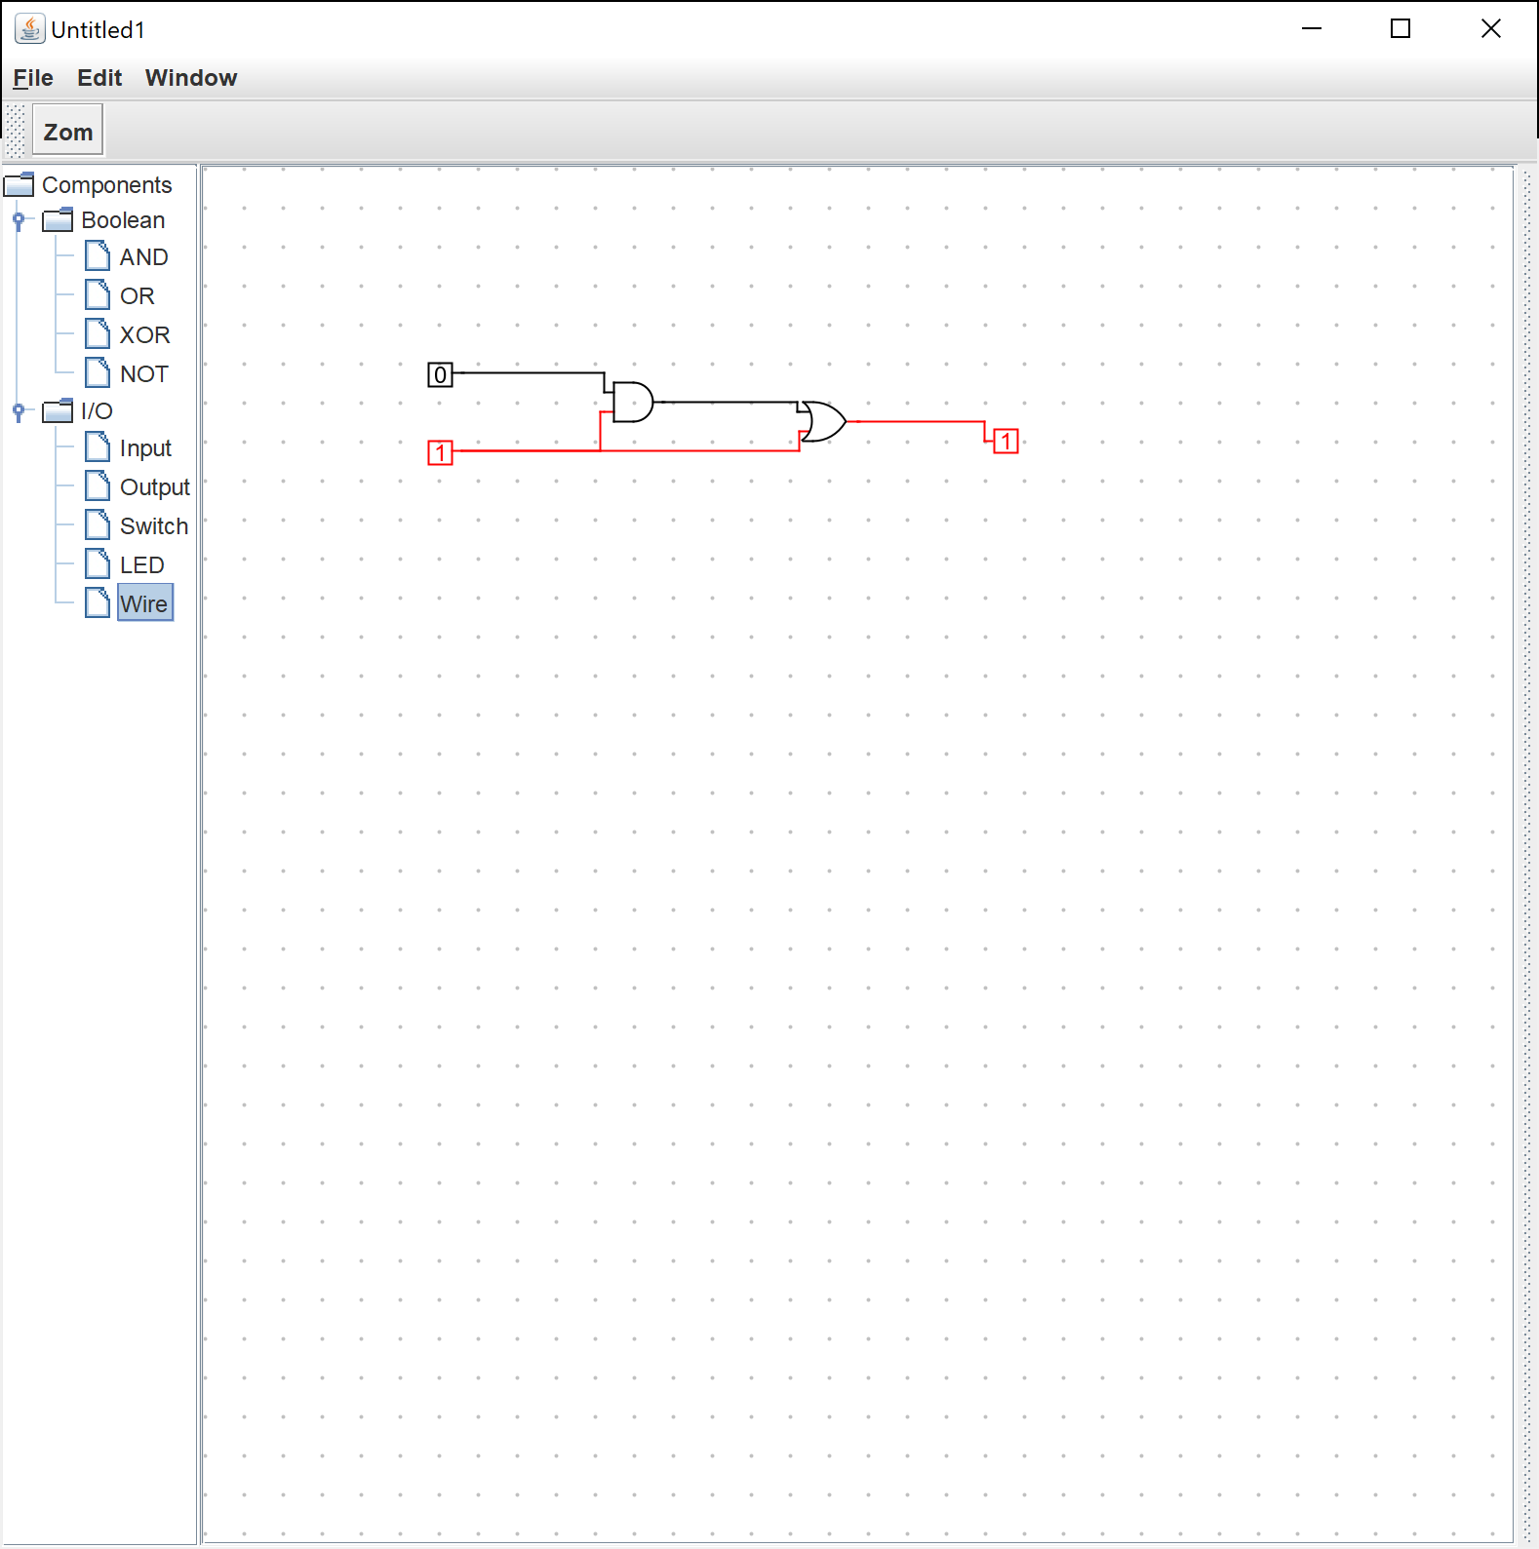
Circuit Logic Software

Slide 31
Web Server
Azure VM.
Converting Java desktop apps to web apps.
CS335 Microsoft Internship.

