Slide 1
The Road to Fortuna
Mark Takata Adobe ColdFusion Technical Evangelist

Slide 2
Introduction

Slide 3
Fortuna – What? When?
The newest version of Adobe ColdFusion
H1 2023 target

Slide 4
What’s in the box?
Cloud Story – Google Cloud Platform
Central Configuration Server (CCS)
SSO CF Admin Integration (SAML/LDAP)
New PDF Engine (PDF Reactor)
Library Updates (Java, Solr, Hibernate)
Native GraphQL Query support
Dozens of bugs fixed
Core Support to 2028, Extended 2029 (tbd)

Slide 5
Google Cloud!
Storage Services
FireStore
GCP Common Profile
GCP PubSub
CloudSQL (MySql8, PostGres 14, MSSQL 2019)
MemStore (Redis, Memcached)

Slide 6
Central Configuration Server (CCS)
Syncing of CF Settings via CF admin & CFsetup & Admin API
Environment
Multi Cluster Support
Versioning
ccs.bat
CCS Admin Page
Installation via CFPM
Auto Discovery
ccs.sh

Slide 7
CF Admin SSO Support
New Admin APIs
setAdminLdapConfiguration
getAdminLdapConfiguration
deleteLdapConfiguration
setExternalAuthentication
getExternalAuthentication
deleteAdminSamlConfig
getAdminSamlConfig
LDAP & SAML for login, configuration and user/group setup

Slide 8
HTMLtoPDF Engine Upgrade
Using PDFReactor Engine
CSS3
HTML5+
SVG
Page breaks, fonts, form elements
Large HTML files
Audio & video embedding

Slide 9
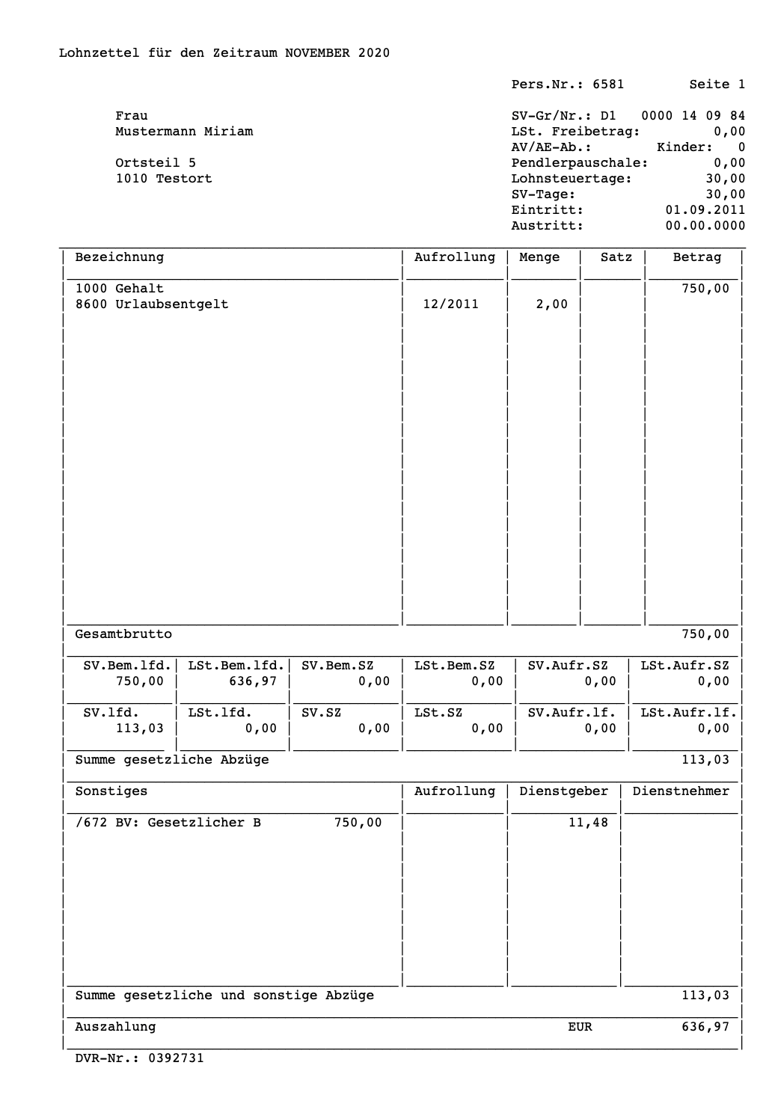
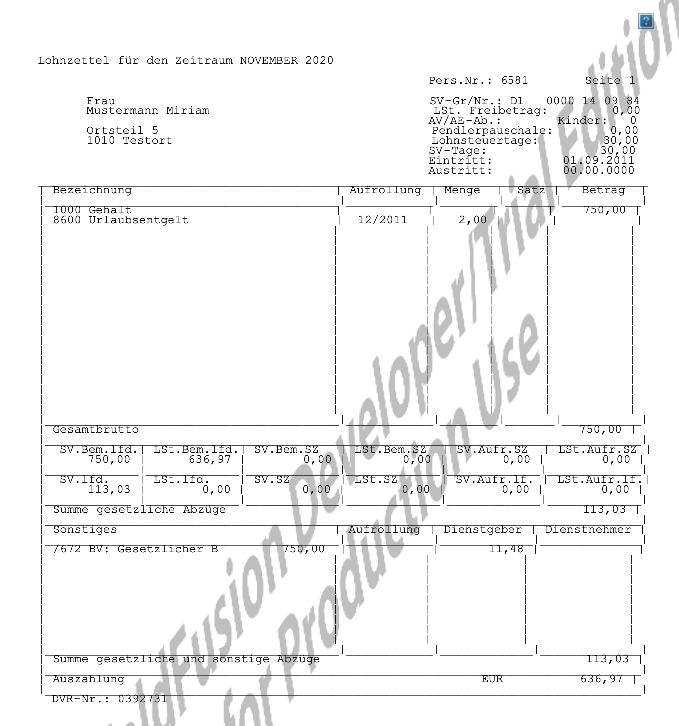
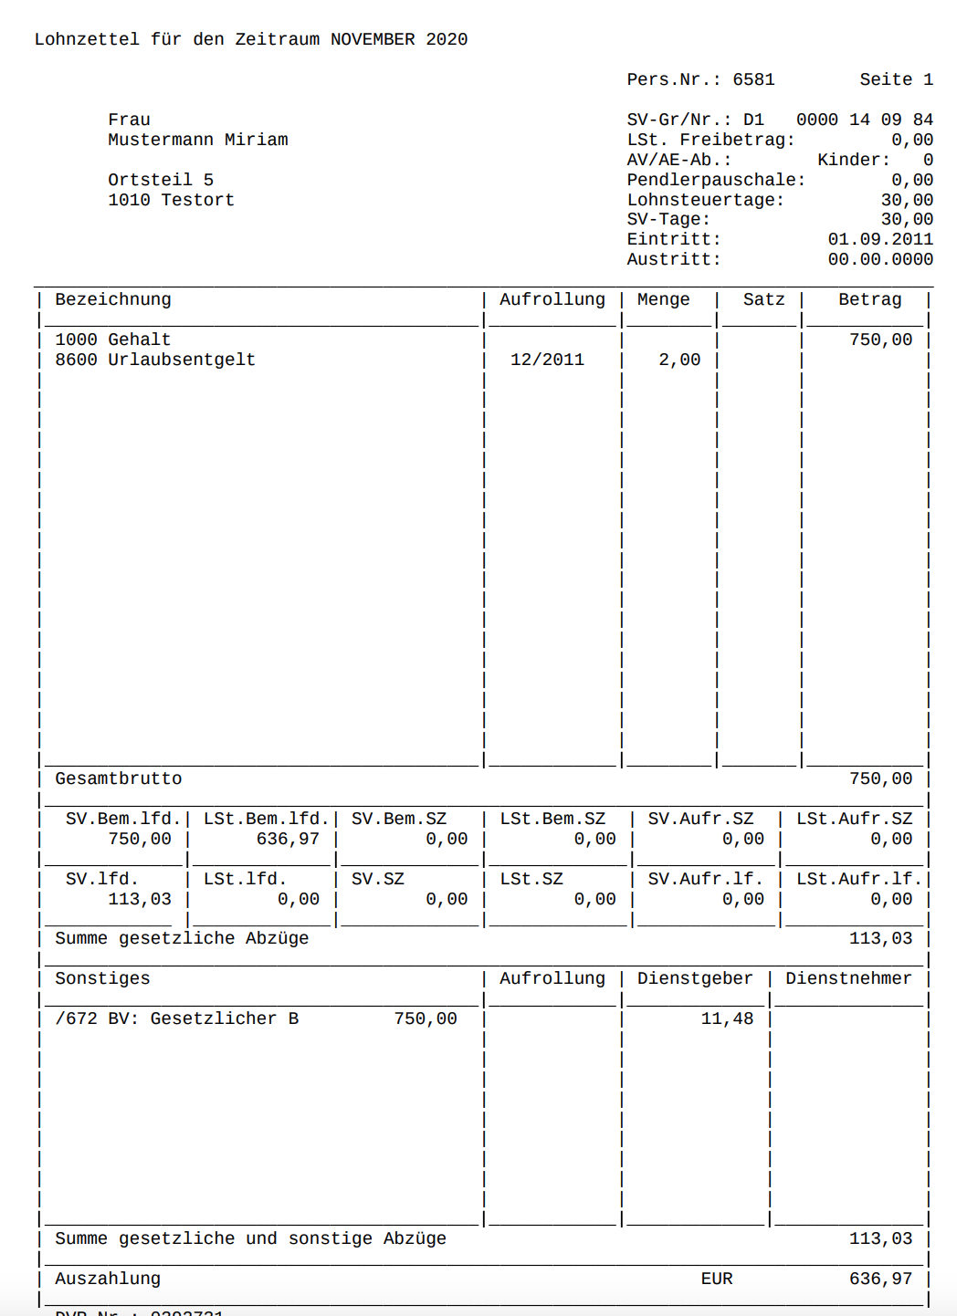
HTMLtoPDF Engine Upgrade
Code running on Chrome Browser
Existing PDF rendering
New PDF rendering

Slide 10
Library Updates
Java 17
SOLR 8.9
Hibernate 5.6+

Slide 11
GraphQL
Ability to connect to & consume GraphQL endpoints using native GraphQL query language
Queries & mutations
Arguments
Variables
Aliases
Fragments
Directives
Operation Names
Subscriptions
Caching (potentially leveraging CF’s caching engines for shared caches & scopes)
We are using the GraphQL specification: https://graphql.org/learn/

Slide 12
Public Alpha .1 Currently Live
Most GCP features available to test
PDF Engine Upgrade
SAML/LDAP Admin integration
Library updates
Includes update to VS Code to support Fortuna testing
Missing:
GraphQL
Realtime Listeners on FireStore
ACL/Policy/Requestor Pay features in GCP
Signups still available, email/msg me for details

Slide 13
Questions?
Email: Takata@adobe.com
Twitter: @MarkTakata
GitHub: https://github.com/MarkRTakata/
LinkedIN: https://www.linkedin.com/in/marktakata/
CFML Slack: Mark Takata (Adobe)

