Slide 1

Tyson and Mark

Slide 2
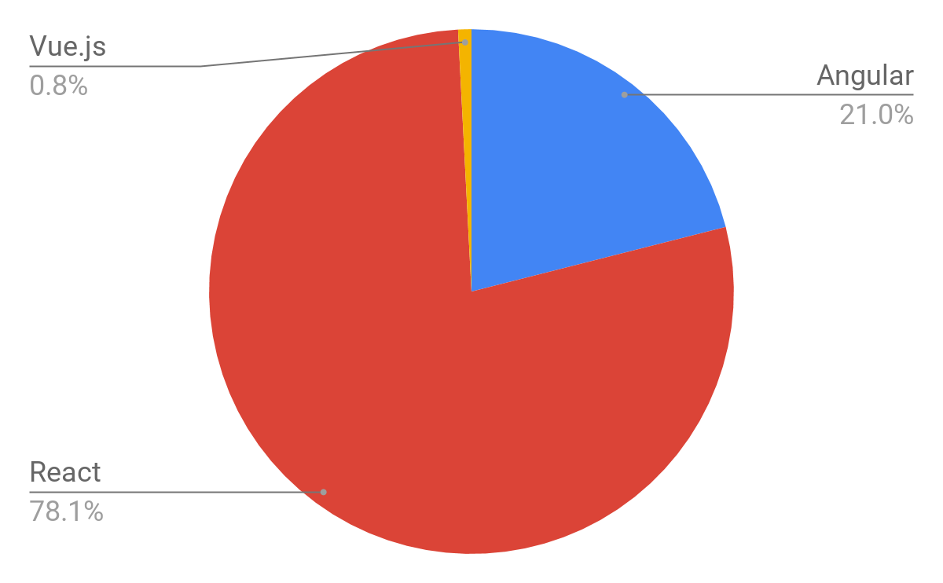

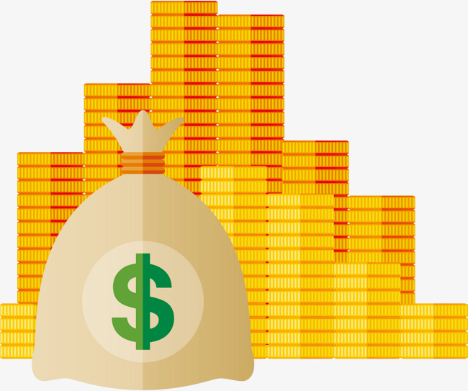

Why should you care?
Popularity
= Clients + Money

Slide 3
Why should you care?
Give specific advantages it has over angular

Slide 4

Why should you care?
Reusability

Slide 5
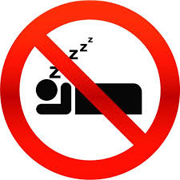
Why should you care?
Easy to learn

Slide 6
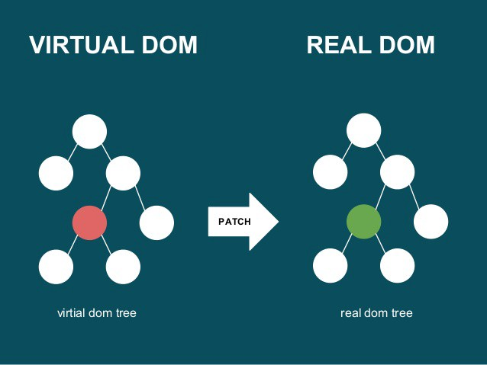
Why should you care?
High performance DOM

Slide 7

So, what is it?
Library

Slide 8
React’s Separation of Concerns
Separation of Concerns.
React’s way?
https://reactjs.org/docs/introducing-jsx.html#why-jsx

Slide 9
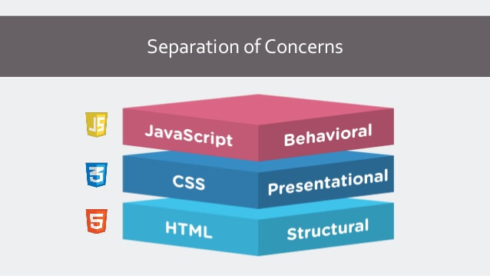
Separation of Concerns

Slide 10
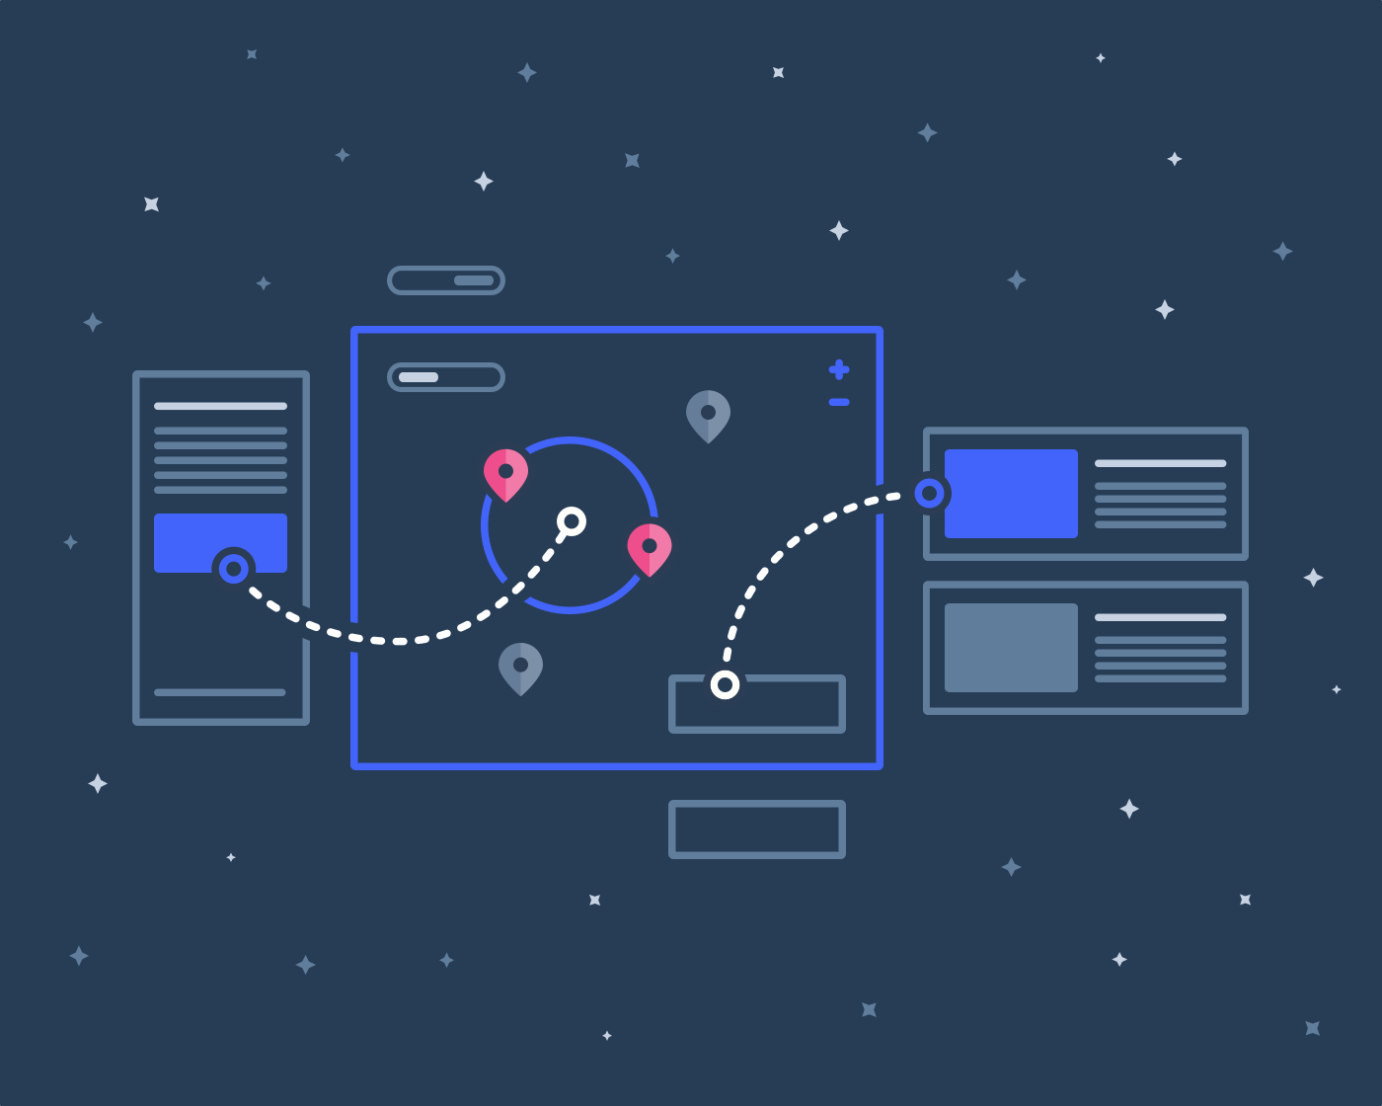
React’s Way

Slide 11
Uncontrolled and Controlled components.
Uncontrolled
Controlled
Stores state locally.
Has methods that can alter the DOM.
Passes data to other components as props.
Uses the virtual DOM.
Outputs values through props.
Notifies changes through callbacks to the parent component.
Uses the DOM.
Binds to DOM elements using the Ref keyword.

Slide 12
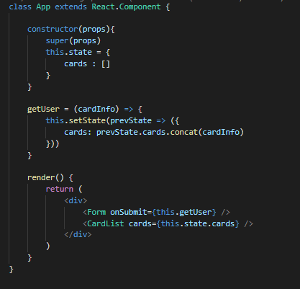
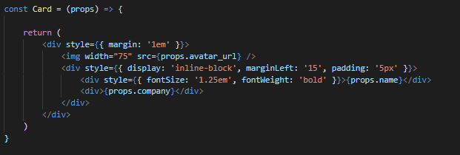
Uncontrolled
Controlled

Slide 13
State/Props
State
Props
State lives locally/internally on a Uncontrolled component.
State has memory, State can be updated or changed.
When state is updated, it will update all sub components that use that state (The components react).
Props are values, passed down from parent components.
Props cannot be changed directly, or updated.
Props are mainly used on controlled components.

Slide 14
How do Components Update?
With the setState() method, this method updates state, and updates all sub components that use that state property.
This process is automatic, but the setState() method, is used in only uncontrolled components.
The setState() can take a parameter, which is the previous state.
The setState() can take a callback function, that can access the new updated state.

