Slide 1

Tyson and Mark

Slide 2
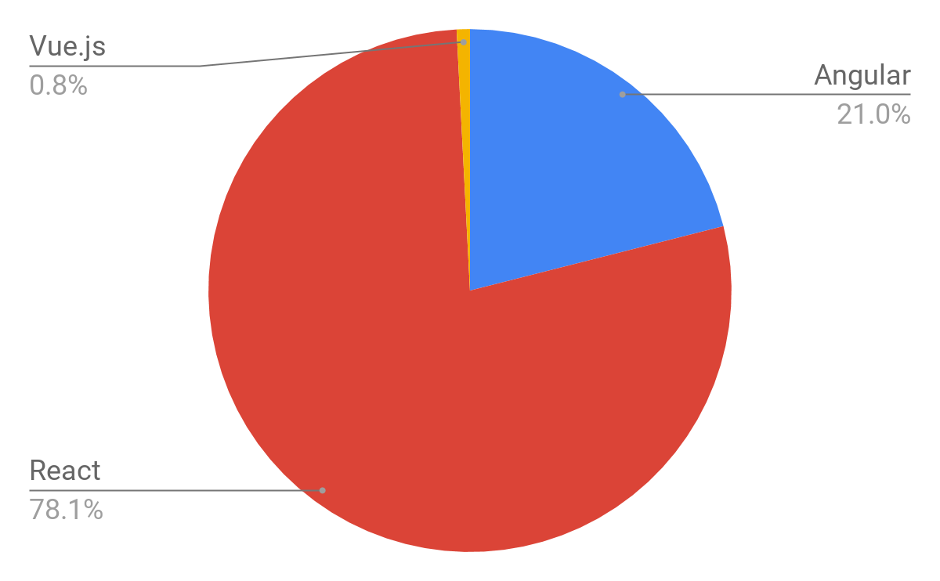

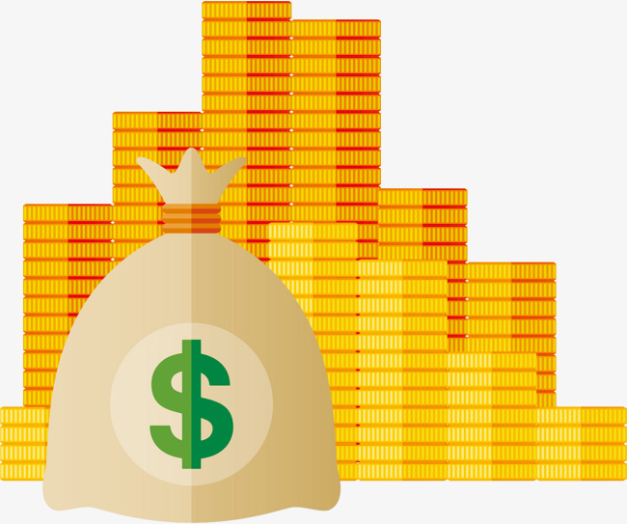

Why should you care?
Popularity
= Clients + Money

Slide 3
Why should you care?
Give specific advantages it has over angular

Slide 4

Why should you care?
Reusability

Slide 5

Why should you care?
Easy to learn

Slide 6
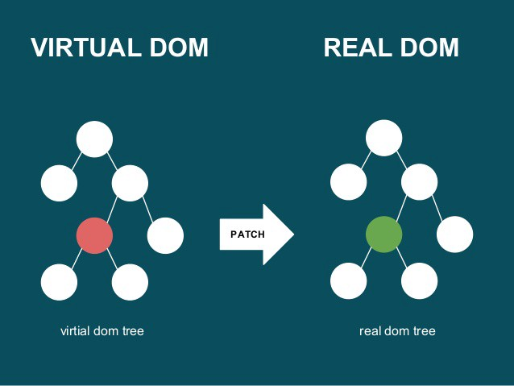
Why should you care?
High performance DOM

Slide 7

So, what is it?
Library

