Slide 1

Tyson and Mark

Slide 2
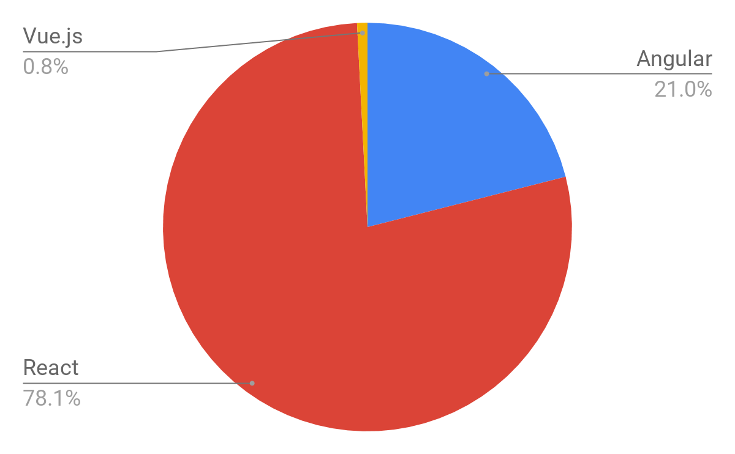

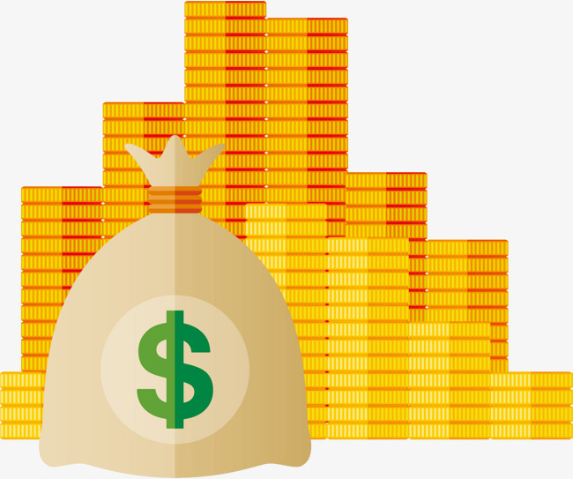

Why should you care?
Popularity
= Clients + Money

Slide 3
Why should you care?
Give specific advantages it has over angular

Slide 4

Why should you care?
Reusability

Slide 5

Why should you care?
Easy to learn

Slide 6
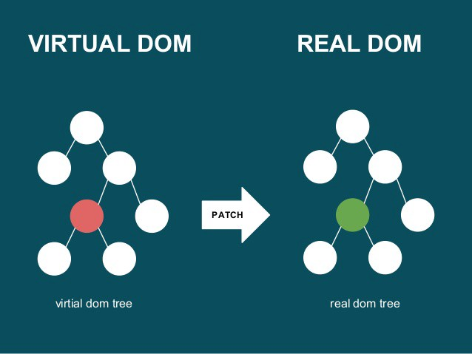
Why should you care?
High performance DOM

Slide 7

So, what is it?
Library

Slide 8
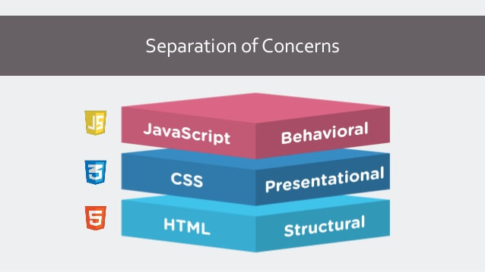
Separation of Concerns

Slide 9
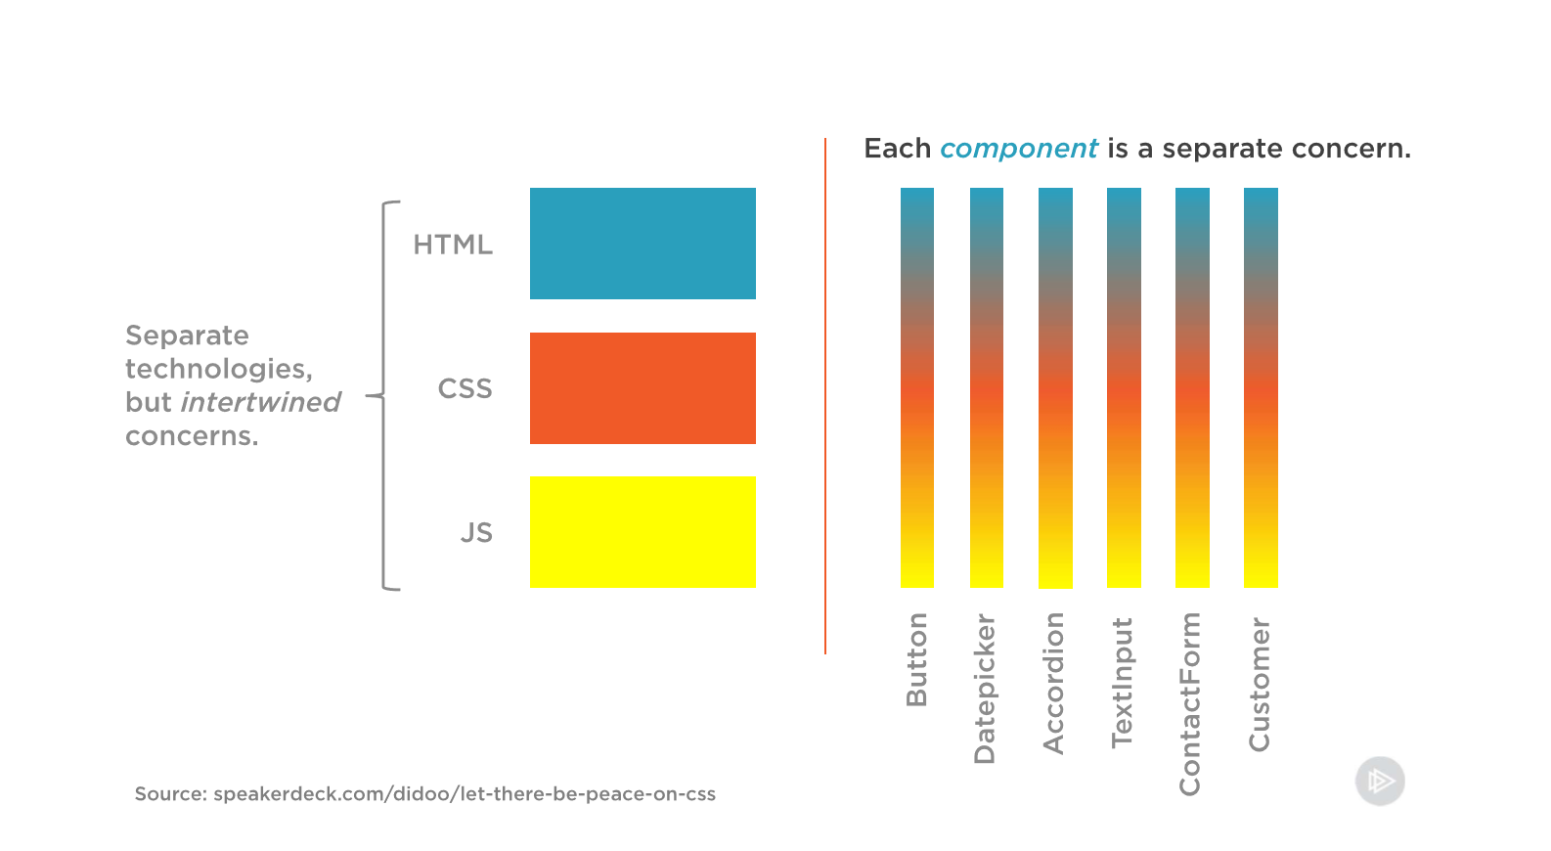
React’s Way

Slide 10
Uncontrolled and Controlled components.
Describes the method of obtaining input data from HTML inputs.
Controlled
Uncontrolled
You specify the value of the input with a state variable, every time a user enters a value, the state is updated via a function call.
Uses the virtual DOM.
Uses the DOM.
Binds to DOM elements using the Ref keyword, or using a event object.

Slide 11
Class Components vs. Functional Components
Class Component
Component is a class.
Has access to state/props, and to the React component life cycle.
I have included links in the README.md to some resources on component life cycle.
Functional Component
Component is a function, that takes props as a parameter.
Can only receive props.
Can’t store state locally.

Slide 12
State/Props
State
Props
State lives locally/internally on a class component.
State has memory, State can be updated or changed.
When state is updated, it will update all sub components that use that state (The components react).
Props are values, passed down from a parent component.
Props cannot be changed directly, or updated.
Props are mainly used on Functional/Pure components.

