Slide 1

Tyson and Mark

Slide 2

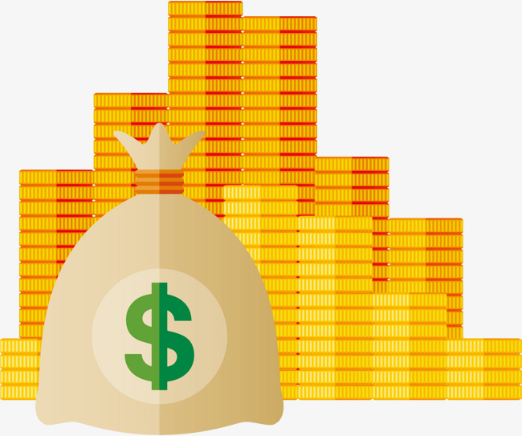

Why should you care?
Popularity
React
Angular
Vue
= Clients + Money

Slide 3

Why should you care?
Reusability

Slide 4

Why should you care?
Easy to learn

Slide 5
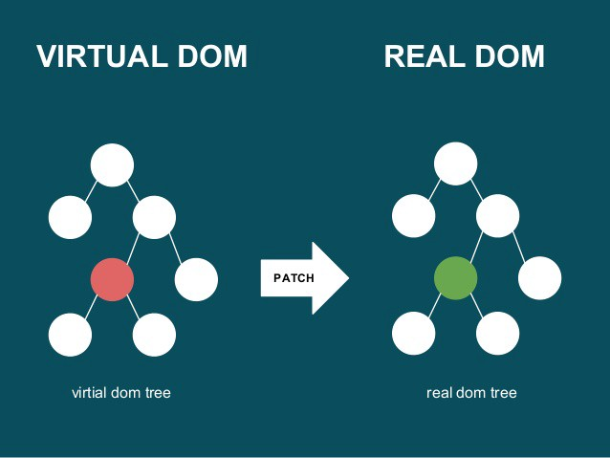
Why should you care?
High performance DOM

Slide 6

So, what is it?
Library

