Slide 1

Tyson and Mark

Slide 2
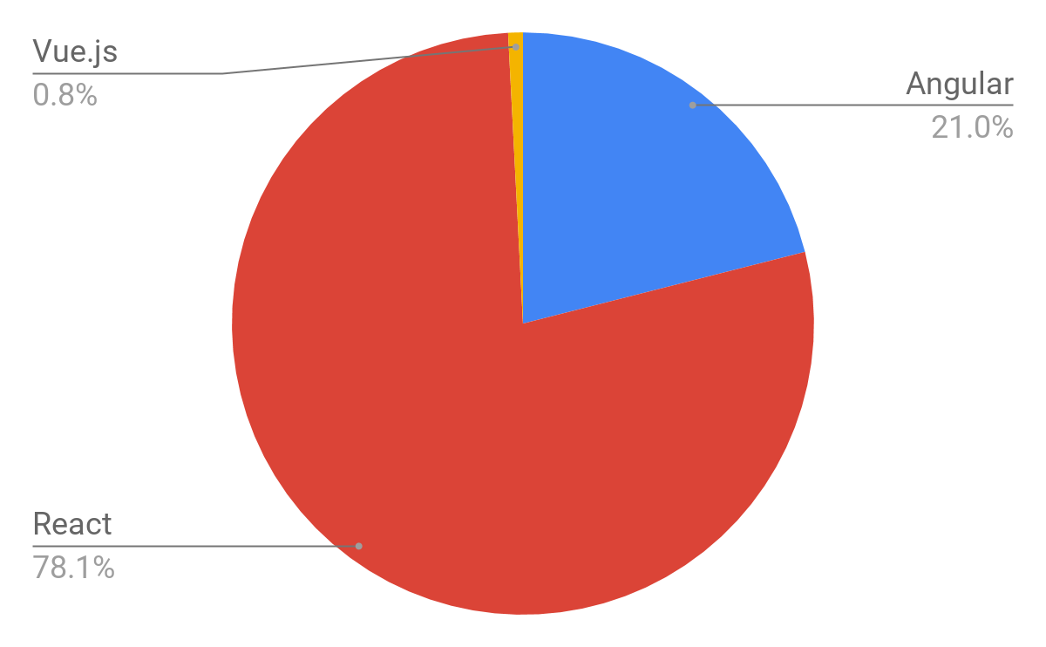



Why should you care?
Popularity
= Clients + Money

Slide 3
Why should you care?
REACT
ANGULAR
JSX
Flexibility (Libraries)
Javascript focused
Typescript
Framework
OOP focues

Slide 4

Why should you care?
Reusability

Slide 5

Why should you care?
Easy to learn

Slide 6

So, what is it?
Library
A set of functions that you can call
You choose the technologies that you want to use in your application such as: ReactJs, Axios, Flux, React-Router-Dom, React-Scroll
Generally most frameworks extends the HTML with JavaScript but ReactJs takes advantage of JSX and uses JavaScript. JSX is basically a abstraction of React.createElement()
Framework
A framework embodies some abstract design and technologies to use
When building a particular application, the application lives inside the framework
The framework offers a tool for all of the items that your application may need (In Angular, no need for Axios you can you just import HttpClient from angular/core)

Slide 7
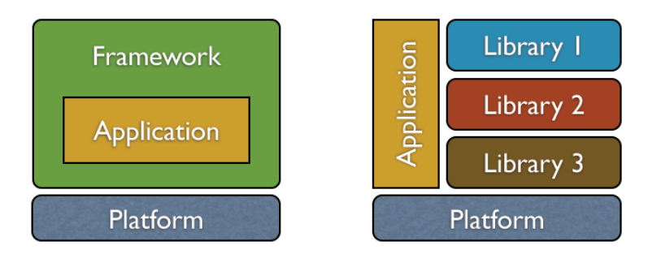
A Visual difference between Framework/Library

Slide 8
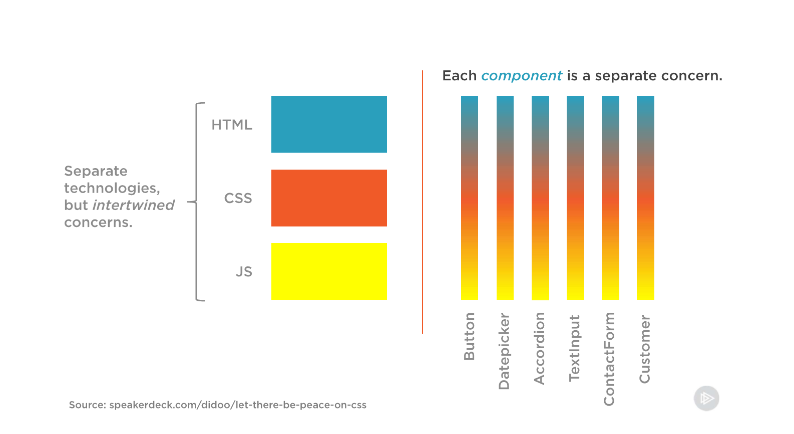
React’s Way

Slide 9
Uncontrolled and Controlled components.
Describes the method of obtaining input data from HTML inputs.
Controlled
Uncontrolled
You specify the value of the input with a state variable, every time a user enters a value, the state is updated via a function call
Uses the virtual DOM
Uses the DOM
Binds to DOM elements using the Ref keyword, or using a event object

Slide 10
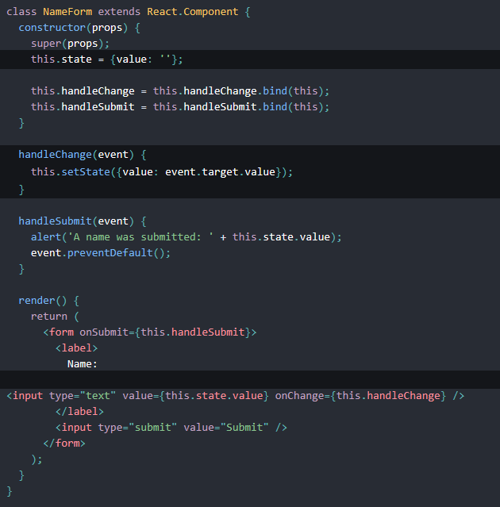
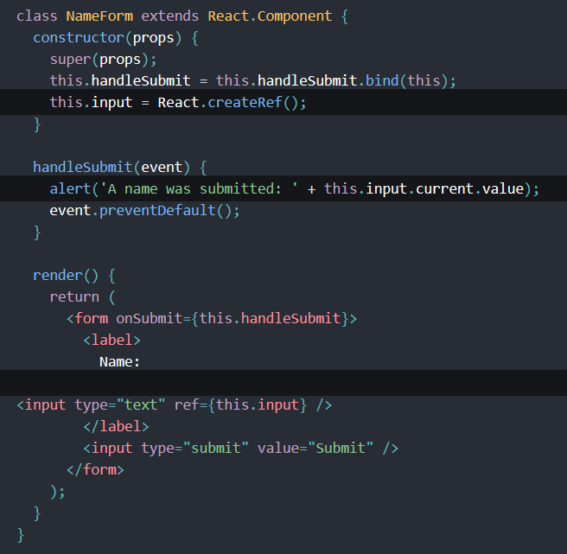
? Component
? Component

Slide 11
Class Components vs. Functional Components
Class Component
Component is a class
Has access to state/props, and to the React component life cycle
I have included links in the README.md to some resources on component life cycle
Functional Component
Component is a function, that takes props as a parameter
Can only receive props
Can’t store state locally

Slide 12
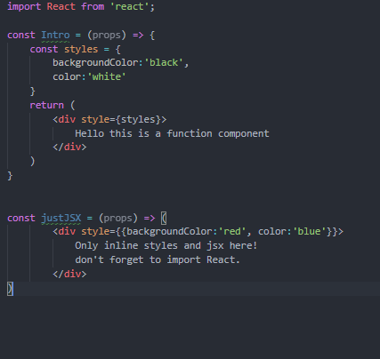
Functional Component

Slide 13
State/Props
State
Props
State lives locally/internally on a class component
State has memory, State can be updated or changed
When state is updated, it will update all sub components that use that state (The components react).
Props are values, passed down from a parent component
Props cannot be changed directly, or updated
Props are mainly used on Functional/Pure components

