Slide 1
Food4All
To help with the struggles of allergies.

Slide 2
Food4All
Every 3 minutes someone has a food emergency.
In the US 200,000 emergencies happen every year due to allergies.
CDC – The number of children with food allergy has increased by 50% since 1997
30% of children with food allergies have more than one allergy.
The cost for dealing with food allergies costs US families $25 billion annually
FARE: https://www.foodallergy.org/life-with-food-allergies/food-allergy-101/facts-and-statistics

Slide 3
Iteration #1
Allow entry/edit/removing people to the database
The ability to search those people to see what conditions they have to food
The ability to add new allergies/conditions into a separate database
Have the capability to add a recipe to the application
Ability to search for recipes via separate API database
Verify Ingredients from any recipe against the contents of the database.

Slide 4
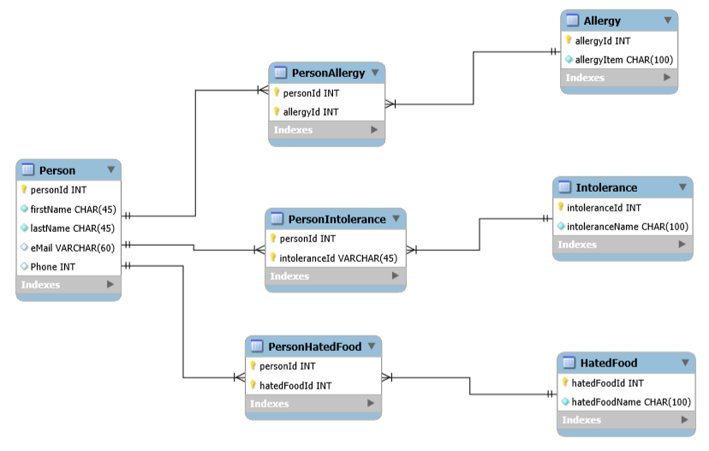
ERD

Slide 5
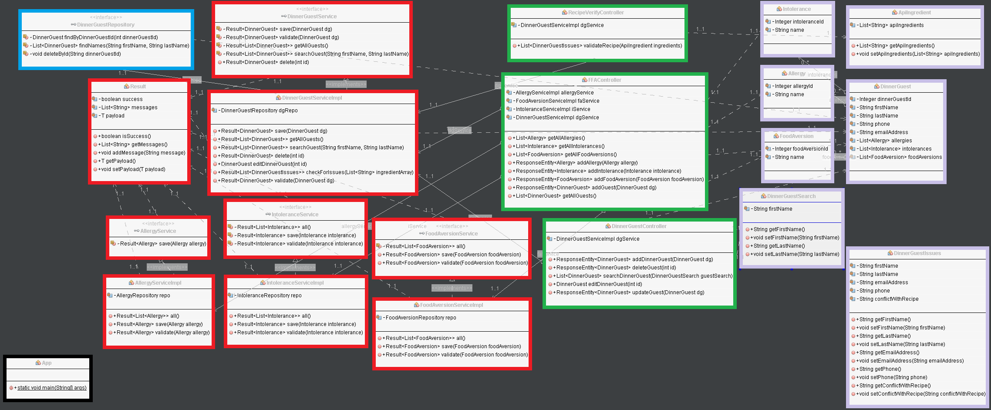
UML

Slide 6
Iteration #2
Solve the issue of having more than one food with sub-allergy database tables (ie. Nuts would need to associate with almond, cashews, etc.)
Select Individuals prior to the search.
Stretch:
Add ability to flag nutritional requirements (protein, fat)
Start on the Android implementation

Slide 7
Presentation

