Slide 1
MATLAB
Coding Standardisation Tutorial
Tips, guides, resources for imporving code quality
and life quality
Mark Sen Dong
1 Jul 2019

Slide 2
01
Why we need code standardisation?
02
Naming Conventions
CONTENTS
03
Loops & Conditional Syntax
04
Functions & Modularisation
05
Commenting & Documentation

Slide 3
01
The Why?
“Any fool can write code that a computer can understand. Good programmers write code that humans can understand. ”
- Martin Fowler

Slide 4
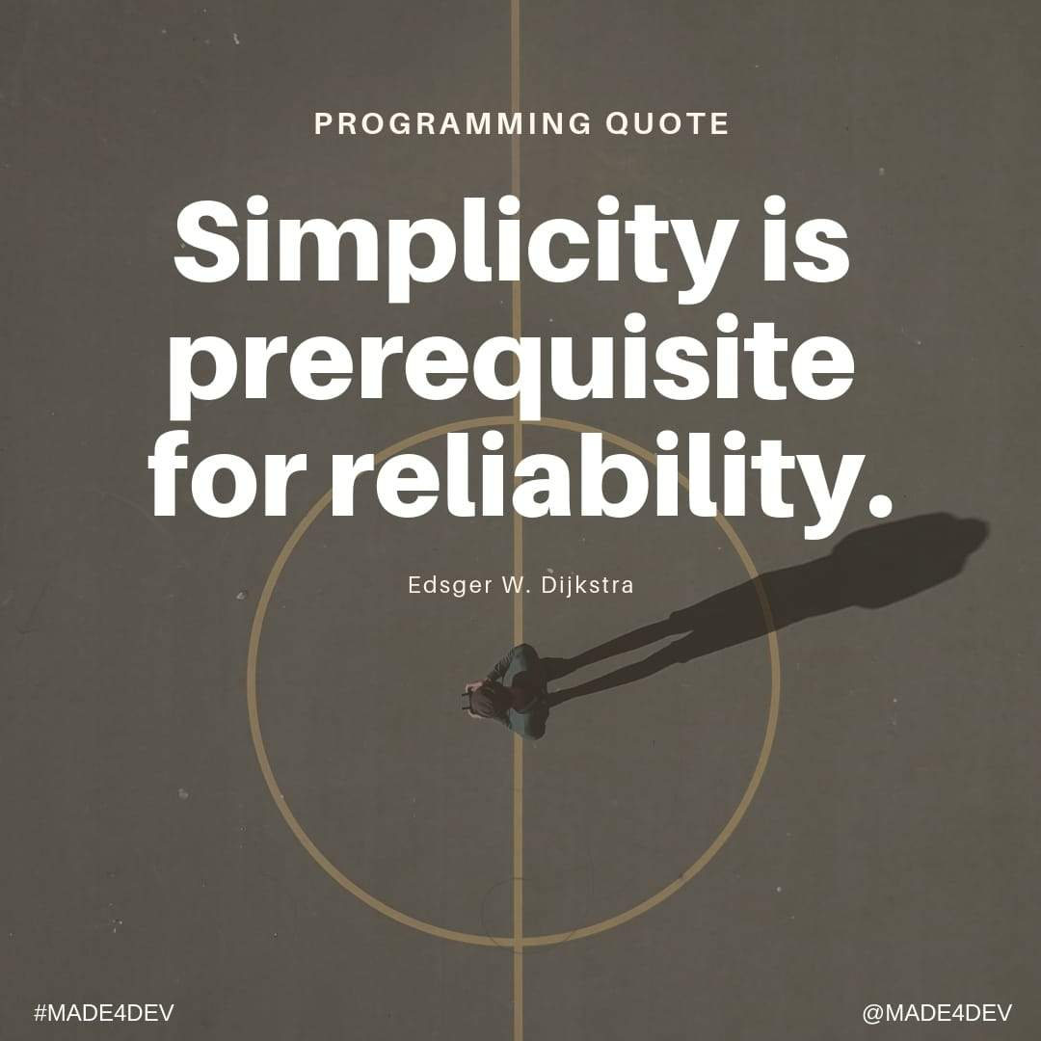
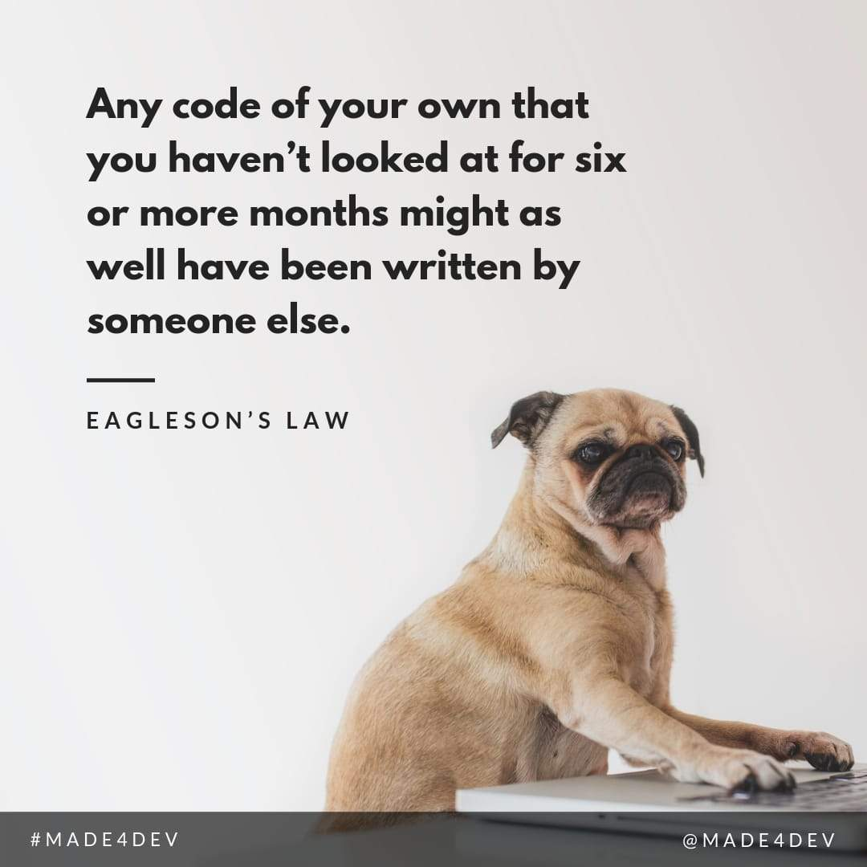

Why we need code standardisation?
Less code means less time to read through, and less potential bugs
Write code for your future self, and don't expect your future self to be much smarter than now
Code should be written with the expectation that one day someone else will use it, debug it or change it

Slide 5
02
Naming Conventions
The purpose of a software naming convention is to help the reader and the programmer.
There is no naming convention that will please everyone.
Following a convention is more important than what the details of the convention are.

Slide 6
Variables
Write variable names in mixed case starting with lower case
linearity, credibleThreat, qualityOfLife
Unless the variable is temperary, make meaningful names, don't be afraid of using long names
Use the prefix n for variables representing the number of objects
nFiles, nSegments
Prefix iterator variable names with i, j, k,l,m (There shouldn't be loops deeper than 5 levels in general)
for i_File = 1 : n_Files
for j_Position = 1 : n_Positions
...
end
end
Use common domain-specific names
Use: roi, or regionOfInterest
Avoid: imageRegionForAnalysis
Minimize abbreviations in names
Use: ArrivalTime
Avoid: arr
Avoid negative Boolean variable names
Use: isFound
Avoid: isNotFound
Avoid Variable Names reserved by Matlab or shadows functions
How to avoid it: https://www.mathworks.com/help/matlab/ref/iskeyword.html

Slide 7
Constants
Constant names with local scope (within an mfile) should be all uppercase using underscore to separate words
MAX_ITERATIONS, COLOR_RED
Use meaningful names for constants
Use: MAX_ITERATIONS
Avoid: TEN, MAXIT

Slide 8
Structures
Structure names should begin with a capital letter
The name of the structure is implicit, and need not be included in a fieldname
Use: Segment.length
Avoid: Segment.segmentLength

Slide 9
Functions
Use meaningful function names
Use: computeTotalWidth
Avoid: compwid
If neccessary, begin function names with a verb or a noun which describes an action
getImage, convertData, imageReorganisation
Name functions that have a single output based on the output
getMean, getStandardError
Functions with no output argument or which only return a handle should be named after what they do
plot
Avoid unintentional shadowing
In general function names should be unique.
Shadowing (having two or more functions with the same name) increases the possibility of unexpected behavior or error.
Names can be checked for shadowing using which -all or exist.

Slide 10
03
Loops & Conditional Syntax

Slide 11
Loops
Initialize loop result variables immediately before the loop
Initializing these variables improves loop speed and helps prevent bugus values if the loop does not execute for all possible indices.
result = nan(nEntries,1);
for index = 1:nEntries
result(index) = foo(index);
end
The end lines in nested loops can have identifying comments
This increases the readability of nested loops, and makes it easier to change the code.
for i_File = 1 : n_Files
for j_Position = 1 : n_Positions
...
end % end of position loop
end % end of files loop
Minimize the use of break in loops
Minimize use of continue in loops

Slide 12
Conditionals
Avoid complex conditional expressions, Introduce temporary logical variables instead
if (value>=lowerLimit) & (value<=upperLimit) & ~ismember(value,… valueArray):
end
should be replaced by:
isValid = (value >= lowerLimit) &(value <= upperLimit);
isNew = ~ismember(value, valueArray);
if (isValid & isNew):
end
Put the usual case in the if-part and the unusual in the else-part of an if else statement
This practice improves readability by preventing special cases from obscuring the normal path of execution.
fid = fopen(fileName);
if (fid~=-1)
:
else
:
end
A switch statement should include the otherwise condition
switch (condition)
case ABC
statements;
case DEF
statements;
otherwise
statements;
end
Use if when the condition is most clearly written as an expression, Use switch when the condition is most clearly written as a variable

Slide 13
General
Use parentheses to clarify operator precedence
Minimize the use of numbers in expressions, use constants instead
This makes it easier for people to know the definition of the value and how to change it.
Be cautious with floating point comparisons
Binary representation of decimal numbers (float) can be inaccurate.
e.g: how to present 0.2 in binary?
0.01 = 1/4 = 0.25 , too big
0.001 =1/8 = 0.125 , too small
0.0011 = 1/8 + 1/16 = 0.1875 , small
0.00111 = 1/8 + 1/16 + 1/32 = 0.21875 , big
0.001101 = 1/8+ 1/16 + 1/64 = 0.203125, still big
0.0011001 = 1/8 + 1/16 + 1/128 = 0.1953125, a bit small
0.00110011 = 1/8+1/16+1/128+1/256 = 0.19921875, almost there
:
:
There is no exact binary representation of 0.2, therefore using 0.2 exactly in a conditional statement sometimes can yield unexpected results.
Solution: multiply float to int, or round float to int before comparison.

Slide 14
04
Functions & Modularisation
The best way to write a big program is to assemble it from welldesigned small pieces (usually functions).
This approach enhances readability, understanding and testing by reducing the amount of
text which must be read to see what the code is doing.

Slide 15
Functions
Any block of code appearing in more than one mfile should be considered for writing as a function
Use existing functions
Make interaction clear
If a function is only used once by another function, it is called a sub function, and should be saved in the same mfile as the main function
Avoid repetitive code as much as possible, use different levels of sub functions to abstract and package the code, less code means less potential bug
If possible, write a test/examplary script for each function

Slide 16
05
Commenting & Documentation
“Commenting is like sex.
When it's good, it's very, very good,
and when it's bad, it's better than nothing.”

Slide 17
Clarification Comments
Clarification comments are intended for anyone (including your future self) who may need to maintain, refactor, or extend your code.
Comment while you code
Comments explain the 'what ' and 'why', while code demonstrates 'how'
Add explaination to non-intuitive solutions
Use comment to prevent people (including your future self) from re-experimenting invalid approaches again in the future
% Dear maintainer: Once you are done trying to 'optimize' this routine, and have realized what a terrible mistake that was,
% please increment the following counter as a warning to the next guy!
% total_hours_wasted_here = 42
Try to write cleaner, shorter, easier to read code instead of using comment to explain twisted and messy logic
But since we are not professional coders, it is more important to comment anything that might be confusing in the future

Slide 18
Documentation Comments
Documentation comments are intended for anyone who is likely to use your source code, but not likely to read through it, debug or change it.
It is also called header file
To display the header file before using a function, use: help function_name;
1st part:
What the script does?
What are the input arguments and data type?
What are the output content and data type?
(optional) example of how to call this function
2nd part:
Meta information
Example:
% author: Mark Sen Dong
% date: 06 Jun 2019
% version: 1.0
%
% The function copies all images into one folder and then reorganises them
% into the PRONIA folder structure so that the pipeline tools will work on the wp3 server.
%
% Inputs:
% original_dir: string, set the original directory of the images
% copy_dir: string, set the destination directoy of the images
% bogan_id: int, set the initial bogan_id for the data set, beware: every image must have a globally unique bogan_id!
%
% Outputs:
% None

Slide 19


Thank you!
Most of the information are extracted from
MATLAB Style Guidelines 2.0 and my personal experiences :)
VISIT MY GITHUB FOR ADDITIONAL RESOURCES
https://github.com/MarkSenDong/Code_Standardization

