Slide 1
点评的维度 - 姚来婧 2019年3月版 大连·中国

Slide 2
In Toastmasters, feedback is called evaluation, and it is the heart of the Toastmasters educational program.

Slide 3
当我们说“点评”的时候，我们到底在说什么？

Slide 4
当我们说“点评”的时候，我们到底在说什么？
-You observe the speeches and leadership roles of your fellow
club members and offer evaluations of their efforts, and they do the same for you.

Slide 5
当我们说“点评”的时候，我们到底在说什么？
-You observe the speeches and leadership roles of your fellow
club members and offer evaluations of their efforts, and they do the same for you.

Slide 6
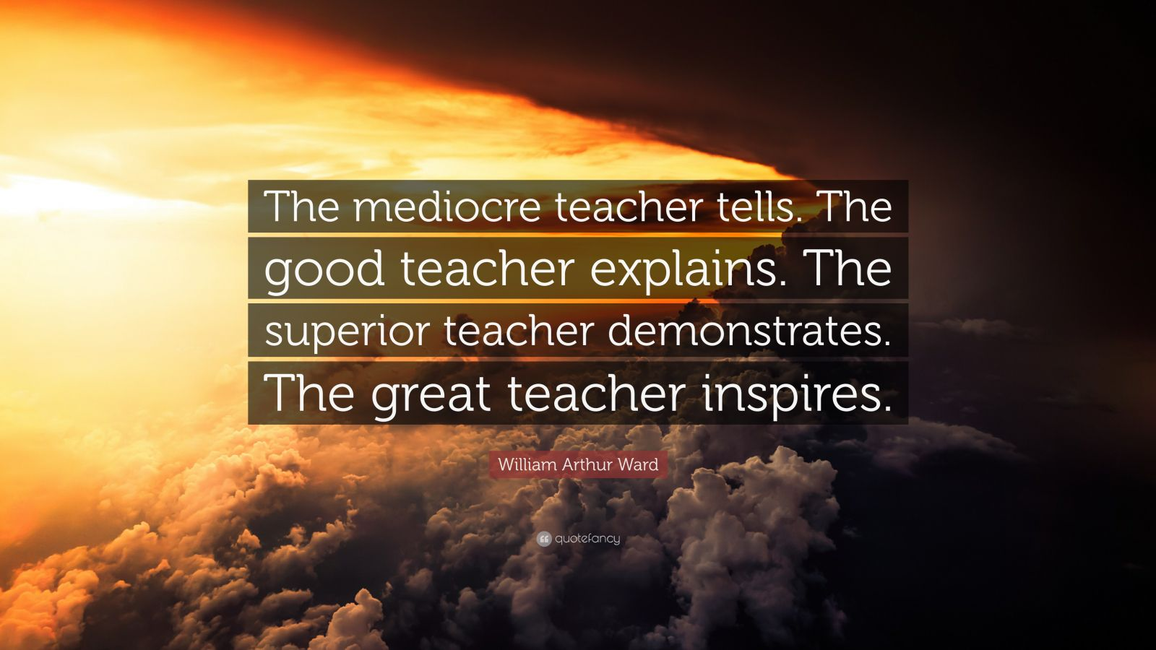

Slide 7
Evaluator

Slide 9
维度1
evaluator

Slide 10
Ie： 2-3分钟以外？

Slide 11
至少30分钟 -what？ -who？ -anything else？

Slide 12
Ie发言的2-3分钟，要避开哪些坑？

Slide 13
A.太模糊，太概括

Slide 14
I like the way you played an ai boy friend and a human boy friend. The ROLE PLAY could have been more VIVID though.

Slide 15
When you described the ai boyfriend’s reaction to his girlfriend’s new lipstick. Using a shorter conversation like this may have worked better. “ruby red” “what?” “ruby red looks good on you, I like your new lipstick” Maybe it would have added more humor.”

Slide 16
b.想说的太多

Slide 17
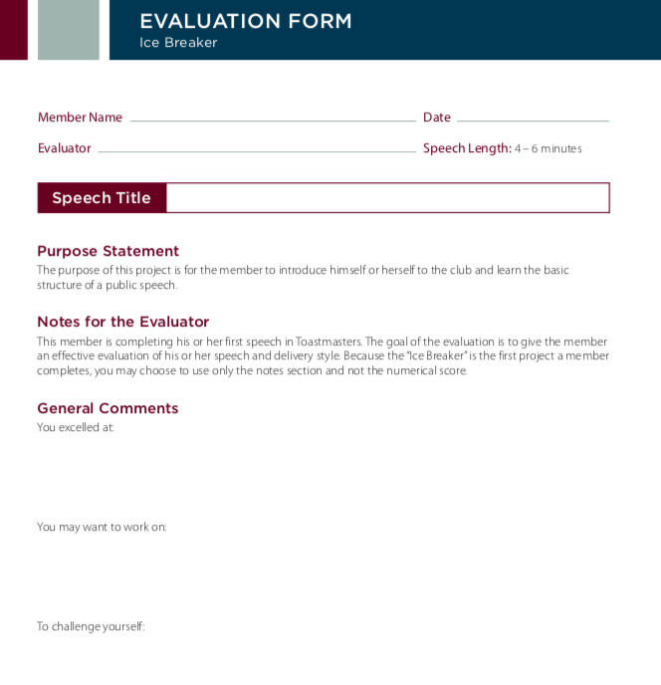
select two or three points
which you feel are most
important and elaborate on them

Slide 18
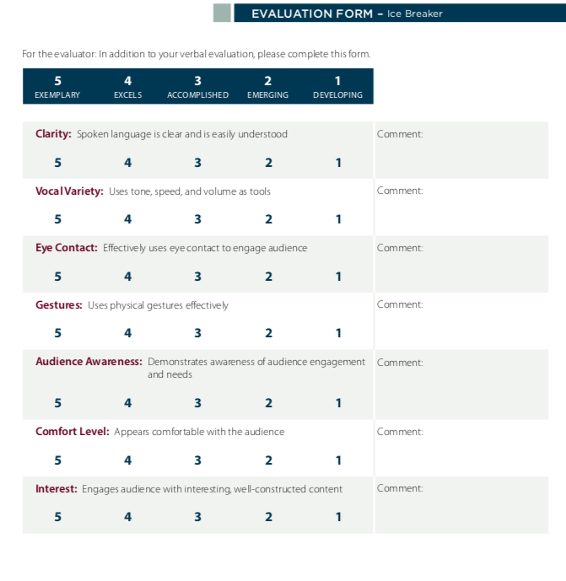
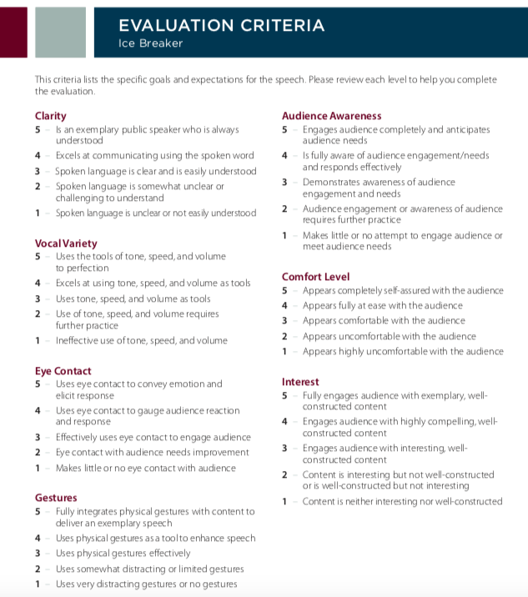

Slide 19
怎么说？

Slide 20
别说:
“we think,”
“we believe,”
“the audience would have,”
“the audience didn’t understand,”

Slide 21
别下判断：
“good public speakers don’t,”
“that was the wrong thing to say,”
“if you want to do it right, you must,”
“you did,” and “you were.”
Eg. “You were too serious!”
Compared to what?

Slide 22
可以说：
“I was impressed with,”
“I was confused about,”
“When I heard,”
“I think the speech’s purpose would have been clearer if,”
“I liked it when…”

Slide 23
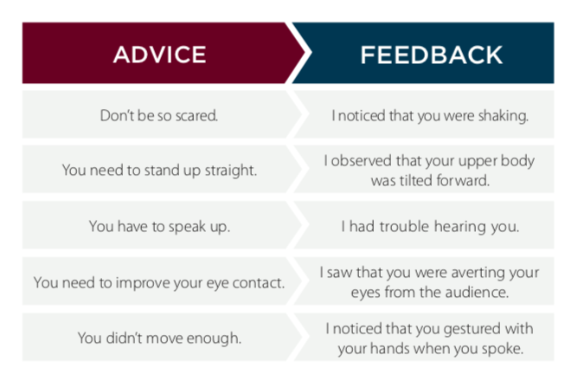
8100

Slide 24
这就大功告成了？

Slide 25

维度2
speakers/leadership role takers

Slide 26
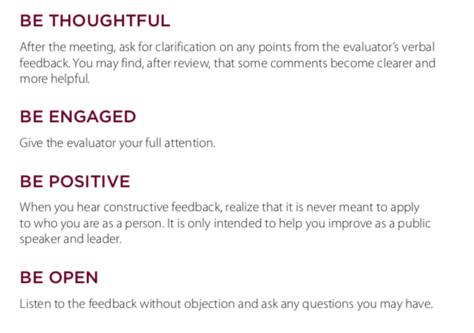

Slide 27
维度3
GEs/officers

Slide 28
To spice things up:
Specialized Evaluation.
Panel Discussions.
Video Evaluations.
Audio Recorded Evaluations.

Slide 29
Evaluator

