Slide 1
Linux Virtual Server: Linux Server Clusters for Scalable Network Services
Wensong Zhang
China National Laboratory for Parallel & Distributed Processing
Free Software Symposium 2002
October 22, 2002

Slide 2
Agenda
Introduction
The Linux Virtual Server framework
Building Scalable Network Services using LVS
Future Work of LVS
Characteristics of LVS

Slide 3
Introduction
Internet
Explosive Growth of the Internet
  100% annual growth rate
Sites receiving unprecedented workload
  Yahoo! 625 million views per day
  AOL Web cache system receiving 5 billion requests per day

Slide 4
Introduction
The requirements of Network Services
Incremental scalability
24x7 availability
Manageability
Cost-effectiveness

Slide 5
Introduction
Possible Solutions
Single server upgrade
  complicated, high cost, single point of failure, ...
Cluster of servers is becoming a viable architecture for SNS
  Redundancy --> HA
  Divide-and-Conquer --> High-performance
  High performance/cost ratio

Slide 6
LVS Framework
The Linux Virtual Server Project
The goal of the Linux Virtual Server project
  to provide a basic framework for building highly scalable and highly available network services using a large cluster of commodity servers.

Slide 7
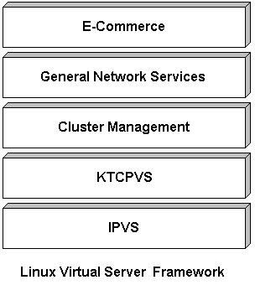
LVS Framework
Framework

Slide 8
LVS Framework
IP Virtual Server
Implemented in the Linux kernel
Three IP load balancing techniques
  Virtual Server via NAT
  Virtual Server via IP Tunneling
  Virtual Server via Direct Routing
Eight scheduling algorithms
IPVS is an advanced Layer-4 switching

Slide 9
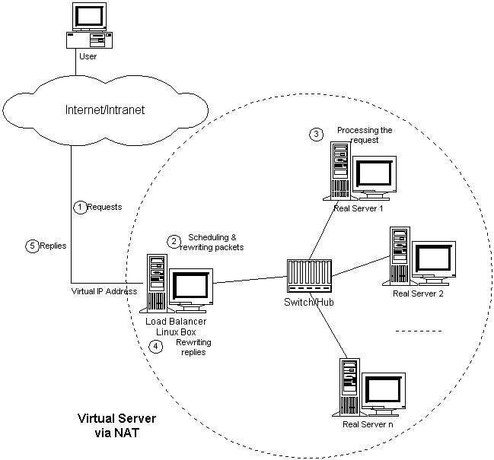
LVS Framework
VS/NAT

Slide 10
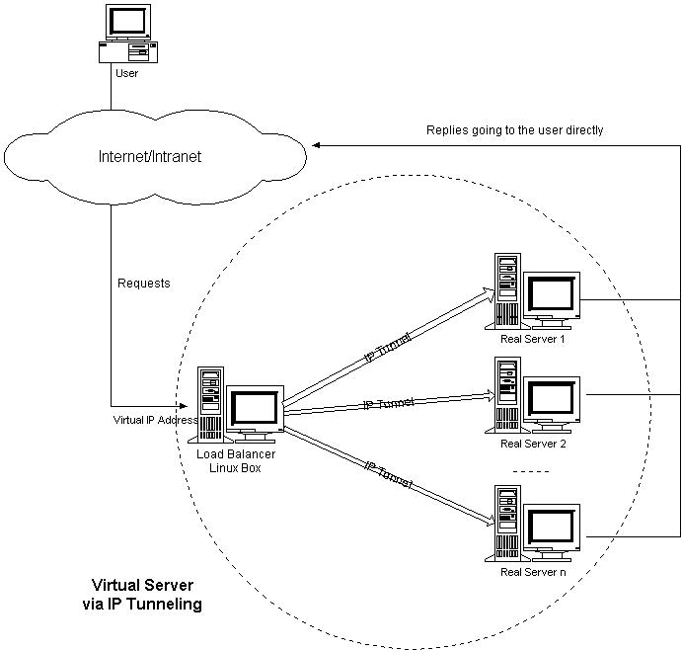
LVS Framework
VS/TUN

Slide 11
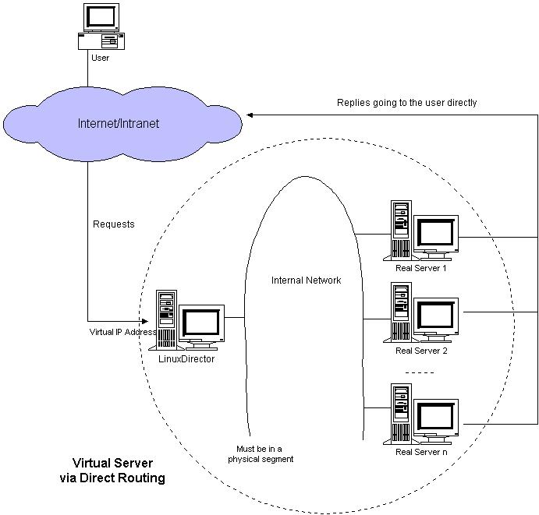
LVS Framework
VS/DR

Slide 12
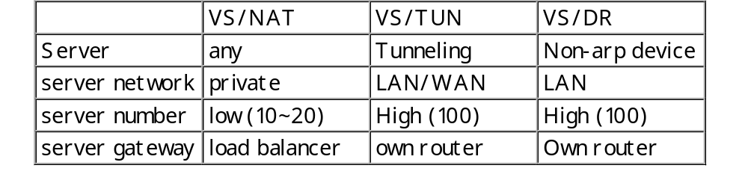
LVS Framework
Comparison
Note: those numbers are estimated based on the assumption that load balancer and backend servers have the same hardware configuration.

Slide 13
LVS Framework
Scheduling Algorithms
Round-Robin
Weighted Round-Robin
Least-Connection
Weighted Least-Connection

Slide 14
LVS Framework
Scheduling Algorithms (Continued)
Locality-Based Least-Connection
Locality-Based Least-Connection with Replication
Source Hashing
Destination Hashing

Slide 15
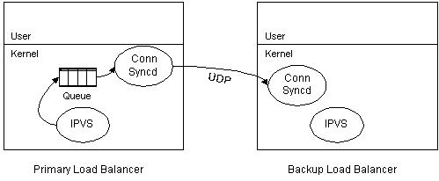
LVS Framework
State Synchronization
Conn Sync daemon (kernel thread)
UDP Multicast

Slide 16
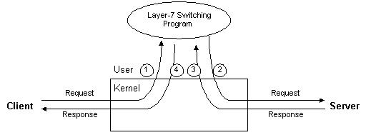
LVS Framework
KTCPVS
Layer-7 switching in user-space
  high overhead of context switching and memory copying
  limited scalability

Slide 17
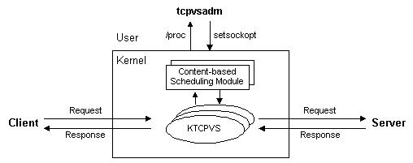
LVS Framework
KTCPVS (Cont’d)
kernel thread
loadable scheduling module

Slide 18
LVS Framework
Cluster Monitoring software
Red Hat Cluster Server / Piranha
  LVS + Piranha
UltraMonkey
  LVS + lvs-gui + heartbeat + ldirectord
Keepalived
Netparse
etc.

Slide 19
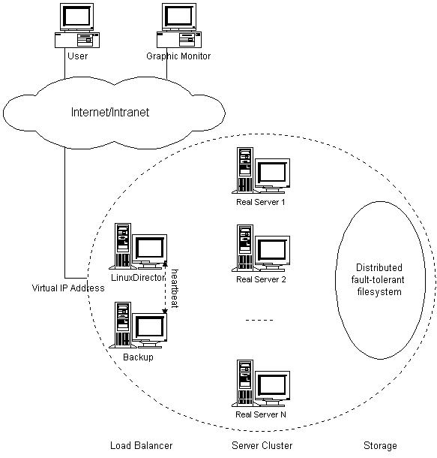
Building SNS using LVS
General Architecture
3 tiers
  Load balancer
  Server cluster
  Shared storage

Slide 20
Building SNS using LVS
Building Blocks
Load balancer
  Layer-4 switching, Layer-7 switching
Server
  HTTP, HTTPS, FTP, SMTP, POP3, IMAP4, most TCP and UDP services
Shared storage
  database, network file system, distributed file system, ...

Slide 21
Building SNS using LVS
High Availability
Server failover
  ping, service detection, etc
Load balancer failover
  state synchronization
  heartbeat

Slide 22
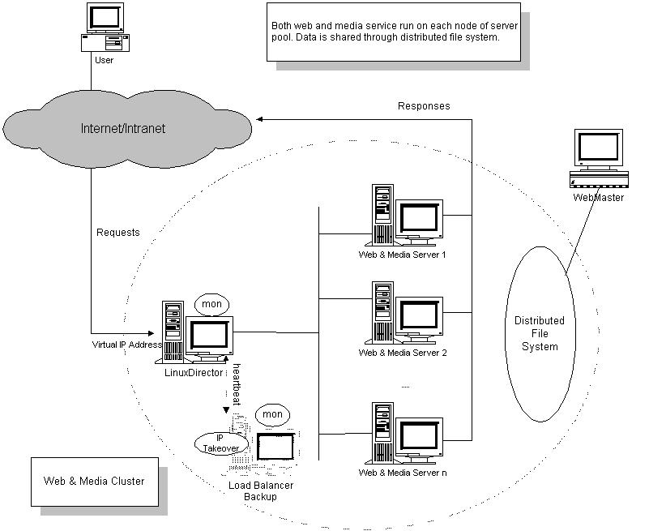
Building SNS using LVS
Web Cluster

Slide 23
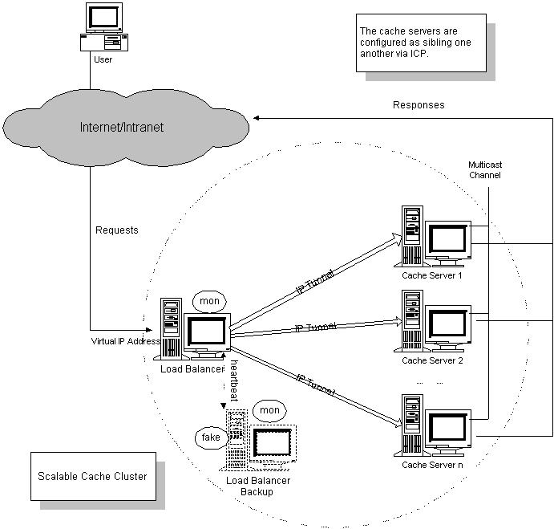
Building SNS using LVS
Cache Cluster

Slide 24
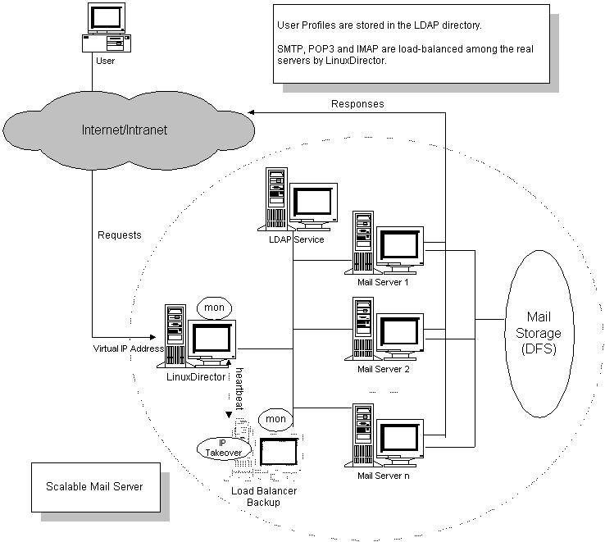
Building SNS using LVS
Mail Cluster

Slide 25
Building SNS using LVS
Some Sites using LVS
UK National JANET Web Cache (wwwcache.ja.net)
linux.com
sourceforge.net
valinux.com
real.com
One of largest PC manufacturers
etc.

Slide 26
Future Works of LVS
Future Works
Adding more load balancing algorithms
Developing more advanced/flexible cluster monitoring software
Making KTCPVS ready for production
Exploring TCP handoff
etc.

Slide 27
Characteristics of LVS
Characteristics
LVS extends Linux kernel to support three IP load balancing techniques
Eight scheduling algorithms
High scalability (up to 100 nodes)
High availability
Supporting most TCP and UDP services, no modifications to either clients or servers

Slide 28
Characteristics of LVS
Compared to Other Commercial Products
More IP load balancing techniques
Multiple scheduling algorithms
State synchronization
A robust and stable code base, a large user and developer base.
Reliability proven in big real world applications
Free to everyone

Slide 29
Summary
Introduction
The Linux Virtual Server framework
Building Scalable Network Services using LVS
Future Work of LVS
Characteristics of LVS

Slide 30
Call to Action
Building scalable network services is complicated and expensive
LVS is here to help make your life easier
LVS is proven stable, and is being deployed by more and more sites.

Slide 31

Collateral
The Linux Virtual Server Project
(http://www.LinuxVirtualServer.org)
wensong@linux-vs.org

