Slide 1

Linux Virtual Server
Miroslav Siket
FIO-FS

Slide 2
Outline
Solutions and comparison
LVS (Linux Virtual Server)
LVS solutions, high availability
Scheduling possibilities
Performance
Deployment

Slide 3
Definition of the problem
Multiple clients (>100) accessing the same resource
Effort to parallelize requests in a distributed system (clusters, computer farms,…)
Create transparent environment for the users
Enable load balancing to increase efficiency and speed
Reliability

Slide 4
Solutions
DNS load balancing (BIND RR)
Proxy servers (Squid, MS, Netscape, Apache)
Reverse proxy (Apache)
Custom built application balancing
Hardware based (CISCO Load Director, intelligent routers,...)
Linux Virtual Server (LVS)

Slide 5
What is LVS
Scalable, highly available server built on cluster of real servers
Offers load balancing
Transparent for users
Can be used for WWW, ftp, ssh or any other TCP/IP, UDP/IP protocol based services

Slide 6
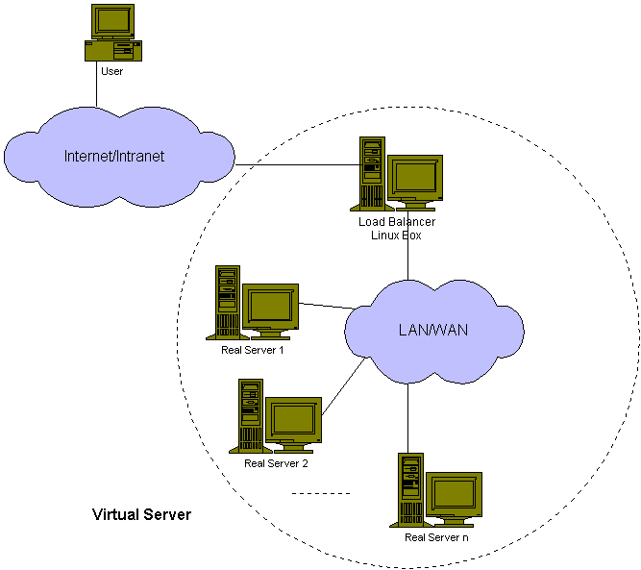
LVS – general schema
Idea is to have transparent service available to users
Should be scalable
Should be dynamical
Should provide fail over mechanism

Slide 7
Solutions with LVS
Is based on “smart” kernel routing of packets over IP
 | LVS-NAT | LVS-TUN | LVS-DR
Network | Any | LAN/WAN | LAN
# of RealS | Low(10-20) | High | High
Gateway | Load Balancer | Own router | Own router

Slide 8
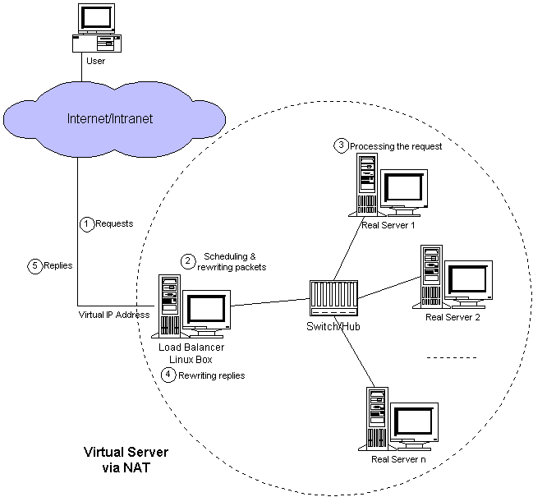
LVS-NAT
Requests translated by load balancer
Allows internal network
Limited by the load balancer
Limited by network connection
Up to 10-20 real servers
NAT (network address translation)

Slide 9
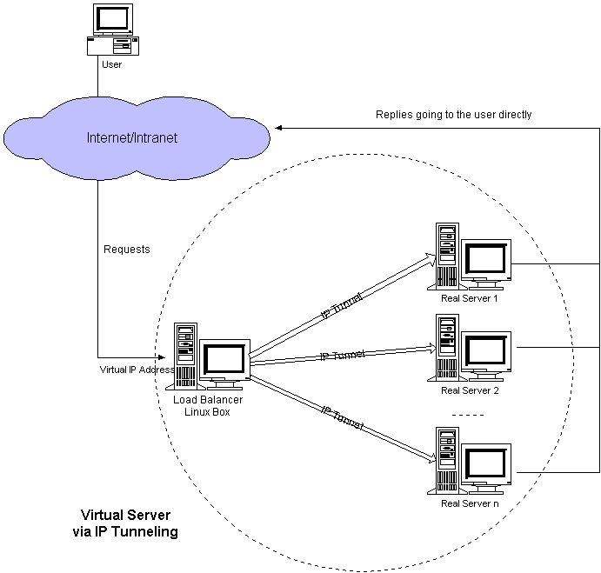
LVS-TUN
Load balancer encapsulates IP packet, sends it to real server
Real server replies directly to client
Works on LAN/WAN
Scalable
TUN (Network Tunneling) – using tunl devices

Slide 10
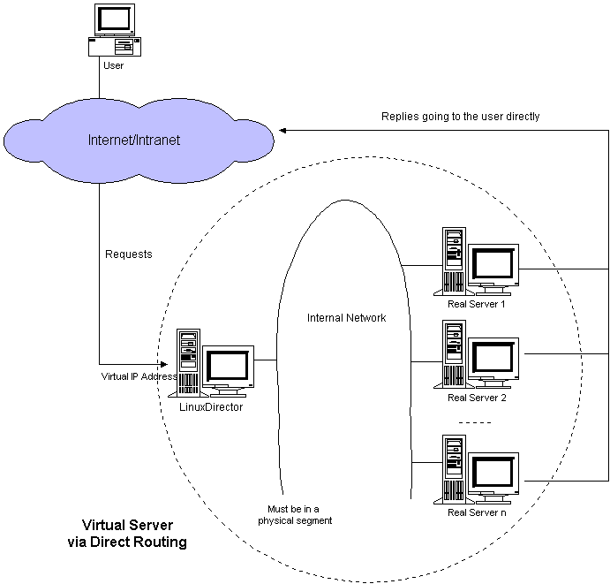
LVS-DR
Load balancer changes MAC address and broadcasts it to the real server
Limited to LAN
Scalable
Replies go directly to user
DR (direct routing) using lo devices

Slide 11
LVS Scheduling
Round Robin
Wighted RR
Least-Connection
Weighted LC
Locality-Based LC
LBLC with Replication
Destination Hashing
Source hashing
LVS also provides support for persistency of connections.

Slide 12
High availability
Real servers are added/removed to/from the pool by a monitoring daemon
Load balancer can be replicated to allow fail over to another (backup) load balancer (spoofing master's IP address)
Provides notification tools

Slide 13
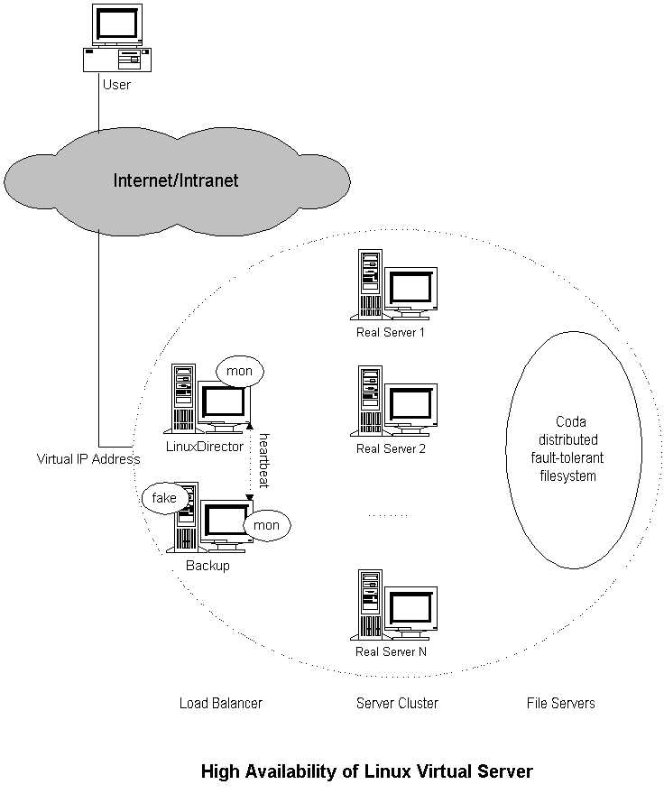
Fail over solution

Slide 14
Requirements
Kernel 2.4.23+ or patched previous kernels (part of the 2.6) for load balancer
In case of LVS-TUN and LVS-DR kernel patch for ARP-hidden for real servers
Standard Apache listening on Virtual IP and real IP
Clients configured for Virtual IP
Mon (standard monitoring server) and Heartbeat
Fake (IP spoofing)

Slide 15
Performance expectations
I have tested 2 real servers + 1 load balancer (LVS TUN and DR), with fail over – all OK
20MB/s performance - below 10% CPU utilization on LoadBalancer
1Gbps+ performance for 100Mbit/s LB
See http://www.linuxvirtualserver.org

Slide 16
Deployment
Possible deployment for the SWREP web servers
Together with head nodes (Apache Proxy or Squid Proxy) should provide stable, highly available and scalable solution with desired throughput
Possible other deployments where high availability is required
Used by linux.com, sourceforge.net,...
Base for the RedHat's Piranha

