Slide 1
What is Scala?
Scala语言自学总结

Slide 2
Scala是什么样的语言？
Scala 是一门多范式（multi-paradigm）的编程语言，设计初衷是要集成面向对象编程和函数式编程的各种特性。
Scala 运行在Java虚拟机上，并兼容现有的Java程序。
Scala 源代码被编译成Java字节码，所以它可以运行于JVM之上，并可以调用现有的Java类库。

Slide 3
环境搭建
JDK
https://www.oracle.com/technetwork/java/javase/downloads/index.html
Scala
https://scala-lang.org/
Scala IDE
http://scala-ide.org/
https://www.jetbrains.com/idea/

Slide 4
Hello World
object HelloWorldScala {
def main(args: Array[String]) {
println("Hello Scala !!")
}
}

Slide 5
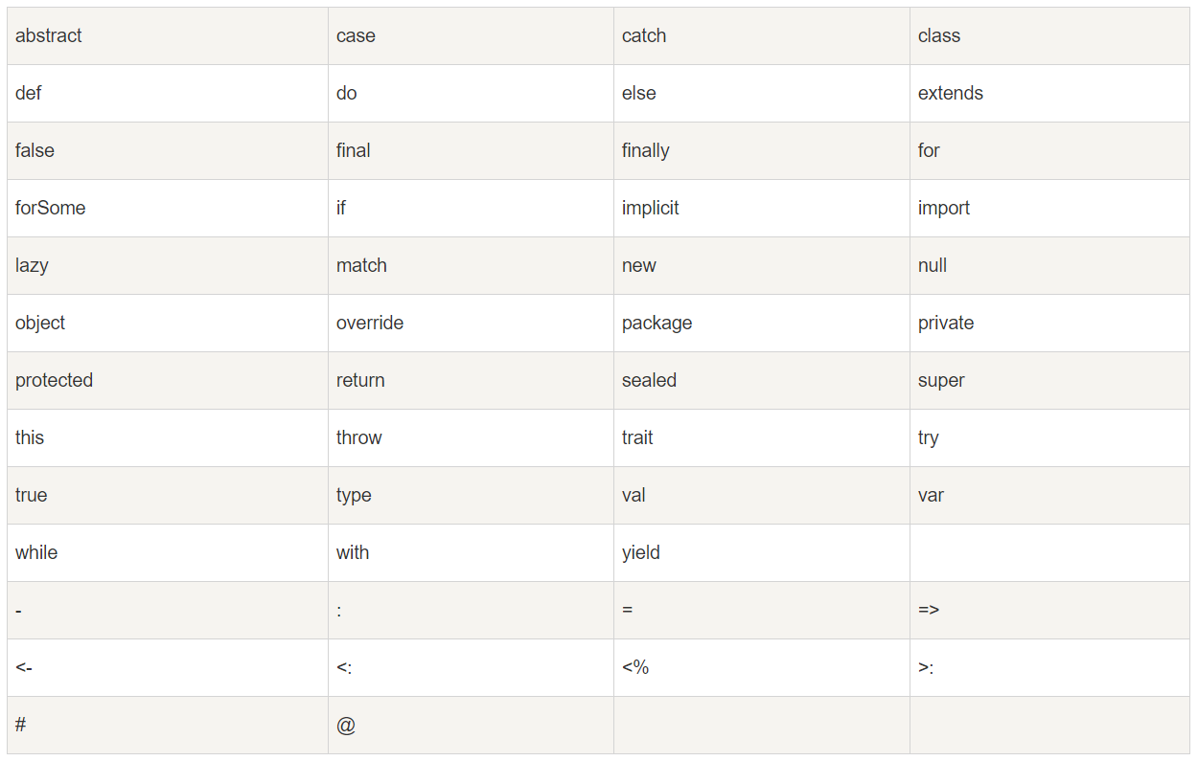
Scala关键字

Slide 6
Variable
val
var
lazy val

Slide 7
val
An immutable variable is declared with the keyword val.
object HelloWorldScala {
def main(args: Array[String]) {
val str = "Hello World";
println(str);
str = "Puma"; // compile error
}
}

Slide 8
var
var declares a mutable variable.
object HelloWorldScala {
def main(args: Array[String]) {
var str = "Hello World";
str = "New String";
println(str);
}
}

Slide 9
lazy var
Lazy val variables are calculated once, the first time the variable is accessed.
object Main {
def main(args: Array[String]) {
val x = 10e20;
val y = 20e10;
lazy val z = x*y;
}
}

Slide 10
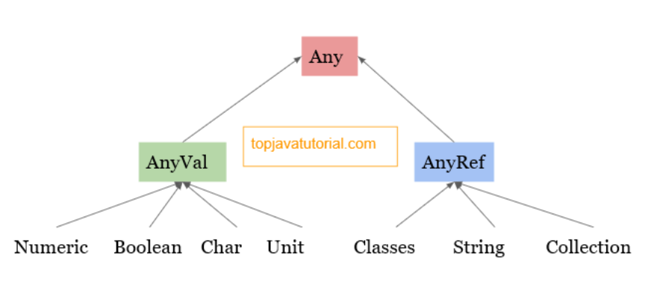
Scala Type Hierarchy

Slide 11
Any
Class Any is the root of the Scala class hierarchy and is an abstract class.
Every class in a Scala execution environment inherits directly or indirectly from this class.

Slide 12
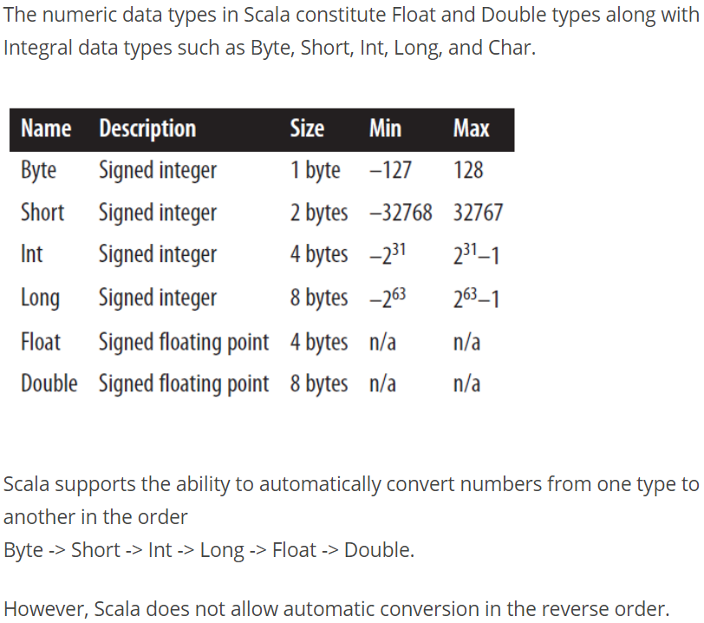
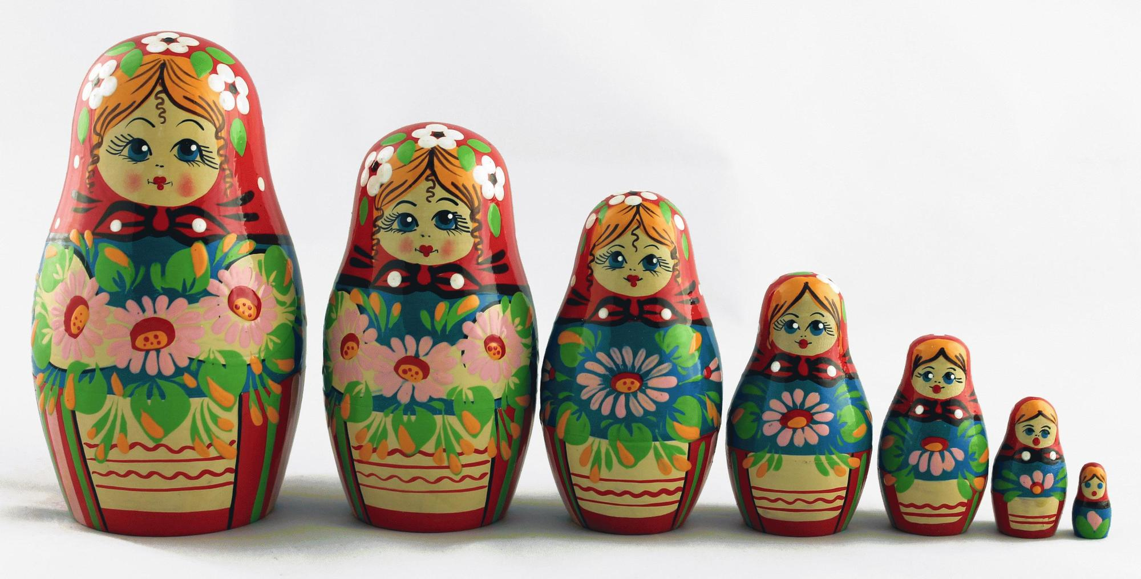
Numeric types

Slide 13
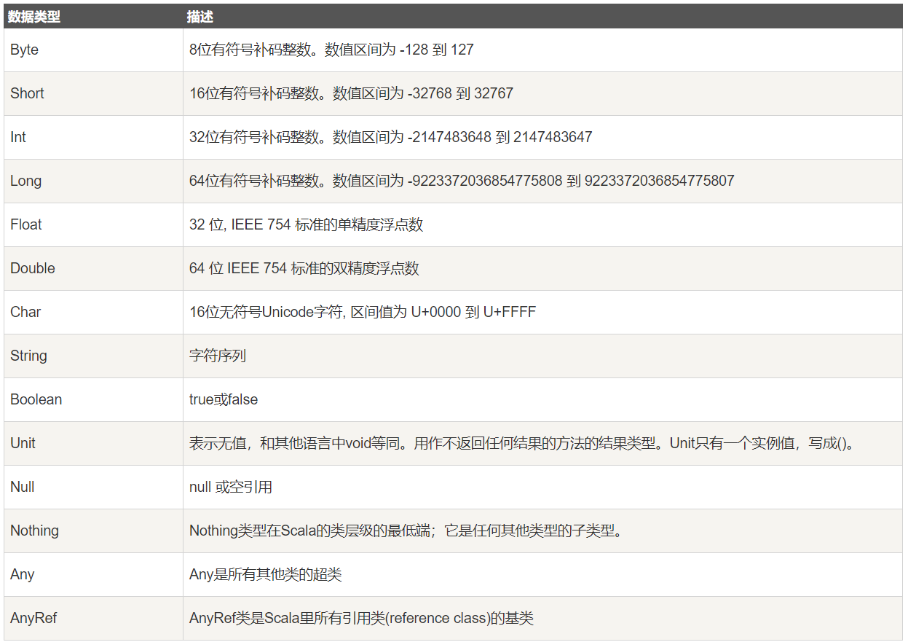
Data Type

Slide 14
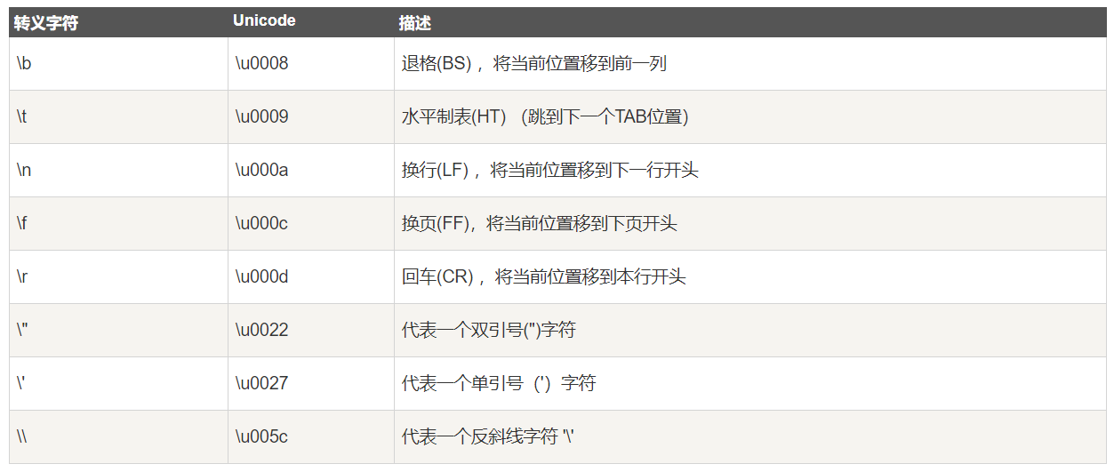
Escape Character

Slide 15
Data Structure

