Slide 1
Definition & Motivation

Slide 2
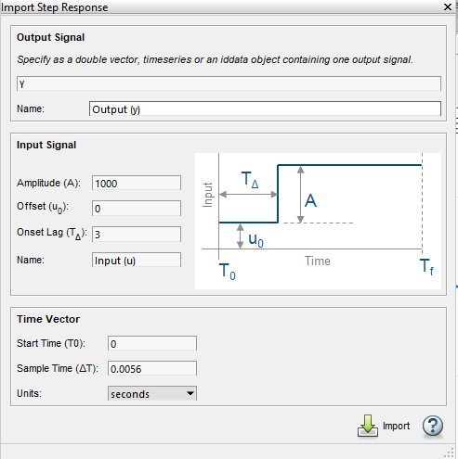
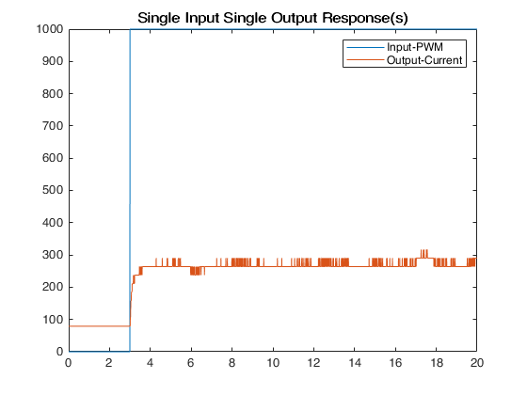
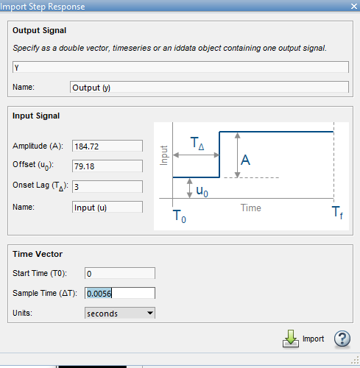
Derive Dynamics
https://www.mathworks.com/videos/control-design-with-matlab-and-simulink-90419.html
Generates a linear plant
>> pidtool

Slide 3
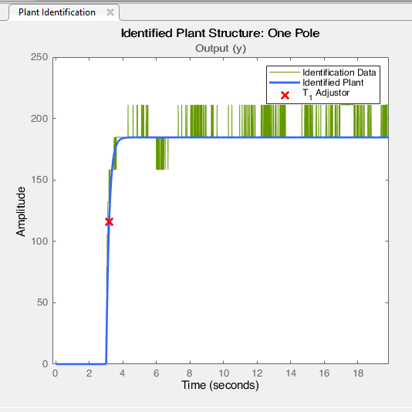
Remove offset (-79.18)… Apply and exit this function.
Add poles as required… Move around blue line and poles to match data
Auto estimate
Click apply and close plant identification
Delete plan and keep only plant1
Filtered PID controller
Add controller effort plot
Add some characteristics…
Export the plant and controller when happy

Slide 4
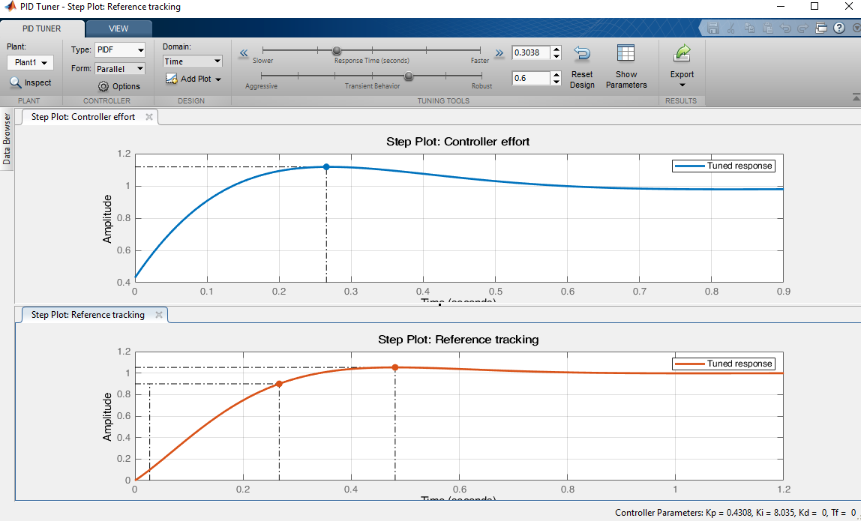

Slide 5
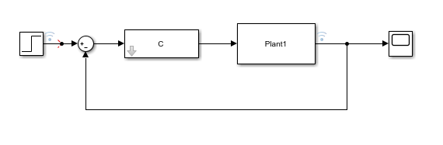
Build Model in Simulink
Turn off add noise on Plant1
Build something basically like this:

Slide 6
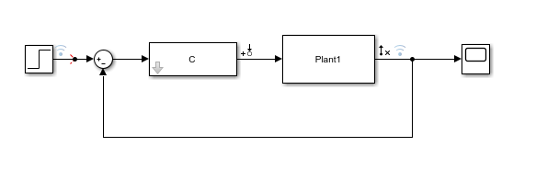
Linearize
https://www.mathworks.com/help/slcontrol/ug/linearize-simulink-model.html
Add: Linear Analysis Points “ “ Input Perturbation.
Add: Linear Analysis Points “ “ Open-loop Output
Open Analysis > Control Design > Linear Analysis.
Select a Bode and then drag linsys1 into MATLAB workspace. Resave the .mat

Slide 7
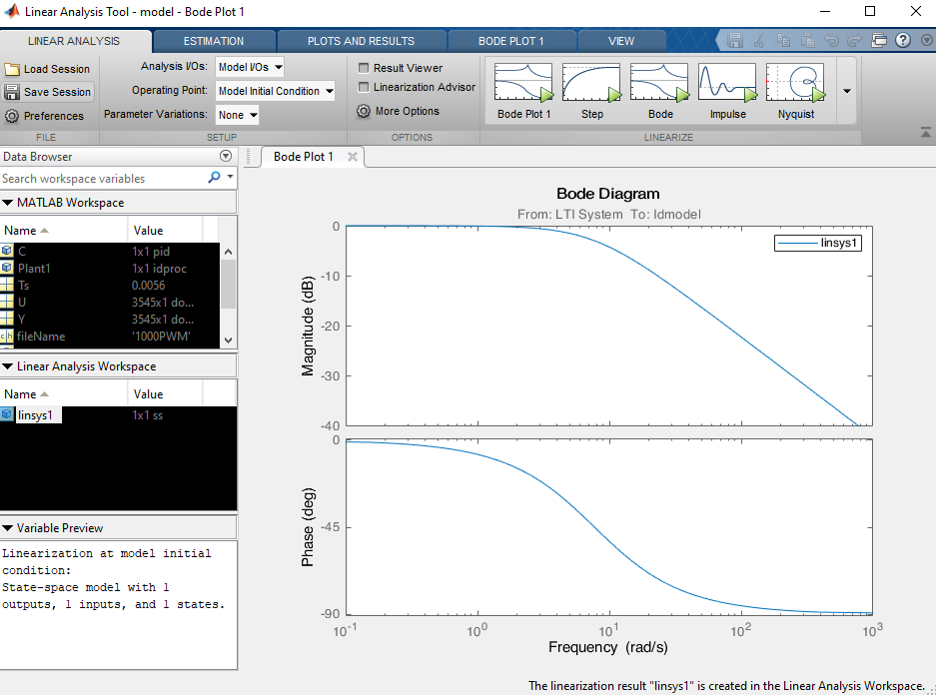

Slide 8
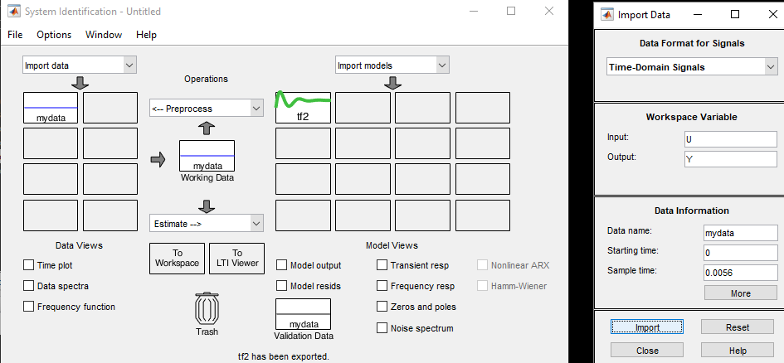
System Identification Toolbox

Slide 9
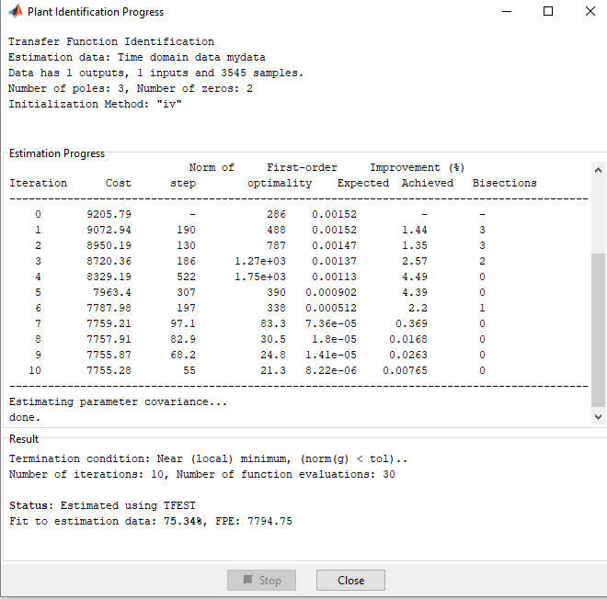

Slide 10
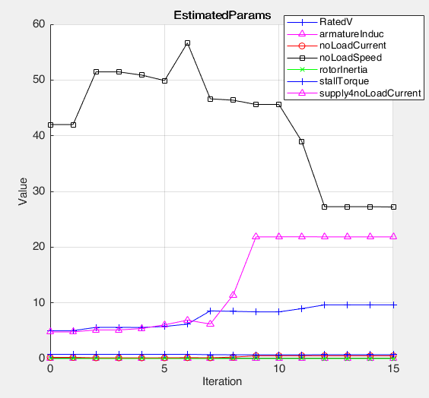
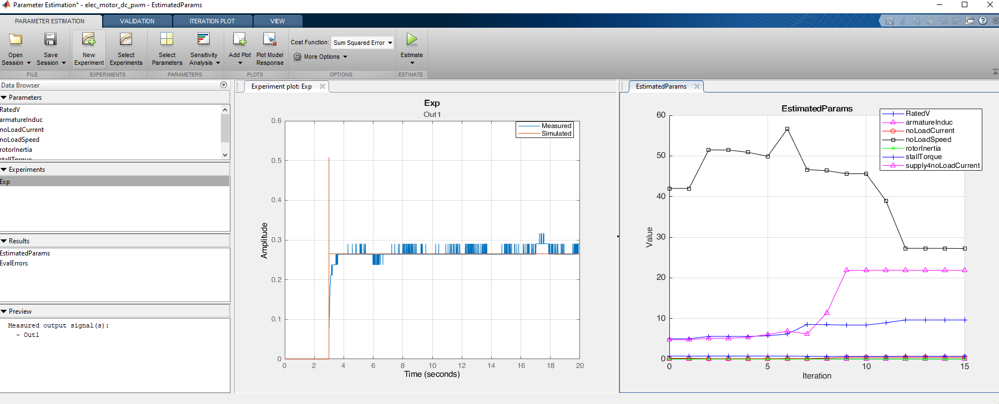
Add in parameters
Add results
Click plot model response

Slide 11
