Slide 1
Writing Good Use Cases
Slides from IBM/Rational
Notes:
Writing Good Use Cases - Instructor Notes
Module 3 - Outlining Use Cases
The purpose of this module is to explain how to outline a use case.
Module timings:
Presentation – 40 minutes
Exercise 3 – 20 minutes

Slide 2
How to Specify Functional Requirements?
Use both use cases and declarative statements.
  Both are necessary to understand any system of significant complexity.
Give preference to use cases, where appropriate.
+
The system shall …
The system must …
The system shall ...
Use Cases
Declarative Statements
? Which one to choose ?
Notes:
MRMUC Instructor Notes
Module 8 - Refine the System Definition
There is no one right answer to the question of how to write requirements about system functionality. For many projects, the answer is a mix: some functional requirements are expressed in use cases, and others are expressed in declarative statements.
How does the analyst decide when to use use cases and when to use declarative statements of requirements? The mix varies greatly from organization to organization and from project to project.
When deciding whether particular behavior is best modeled with use cases, consider:
Context of the application and the project.
Skills and comfort level of the developer organization.
Client preferences and environment.
Risks in your project and how best to address those risks.
Now that we’ve talked about what is in an SRS, let’s get to the specifics of defining the software requirements.
Use cases have the advantage of showing a whole sequence of system behaviors, which gives a context to each requirement of what the system should do.
However, there may be situations where use cases are not appropriate. (This is a lead-in to the following slide.)

Slide 3
INTRODUCTION

Slide 4
Process of writing use cases
Find actors
Registrar
Close Registration
Find use cases
Brief description: This use case allows a Registrar to close the registration process. Courses that do not have enough students are cancelled. The Billing System is notified for each student in each course that is not cancelled, so the student can be billed.
Outline a
use case
Close Registration Outline
-Flow of events
  Step by step
Close Registration Use-Case Specification
-Detailed Flow of Events
-Special Requirements
Pre/Postconditions
Detail a
use case
Notes:
Writing Good Use Cases - Instructor Notes
Module 2 - Finding Actors and Use Cases
To write use cases, you must find actors and use cases, outline the use cases, and then detail the use cases.
You must go through these activities, but the process is rarely as linear as the graphic suggests. Use-case writing is an iterative process.
Engage the students in a discussion about why a use case writing process is important.

Slide 5
Process of writing use cases (cont.)
Find actors
Important Note:
Use case writing is an iterative process
Find use cases
Outline a
use case
Detail a
use case
Notes:
Writing Good Use Cases - Instructor Notes
Module 2 - Finding Actors and Use Cases
In all but the most trivial of systems, use cases are not written in one sitting. As with any iterative process, a use case evolves from the spark of an idea to a fully detailed description of how your system behaves.
1. First, you find the actors of the system.
2. Next, you find and briefly describe the use case. A brief description describes the goal in two or three sentences. When finding use cases, you may find additional actors that require you to refine the list of actors.
3. The next stage of evolution is to outline the use case. This can be a bulleted list of just the basic flow. You may also choose to identify (not outline) possible alternate flows. This enables you to gain an understanding of the potential size and complexity of the use case. When outlining the use case, you may end up merging or splitting use cases.
4. Finally, you fully detail the use case, but iteratively. You identify particular flows for development in an iteration and then fully describe and implement just those flows. You then identify flows for subsequent iterations and fully detail and implement those during that iteration. At the end of the project, you have all of your use cases fully detailed.
Remember, the use case writing process is an iterative process. You will likely go through many cycles of refinement before you complete your use case.
Explain that use case writing is an iterative process. It is rare that they will write complete and perfect use cases in one sitting.

Slide 6
Process of writing use cases
Find actors
  Name and briefly describe the actors that you have found
Find use cases
Outline a
use case
Detail a
use case
Notes:
Writing Good Use Cases - Instructor Notes
Module 2 - Finding Actors and Use Cases

Slide 7
Actors and the system boundary
Determine what the system boundary is
Everything beyond the boundary that interacts with the system is an instance of an actor
System boundary?
Is the Accounts Receivable System an actor or part of the system?
Financial
Analyst
?
?
Order Entry System
Accounts
Receivable
System
Financial
Analyst
Notes:
Writing Good Use Cases - Instructor Notes
Module 2 - Finding Actors and Use Cases
Actors help to define the system boundary.
If we are building the Order Entry System, the Accounts Receivable System that it interacts with is an actor. A Financial Analyst who uses the Account Receivable System, is not an actor to the Order Entry System.
But, if we are building a larger system that combines the Order Entry System and the Accounts Receivable System, then the Financial Analyst is our actor, and the accounts receivable system is just a part of what we are building.

Slide 8
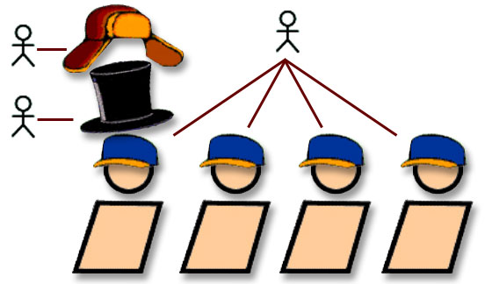
Actors and roles
An actor represents a role that a human, hardware device, or another system can play in relation to the system.
Notes:
Writing Good Use Cases - Instructor Notes
Module 2 - Finding Actors and Use Cases
The difference between an actor and an individual system user is that an actor represents a particular class of user rather than an actual user. Several users can play the same role, meaning that they can be the same actors. In that case, each user constitutes an instance of the actor. However, in some situations, one person plays multiple roles modeled by several actors.

Slide 9
Find actors
Who or what uses the system?
Who or what gets information from this system?
Who or what provides information to the system?
Where in the company is the system used?
Who or what supports and maintains the system?
What other systems use this system?
Notes:
Writing Good Use Cases - Instructor Notes
Module 2 - Finding Actors and Use Cases
This slide lists several questions to ask that can help find the actors in the system.
To fully understand the system's purpose, you must know who or what the system is for; that is, who or what use it. Different user types are represented as actors.
Point out that this is an important page. Suggest that the students put a sticky note on it so they can find it easily when they want to identify actors.
Remind students that an actor is a role. For a human actor, you should usually be able to name several different people who can act as a specific actor. Try to avoid an actor called “User,” rather try to figure out the role of that particular user.
One way to do this is to think of the actor in the context of the business that the system is supporting.

Slide 10
Name the actor
Actor names should clearly convey the actor’s role
Good actor names describe their responsibilities
Student
Professor
Registrar
Course Catalog
System
Notes:
Writing Good Use Cases - Instructor Notes
Module 2 - Finding Actors and Use Cases
Actor is a role, not a particular person or thing. The name of the actor should represent, as clearly as possible, the actor’s role.
Make sure that there is little risk of confusing one actor’s name with another at a future stage of the work. Also, try to avoid an actor called “User”, rather, try to figure out the role of that particular user.
In most instances, some person or some other system does something to trigger the start of the use case. If a use case in your system is initiated at a certain time, for example, at the end of the day or the end of the month, this can be modeled with a special actor, such as the “scheduler” or “time.” “Scheduler”, as opposed to “time”, is a useful name for such an actor because scheduler may be human or non-human.

Slide 11
Describe the actor
Name Student
Brief description A person who signs up for a course
Relationships with
use cases
Register for courses
Student
Notes:
Writing Good Use Cases - Instructor Notes
Module 2 - Finding Actors and Use Cases
Define each actor by writing a brief description that includes the actor's area of responsibility and what the actor needs the system to do. Because actors represent things outside of the system, you don’t need to describe each actor in detail .
Include this information in each brief description for each actor:
What or whom the actor represents
Why the actor is needed
What the actor’s area of responsibility is
What interests the actor has in the system
Some information about the actors is also shown on use-case diagrams, which show the name of the actor and the actor’s relationships with use cases.
Emphasize that the actor name is a label that can be used to refer to it throughout the model. The brief description should clarify any ambiguity that the name might suggest.

Slide 12
Review
How do you find actors?
Notes:
Writing Good Use Cases - Instructor Notes
Module 2 - Finding Actors and Use Cases
How do you find actors?: slide 8-10

Slide 13
Process of writing use cases
Find actors
  Name and briefly describe the use cases that you found
  Create a use-case diagram
  Assess business values and technical risks for use cases
Find use cases
Outline a
use case
Detail a
use case
Notes:
Writing Good Use Cases - Instructor Notes
Module 2 - Finding Actors and Use Cases

Slide 14
Find use cases
What goal am I trying to achieve by using the system?
GOAL 1
Actor
GOAL 2
Notes:
Writing Good Use Cases - Instructor Notes
Module 2 - Finding Actors and Use Cases
After you have identified the actors, finding the use cases is the next step in developing your use-case model. Use cases describe what an actor wants a system to do that provides some value to the actor.
Use this process to identify the use cases for each actor.
Start with the highest-priority actor. For all actors, but individually, ask:
What goals are they trying to achieve with the system?
How will the solution help them do their jobs?
How will the solution change their jobs?
By searching for a goal instead of a task, you are forced to take a step back and look for the larger context.
You are more likely to avoid functional decomposition when searching for the goal or by being goal-oriented when identifying your use cases.

Slide 15
Find use cases (cont.)
What are the goals of each actor?
  Why does the actor want to use the system?
  Will the actor create, store, change, remove, or read data in the system? If so, why?
  Will the actor need to inform the system about external events or changes?
  Will the actor need to be informed about certain occurrences in the system?
Does the system supply the business with all of the correct behavior?
Notes:
Writing Good Use Cases - Instructor Notes
Module 2 - Finding Actors and Use Cases
This slide lists several questions that can help you find the use cases in your system. The best way to find use cases is to consider what each actor requires of the system. Go through all of the actors and identify the particular needs of each actor.
When you have made your first list of use cases, verify that all required functionality has been addressed. Include special use cases for system startup, termination, or maintenance. Also, include use cases for automatically scheduled events. For example, a time-initiated job may run the payroll at midnight on the last day of each month. Use cases that concern automatically scheduled events are usually initiated by a special actor: the Scheduler.
Try to keep all use cases at approximately the same level of importance. The notion of use-case levels as popularized by some authors is not recommended, because it can lead to a functionally decomposed system.
These questions can help you get to the appropriate level of granularity (also see the definition of a use case). Ask yourself:
Would you ever want to perform a particular activity as an end result in itself?
Are there any activities that should be kept together, so you can review, modify, test, and document them together?
Is the use case too complex? If it is, you may want to split it (a use-case report significantly longer than 10 pages may be a candidate).
Does it deliver something of value to multiple actors? If so, it may be too large.
This is an important slide because it lists questions that help you identify use cases. Suggest that the students mark this slide for easy access later.
Remind the students of the definition of a use case. A use case is:
the specification of a set of actions
performed by a system
which yields an observable result that is, typically,
of value for one of more actors or other stakeholder of the system
Emphasize that the use cases are the goals of some actor. What does the actor want to accomplish with the help of the system?
In addition to the list of questions on the slide, mention other use cases not to forget (see Student Notes):
System startup
System termination
System maintenance
Automatically schedule events

Slide 16
Is Log in a use case?
By UML definition, log in is not a use case, because it does not produce results of value to an actor.
However, in many cases, there is a need to capture log in separately because it:
  Captures more and more complex behaviors (security, compliance, customer experience)
  Is included in other use cases
Recommendation: Make an exception and capture log in as a separate use case.
Log in
User
Notes:
Writing Good Use Cases - Instructor Notes
Module 2 - Finding Actors and Use Cases
If log in is a separate use case, being logged in becomes a precondition to other use cases that requires login. We will show an example of this in Module 4, when we introduce precondition.

Slide 17
CRUD Use Cases
A CRUD use case is a Create, Read, Update, or Delete use case
Remove CRUD use cases if they are data- management use cases that do not provide results that are of value to actors
Create a schedule
Read a schedule
Do not confuse use cases with functions
Focus on value
Register for
courses
Update a schedule
Delete a schedule
Notes:
Writing Good Use Cases - Instructor Notes
Module 2 - Finding Actors and Use Cases
A CRUD use case is a Create, Read, Update, or Delete use case. Data management use cases such as these are another form of functional decomposition. Managing the data this way is usually part of some higher goal (typically, maintenance of information), which may mean that the data should be combined into a single use case. These CRUD use cases describe things that the system must do, but they are all related to one single use case that the student wants to do on the system: register for courses.

Slide 18
Name the use case
A use case name should:
  Be unique, intuitive, and self-explanatory
  Define clearly and unambiguously the observable result of value gained from the use case
  Be from the perspective of the actor that triggers the use case
  Describe the behavior that the use case supports
  Start with a verb and use a simple verb-noun combination
Register for
courses
Select a
course to teach
Guideline: Conduct a survey to learn whether customers, business representatives, analysts, and developers all understand the names and descriptions of the use cases
Notes:
Writing Good Use Cases - Instructor Notes
Module 2 - Finding Actors and Use Cases
Give each use case a name that indicates what an instance of the use case does. The name may need to be several words to be clearly understood.

Slide 19
Describe a use case (text description)
Name Register for Courses
Brief description
The student selects the courses they wish to attend to the next semester. A schedule of primary and alternate courses is produced.
Relationships with
actors
Register for courses
Student
Notes:
Writing Good Use Cases - Instructor Notes
Module 2 - Finding Actors and Use Cases
This information is necessary to describe the use case in the use-case model:
Name: The name of the use case
Brief description: A brief description of the purpose of the use case
Relationships: The relationship (communicates-association) in which the use case participates
Some information about the use cases is also shown on use-case diagrams in the use-case model. The use-case diagrams show the names of the use cases and the relationships with actors.

Slide 20
Checkpoints for actors
Have you found all of the actors?
Have you accounted for and modeled all roles in the system's environment?
Is each actor involved with at least one use case?
Do any actors play similar roles in relation to the system? If so, merge them into a single actor.
Notes:
Writing Good Use Cases - Instructor Notes
Module 2 - Finding Actors and Use Cases
This list of actor checkpoints is a summary of the list in the IBM® Rational Unified Process® (RUP ^{®)}.

Slide 21
Do any actors play similar roles in relation to the system? If so, merge them into a single actor.
Name | Upload Additional Data
ID | 11
Requirement Number | 3.5
Description | Defines how the contributor and system administrator upload additional data to already publish entries
Primary Actor | Contributor
Secondary Actor(s) | System administrator
Pre-condition | A published entry already exist, user must have contributor or system administrative permissions
Post-condition | A newly updated entry
Trigger | Contributor/System Administrator selects to add new data to existing entry

Slide 22
Do any actors play similar roles in relation to the system? If so, merge them into a single actor.
Name | Upload Additional Data
ID | 11
Requirement Number | 3.5
Description | Defines how a user uploads additional data to already published entries.
Primary Actor | User
Secondary Actor(s)
Pre-condition | A published entry already exist, user must have contributor or system administrative permissions
Post-condition | A newly updated entry
Trigger | User selects to add new data to existing entry

Slide 23
Checkpoints for use cases
The use-case model presents the behavior of the system; it is easy to understand what the system does by reviewing the model.
All use cases have been identified; the use cases collectively account for all required behavior.
The use-case model contains no superfluous behavior; all use cases can be justified by tracing them back to a functional requirement.
All CRUD use cases have been removed.
  Create, Retrieve, Update, Delete
Notes:
Writing Good Use Cases - Instructor Notes
Module 2 - Finding Actors and Use Cases
This list of use-case checkpoints is a summary of the list in the IBM® Rational Unified Process® (RUP ^{®)}.

Slide 24
Checkpoints for use cases (cont.)
The use cases have unique, intuitive, and explanatory names so that they cannot be confused at a later stage. If not, change their names.
Customers and users understand the names and descriptions of the use cases.
The brief description gives a true picture of the use case.
Each use case is involved with at least one actor.
No use cases have very similar behaviors or flows of events.
Notes:
Writing Good Use Cases - Instructor Notes
Module 2 - Finding Actors and Use Cases

Slide 25
Use-case diagrams: communicates-association
A channel of communication between an actor and a use case
A line represents a communicates-association
Actor 1
Use Case
Actor 2
Actor 3
Notes:
Writing Good Use Cases - Instructor Notes
Module 2 - Finding Actors and Use Cases
Relationships between actors and use cases are called communicates-associations. A communicates-association between an actor and a use case indicates that they interact: The actor participates in and communicates with the system containing the use case. A communicates-association is represented on UML diagrams as a solid line.
This slide describes the relationship between actors and use cases. This relationship is indicated in a use-case diagram by a line.
Actors and use cases are both classifiers in the UML. The rules governing the use of an association are the same for all classifiers, for example, classes.

Slide 26
Each communicates-association is a whole dialog
Student logs on to system
System approves logon
Student requests course information
Register for Courses
Student
Course
Catalog
System
System displays course list
Student selects courses
System displays approved schedule
System transmits request
Course Catalog returns course information
Notes:
Writing Good Use Cases - Instructor Notes
Module 2 - Finding Actors and Use Cases
A communicates-association is a two-way dialog. The relationship between an actor and a use case is represented on the diagram by a single line, which represents a whole dialog. For example, the relationship between the Student actor and the Register for Courses use case might include the whole dialog shown on the left side of this slide. The relationship between the Register for Courses use case and the Course Catalog System actor might include the whole dialog shown on the right side of this slide.
The dialogs are recorded in the Flows of Events in the Use-Case Specification.
Emphasize that the use-case diagram is intended only to show the actors, use cases, and the relationships between them. But the relationships are spelled out in detail in the descriptions of use cases.

Slide 27
Use-case diagram example
Register for Courses
Request Course
Catalog
Course Catalog
System
Student
View Grades
Billing System
Close Registration
Select Courses
to Teach
Professor
Registrar
Get Class List
for a Course
Submit
Grades
Notes:
Writing Good Use Cases - Instructor Notes
Module 2 - Finding Actors and Use Cases
Here is an example that raises questions that need to be answered by the customer or user:
Are the use cases too small?
Does the diagram cover all activities?
How do you know what is done in each use case?
You might notice that the Student and the Professor interact with the system during Close Registration. Does this mean that they have to be present when registration closes? No, it doesn’t. They are informed of the outcome through e-mail or postal mail. Another technique is to make the e-mail server or the postal service an actor. There is no right or wrong answer; both are correct. Use whichever method more clearly conveys your requirements.
The example is not necessarily the best or only solution for the course registration system, but it is good for stimulating discussion.
Regarding the question “How do you know what is done in each use case?”, the answer is that you do not know from the diagram. This is a good lead-in for the need to develop the flow of events.
Reminder: Each use case is detailed in a use-case specification document.

Slide 28
Assess business value and technical risk
For each use case identified, get consensus with stakeholders about its business value and technical risk
The business team decides what is high-value and what is not
The technical team decides what is architecturally significant and what is risky
Hints:
  Limit time
  Use high, medium, low
Notes:
Writing Good Use Cases - Instructor Notes
Module 2 - Finding Actors and Use Cases
Business value is based on increased revenues, decreased expenses, or intangible benefits. Where disagreements occur, quantify and compare dollar values.
Risk is based on the known architectural risks associated with implementing the functionality in the use case, the degree of complexity of development, or the amount of uncertainty about the solution. For packaged or commercial off-the-shelf (COTS) solutions, consider integration risks as primary.
Time-limit the sessions for assessing business values and technical risks.
Assign a value of high, medium, or low to the business value or risk.
As a result of assessing business value and technical risk, you will know which use cases to outline and define in detail first.
Suggest time boxing assessment activities; otherwise people will create finer and finer distinctions of little additional value. That time would be better spent writing use cases.
Business values should be the same for different departments or organizations within the same company. Technical risks, however, will vary from project to project.

Slide 29
Review
How do you find use cases?
Notes:
Writing Good Use Cases - Instructor Notes
Module 2 - Finding Actors and Use Cases
How do you find use cases?: slide 16-20

Slide 30
OUTLINING USE CASES

Slide 31
Process of writing use cases
Find actors
  Outline the flow of events
  Capture use-case scenarios
  Collect additional requirements
Find use cases
Outline a
use case
Detail a
use case
Notes:
Writing Good Use Cases - Instructor Notes
Module 3 - Outlining Use Cases

Slide 32
Outline each use case
An outline captures use case steps in short sentences, organized sequentially
Use Case Name
Brief Description
Basic Flow
1. First step
2. Second step
3. Third step
Alternative Flows
  Alternative flow 1
  Alternative flow 2
  Alternative flow 3
Structure the basic flow into steps
Number and name the steps
Identify
alternative
flows
Notes:
Writing Good Use Cases - Instructor Notes
Module 3 - Outlining Use Cases
Developing a use-case sequence of actions is an iterative process. Start by developing an outline or draft, such as the one on this page. Later, add the descriptions. The outlines are not official documents, but merely a start toward developing a document.
The basic flow shows the major steps in accomplishing the goal of the use case.
The alternative flows show alternatives behavior (what may go wrong and optional behavior). At this point in the process, it is enough to identify the most significant alternatives without describing them in detail.
Structure the flow into steps with either bullets or numbers.
Review the basic concepts for developing a use-case outline.
See Student Notes.

Slide 33
Why outline use cases?
DRAFT
Use-Case Size
Too Big?
Too Small?
Is it more than one use case?
?
?
Outlining helps find alternative flows
Use Case
?
Notes:
Writing Good Use Cases - Instructor Notes
Module 3 - Outlining Use Cases
Reasons to outline your use cases:
Iterative development reduces risk. For the same reason that you do not implement the whole system at once, you do not develop the detailed requirements all at once.
Avoid writing too much detail too early.
You do not know everything at first. Outlining helps you discover what you don’t know.
Outlining use cases creates a rough draft to use as a starting point for fully specifying your use cases.
Outlining helps determine whether the use case is too small on its own or too big to be just one use case. It might also help you decide whether the use case is actually more than just one use case.
After you outline your steps, you might find that they really belong in another use case. Also, if the outline shows that the use case does not have much to it, it may not be a use case at all.
Outlining adds value to finding all possible alternate flows.

Slide 34
Flows of events (basic and alternative)
A flow is a sequential set of steps
One basic flow
  Successful scenario from start to finish
Many alternative flows
  Regular variants
  Odd cases
  Exceptional (error) flows
Notes:
Writing Good Use Cases - Instructor Notes
Module 3 - Outlining Use Cases
The outline of the flow of events for a use case has two main sections:
Basic Flow of Events
Alternative Flow of Events
The outline is used as a base when you start to write the full use-case specification.
Structure the flows in such a way that it is easy to follow the different scenarios and to be able to understand what happens when alternatives occur and where they pick up and finish.
The basic flow of events should be relatively short and easy to read, like a single story line. The basic flow should show the steps needed to achieve the main goal of the use case.
Most of the other details go into alternative flows. You can think of the alternative flows as “detours” from the basic flow of events, some that return to the basic flow of events and some that end the execution of the use case. In the diagram on the slide, the straight arrow represents the basic flow and the curves represent alternative paths in relation to the basic flow. Examples of different kinds of alternative flows for the Register for Courses use case are:
Regular variants: Handle freshman enrollments differently.
Odd cases: Handle registering for more than 25 credit hours differently.
Exceptional (error) flows: Invalid student ID number.
Note: The diagram on the slide is informational only and is not a valid UML diagram.
This slide adds more depth about basic and alternative flows. Review some reasons to have alternative flows of events.
Ask: “Why not just put all the descriptions of all the options into the basic flow of events?”
Answer: Because it would be hard to read, like reading a flowchart in text form.
The basic flow of events should be relatively short and very easy to read (like a single story). Typically, most of the other descriptions are located in alternative flows.
A short example may help to illustrate the different kinds of alternative flows (see Student Notes).

Slide 35
Outline the flows of events
Basic flow
  What event starts the use case?
  How does the use case end?
  How does the use case repeat some behavior?
Alternative flows
  Are there optional situations in the use case?
  What odd cases might happen?
  What variants might happen?
  What may go wrong?
  What may not happen?
  What kinds of resources can be blocked?
Notes:
Writing Good Use Cases - Instructor Notes
Module 3 - Outlining Use Cases
Here is a list of questions to help you make decisions about the details in the flow of events.
Alternative flows describe how the system should behave when things go wrong or when unusual things happen.
When working on the alternative flows, questions regarding the behavior of the system are bound to surface. List these questions and have the system users answer what the system is supposed to do, and how they expect to interact with the system in each scenario. Understanding the alternatives is an important step in clarifying the requirements.
At this point in the process, however, it is enough to identify the alternatives without describing them in detail.
This is a good list of questions for students to use in developing their own flow of events. Suggest that the students mark this page so they can find it easily.
Use lots of examples to illustrate the differences between the types of alternative flows. There is a different question to identify each type.
What variations or options do we need to consider?
What unusual circumstances must be handled a bit differently?
What can go wrong?
The point is to be able to identify all of the alternatives needed in a use case.

Slide 36
Step-by-step outline: Register for Courses
Basic Flow
  1. Student logs on.
  2. Student chooses to create a schedule.
  3. Student obtains course information.
  4. Student selects courses.
  5. Student submits schedule.
  6. System displays completed schedule .
Alternative Flows
  A1. Unidentified student.
  A2. Quit.
  A3. Cannot enroll.
  A4. Course Catalog System unavailable.
  Can we allow students to register if the Course
  Catalog is unavailable?
  A5. Course registration closed.
What are other alternatives?
Notes:
Writing Good Use Cases - Instructor Notes
Module 3 - Outlining Use Cases
This is an example of a step-by-step outline for the Register for Courses use case. The basic flow shows the major steps. The alternative flows show optional or conditional behavior.
Notice the level of detail in this example. Remember, this is just a brief step-by-step outline to help you understand what functions are contained in the use case. These steps are described further in a later module.
Go over the outline. This is a first draft for the use case; you develop more detail later.
Points for discussion:
What can you tell about the use case by looking at this outline?
What questions might you have about this use case that are still not defined?

Slide 37
What is a use-case scenario?
An instance of a use case
An ordered set of flows from the start of a use case to one of its end points
Flow
Scenario
Note: This diagram illustrates only some of the possible scenarios based on the flows.
Notes:
Writing Good Use Cases - Instructor Notes
Module 3 - Outlining Use Cases
A use-case scenario describes an instance of using the system (an instance of a use case). It is one path through a use case that flows from its beginning to one of its end points.
Each use case has a web of flows of events, with a scenario as just one description of a particular path through the web. The scenario might involve the basic flow and any number of alternative flows in any number of combinations.
Question: How many scenarios do you need?
Simple answer: As many as you need to understand the system that you are developing.
We talk about scenarios here in the course because sometimes when people find use cases they find use case scenarios first and end up merging these scenarios into a use case.

Slide 38
Why capture use-case scenarios?
Help you identify, in concrete terms, what a system will do when a use case is performed
Make excellent test cases
Help with project planning
Useful for analysis and design
Notes:
Writing Good Use Cases - Instructor Notes
Module 3 - Outlining Use Cases
Note: The RUP use-case specification template contains a section for listing key scenarios.
Documenting scenarios is useful because, although you write flows (basic, alternative, subflows) in a use case, you implement and test scenarios.
Each scenario captures a family of test cases. Each test case in the family follows the same path through the use case, but uses different data values to ensure that all of the boundary conditions are tested.
In iterative development, when software architects propose the technical contents and the order of successive iterations, they select a certain number of architecturally significant scenarios and use cases to analyze and design first.
According to Use Case Modeling, a book by Kurt Bittner and Ian Spence, capturing scenarios is useful for these reasons:
The scenarios will match your test cases.
Scenarios are what actually gets performed, so they are useful for discussing what the system will do in practice.
Scenarios are useful for analysis and design, because they help the developers think about how the system will be used.
Scenarios, not use cases, map to test cases.
When planning a project, we need to decide which use cases or which flows we plan on building in the current iteration. If you have enumerated the scenarios for a use case you can use those as a planning mechanism. You allocate a scenario to an iteration.

Slide 39
How to capture use-case scenarios
Capture scenarios in the Use-Case Specification in their own section
Give each scenario a name
List the name of each flow in the scenario
  Place the flows in sequence
Example:
Use Case: Register for Courses
Scenario: Quit before registering
    Flows: Basic Flow, Quit
Notes:
Writing Good Use Cases - Instructor Notes
Module 3 - Outlining Use Cases
Capture scenarios in a separate section of your use-case specification or as part of your test cases. The benefit of capturing the scenarios in the use-case specification is that all of the information required for analysis, design, and testing is then included with the use-case specification.
Give the scenario a descriptive name and list the flows (in order) that make up the scenario.
It’s a good practice to elaborate the scenarios of the interesting and high-risk use cases. You can use scenarios to understand, as well as to validate, the use-case flows of events.
Some people write scenarios first and then extract use cases, but others find use cases first and validate those use cases by writing scenarios. Scenarios make excellent test cases.
Scenarios do not contain details of the system input or output data. That information forms part of your test cases.

Slide 40
Outline: Register for Courses
Basic Flow of Events
  1. Student logs on.
  2. Student chooses to create a schedule.
  3. Student obtains course information.
  4. Student selects courses.
  5. Student submits schedule.
  6. System displays completed schedule.
Alternative Flows
  A1. Unidentified student.
  A2. Quit.
  A3. Cannot enroll.
  A4. Course Catalog System unavailable.
  A5. Course registration closed.
  …
Scenarios
  Register for courses: Basic Flow
  Unidentified Student: Basic Flow, Unidentified Student
  Quit before registering: Basic Flow, Quit
…
What are other scenarios?
Notes:
Writing Good Use Cases - Instructor Notes
Module 3 - Outlining Use Cases
This is an example of a step-by-step outline with some key scenarios identified for the Register for Courses use case.

Slide 41
Checkpoints for use cases
Each use case is independent of the others
No use cases have very similar behaviors or flows of events
No part of the flow of events has already been modeled as another use case
Notes:
Writing Good Use Cases - Instructor Notes
Module 3 - Outlining Use Cases
This list of use-case checkpoints is a summary of the list in the IBM® Rational Unified Process® (RUP®).

Slide 42
Collect additional requirements
Collect system requirements that cannot be allocated to specific use cases in other requirements documents, such as Supplementary Specifications
Supplementary
Specification
Notes:
Writing Good Use Cases - Instructor Notes
Module 3 - Outlining Use Cases
In the process of writing use cases, functional and non-functional requirements specific to a use case will be captured in the use-case specification. For those that cannot be applied to specific use cases, you can put them in a document such as the Supplementary Specifications.
Although many of the functional requirements will be documented in use cases, there are some functional requirements that cannot be applied to specific use cases. Among those are reporting, auditing, printing, security, licensing support or enforcement, and authentication requirements. Document these functional requirements in the Supplementary Specification.
In the process of writing use cases, functional and non-functional requirements specific to a use case will be captured in the use-case specification. For those that cannot be applied to specific use cases, you can put them in the Supplementary Specifications.

Slide 43
Review
What is the basic flow?
What is an alternative flow?
What is a scenario?
Why do you capture use-case scenarios?
Where do you collect requirements other than use cases?
Notes:
Writing Good Use Cases - Instructor Notes
Module 3 - Outlining Use Cases
What is the basic flow?: slide 6
What is an alternative flow?: slide 6
What is a scenario?: slide 9
Why do you capture a use-case scenario?: slide 10
Where do you collect requirements other than use cases?: slide 14

Slide 44
DETAILING A USE CASE

Slide 45
Process of writing use cases
Find actors
  Detail the flow of events
  Structure the flow of events
  Specify additional use case properties
Find use cases
Outline a
use case
Detail a
use case
Notes:
Writing Good Use Cases - Instructor Notes
Module 4 - Detailing a Use Case
Detailing the use-case description is where the “real work” in use-case modeling occurs. The outline of the flow of events in each use case that you developed earlier lacks important details. The main purpose of detailing a use case is to elaborate the step-by-step outline of the flow of events.
Without a detailed description of the flows of events, it is nearly impossible to implement a solution. The reason is that the use-case outline does not contain any real software requirements. Instead, the outline just contains a high-level description of the flows.
The detailed flow of events includes what the actor does and what the system does in response.

Slide 46
Detail a use case
You found actors and use cases, then outlined the use cases. Next, you add detail.
<Use-Case Name>
1. Brief Description
2. Basic Flow of Events
3. Alternative Flows
4. Subflows
5. Key Scenario
6. Preconditions
7. Postconditions
8. Extension Points
9. Special Requirements
10. Additional Information
Add Detail
Notes:
Writing Good Use Cases - Instructor Notes
Module 4 - Detailing a Use Case
This is a template for a Use-Case Specification.
For each use case, start with the step-by-step outline and gradually add detail to each step. You want to understand what really happens so you do not miss anything. Typically, you begin with refining the basic flow, and then refine the alternative flows.
Work with system users to revise and detail the outline. Expect to revise the outline and the details many times.
There is no minimum or maximum size for a Use-Case Specification. It needs to be big enough to contain an unambiguous description of how the system behaves, yet short enough to be as concise as you can . Be sure that your description is complete and that you have answered all of the questions that people may have about the events in the use case.
The Use-Case Specification describes the details of a particular use case. In addition to the Flow of Events, there are other properties that detail a use case. It is best to use a standard template for your use cases, such as the one shown here (from the IBM® Rational Unified Process®). Regardless of whether you have any properties within the section, use the standard outline.
Tell students that we encourage them to create use-case diagrams. However, if they do not have use case diagrams, they can add a section to the Use-Case Specification template to list actors related to the use case.

Slide 47
Use case style
Use cases are structured text
How you structure the text is the use case style
There are a number of acceptable styles
Choose and use only one style
  For consistency
  For readability
  For usability by the development team
The examples in these slides use the RUP style
However, the principles generalize
Notes:
Writing Good Use Cases - Instructor Notes
Module 4 - Detailing a Use Case
Use-case style refers to how the use case is structured.
There are many successful styles that can be adopted for writing use cases.
The style that you choose must make the use case easily understood by all audiences. It should be consistent across all use cases on a project and, ideally, consistent across all use cases in the organization.
This course uses the RUP style.
People might bring up other use case styles such as:
Tagged style: The tagged use case style is a popular format used by Bittner and Spence in Use Case Modeling. This style is very similar to the RUP style. The major difference is that the tagged style uses tags to refer to particular steps in the flows.
Table style: The table style puts use cases into tables. It can be cumbersome and lead to overly detailed use cases. But, it can be very effective for enforcing consistency across use cases.
Cockburn style: The Cockburn style is a popular approach that defines different levels of use case starting at the high level (summary level) and moving through (user level) down to very detailed definitions. It is very different from the RUP style.

Slide 48
Detail the basic flow of events
Register for Courses
1.1 Basic Flow
1. Log On.
This use case starts when someone accesses the Course Registration System and chooses to register for courses. The system validates that the person accessing the system is an authorized student.
2. Select “Create a Schedule ”.
The system displays the functions available to the student. The student selects “Create a Schedule ”.
3. Obtain Course Information.
The system retrieves a list of available course offerings from the Course Catalog System and displays the list to the student .The student can search the list by department, professor, or topic to obtain the desired course information .
4. Select Courses.
The student selects four primary course offerings and two alternate course offerings from the list of available offerings course offerings.
…
Structure the flow into steps
Number and
title each step
Describe the steps
Notes:
Writing Good Use Cases - Instructor Notes
Module 4 - Detailing a Use Case
When you detail each step in the outline, be sure to describe the flow of events, not only what the system is doing. A suggestion for how to enforce this is to start every step with “When the [actor] ....”
When possible, make each step in the flow of events show a roundtrip of events, usually in the form of messages:
What the actor does: <Actor> sends a message to <System>, and....
What the system does in response: <System> sends a message to <An Actor>....
Making each step a roundtrip ensures testability, ensures adherence to the purpose of a use case, and makes sequence diagrams easier to develop and read.
Some interactions are system-controlled. That is, after the user’s request that begins the use case, the system controls the interaction: The system asks for information and the user supplies information, and so on. In these cases, a roundtrip within a step would begin with system actions and then have the user respond.
Review the example of a basic flow for the Register for Courses use case.
Detail the use case by defining the basic flow of events.
Structure flow into steps.
Number each step.
Describe each step in 1-3 sentences.
Strive for roundtrip descriptions, but they are not always practical.

Slide 49
Phrasing of steps
Use the active voice
  Say: “The Professor provides the grades for each student”
  Instead of: “When the Professor has provided the grades”
Say what triggers the step
  Say: “The use case starts when the Professor chooses to submit grades”
  Instead of: “The use case starts when the Professor decides to submit grades ”.
Say who is doing what (use the Actor name)
  Say: “The Student chooses …”
  Instead of: "The user chooses …"
  Say: “The System validates …”
  Instead of: "The choice is validated …"
Notes:
Writing Good Use Cases - Instructor Notes
Module 4 - Detailing a Use Case
The description of the steps in a use case is structured text and should be consistent.
The distinction between chooses and decides:
Decides can be totally unrelated to the system. For example, the Professor can decide to submit grades while eating breakfast or while driving to campus.
Chooses, on the other hand, implies an interaction with the system.

Slide 50
Example
Name | Upload Additional Data
ID | 11
Requirement Number | 3.5
Description | Defines how a user uploads additional data to already published entries.
Primary Actor | User
Secondary Actor(s)
Pre-condition | A published entry already exist, user must have contributor or system administrative permissions
Post-condition | A newly updated entry
Trigger | User selects to add new data to existing entry
Notes:
Can we think of a clearer way to state this?

Slide 51
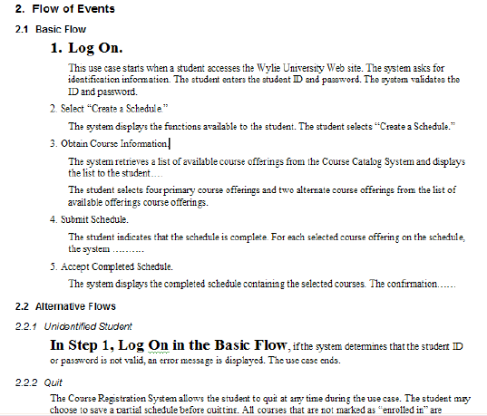
Cross-referencing using a label
Register for Course
RUP Style
1. Student Logs On
In the Student Logs On step of the Basic Flow,
Notes:
Writing Good Use Cases - Instructor Notes
Module 4 - Detailing a Use Case
Use cases typically have a great deal of cross-referenced information within them. The overhead of maintaining this cross-referencing is what typically causes use cases to become out of date. To make maintenance easier, refer to a use case step by its label rather than by number. If you change the text of the label, then the location that references the label also needs to be updated.
Word processors and page layout software , such as Microsoft® Word and Adobe® FrameMaker®, have book-marking and cross-referencing capabilities that can make the maintenance of cross-references easier.
Instead of referring to a particular step by step number, we suggest that you refer the step by its label for easy maintenance.

Slide 52
Review: Flows of events (basic and alternative)
One basic flow
  Happy day scenario
  Successful scenario from start to finish
Many alternative flows
  Regular variants
  Odd cases
  Exceptional (error) flows
Notes:
Writing Good Use Cases - Instructor Notes
Module 4 - Detailing a Use Case

Slide 53
Detail of Alternative Flows
Describe what
happens
2.8 Unidentified Student.
In the Log On step of the Basic Flow, if the system determines that the student identification information is not valid, an error message is displayed, and the use case ends.
2.9 Quit and Save.
At any time, the system will allow the Student to quit. The student chooses to quit and save a partial schedule before quitting. The system saves the schedule, and the use case ends.
2.10 Waiting List
In the Select Courses step of the Basic Flow, if a course the Student wants to take is full, the systems allows the student to be added to a waiting list for the course. The use case resumes at the Select Courses step in the Basic Flow.
Location
Condition
Actions
Resume location
Notes:
Writing Good Use Cases - Instructor Notes
Module 4 - Detailing a Use Case
There are always different ways to structure the text. The main goal is to make the document easy to read.
Describe the alternative flows in their own section, not within the basic flow (although some people have found it useful to add pointers where these may be inserted for clarification purposes).
This slide shows both specific and generic alternative flows from the Register for Course example. A specific alternative flow occurs at a specific step in the basic (or other) flow. A generic alternative flow can occur anywhere in another flow.
For specific alternative flows, detail this information:
The start location in the basic or another subflow where the alternative flow is triggered
Example: “In <step name> of the basic flow….”
The condition that triggers its start
Example: “If the line goes down….”
The actions taken in the alternative flow
Where the basic flow or a subflow resumes after the alternative flow ends
Example: “Resume at <step name> of the basic flow.”
If the use case ends in the alternative flow, state in the alternative flow that “The use case ends….”
For generic alternative flows, there is no start location, because a generic alternative flow can begin anywhere.
Describe the process of defining alternative flows.
Use one section for each alternative flow.
A specific alternative flow occurs at a specific step in the basic (or other) flow.
A generic alternative flow can occur anywhere in another flow.
Ask: Which examples of alternative flows on this slide are specific and which are generic?

Slide 54
Visualize behavior
Visual modeling tools
  Activity diagrams or flow charts
  Business process models
Should you illustrate behavior?
  Pro
    Great tool to identify alternative flows, especially for visually oriented people
    Succinctly conveys information about use case flows
  Con
    Costly to keep diagrams and use-case specifications synchronized
Notes:
Writing Good Use Cases - Instructor Notes
Module 4 - Detailing a Use Case
You can use activity diagrams to visualize the flows, but they’re time-consuming to create .
While activity diagrams provide a nice way to visualize flow of events, they quickly become messy and difficult to maintain. Activity diagrams also take longer to develop (and therefore cost more) than a use case because most authors spend too much time making sure everything is lined up and no lines cross on the diagram.
In most cases activity diagrams are not required.
Tell the students that it is up to them when they create diagrams to represent a use case flow of events. They can choose what works for them.
System
Quote
System

Slide 55
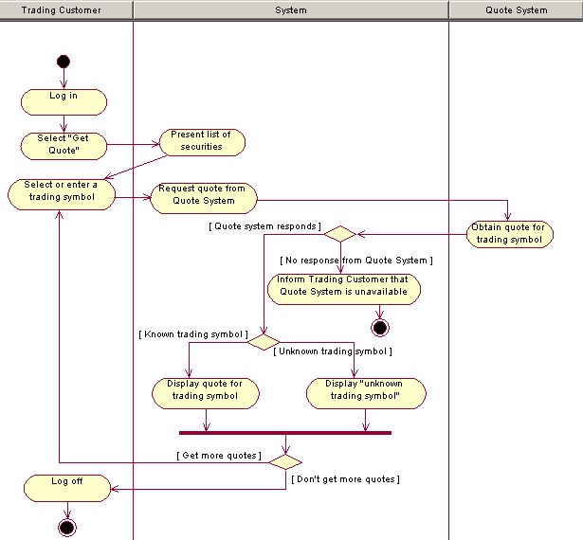
Visualize Alternative Behavior
Trading System Quote System
Customer
Notes:
MRMUC Instructor Notes
Module 8 - Refine the System Definition
Activity diagrams can be used to visualize alternative flows.
It is important that you make use of swim lanes. If you do not, then the activities float in a “semantic emptiness” because they cannot be anchored as a responsibility of any one or thing. Compare the following example with the one above.
While activity diagrams provide a nice way to visualize alternative behavior, they quickly become messy and difficult to maintain. Activity diagrams also take longer to develop (and therefore cost more) than a use case because most authors spend too much time making sure everything is lined up and no lines cross on the diagram.
In most cases activity diagrams are not required.

Slide 56
Subflows
If flows become unwieldy, break individual sections into self-contained subflows
Subflows
  Increase clarity
  Allow internal reuse of requirements
  Always return to the line after they were called
  Are called explicitly, unlike alternative flows
Alternative Flows
Subflow
Notes:
Writing Good Use Cases - Instructor Notes
Module 4 - Detailing a Use Case
A complex flow of events should be further structured into subflows. The main goal should be to improve the readability of the text. Subflows can be invoked many times from many places. Remember that the use case can perform subflows in optional sequences, in loops, or even several at the same time.
The difference between an alternative flow and a subflow is that alternative flows are insert themselves into another flow. The flow it inserts itself into has no knowledge of the alternative flow. An alternative flow may also resume at any place within the use case.
A subflow is explicitly called from a flow. When a subflow completes, it always returns to the line after the line that it was called from. It is similar in concept to a subroutine call in some programming languages.
Subflows are not listed as part of a scenario. By definition, if the calling flow is in the scenario, the subflow is also in the scenario.
As with any other flow, a subflow may have alternative flows.
One way you can describe a subflow to students with a programming background is to use the analogy of a subroutine call. You call a subflow, and when it completes, it always returns to the line after the call.
This graphic conveys some concepts related to use case flows. However, it is not an official modeling representation, so do not over analyze the graphic.

Slide 57
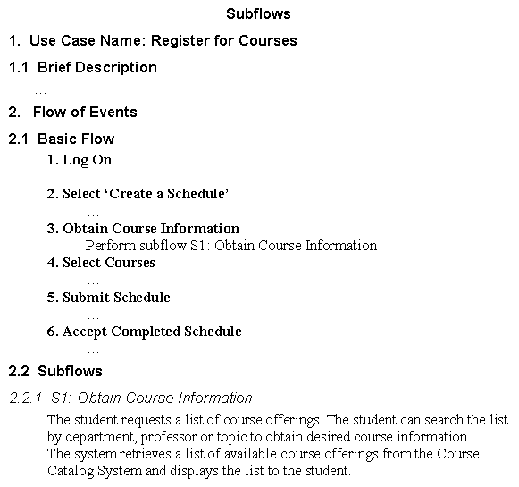
Example subflow
Notes:
Writing Good Use Cases - Instructor Notes
Module 4 - Detailing a Use Case
This is an example of how to write a subflow. Notice that subflows are in a separate section in the Use-Case Specification. In this style, the subflow names have an identifier in front of them (S1, S2 , and so on) to help identify them as subflows.
Unlike alternative flows, subflows do not need a line that says where they return to, because they always return to the line after the line from which they were called.
In this example, when the subflow S1: Obtain Course Information completes, the flow will resume at 4. Select Courses.
The example on the slide serves as an example of how to write a subflow. You would normally choose a more complex flow to factor into a subflow.

Slide 58
Preconditions
Describe the state that the system must be in before the use case can start
  Simple statements that define the state of the system, expressed as conditions that must be true
  Should never refer to other use cases that need to be performed prior to this use case
  Should be stated clearly and should be easily verifiable
Optional: Use only if needed for clarification
Example
  Register for Courses use case
  Precondition:
  The list of course offerings for the semester has been created and is available to the Course Registration System
  Student has logged into the Course Registration System
Notes:
Writing Good Use Cases - Instructor Notes
Module 4 - Detailing a Use Case
A precondition for a use case is a condition in the system that must be true before the use case can begin. For example, the list of course offerings must be available before a student can register for courses. Otherwise, the student could not select from the course list.
A precondition is not the event that starts the use case. For example, if a use case is written in such a way that logging on to the system is the first event in the use case, then logging on is not a precondition. But if a use case is written so that logging on must happen before the use case begins, then “The user has logged on to the system” would be a precondition.
Preconditions reduce the need for validation inside the use-case flows. In this example, you do not need to test whether the course offerings are available anywhere in the use-case flows of events, because, by definition, they must have been available or the use case could not execute.
Preconditions do not describe things outside of the system. For example, “The customer has a valid PIN” would be an invalid precondition. Validating the PIN is something that the system does in the use case.
Preconditions are optional. They are used only if they are needed for clarification.
Note: Preconditions can also be used at the beginning of an alternative flow or subflow. More commonly, they are used only on the basic flow. An example of using a precondition on an alternative flow is to describe security. If only certain actors can perform a given flow, you could attach a precondition to that flow to ensure that the user has the appropriate authentication to perform the flow.
There is no need to state the obvious pre or post conditions.

Slide 59
Postconditions
Describe the state of the system at the end of the use case
  Use when the system state is a precondition to another use case, or when the possible use case outcomes are not obvious to use case readers
  Should never refer to other, subsequent use cases
  Should be stated clearly and should be easily verifiable
Optional: Use only if needed for clarification
Example:
  Register for Courses use case
  Postcondition: At the end of this
  use case either the student has been
  enrolled in courses, or registering was
  unsuccessful and no changes have been made to the student schedules or course enrollments
Notes:
Writing Good Use Cases - Instructor Notes
Module 4 - Detailing a Use Case
A postcondition defines the state that the system is in at the end of a use case. In many cases, you can omit the postcondition entirely when the result of the use case is obvious or when there is no significant state change in the system.
When you need to call attention to the different conditions that may exist when a use case completes, you can enumerate all the postconditions.
Postconditions can be a powerful tool for developing use cases. You must first define what the use case is supposed to achieve (the postcondition). Then describe the different ways to reach this condition (the flow of events needed).

Slide 60
Sequence use cases with pre and postconditions
Use case 1
Use case 2
Use cases do not interact with each other.
However, a postcondition for one use case
can be the same as the precondition for another.
Notes:
Writing Good Use Cases - Instructor Notes
Module 4 - Detailing a Use Case
As described in Use Case Modeling by Kurt Bittner and Ian Spence:
“Use cases do not directly communicate with one another. The only way for use cases to interact is via the state of the underlying system. Use cases can check the state of the system at any time, or wait for the state of the system to change, or can even be dependent on the state of the system via the use of preconditions.”
For example, you may have a use case called Manage Session that handles authenticating users when they log on and then creates a session based on their user profiles. When they log off the system, the use case cancels the session. This use case starts with a precondition that there are no current active sessions in the system. When it authenticates the user, it sets the system state to “active session”. The use case then waits until the user logs off. When the user logs off, it changes the system state to “no active session”.
To ensure that the user has logged onto the system before you start another use case, you would use a precondition of “There is an active session in the system”. (Note: active session should be in your glossary.) This effectively ensures that the Manage Session use case runs before the other use case.
Preconditions can test only the state of the system. For example, you cannot have a precondition that states “Use Case A must have been executed before Use Case B can begin.”

Slide 61
Sequencing with pre/post conditions
Name | Upload Additional Data
ID | 11
Requirement Number | 3.5
Description | Defines how a user uploads additional data to already published entries .
Primary Actor | User
Secondary Actor(s)
Pre-condition | A published entry already exists, user must have contributor or system administrative permissions
Post-condition | A newly updated entry (not a statement)
Trigger | User selects to add new data to existing entry

Slide 62
Sequencing with pre/post conditions
Name | Upload Additional Data
ID | 11
Requirement Number | 3.5
Description | Defines how a user uploads additional data to already published entries .
Primary Actor | User
Secondary Actor(s)
Pre-condition | A published entry already exists, user is logged in , and must have contributor or system administrative permissions
Post-condition | The new data is associated with the entry.
Trigger | User selects to add new data to existing entry

Slide 63
Other use case properties
Special requirements
  Related to this use case, not covered in flow of events
  Usually nonfunctional requirements, data, and business rules
Extension points
  Name a set of places in the flow of events where extending behavior can be inserted
Additional information
  Any additional information required to clarify the use case
Notes:
Writing Good Use Cases - Instructor Notes
Module 4 - Detailing a Use Case
Special requirements are requirements related to this use case that are not covered by the flow of events but that could influence the design of the system. These are usually nonfunctional constraints for the use case, such as reliability and performance.
Extension points name a set of places in the flow of events where extensions can be attached.
Additional information can be included if it helps to clarify the use case. For example, you can use interaction or activity diagrams to help clarify the flow of events.
The optional properties are used only if there are items of that kind to discuss. For example, there may be no special requirements. These are the rest of the properties of a use case.
Extension points are related to the <<extend>> relationship between use cases. This course does not discuss <<include>>, <<extend>>, and generalization relationships and restructuring the use-case model. Restructuring the use-case model takes place after you detail the use case. It is often done by architect.

Slide 64
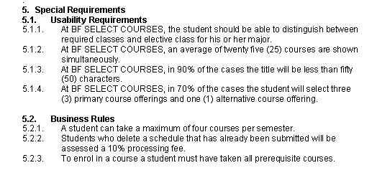
Business rules and other special requirements
Guideline:
If the business rule is specific to the use case, put it in the use case.
If it is general to the application, put it in a business rules document, Supplementary Specification, or domain model.
Notes:
Writing Good Use Cases - Instructor Notes
Module 4 - Detailing a Use Case
According to Bittner and Spence (2003), business rules are requirements that constrain how the business itself works. Examples:
A person must be a member of the cooperative before they can make a purchase.
A customer may have no more than one outstanding order.
Some business rules relate to how information is validated. Others relate to the way work is performed.
A domain model is a good mechanism for capturing business rules, especially those that constrain the relationships between things or the validation of information.
All requirements need to be captured somewhere. If they are not included in the Use-Case Specifications, they should be included in a document such as the Supplementary Specifications.
Explain what business rules are. Point out that a domain model is a good way to capture business rules.

Slide 65
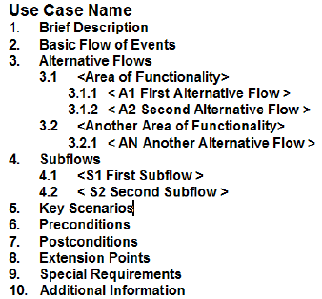
RUP style summary
Basic flow
  Steps are numbered and named
  Steps do not reference alternative flows
  Shows the main actor succeeding in that actor’s main goal
Alternative flows
  Have names
  May have steps
RUP Use-Case Specification Template
Notes:
Writing Good Use Cases - Instructor Notes
Module 4 - Detailing a Use Case
Alternative flows always:
Say where they start.
Say what caused them to start.
Say what happens.
Say where the use case resumes or say that it ends.

Slide 66
Use case checkpoints
The actor interactions and exchanged information is clear
The communication sequence between actor and use case conforms to the user's expectations
How and when the use case's flow of events starts and ends is clear
The subflow in a use case is modeled accurately
The basic flow achieves an observable result for one or more actors
Notes:
Writing Good Use Cases - Instructor Notes
Module 4 - Detailing a Use Case

Slide 67
Review
What are the steps to detailing a use case?
Give a few examples of best practices in phrasing use case steps?
What is a subflow, and when should you use one?
What are pre- and postconditions, and when should you use them?
Notes:
Writing Good Use Cases - Instructor Notes
Module 4 - Detailing a Use Case
What are the steps to detailing a use case?: slide 7
What are some best practices in phrasing use case steps? slide 8
What is a subflow and when should you use one?: slides 14, 15
What are pre- and postconditions and when should you use them?: slides 16-18

Slide 68
MANAGE THE LEVEL OF DETAIL
Notes:
Writing Good Use Cases - Instructor Notes
Module 4 - Detailing a Use Case
Instructor Notes go here

Slide 69
Manage the detail
Black Box
White Box
Know your audience
Strive for black box
Some white box text may make it easier to understand because it makes the use case more concrete
Notes:
Writing Good Use Cases - Instructor Notes
Module 4 - Detailing a Use Case
A black-box use case contains no description of the system’s internal processing. A white-box use case contains descriptions of the system’s internal processing.
The problem with black-box use cases is that sometimes the description becomes too trivial to be useful. This is particularly true in systems where there is little externally observable behavior.
The problem with white-box use cases is that by describing the internal processing you can accidentally influence the design of the system by stating what the system does inside and when it does it. Sometimes, it is useful to provide a little internal description because it gives some context to the next interaction with an actor.
The question that has plagued use-case authors for many years is: “Just how much detail is enough when writing a use case?”
The answer is that you should adapt the amount of detail to suit your audience. A user is typically interested in a black-box description of the system. A subject-matter expert is interested in much more information.
This is an example of where tool support can help you manage the detail. You can use the features of your word processor to turn on or turn off the detail, based on your audience. An example of this is the hidden text feature in Microsoft Word, which you can use to write internal descriptions in a style that uses hidden text that you can suppress, or hide, when you wish.
When writing your use cases, strive as much as possible for black-box use cases. If you do need to add internal processing information, do it with caution and attention to your audience.
Points to emphasize:
You should strive for black-box, but you cannot avoid white box.
Some white-box text might improve understandability because it makes the use case more concrete.

Slide 70
What guides the level of use case detail on a project?
Fewer, better use cases
What
Functional decomposition
What and how
Experienced analysts
Experienced architects
Better techniques and methods
Training, mentoring, guidance
Developers’ demands
Transition from old requirements approach
Waterfall approaches
Low team sophistication about modeling
Notes:
Writing Good Use Cases - Instructor Notes
Module 4 - Detailing a Use Case
Refer to the student notes for more details about ideas presented on the slide.
For those who work with clients, generally, the client-side staff are not as good at abstraction, and are not as sophisticated about iterative approaches. They frequently push us to both waterfall approaches and very detailed statements of requirements.
There are many reasons why a project may be pushed or pulled toward a specific level of detail with use cases.
Developers’ demands – Developers rely on use cases as their only user interface or business rule definition, thus they demand more and more detail in them so they can develop effectively.
Transition from old requirements process – Most older styles of gathering requirements for software projects involve substantial hierarchies of more and more decomposed requirements.
Waterfall approaches – In waterfall methods, analysts are pressured early in the project lifecycle to capture all of the requirements to 100% completeness that anyone might need downstream. This leads to large, very detailed requirement sets.
Low modeling sophistication of the team – Object-Oriented Analysis and Design (OOAD) associates responsibilities with components in the design processes through use case realizations in sequence diagrams and class models. User interface design can be similarly broken down using more systematic approaches. Use cases often include information that should be in the intermediate design artifacts.
Experienced analysts – The more experienced the analysts are in multiple aspects of software development, the better they understand the implications of inappropriate level of detail.
Experienced architects –Software architects who understand the appropriate level of detail for use cases as input to their fundamental work will be the most powerful force for better practices.
Better techniques and methods – If the method calls for useful intermediate work products and artifacts and provides guidance on how and when to create them, that’s a powerful force for appropriate level of detail.

Slide 71
Correct level of detail
No user interface design details – focus on information and events not formats and controls
No architectural assumptions (requirements not design)
  But use case steps may affect the architecture
No internal processing unrelated to a stakeholder requirement –focus on what behavior to capture, not how to implement the behavior
How much detail in a use case?
  Enough to satisfy all stakeholders that their interests (requirements) will be satisfied in the delivered system.
Notes:
Writing Good Use Cases - Instructor Notes
Module 4 - Detailing a Use Case
One of the most difficult aspects of writing good use cases is capturing the correct level of detail.
It is important to capture all of the requirements but not stray into designing the system or the user interface.
Both end users and subject-matter experts are stakeholders of the system, thus they can drive requirements from different perspectives. When using an ATM to withdraw cash, end users may be interested only that the machine dispenses the right amount of money and prints a receipt. But a subject-matter expert is interested in far more. For instance, the banking subject-matter expert is interested in what the ATM does to ensure that the transaction is recorded correctly and that the transaction is communicated to the bank for processing. Therefore, a use case should capture requirements from different stakeholders. (Bittner and Spence, 2002)

Slide 72
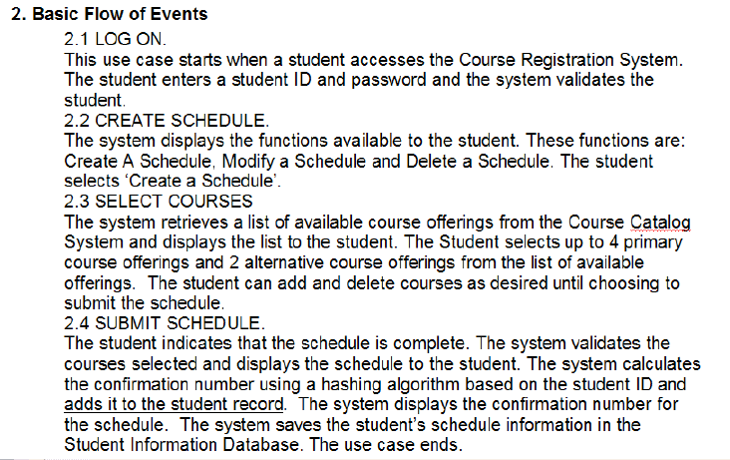
Discussion: Use case example 1
Notes:
Writing Good Use Cases - Instructor Notes
Module 4 - Detailing a Use Case
Review the example on the slide:
What is good about the way the use case is written?
What is not good about the way the use case is written?
Is this the right level of detail?
How would you write it differently?
Ask the students to review the example on the slide.
Ask students if this is the right level of detail. Is it too much or too little?
When you click the mouse, three areas on the slide are highlighted.
In the first highlighted example on the slide, Student ID and password can be included in the use case if it indicates intended system behavior. However, if you just want to authenticate the student, specifying this detail will impose an unnecessary constraint on the system.
The last example on the slide, Student Information Database, is also valid if the Student Information Database is an actor for the system.

Slide 73
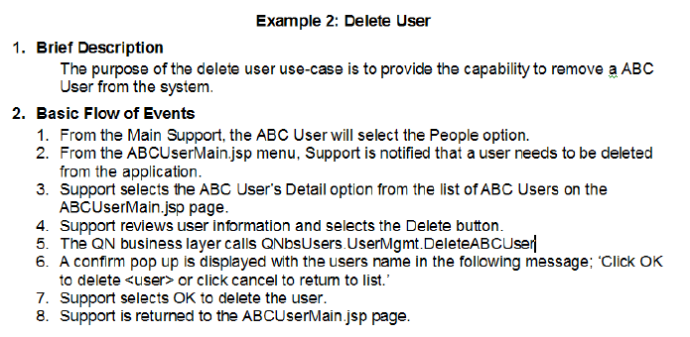
Discussion: Use case example 2
Notes:
Writing Good Use Cases - Instructor Notes
Module 4 - Detailing a Use Case
Review the example on the slide:
What is good about the way the use case is written?
What is not good about the way the use case is written?
Is this the right level of detail?
How would you write it differently?
Ask students if this is the right level of detail. Is it too much or too little?
When you click the mouse, areas on the slide are highlighted. Discuss these areas.

Slide 74
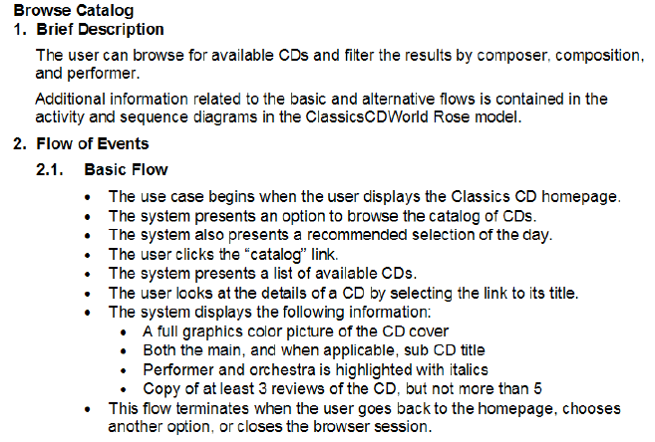
Discussion: Use case example 3
Notes:
Writing Good Use Cases - Instructor Notes
Module 4 - Detailing a Use Case
Review the example on the slide:
What is good about the way the use case is written?
What is not good about the way the use case is written?
Is this the right level of detail?
How would you write it differently?
Ask students if this is the right level of detail. Is it too much or too little?
When you click the mouse, areas on the slide are highlighted. Discuss these areas.
When working with familiar user interface implementations such as web browsers, it is easy to stray into implementation details like assuming hyperlinked titles will be used.
Maybe the best solution is to use portlets, but the use-case specifications adds unnecessary constraints and assumptions making this difficult.

Slide 75
More use case checkpoints
The use case contains no embedded architectural assumptions
The use case contains no embedded user-interface assumptions
Notes:
Writing Good Use Cases - Instructor Notes
Module 4 - Detailing a Use Case

Slide 76
Review
What kinds of information should not be included in your detailed use case?
How do you determine the correct level of detail for a use case?
Notes:
Writing Good Use Cases - Instructor Notes
Module 4 - Detailing a Use Case
What kinds of information should not be included in your detailed use case?: slide 25
How do you determine the correct level of detail for your use case?: slide 27

Slide 77
USE CASE WRITING TIPS

Slide 78
Use-case writing challenges
How do you keep the use case flows focused and concise?
How do you deal with issues about the user interface?
What do you do in a flow when
  An actor may choose among different options?
  An actor may repeat actions before moving forward?
  Steps are not necessarily sequential?
How do you handle conditional behavior in the use case flow?
Notes:
Writing Good Use Cases - Instructor Notes
Module 5 - Use-Case Writing Tips
This section provides guidance on a range of topics related to writing the text of use cases.

Slide 79

How to keep flows focused and concise?
Capture common vocabulary in a glossary
  Define terms used in the project in the glossary, not in flows
  Help prevent misunderstandings
  Start as soon as possible
  Continue throughout the project
Glossary
Notes:
Writing Good Use Cases - Instructor Notes
Module 5 - Use-Case Writing Tips
Start identifying the common vocabulary at the beginning of a project.
There should be one glossary for a system. This document is important to all stakeholders, especially when they need to understand and use terms that are specific to the project.
All text descriptions of the system, especially Use-Case Specifications, should use and refer to the terms defined in the glossary.
In some cases, you may build a domain model to further visualize the terms in the glossary.
Start identifying the common vocabulary at the beginning of a project.

Slide 80
What terms need defining?
Name | Upload Additional Data
ID | 11
Requirement Number | 3.5
Description | Defines how a user uploads additional data to already published entries
Primary Actor | User
Secondary Actor(s)
Pre-condition | A published entry already exists, user is logged in, and must have contributor or system administrative permissions
Post-condition | A newly updated entry
Trigger | User selects to add new data to existing entry

Slide 81
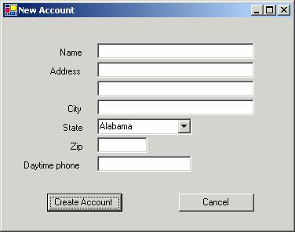
Use the glossary effectively
Use Case
5. Enter Customer Information
  The system prompts the Customer to enter their Customer Details.
  The Customer enters the Customer Details.
  The Customer creates the account.
Glossary
Customer Details Information that uniquely identifies and provides contact information for a customer located in the U.S.A. The information consists of Name, two address lines, city, state, ZIP code, and daytime phone number.
Implementation
Notes:
Writing Good Use Cases - Instructor Notes
Module 5 - Use-Case Writing Tips
Describing how actors interact with forms is common in use cases. There are many techniques that writers use, such as placing them in the flow or in the Special Requirements.
For example
5. Enter Customer Information
The system prompts the Customer to enter name, address (two lines), city, state, zip code, and phone number.
The Customer enters the information.
The Customer creates the account.
This style has a tendency to distract the reader from the flows of events and is harder to maintain.
The safest method is to use the glossary. This ensures that there is only a single place to maintain the information. It ensures consistency if the same data is used in multiple use cases. It also makes the use-case description cleaner and easier to read. The glossary can be used by your database and user interface designers more effectively.
While you should always strive to use the glossary, an alternative approach is to specify the detailed data requirements in the Special Requirements section of a Use-Case Specification or place them in the Supplementary Specification.

Slide 82
Visualize the glossary with a domain model
Student
1
0..*
Schedule
0..*
0..4
Course Offering
0..*
0..*
0..1
1
Part-time Student
Full-time Student
Professor
Course
Notes:
Writing Good Use Cases - Instructor Notes
Module 5 - Use-Case Writing Tips
A domain model provides a visual model of key business objects that are captured in the glossary. The benefit of a domain model is that the relationships between the glossary terms can be represented visually, thereby improving the stakeholders’ understanding of the domain .
This is an example of part of a domain model for a course registration system. It shows that there are student, schedule, course offering, course, and professor. There are two types of students: full-time students and part-time students.
The numbers on associations between objects indicate how many objects that a particular object can be related to. This diagram shows
A student can have zero-to-many schedules. A schedule must be associated with a student.
A schedule is associated with zero-to-four course offerings. A course offering can exist in zero-to-many schedules.
A course offering is associated with zero-to-one professor. A professor can teach zero-to-many course offerings.
A course offering is associated with a course. A course can have zero-to-many course offerings.
Explain the example (see student notes).
Emphasize that you may or may not find a visual model like this useful. You definitely want to capture the business terms and objects in a glossary. You may want to represent some of the glossary items in a domain model.
Domain modeling can be used as an alternative to a full business modeling activity.
Domain modeling benefits:
Develops key business objects rapidly
Formalizes the vocabulary for the project
Simplifies reasoning about different terms
Describes relationships between terms
Provides visual representation of relationships

Slide 83
How do you deal with the user interface?
Leave the user interface out of the use case
  Use cases are independent of the user interface
  Describe user interfaces with
    User-experience models or prototypes
    User interface specifications
Words to Avoid
Words to Use
Click Drag Form
Open Close Drop
Button Field Drop-down Pop-up Scroll Browse Record Window
Prompts Chooses
Initiates Specifies
Submits Selects
Starts Displays Informs
Notes:
Writing Good Use Cases - Instructor Notes
Module 5 - Use-Case Writing Tips
Use cases were never intended to describe a user interface. Describing a visual thing with words is always open to interpretation and very hard to review. For example, picture a bucket. You may imagine that it is a plastic container with an open top and a handle. But someone else may imagine it as being made of metal, with a handle, painted red, and with the word “Fire” written on it. Everyone interprets descriptions differently. For the same reason, user interfaces are best described visually.
Another reason to keep a user interface out of a Use-Case Specification is that the requirements of the system may be the same regardless of the technology used.
Consider the Use-Case Specification for a mobile phone. One of the use cases may be Receive Call. In this use case, the system needs to notify the user that there is an incoming call. Typically, use-case authors would write “The system rings the phone.” But with modern phones, the ring tone could be turned off. In fact, the phone could ring, vibrate, display a message on the screen, or any combination of the three, depending on which features have been enabled. In this case, the use-case description should be “The system notifies the user of an incoming call. Refer to the special requirements for a description of how the system can notify the user.” In the Special Requirements, there would be a matrix of how the system can notify the user, depending on the features that have been enabled in the system. This tells the implementer and tester that this is configurable and that the notification method is based on the system’s configuration.
Even if you know what your system’s interface is going to be, your use cases should still be as interface-independent as possible. Put interface specific information in the user-interface specifications or user experience models.
Emphasize that even if you know what your system’s interface is going to be, your use cases should still be as interface independent as possible. In the future, the interface may change, such as going from a Windows client to an Eclipse-based client. Put interface specific information in the user-interface specifications or user experience models.

Slide 84
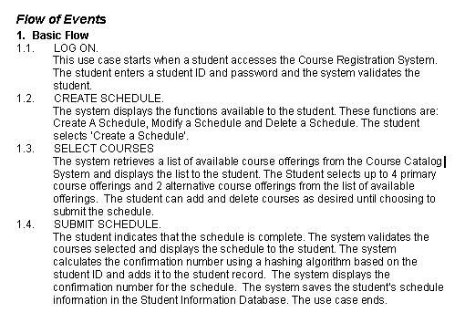
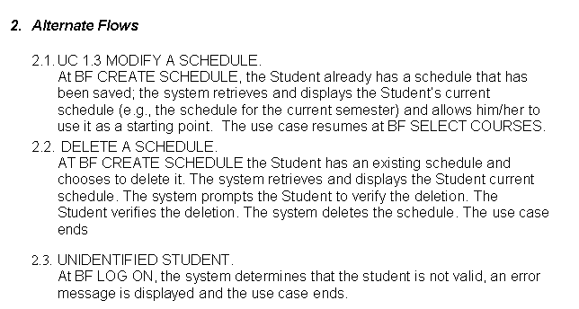
How do you handle actor choice in the flow?
Register for Courses
Include one choice in the basic flow; put other choices in the alternative flows.
CRUD use cases
Notes:
Writing Good Use Cases - Instructor Notes
Module 5 - Use-Case Writing Tips
People differ on how to deal with choices in use cases alternative flows or separate use cases?
If the choices are reasonably simple, keep them in the same use case. Include one choice in the basic flow, and put other choices in the alternative flows. If they have their own very different flows, you may want to consider putting them in separate use cases. However, avoid having too many fragmented use cases, because this makes it very difficult to understand the key functionality of the system. Also, avoid creating (separate) CRUD use cases.
CRUD = Create, Read, Update, Destroy
The example shown on this slide includes one choice in the basic flow, and puts other choices in the alternative flows.

Slide 85
How do you handle repetitive behavior?
Register for Courses
Simple, repetitive behavior can be captured within the basic flow.
Notes:
Writing Good Use Cases - Instructor Notes
Module 5 - Use-Case Writing Tips

Slide 86
How do you handle repetitive behavior? (cont.)
Basic Flow
Log On.
…
2. Create Schedule.
1.2. The system displays the functions available to the student. These functions are Create A Schedule, Modify a Schedule and Delete a Schedule. The student selects ‘Create a Schedule’.
Perform Subflow Select Courses
Submit Schedule
…
Alternative Flows
1. Modify Schedule.
1.1 In the Create Schedule step of the Basic Flow, if the student already has a schedule that has been saved; the system retrieves and displays the Student’s current schedule (e.g., the schedule for the current semester) and allows him/her to use it as a starting point.
1.2 Perform Subflow Select Courses.
1.3 The use case resumes at the Submit Schedule step of the Basic Flow.
…
Subflows
Select Courses.
1.1 The system retrieves a list of available course offerings from the Course Catalog System and displays the list to the student.
1.2 The Student selects up to 4 primary course offerings and 2 alternative course offerings from the list of available offerings.
1.3 The student can add and delete courses as desired until choosing to submit the schedule.
Register for Courses
Repetitive flow of events can be captured using a subflow.
Notes:
Writing Good Use Cases - Instructor Notes
Module 5 - Use-Case Writing Tips
According to Bittner and Spence (2003), subflows can be used to reduce the redundancy, improve the consistency, and increase the readability of the use case.

Slide 87
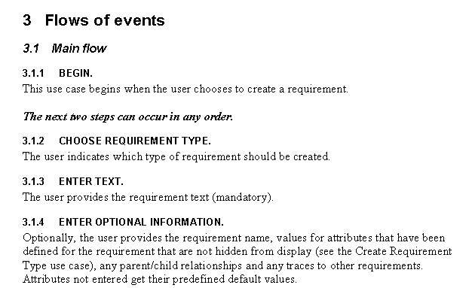
How to handle steps that are not sequential?
Create Requirement
Developers will assume that steps are sequential unless you specify otherwise.
Notes:
Writing Good Use Cases - Instructor Notes
Module 5 - Use-Case Writing Tips
If steps can occur in parallel, state this in the use case. Avoid inadvertently placing additional constraints on the design by ignoring optional ordering of steps.

Slide 88
How do you handle conditional?
Option 1: Use inline conditional behavior (if statements) in the basic flow
Pros
  Familiar to programmers
  Easier to handle small variations in flows
Cons
  Can be hard to follow
  Harder to identify scenarios
  Harder to implement and test
Basic Flow
1. Log On.
…
2. Create Schedule.
The student chooses to create a schedule. The system retrieves a list of available course offerings from the Course Catalog System and displays the list to the student.
If the student has an existing schedule and chooses to modify a schedule, the system retrieves and displays the student’s current schedule (e.g., the schedule for the current semester) and allows him/her to use it as a starting point.
If the student has an existing schedule and chooses to delete it, the system retrieves and displays the Student current schedule. The system prompts the Student to verify the deletion. The Student verifies the deletion. The system deletes the schedule.
  …
Register for Courses
How would you remove the ifs?
Notes:
Writing Good Use Cases - Instructor Notes
Module 5 - Use-Case Writing Tips
It is common to see conditional statements such as IF-THEN-ELSE-ENDIF in Use-Case Specifications. The primary reason for including conditional statements in a use case flow is that they are very natural and convenient to write. However, every time you include a conditional statement, you add a level of complexity to the use case. The readers need to keep in mind the condition that got them to the subflow. With one level of condition, this is easy. But as you add more conditions, the level of complexity goes up an order of magnitude.
For example
IF a THEN
do something
IF b THEN
do something else
When ELSE
do something else again
ENDIF
ENDIF
Implementing and writing test scripts for use cases that make excessive use of conditional statements is difficult and prone to error. A far better approach is to use alternative flows.
There are tradeoffs. A use case with many alternative flows becomes difficult to read because the flows are fragmented throughout the document. The side effects of overuse of conditional statements far outweigh this problem.

Slide 89
How do you handle conditional behavior?
Option 2: Use alternative flows
Register for Courses
Pros
  Can be used anywhere there is conditional behavior
  Clearer
  Easier to read
  Easier to define scenarios
Cons
  More alternative flows
  Increased complexity in maintaining cross-references
Basic Flow
Log On.
…
2. Create Schedule.
The system displays the functions available to the student. These functions are Create A Schedule, Modify a Schedule and Delete a Schedule. The student selects ‘Create a Schedule’.
3. Select Courses
…
Alternative Flows
1. Modify Schedule.
In the Create Schedule step of the Basic Flow, if the student has an existing, the system retrieves and displays the student’s current schedule (e.g., the schedule for the current semester) and allows him/her to use it as a starting point. The use case resumes at the Basic Flow Select Courses.
2. Delete a Schedule
In the Create Schedule step of the Basic Flow, if the student has an existing schedule and chooses to delete it, the system retrieves and displays the student current schedule. . The system prompts the Student to verify the deletion. The student verifies the deletion. The system deletes the schedule. The use case ends
Notes:
Writing Good Use Cases - Instructor Notes
Module 5 - Use-Case Writing Tips
Most people begin writing with If statements. Students’ initial response might be that this example is not clearer.
It takes some time getting used to write like this. When there is more complex behavior, we shall avoid inline conditional behaviors in the flows.

Slide 90
Review
What is the value of using a glossary?
How do you deal with the user interface in a use case?
How do you deal with actor choice in a use case flow?
How do you handle repetitive behavior in a use case flow?
How do you handle steps that are not necessarily sequential?
How do you handle conditional behavior in a use case flow?
Notes:
Writing Good Use Cases - Instructor Notes
Module 5 - Use-Case Writing Tips
What is the value of a glossary?: slides 4-5
How do you deal with the user interface in a use case?: slide 7
How do you deal with actor choice in a use case flow?: slide 8
How do you handle repetitive behavior in a use case flow?: slide 9-10
How do you handle steps that are not necessarily sequential?: slide 11
How do you handle conditional behavior in a use case flow?: slides 12-13

Slide 91
Writing Good Use Cases summary
An actor represents a role that a human, hardware device, or another system can play in relation to the system
A use case is…
  the specification of a set of actions
  performed by a system,
  which yields an observable result that is, typically,
  of value for one or more actors or other stakeholders of the system. (Unified Modeling Language - UML 2.0)
A use-case model is composed of
  Use-case diagrams (visual representation)
  Use-case specifications (text representation)
Notes:
Writing Good Use Cases - Instructor Notes
Module 5 - Use-Case Writing Tips

Slide 92
Writing Good Use Cases summary (cont.)
Find actors
Name and briefly describe the actors you have found.
Name and briefly describe the use cases you have found.
Create a use-case diagram.
Assess business values and technical risks for use cases.
Outline the flow of events.
Capture use case scenarios.
Collect additional requirements.
Detail the flow of events.
Structure the flow of events.
Specify additional use case properties.
Find use cases
Outline a
use case
Detail a
use case
Notes:
Writing Good Use Cases - Instructor Notes
Module 5 - Use-Case Writing Tips

Slide 93
Writing Good Use Cases summary (cont.)
Requirements of a use case
  Must provide value to an actor/stakeholder
    Goal orientation
  Must be a complete narrative describing how the value is provided
    Must have basic and alternative flows
  Must stand alone
    No sequencing of use cases
  Must not describe internal processing unrelated to a stakeholder requirement
    Focus on what, not how
Notes:
Writing Good Use Cases - Instructor Notes
Module 5 - Use-Case Writing Tips

Slide 94
Use cases and legacy systems
If you are maintaining or enhancing a legacy system that is not documented using use cases, it is still beneficial to find actors and use cases for the legacy system
  Provide an overview of what the system does for its actors and stakeholders
  Help understand change impact and test coverage
Rather than detail all use cases, focus on new requirements
Notes:
Writing Good Use Cases - Instructor Notes
Module 5 - Use-Case Writing Tips

Slide 95
Additional resources
Use and Abuse Cases, Martin Fowler, 1998
http://www.martinfowler.com/distributedComputing/abuse.pdf
Why use cases are not functions, Kurt Bittner, 2000
http://www-128.ibm.com/developerworks/rational/library/content/RationalEdge/dec00/WhyUseCasesAreNotFunctionsDec00.pdf
Hunting for use-case scenarios, Pan-Wei Ng, 2003
http://www-106.ibm.com/developerworks/rational/library/content/RationalEdge/oct03/m_hunting_ng.pdf
Use Cases: Yesterday, Today, and Tomorrow, Ivar Jacobson, 2003
http://www-128.ibm.com/developerworks/rational/library/775.html
Traceability from Use Cases to Test Cases, Peter Zielczynski, 2006
http://www-128.ibm.com/developerworks/rational/library/04/r-3217/index.html
Notes:
Writing Good Use Cases - Instructor Notes
Module 5 - Use-Case Writing Tips

Slide 96
What About Nonfunctional Requirements?
The “URPS” of FURPS
  Usability
  Reliability
  Performance
  Supportability
Compliance with Legal and Regulatory requirements
  FCC
  FDA
  DOD
  ISO
Design Constraints
  Operating Systems
  Environments
  Compatibility
  Application Standards
F
unctionality
Feature set
Capabilities
Generality
Security
U
sability
Human factors
Aesthetics
Consistency
Documentation
Frequency/Severity
of failure
Recoverability
Predictability
Accuracy
MTBF
R
eliability
P
erformance
Speed
Efficiency
Resource usage
Throughput
Response time
S
upportability
Testability
Extensibility
Adaptability
Maintainability
Compatibility
Configurability
Serviceability
Installability
Localizability
Robustness
Notes:
MRMUC Instructor Notes
Module 8 - Refine the System Definition
The URPS of FURPS specify the nonfunctional requirements of the system. They typically describe the quality aspects of the system.
What other types of nonfunctional requirements need to be specified?
Requirements must be verifiable. If you cannot verify that you have met the condition or capability, then it is not a requirement. In this case, it is better to specify as a constraint or goal and then create a requirement that can be tested. For example, how can you verify “the system must be available 99.9% of the time over a 12 month period?”
Do you run a test harness for a year? I hope not. Instead, specify it as a goal and then create a testable requirement that the customer agrees to. For example, “The system must be available, under load, 100 percent of the time over a one week period. During this time there must be no degradation of the following system resources: memory, available file handles, and disk space.”
URPS requirements may be in either a particular use case or in the supplementary specifications.

Slide 97
Example: Nonfunctional Requirements
Example:
  The system must provide price quotes that are no more than 15 minutes delayed.
What are some others?
Where should each of these be specified?
Notes:
MRMUC Instructor Notes
Module 8 - Refine the System Definition
Two examples from the RU e-st stock trading system.

Slide 98
Specify Usability Requirements
Usability is the ease with which software can be learned and operated by the intended users.
Usability requirements include:
  Training time requirements, measurable task times.
  User abilities (beginner/advanced).
  Comparison to other systems that users know and like.
  Online help systems, tool tips, documentation needs.
  Conformity with standards.
    Examples: Windows, style guides, GUI Standards
All user documentation must conform to the
Microsoft® Manual of Style for Technical Publications.
Notes:
MRMUC Instructor Notes
Module 8 - Refine the System Definition
How can you “quantify” usability so it can be testable?
The ISO9241 specification provides a similar definition of usability: The effectiveness, efficiency and satisfaction with which specified users achieve specified goals in particular environments.
An example of a usability requirements mapping use cases is Microsoft’s Accessibility option in the Windows control panel.
Discussion: How can you “quantify” usability so it can be testable?

Slide 99
Specify Reliability Requirements
Reliability is the the ability for the software to behave consistently in a user-acceptable manner.
Reliability requirements include:
  Availability (xx.xx%)
  Accuracy
  MTBF (xx hrs)
  Max. bugs per/KLOC (0-x)
Reporting of velocity for the Mars Lander must be in units of meters per second and accurate to 1 in 1e6.
Notes:
MRMUC Instructor Notes
Module 8 - Refine the System Definition
How can we quantify reliability so that it is testable?
MTBF – Mean Time Between Failures
KLOC – Thousand Lines of Code
The example given is an accuracy requirement. The subsystems in the space probe need reliable/accurate measurements in order to ensure that the probe will not plummet into the surface of the planet or miss the planet entirely.
Discussion: How can we quantify reliability so that it is testable?”

Slide 100
Specify Performance Requirements
Performance is a measure of speed or efficiency of the running system.
Performance requirements include:
  Capacity - Memory
  Throughput - Degradation modes
  Response time - Use of scarce resources
    Processor, memory, disk, network bandwidth
There must be no more than four protocol exchanges, of no greater size than 512k bytes each, between the client and the server for each user action.
Notes:
MRMUC Instructor Notes
Module 8 - Refine the System Definition
How can you “quantify” performance so that it is testable?
The example is based on a Network Sociability Guidelines standard that is used in an Australian telecommunications company. The requirement is in place to ensure that any new application that is brought on line has a predictable impact on the corporate WAN. “Each user action” means any keyboard of mouse action. So, for example, if the user clicks an OK button, the client and server are allowed no more than four protocol exchanges. Each exchange is limited to a maximum of 512 kilobytes of data.
Discussion: How can you “quantify” performance so that it is testable?

Slide 101
Specify Supportability Requirements
Supportability is the ability of the software to be easily modified to accommodate enhancements and repairs.
Supportability requirements include:
  Languages, DBMS, tools, and so on.
  Programming standards.
  Error handling and reporting standards.
Often difficult to specify
  If not measurable or observable, it is not a requirement.
  Is it a design constraint?
  Is it an intent or goal?
Notes:
MRMUC Instructor Notes
Module 8 - Refine the System Definition
How can you “quantify” supportability so that it is testable? Here are examples of observable standards and tools that may be specified to enhance supportability.
The supportability area is the hardest to specify as observable or measurable requirements. Often these items are stated as design constraints, or, they may be stated as intent and goals in the Vision document.
An example of a supportability requirement is: “The Web system must remain available to users while it is being upgraded.” This requirement would have a significant architectural impact on the system.
Discussion: How can you “quantify” supportability so that it is testable? Here are examples of observable standards and tools that may be specified to enhance supportability.

Slide 102
How to Describe Communication Protocols
Specify a communication protocol if the actor is another system or external hardware.
  The description of the use case should state if some existing protocol is to be used.
  If the protocol is new, it will be fully described during object-model development.
Notes:
MRMUC Instructor Notes
Module 8 - Refine the System Definition
You might need to define a communication protocol if the actor is another system or external hardware. The description of the use case should state if some existing protocol (http, tcp/ip) is to be used. If the protocol is new, you must fully describe it during the object-model development.
Make this following point very clear to the students:
You may need to define a communication protocol if the actor is another system or external hardware.

Slide 103
Review: Refine the System Definition
When are use cases used to specify requirements?
When are declarative statements used?
What is the difference between black and white-box use cases? Which is better? Why?
What are some alternatives for expressing conditional behavior? What are the benefits and drawbacks of each alternative?
When would you use a subflow?
How should you handle describing forms or data types in a use case?
What are the benefits of using pre- and postconditions?
Notes:
MRMUC Instructor Notes
Module 8 - Refine the System Definition
1.
2.
3.
4.
5.
6.
7.
Use these questions to monitor the students’ level of understanding and to help them review.
The students can look back through the material to get the answers.
Give them time to answer.
Remind the students that they can get more detail on this topic by reading Team Skill 6, “Refining the System Definition” in Managing Software Requirements, by Dean Leffingwell and Don Widrig.

Slide 104
EXAMPLE

Slide 105
Name | Upload Additional Data
ID | 11
Requirement Number | 3.5
Description | Defines how the contributor and system administrator upload additional data to already publish entries
Primary Actor | Contributor
Secondary Actor(s) | System administrator
Pre-condition | A published entry already exist, user must have contributor or system administrative permissions
Post-condition | A newly updated entry
Trigger | Contributor/System Administrator selects to add new data to existing entry

Slide 106
Normal Scenario
1. | Contributor/System Administrator logs into the system
2. | Contributor/System Administrator selects option to upload additional data to an entry
3. | Contributor/System Administrator selects on which entry to upload additional data
4. | Contributor/System Administrator revises newly added data
5. | Contributor/System Administrator saves additional data to entry
6. | Contributor/System Administrator signs out of system

Slide 107
Extensions
1.1 | Contributor/System Administrator does not have a login account: 1.1.a – Contributor/System Administrator creates account to login into the system
3.1 | Chosen entry does not exist: 3.1.a – Contributor/System Administrator creates a new entry into system

Slide 108
Name | Update Item
ID | 11
Requirement Number | 3.5
Description | A user modifies or adds attributes of an Item that is in the System.
Primary Actor | User
Secondary Actor(s) | (none)
Pre-condition | The User is logged into the System and has appropriate privilege to perform the operation, and the Item exists in the System.
Post-condition | The value(s) of the attribute(s) of the Item have been updated.
Trigger | User indicates the desire to update the Item.

Slide 109
Normal Scenario
1.
2. | Contributor/System Administrator selects option to upload additional data to an entry
3. | Contributor/System Administrator selects on which entry to upload additional data
4. | Contributor/System Administrator revises newly added data
5. | Contributor/System Administrator saves additional data to entry
6. | Contributor/System Administrator signs out of system

Slide 110
Normal Scenario
1. | User requests initiation of update, specifying the Item whose attributes are to be modified.
2. | System displays current values of attributes that can be modified.
3. | User selects attribute to modify, enters value, and submits update request.
4. | System confirms update and displays updated attribute.

Slide 111
Extensions
1.1 | Contributor/System Administrator does not have a login account: 1.1.a – Contributor/System Administrator creates account to login into the system
3.1 | Chosen entry does not exist: 3.1.a – Contributor/System Administrator creates a new entry into system

