Slide 1
CptS 421 : Senior Design (Capstone)
Announcements
Github teams, repos; Discord channels have been setup
  Important to keep all team correspondence in one place
Project report assignment due dates updated
  Important to meet clients and clarify problem description, scope
    send a draft to them for feedback
Coaching meeting schedule available
Important to schedule a recurring meeting with clients
  Ideally once per week; if not: send weekly email updates
  teams negotiate all meetings directly with clients
Important to schedule a weekly team standup meeting
Notes:
Template-WSU Hrz 201.ppt

Slide 2
CptS 421 : Senior Design (Capstone)
Intro to Agile
Notes:
Template-WSU Hrz 201.ppt

Slide 3
Agile Process
Ability to create, while responding to change
Dealing with and succeeding in uncertain and turbulent atmosphere
Why do we need Agile?
  Waterfall process is rigid and does not respond to changes quickly
  Agile process is iterative and adaptable
  Agile incurs less risk and lower cost of change
Notes:
Template-WSU Hrz 201.ppt

Slide 4
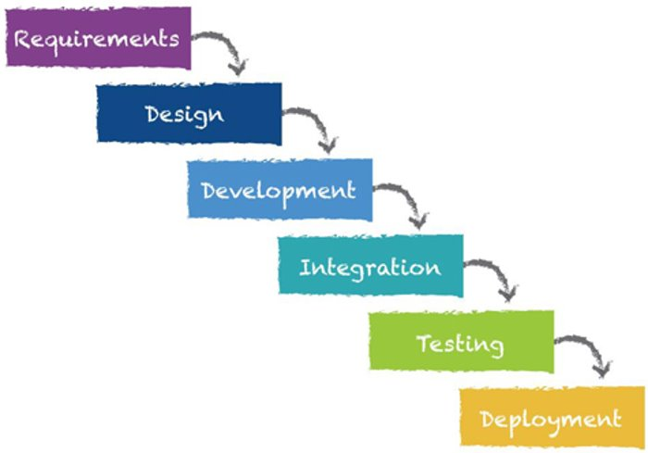

Slide 5
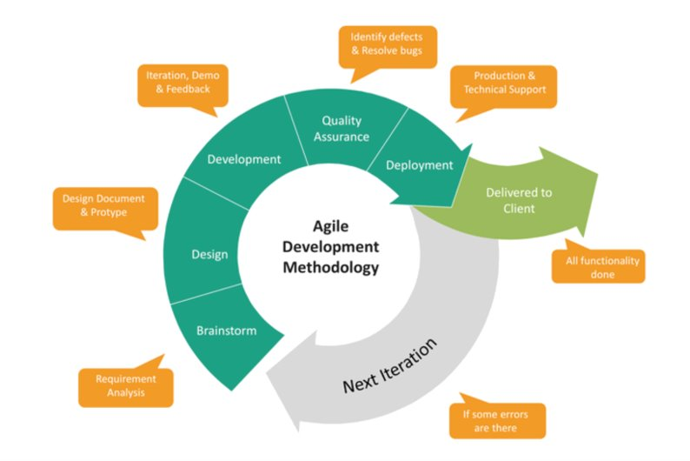

Slide 6
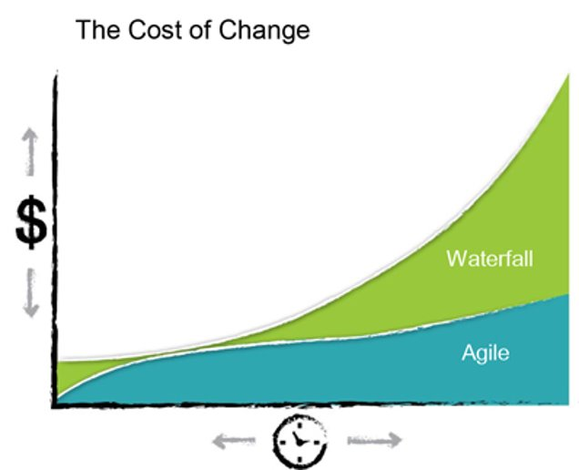

Slide 7
Agile Process
More than an algorithm
  Philosophy rooted in 12 principles of the Agile Manifesto
  Collection of frameworks (e.g. scrum, extreme programs, feature-driven dev)
  Collection of practices (e.g. pair programming, stand ups, sprints)
Notes:
Template-WSU Hrz 201.ppt

Slide 8
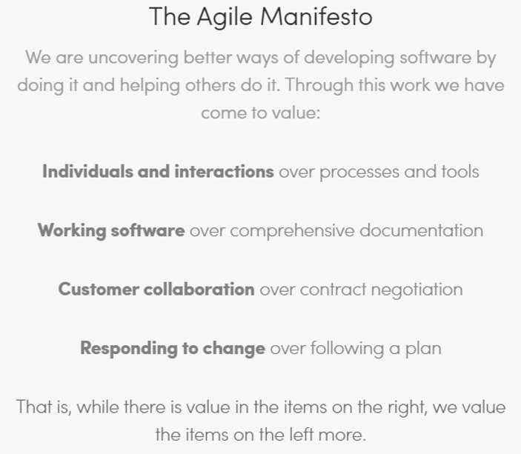
https://www.agilealliance.org/agile101/the-agile-manifesto/
Notes:
Template-WSU Hrz 201.ppt

Slide 9
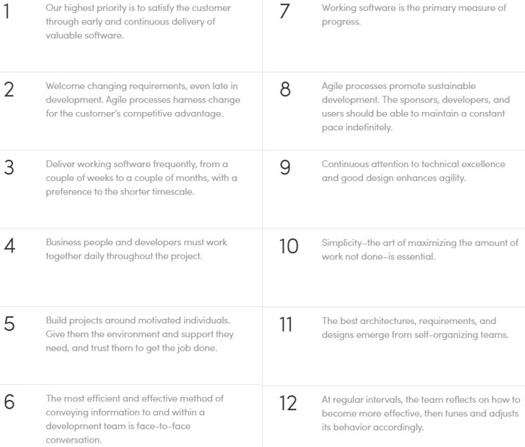
https://www.agilealliance.org/agile101/the-agile-manifesto/
Notes:
Template-WSU Hrz 201.ppt

Slide 10
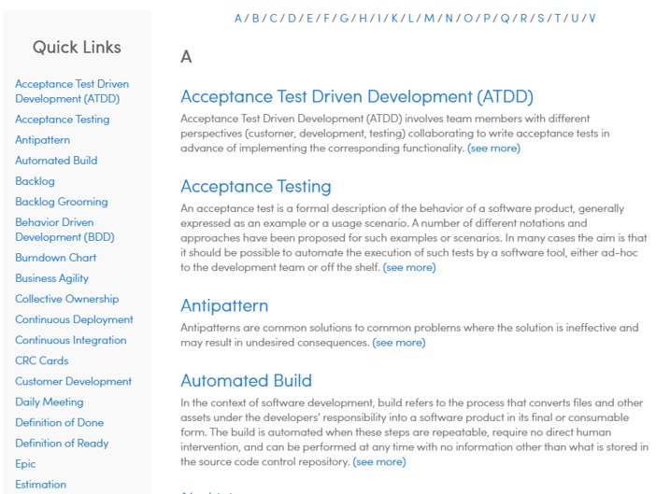
https://www.agilealliance.org/agile101/agile-glossary/
Notes:
Template-WSU Hrz 201.ppt

Slide 11
Key Agile Practices
Stand-ups (What did I do yesterday? What will I do today? What is preventing progress?)​
User Stories (“As a x, I want to do y so that z”)​
Automated Testing and Builds (software works at all times)​
Continuous Integration (software updated frequently)​
Planning/Tracking (Release > iteration, a.k.a. “sprint” > task)​
  Release = epic or collection of user stories that form a software release​
  Iteration = subset of user stories doable in a few weeks​
  Task = bite-size pieces needed to complete a user story​
Pair Programming (quicker results, fewer defects)​
Retrospectives (what went well, what can be improved, what we will do differently)​
Notes:
Template-WSU Hrz 201.ppt

Slide 12
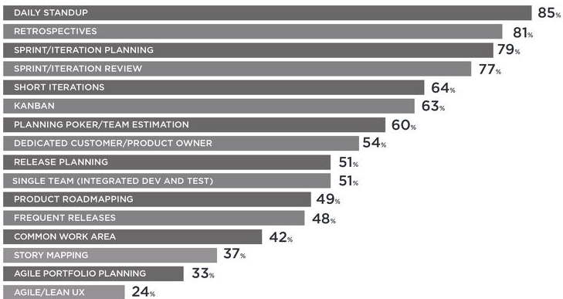
Agile Practices Used in Industry
(2019 14th Annual State of Agile Report)

Slide 13
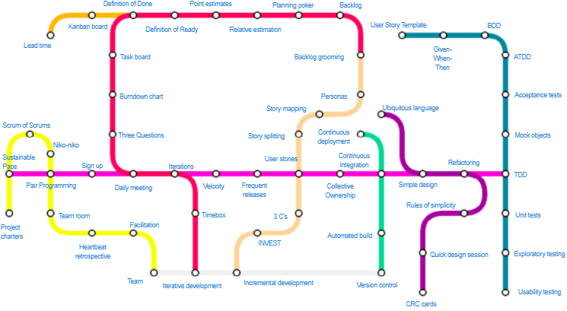

Relationships among Agile Practices https://www.agilealliance.org/agile101/subway-map-to-agile-practices/
Notes:
Shows relationships between different agile processes. You can follow a particular line to see all of the practices of a particular “camp” or “tribe.” Common “stations” in different lines show points of intersection.

Slide 14
Using Agile in CptS 421
Stories / Issues (Week 4 onwards)
  Define, Prioritize, Develop, Release, Retrospect
  Iterate
Sprints / milestones
  Each month has a sprint due
  Demos and project reviews at the end of each sprint
  Use Github to track dev (commits, issues, Kanban board, feature branches, pull requests, code reviews)
  Automate building and testing
    CI/CD can be viable for some projects
Notes:
Template-WSU Hrz 201.ppt

Slide 15
Any questions?
Notes:
Template-WSU Hrz 201.ppt

