Slide 1
CptS 421 : Senior Design (Capstone)
Announcements
WA2 due soon
  Not all teams will receive requirements from clients
    Most teams need to analyze project goals and produce req specs
      Requires thinking about steps to reach the end goal
Github Repo
  One-point data store for anything your team produces
    Code, docs, reports, meeting minutes, demo videos, presentation files, etc.
  Commit as you do the work
    Whoever does the work should commit
  Create issues → assign on Project board
    work on an issue → commit to a feature branch → create a pull request
      others review the pull request approve/suggest modifications
        Approved? Merge to main branch
Notes:
Template-WSU Hrz 201.ppt

Slide 2
CptS 421 : Senior Design (Capstone)
Announcements
Sprint 1 coming to an end
  Project documentation, Github README and some skeleton code
    README template in Canvas, under Sprint assignment items
  A part of demo video for Sprint 1 can be Github walkthrough
  A sprint report is required
  Don’t forget peer evaluations, you’ll receive an email from CATME system
Sprint 2
  UI/UX mockups
    Figma, Balsamiq or other tools
  Prototype Initialization
    Some features of the product implemented
    Client satisfaction is important
Notes:
Template-WSU Hrz 201.ppt

Slide 3
CptS 421 : Senior Design (Capstone)
Announcements
Current class expectations
  At least a few meetings with clients
  Project skeleton code initiated
  WA1 submitted; WA2 almost done
Grading ongoing
  Common issues so far
    Lack of references / citations in the reports
    Lack of proactivity or enthusiasm in some team members
Notes:
Template-WSU Hrz 201.ppt

Slide 4
CptS 421 : Senior Design (Capstone)
User Stories, Issues, Kanban Boards, Feature Branches
Notes:
Template-WSU Hrz 201.ppt

Slide 5
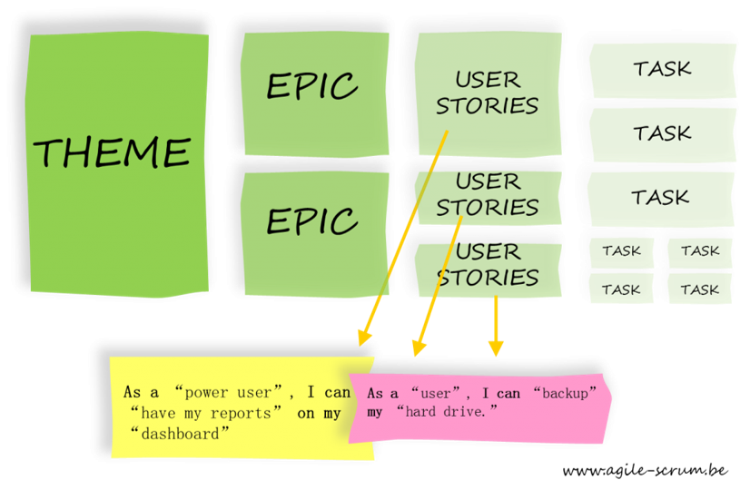
User Stories
Notes:
Template-WSU Hrz 201.ppt

Slide 6
User Stories
User stories force devs to think
  What will my product be like?
  How are users expected to interact with my product?
Template: As a <type of user>, I want <some feature> so that <some reason>
Example:
As a course operator, I want to be able to create interactive timelines for sprints so that students can follow an abstract schedule
Notes:
Template-WSU Hrz 201.ppt

Slide 7
User Stories
Keep them short and simple
Write from the perspective of a user
Users can be customers, admins, devs, mods, etc.
Focus
  Value of product
  One story = one feature
Writing user stories as a team may help
Acceptance criteria
  How do you evaluate success of implementing a feature?
Notes:
Template-WSU Hrz 201.ppt

Slide 8
User Stories
Acceptance criteria example
Story:
As a course operator, I want to be able to create interactive timelines for sprints so that students can follow an abstract schedule
Criteria:
  Users should be able to log in
  Teachers should be able create and moderate interactive timelines
  Students should be able use the timelines
  Timelines should match the semester duration
Notes:
Template-WSU Hrz 201.ppt

Slide 9
User Stories
User stories are the basis for sprint velocity
  How many stories did a dev complete in a sprint?
  How quickly did a dev complete those stories?
Sprint velocity is used as a performance evaluator in some companies
Controversial
  Some companies like it, some don’t
    https://lithespeed.com/throw-agile-estimation-vs-noestimates/​
    https://ronjeffries.com/xprog/articles/the-noestimates-movement/
Notes:
Template-WSU Hrz 201.ppt

Slide 10
Issues, Feature Branches, Kanban Boards
Issues contain one or more user stories
  One or more issues forms an epic
  Multiple epics form a theme
  Sprints are usually based on a theme
Feature Branch
  Dev1 works on Issue1 using FeatureBranchIssue1
  Feature branches are merged onto main branch by pull requests
  Never commit directly to main before code review
Project (Kanban) boards
  Helps keep track of all project tasks
  Easy to know who is working on what
Notes:
Template-WSU Hrz 201.ppt

Slide 11
Commits
Upload changes to code, helps with version control
Push code: upload code from workstation to the cloud
Pull code: download code from workstation to the cloud
  Pull request (PR): merge a feature branch to the main branch
Best practices
  Commits focus on a single issue or concern
  Commit frequently
  Be accurate and precise
    Identify exactly what was changed in the commit
  Rationale
    Why was the change made to the code?
Notes:
Template-WSU Hrz 201.ppt

Slide 12
Commits
Bad commit message
  “Made some changes to make the product better”
Good commit message
  “Partially implemented UI to enable user to search for recipes​
    Added search box and search button at top of recipe list page​
    User can hit <enter> in search button or click on search button to search”
Notes:
Template-WSU Hrz 201.ppt

Slide 13
Any questions?
Notes:
Template-WSU Hrz 201.ppt

