Slide 1
CptS 421 : Senior Design (Capstone)
Announcements
Don’t forget to keep your repo up-to-date
    Timely commits
    Updates on issues / project board
Current class situation
  Created UI / UX mockups; obtained approval from clients
  Implement some features of the product prototype
  Testing plan ready
Notes:
Template-WSU Hrz 201.ppt

Slide 2
CptS 421 : Senior Design (Capstone)
Announcements
A draft of the prototype report is due in Nov
Final prototype report is due in Dec
In-class presentation videos due 12/02
  Peer-reviews due 12/09
    Each student must review 3 videos
Client presentation assignments due 12/09
Notes:
Template-WSU Hrz 201.ppt

Slide 3
CptS 421 : Senior Design (Capstone)
DevOps
Notes:
Template-WSU Hrz 201.ppt

Slide 4
DevOps
DevOps includes CI/CD
  Continuous integration and delivery/deployment
  Steps:
    Code (Visual Studio, Vim, …)
    Version Control (Git, Subversion, …)
    Verify (Scripts)
    Validate (Review frameworks)
    Containerize aka Package (Docker)
    Release aka Deploy (AWS, Kubernetes, GCP, …)
Notes:
Template-WSU Hrz 201.ppt

Slide 5
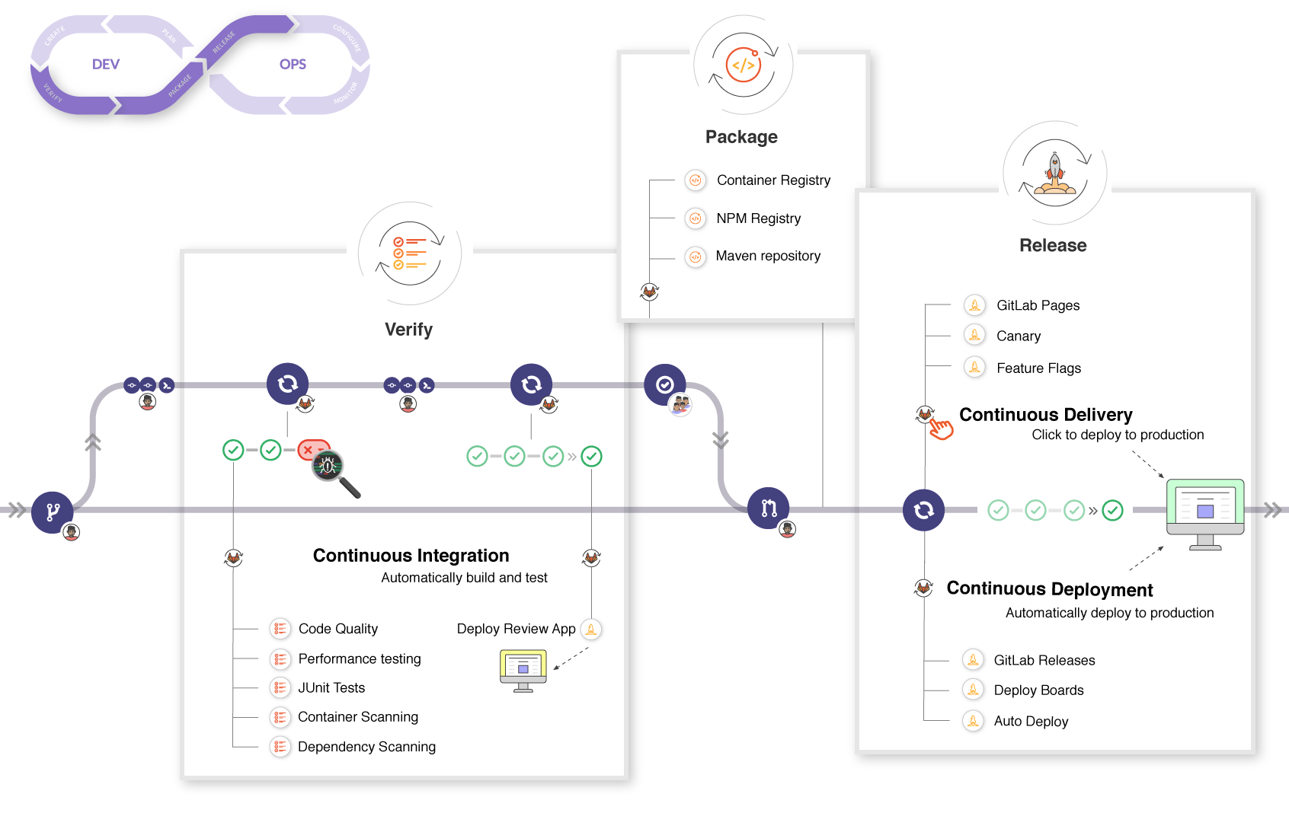

Slide 6
SDLC
CI/CD Pipeline fundamentals
  Pipeline is a set of step-by-step command list
  Commands are usually specified in a file (‘.github-actions-demo.yml’)
  Commands use predefined keywords (events in github)
    Events vary between platforms
    Github Actions event reference
      https://docs.github.com/en/actions/learn-github-actions/events-that-trigger-workflows
  Pipeline needs storage and memory to execute
    The storage & memory providers are called ‘agents’ (‘runners’ in github)
  Runners can be
    Self-hosted
      Machines you own or control
      Cloud providers like AWS, GCP, Azure
    Github also provides runners
Notes:
Template-WSU Hrz 201.ppt

Slide 8
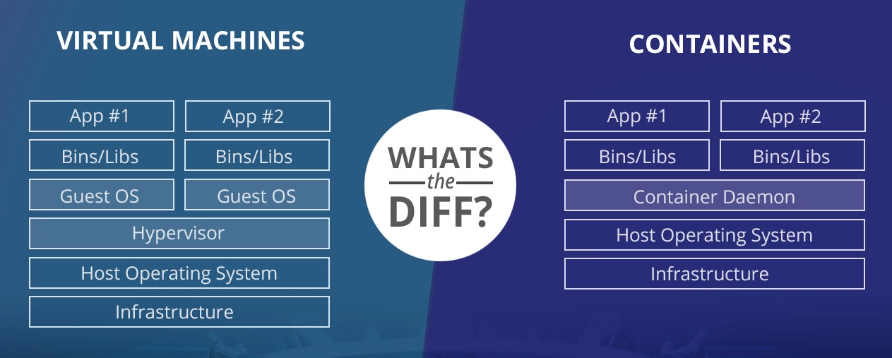
Image source: https://www.backblaze.com/blog/vm-vs-containers/
Notes:
Template-WSU Hrz 201.ppt

Slide 9
SDLC
Containerization fundamentals
  Need an image to containerize
  Image is a blueprint, specifies what the container should contain
  Blueprint is specified using step-by-step commands
  Commands are usually specified in a file (‘Dockerfile’ for Docker)
  Commands use predefined keywords
    Keywords vary between platforms
    Dockerfile keyword reference: https://docs.docker.com/engine/reference/builder/
Once containerized, the app can be deployed to multiple clusters
  Use AWS or Kubernetes
    Need a deployment config file (e.g. Kubernetes YAML, AWS AppConfig)
Notes:
Template-WSU Hrz 201.ppt

Slide 10
DevOps Expectations
DevOps on Github Education is limited
  Limits per month:
    3000 minutes
    10GB for packaging
    2 GB for stored workflows and packages
Please use Github DevOps only if your clients or project requires it
  Send me an email if so
Learning resources
  https://docs.github.com/en/actions/quickstart
  https://lab.github.com/githubtraining/devops-with-github-actions
    Intensive course, highly recommended
Notes:
Template-WSU Hrz 201.ppt

Slide 11
CptS 421 : Senior Design (Capstone)
WA 5 – Prototype Report
Notes:
Template-WSU Hrz 201.ppt

Slide 12
WA5 –Prototype Report
Describes your project’s prototype
6+ pages of text
  ToC, images, and use-case diagrams don’t count
Template is on Canvas
  Feel free to edit
  Follow the formatting directions
Notes:
Template-WSU Hrz 201.ppt

Slide 13
WA5 – Overview
Introduction (WA1)
Team Bios and Project Roles (Team Inventory)
Project Requirements (WA2)
Solution Approach (WA3)
Testing and Acceptance Plans (WA4)
Prototype Description
  Subsystems
    Functions and Interfaces implemented
    Preliminary Tests
Prototype Demonstration
Future Work
Glossary, References, Appendices
Notes:
Template-WSU Hrz 201.ppt

Slide 14
WA5 –Prototype Description
Describe what parts of your solution approach has been implemented
  How much of the proposed system is ready?
List all the subsystems you have implemented
  Functions and interfaces
  Preliminary tests
Include plenty images
  Diagrams / Figures
  Screenshots of tests (pass or fail, doesn’t matter)
  Screenshots of UI / system
  Pictures of debugging attempts
Notes:
Template-WSU Hrz 201.ppt

Slide 15
WA5 –Prototype Demonstration
Summary of the prototype’s functionality
  Should serve as a document accompanying your client demo
Notes:
Template-WSU Hrz 201.ppt

Slide 16
WA5 – Future Work
Plans for the second semester
  How will you expand the Prototype and turn it into a final deliverable?
  Describe each task briefly
Notes:
Template-WSU Hrz 201.ppt

Slide 17
WA5 – Glossary, References, Appendices
Glossary: define any abbreviations used in the document
References: cite your sources
Appendices
  Large images, charts, tables, data sheets, codebase, complete algorithms etc.
  Used to keep the main doc short and concise
  No limit on number of pages for Appendices
Notes:
Template-WSU Hrz 201.ppt

Slide 18
WA5 – Tips
Read through the template well before the deadline
Prepare a list of questions you have
Ask your clients / mentors
Notes:
Template-WSU Hrz 201.ppt

Slide 19
CptS 421 : Senior Design (Capstone)
Presentation Assignments
Notes:
Template-WSU Hrz 201.ppt

Slide 20
Presentation Assignments
In-class presentation
  No schedule; peer-reviewed video presentations
  Create a video: 6 mins presentation
  Template and grading rubric on Canvas
Client presentation et demo
  Teams individually schedule this with clients
    Must be given by Dec. 09th at any cost
  Usually one hour (40 mins presentation + 20 mins Q&A)
    Can vary from team to team as per client preference
  Take the In-Class presentation template and expand it
Notes:
Template-WSU Hrz 201.ppt

Slide 21
In-Class Presentation
Should be 1 or at most 2 presenters
Project Overview and Requirements (~ 1 minute)
  Main goal
  Two or three main functional and non-functional requirements
Solution Approach (~3 minutes)
  Major components
  Tools, frameworks, libraries, etc. being used
Current Status (~1 minute)
  How much of your proposed solution have you implemented?
Future Work (~1 minute)
  What else is left to be implemented and what is your plan?
Notes:
Template-WSU Hrz 201.ppt

Slide 22
Client Presentation
Can be 3 or 4 people
  Better to keep it to 1 or 2 presenters
Project Overview and Requirements (~ 5 minutes)
  Main goal
  Two or three main functional and non-functional requirements
Solution Approach (~15 minutes)
  Major components
  Tools, frameworks, libraries, etc. being used
Current Status and Demo (~15 minutes)
  How much of your proposed solution have you implemented?
  Demo your alpha prototype
Future Work (~5 minutes)
  What else is left to be implemented and what is your plan?
Notes:
Template-WSU Hrz 201.ppt

Slide 23
Any questions?
Notes:
Template-WSU Hrz 201.ppt

