Slide 1

Civic Hacking and Open Data
Bill Bushey
Open Twin Cities
Minnebar 8
Notes:
~28 minutes

Slide 2
What is Civic Hacking?
What is Open Data?
What is happening around the country?
What is happening in the Twin Cities?

Slide 3
What is Civic Hacking?

Slide 4

commons.wikimedia.org/wiki/File:EGov.svg
Notes:
Starts with E-Government
E-Government: Governments applying IT to government processes and interactions with citizens, businesses, and agencies
Focused on governments building websites to provide information and government services, and implementing government IT infrastructure
It was the government version of what was also happening in the private sector: an internal drive to modernize via IT

Slide 5

Notes:
Civic Hacking takes the idea of E-Government and adds a bit of Open Source philosophy to it.
When I say open source, I do not mean advocating that governments use open source software.
What I mean is the philosophy that, if I want something to be better, I’ll make it better.
Civic Hacking is about empowering citizens to build the better government interactions that they want. It is about citizen led technology improvements in their community.

Slide 6

creativecommons.org/weblog/entry/32434
Notes:
It is also about experimentation.
When you open up the field of who can construct the technology of the community to be the entire community, you end up with a lot more ideas and implementations.
Every one of those implementations will have strengths and weaknesses. As a community, we learn from the results of any attempt to change civic technology, and we can apply this new knowledge to future experiments in civic technology.
Ultimately, this is about democratizing innovation in civic technology. And in doing so, the innovation can occur faster and with better outcomes for governments and citizens.

Slide 7
What is Open Data?

Slide 8
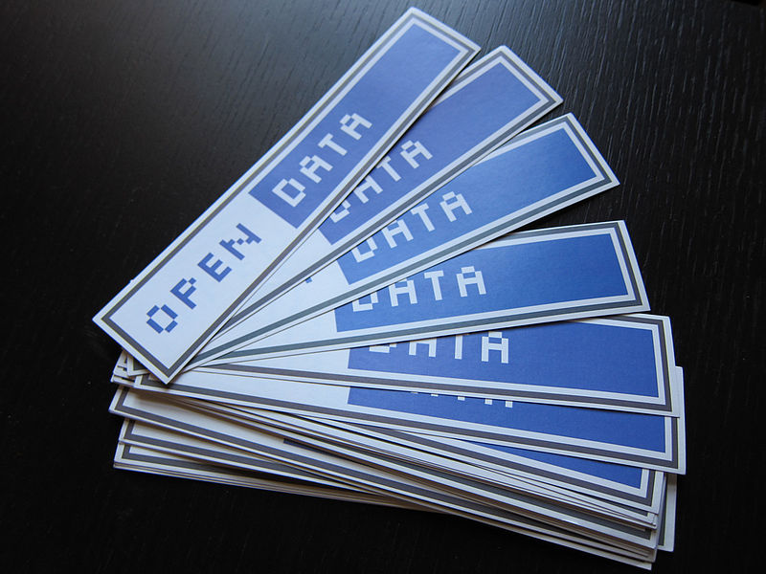
Open Data
en.wikipedia.org/wiki/File:Open_Data_stickers.jpg
Notes:
Open Data is the Yin to Civic Hacking’s Yang. It is a distinct concept, but the two need each other to reach their full potential.
Data is the raw material of software development. For civic technologies, much of this information has to come from the government.
<Maintain the distinction between Data and Information>

Slide 9
4 Levels of Open Data
Real Time Access
Structured Access
Equitable Access
Legal Access
Notes:
There are several definitions of open data out there…
Fundamentally about citizen access to data in a useful format and expected timeframe.
In my opinion there are four levels of open data access:
Legal Access: I legally have the right to obtain data from my government. This manifests in FOIA and the Data Practices Act.
Equitable Access: Government data can be accessed free of onerous costs and processes. As a citizen, I have just as much of a capability to access government data as a well resourced organization. An example of not-equitable access: Hennepin Country charges 5 cents per parcel for a request of real estate parcels in the county, depending on who is requesting the data. To get all parcels (~250,000) will cost ~$12,000. An example of equitable access: Chicago uploaded all of their property parcel data to Github and put an open license on it.
Structured Access: I can receive government data in a format that I can write a program against. As a software developer, if I receive government data as a PDF, or even as a regular webpage, I’m receiving data that still requires a lot of processing before it can be used for application development or analysis. If it can be processed at all. What I want to receive as a developer or an analyst is at least a CSV, with complete metadata concerning sources and methods for creating the data.
Real Time Access: I can receive structured government data as soon as possible after it is created. Put another way, there is an API I can access to retrieve government data.

Slide 10
What is happening around the country?

Slide 11


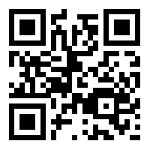
Brought to you by:
bit.ly/d8tWvm
Notes:
Around the country, citizens have been organizing CityCamps - unconferences a lot like Minnebar, except with a focus on the intersection of technology, communities, and governments.
Has been going on for 3 years, the first one was in Chicago. Have since been held in 25 cities in the US, UK, Mexico, and Argentina
There is also a national CityCamp organization, a non-profit which helps to connect organizers and participants with each other across the country. The national organization also shares lessons, and helps local CityCamps raise money.
E-Democracy (my employer) is the fiscal agent for the national CityCamp organization, which means it handles money for CityCamp as a non-profit organization.

Slide 12

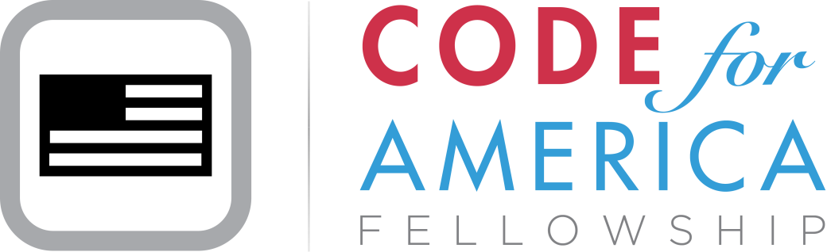


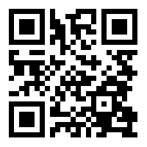
c4a.me/bDsdud
Notes:
A lot of civic hacking has been happening around the country. Code for America is a non-profit formed 4 years ago to be a national focal point and facilitator of civic hacking.
The most important thing about Code for America is not that it is building applications, but that it is building networks.
All of CfA’s programs place an emphasis on connecting people: connecting coders with governments, connecting citizens with coders, connecting civic technologists with each other, and connecting civic innovators with mentors.
This year, 10 cities are hosting Fellows.
Kansas City, MO
Kansas City, KS
Las Vegas, NV
Louisville, KY
New York, NY
Oakland, CA
San Francisco, CA
San Mateo County, CA
South Bend, IN
Summit County, OH

Slide 13
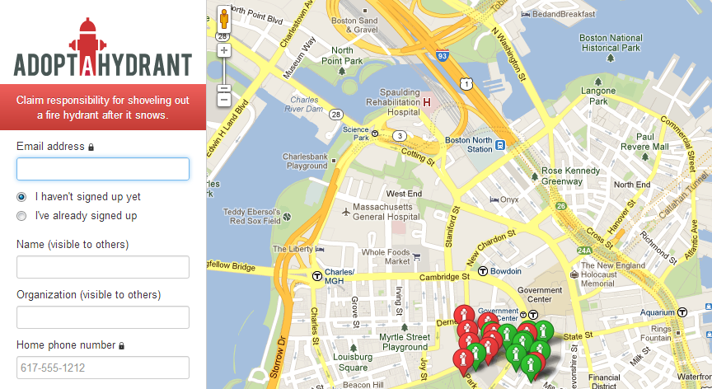
Notes:
Adopt-a-hydrant, an application developed in Boston as part of the Code for America Fellowship Program. The idea of the application is to help citizens find hydrants that need to be cleared off after snow storms, so that firefighters don’t have to.

Slide 14
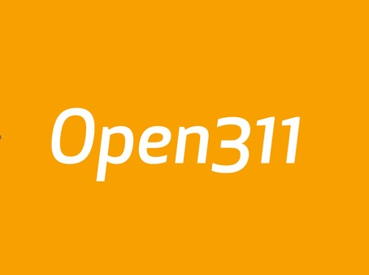

Notes:
An open API for submitting and retrieving 311 requests. Allows for the development of common tools that can be used across cities, such as SeeClickFix.
Now implemented by 32 cities around the world in the US, Canada, Australia, and Germany

Slide 15


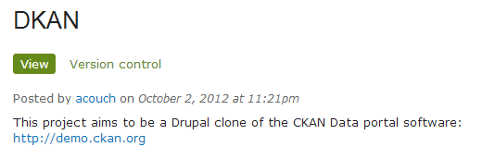
Notes:
A lot of projects and groups end up acquiring data from governments and want to put it online. Because of this, an open source, open data hosting platform has been developed: ckan. Numberous governments us ckan for their public, open data hosting, including the US government for data.gov.
The Data Hub – a shared installation of ckan that people are free to put public data. Kind of like a github for open data.
DKAN, a Drupal clone of ckan

Slide 16
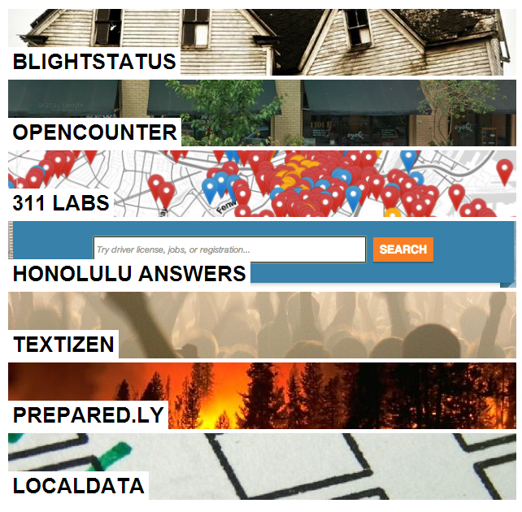
Notes:
There are a lot more projects. Here is just a sampling of the 28 applications that Code for America currently highlights on its site.

Slide 17
What is happening in the Twin Cities?

Slide 18
Partners
Open Twin Cities

Slide 19
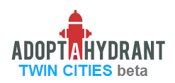
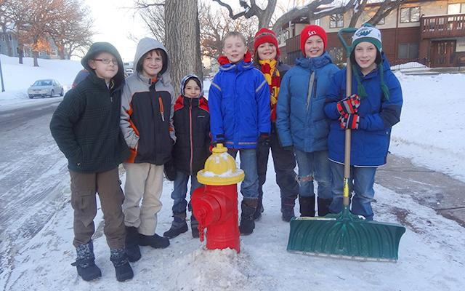
bit.ly/VKIMH5
Notes:
We have deployed a Twin Cities version of Adopt-a-Hydrant, covering all of the fire hydrants in both Minneapolis and St. Paul.
We get colder and get more snow than Boston, so we should have this.
The picture you see here is from a story by Minnpost of the Hoppity Hats, group of St. Paul 3rd graders who decided to us Adopt-a-Hydrant as part of a class project on community service.

Slide 20
Events
Monthly Meetups
Open Data Day Hackathon
Visualizing Neighborhoods
National Day of Civic Hacking
CityCampMN
Notes:
Each slide will have a bitly and QR code to more information

Slide 21

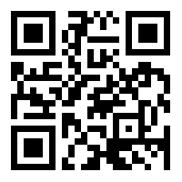
Monthly Meetups
Every 4th Tuesday Evening
bit.ly/VZSUYr
Notes:
Logistics on the slide

Slide 22
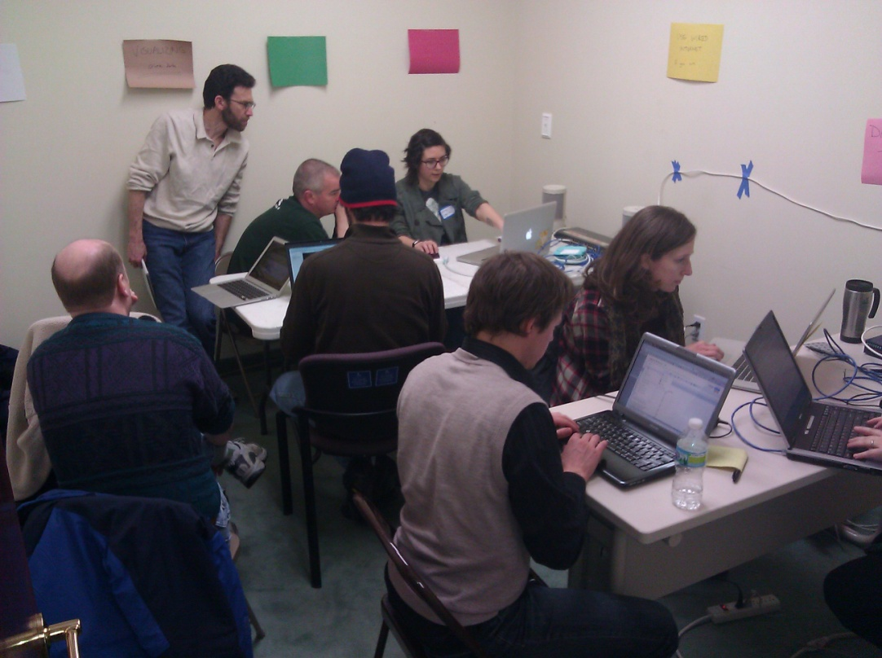
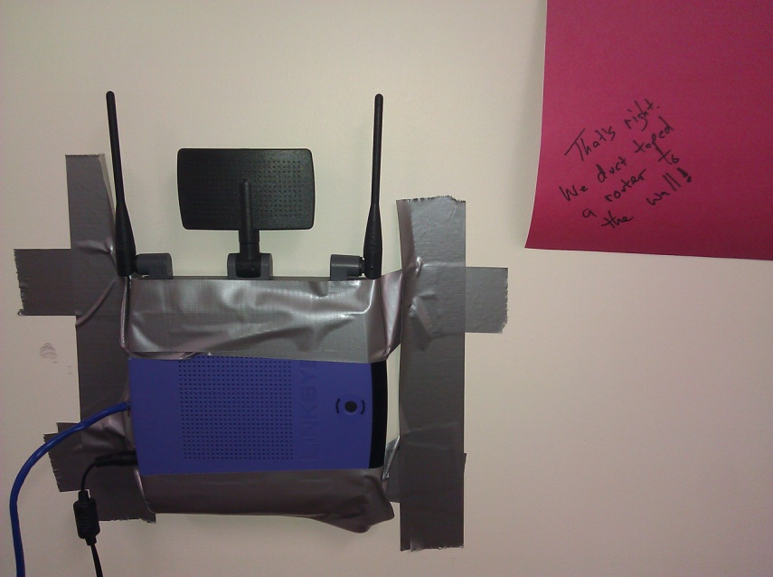
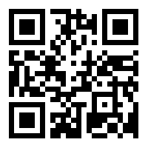
Open Data Day Hackathon
bit.ly/Wqip50
Notes:
2/23 – part of International Open Data Day and Code Across America
The first Civic Hackathon in the Cities, and maybe all of Minnesota
4 Great projects from ~20 participants:
Categorized listing of 900+ MN datasets
Mapping of crimes in St. Paul
Display of Crime Density per Neighborhood in Minneapolis
Cleaning up Community Technology Center location data
A candidate for mayor of Minneapolis came at the end and learned about these projects and civic hacking

Slide 23

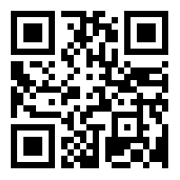
May 25th at Minneapolis Central Library
Data Viz meets Neighborhood Needs
bit.ly/ZeMetp
Notes:
Already full with 100+ registrants!
Coinciding with FOSS4G and Neighborhoods USA Conferences in downtown Minneapolis
There will be pre-event gatherings to connect people and generate ideas
Will focus on technology for neighborhood
Led by Center of Urban and Regional Affairs at the University of Minnesota, the city of Minneapolis, and OTC
Maybe best example that the cities are ready for this movement… the U and the city are pushing it

Slide 24
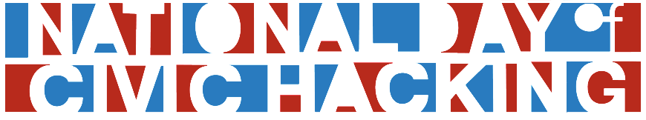
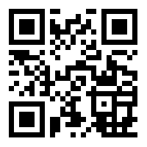
June 1st & 2nd at DevJam Studios
Hack for MN
bit.ly/ZWFFKc

Slide 25

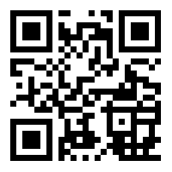
Fall 2013
A tech, community, and government unconference
bit.ly/mTuMJH
Notes:
Still planning
One was held in 2011, had over 100 participants and and 5+ tracks
If you have ideas for tracks, let me know

Slide 26
Notes:
We are fund raising for most of these events, and OTC in general. So if you would like to donate, or if your interested in having your company become a sponsor, I’ll be more than happy to talk with you afterwards.

Slide 27

Thank You
opentwincities.org
@opentwincities
octodex.github.com/
Notes:
Questions?

