Slide 1

Database Project
Made by Mark Tretiak (TDIfu-23)
MM/DD/20XX

Slide 2

Overview
My course project is based on designing and implementing a complete relational database in Microsoft SQL Server.
I created a database for a small online store, which includes customers, products, categories, orders, payments, logs.
All required SQL concepts were implemented inside the .sql file, including table creation, data manipulation, queries, joins, a view, a function and trigger.
2

Slide 3

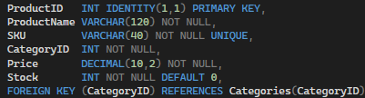
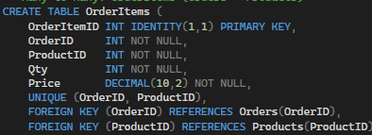
Database Design
The script begins by creating a new database called OnlineStore.
I designed seven tables needed for an online shop.
Every table includes an auto-incrementing Primary Key (INT IDENTITY) to uniquely identify each record.
I also defined Foreign Keys to maintain relationships:
Orders → Customers
Products → Categories
OrderItems → Orders
OrderItems → Products
Payments → Orders
Logs → Customers
A many-to-many relationship between Orders and Products is implemented through the OrderItems junction table, which also contains a UNIQUE constraint to prevent duplicates.
The database uses a wide range of data types, such as INT, VARCHAR, DATETIME, DECIMAL, and BIT
3

Slide 4

Indexes
To improve performance, the project includes several indexes:
A unique index on customer emails
An index on ProductName to speed up product searches
An index on OrderDate for efficient sorting and filtering
These meet the requirement of demonstrating both unique and non-unique indexes.
4

Slide 5
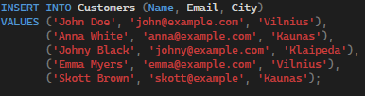


Data Manipulation
The Course Project.sql file contains full examples of:
INSERT statements using multi-row inserts for all tables
UPDATE operations, such as applying discounts and increasing stock
DELETE operations applied to filtered rows
A TRUNCATE operation on the Logs table
This demonstrates all required types of data manipulation.
5

Slide 6
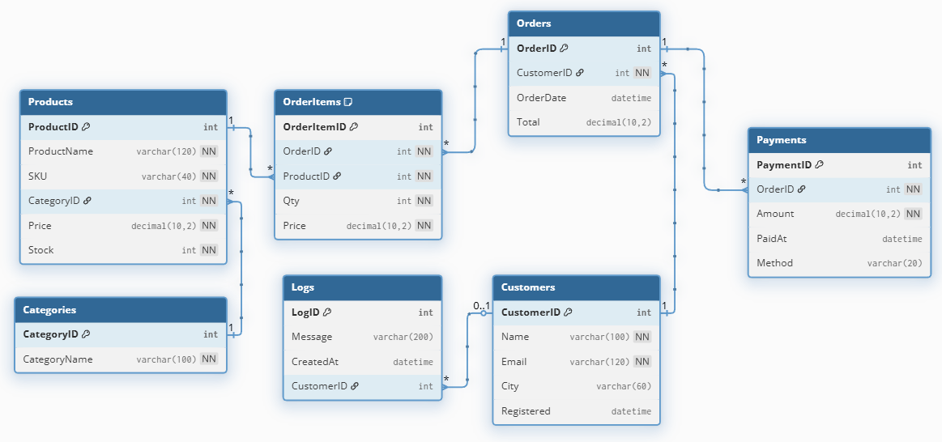
Diagram
6

Slide 7
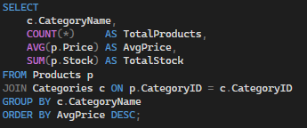

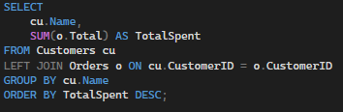
Data Retrieval and Queries
Aggregation and Grouping:
Utilized aggregate functions like COUNT, AVG, and SUM to calculate product statistics, total spending by customers, and product stock by category.
Pagination:
Implemented pagination using OFFSET … FETCH NEXT to retrieve products in pages.
Aggregation of Customer Spending:
Summed up the total spending per customer using LEFT JOIN between Customers and Orders.
7

Slide 8



Joins and Views
Joins:
INNER JOIN: Combined data from Customers and Orders.
LEFT JOIN: Used to calculate total spending by customer.
Multi-table JOIN: Combined Customers, Orders, OrderItems, and Products to retrieve complete order details.
View:
Created a view named OrderDetails that combines data from Customers, Orders, OrderItems, and Products, making it easier to query for detailed order information.
8

Slide 9

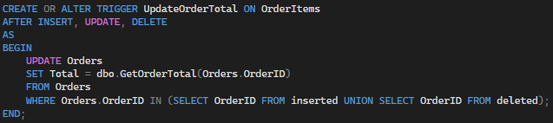
Procedures, Functions, Triggers, and Transactions
SQL Function:
GetOrderTotal: Calculates the total value of an order by summing up the price and quantity of products in the order.
Trigger:
UpdateOrderTotal: Automatically updates the Total field in the Orders table whenever OrderItems are inserted, updated, or deleted.
9

Slide 10
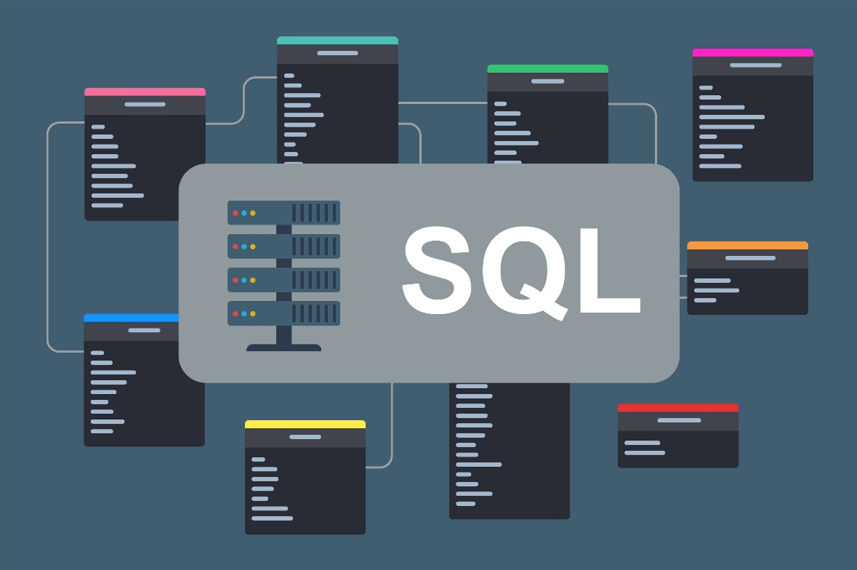
Conclusions
This project demonstrates practical experience in designing and implementing a relational database in Microsoft SQL Server, covering all aspects of database management, from creation and population to querying and advanced operations.
10

Slide 11
Thank you
Do you have any questions?
11

