Slide 1
Sound Generator PoC with dsPIC
Mark Wendler
08.2021

Slide 2
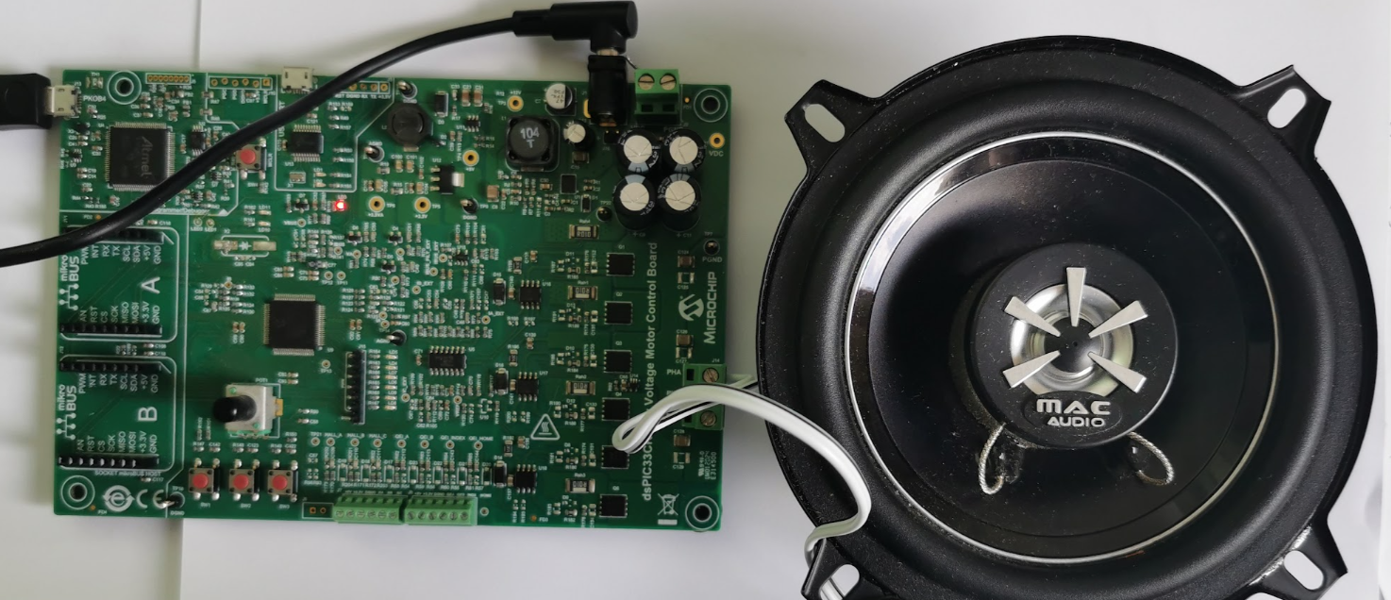
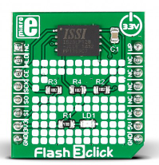
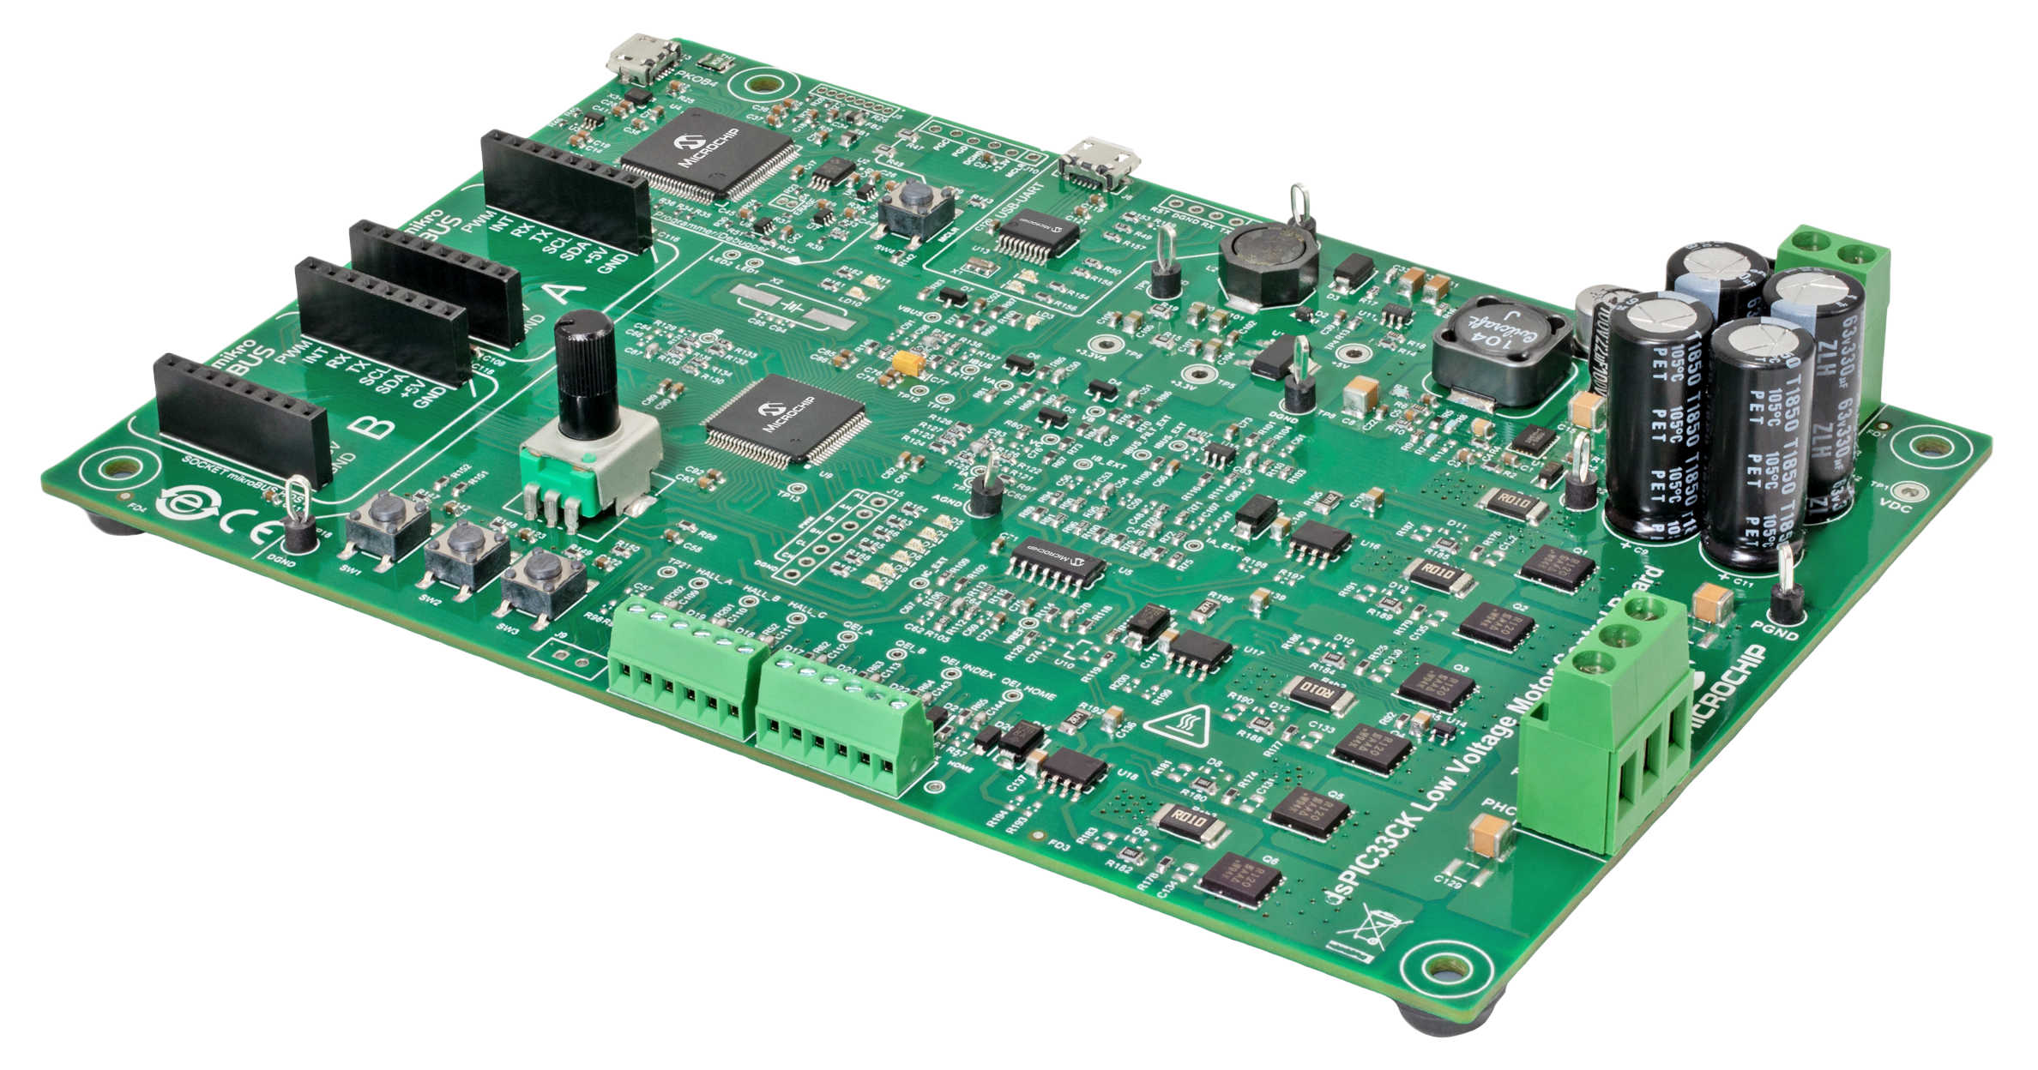
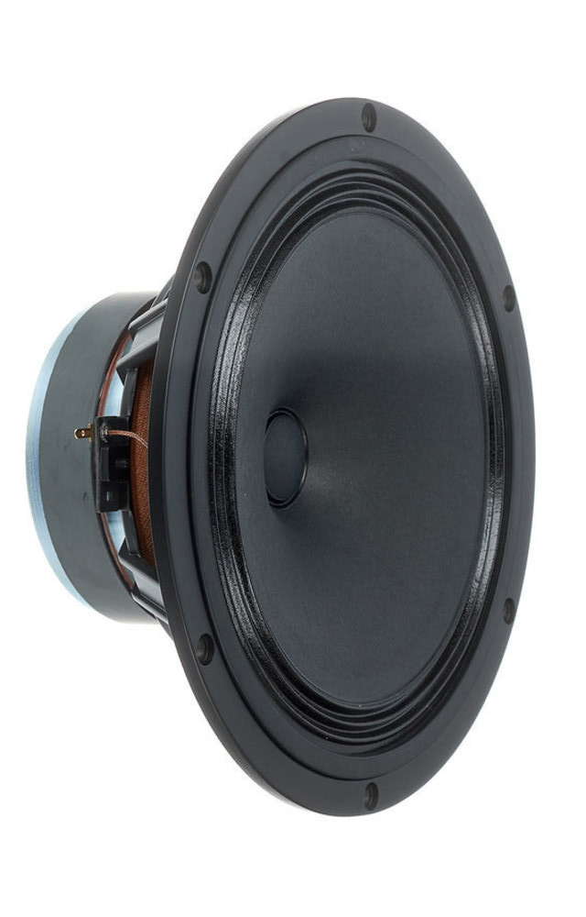
High level concept
LVMC board for start
Input DC voltage: 12V to 48V
Nominal phase RMS current:
10A at +25°C ambient temperature
LC filter
(No need for demo)
SW repository: https://bitbucket.microchip.com/users/m18034/repos/noisegen/browse
Video1: First test run video
Video2: With “car” sound

Slide 3

Software (current status)
2 mode implemented with Scilab model:
Simple sine wave generator with auto sweeping
Sound generator from lookup table (MCU builtin flash 4k samples limit)
Optional current control mode (Further tuning/investigation needed)
Quick start:
SW3 starts PWM output
SW1 switches between sine wave and sound gen mode
POT changes the playback frequency or sweeping frequency
Wav 4k sample lookup table
X2C model
(20kHz)
PWM control
(100kHz)
POT and buttons
HW initialization and peripheral APIs

Slide 4
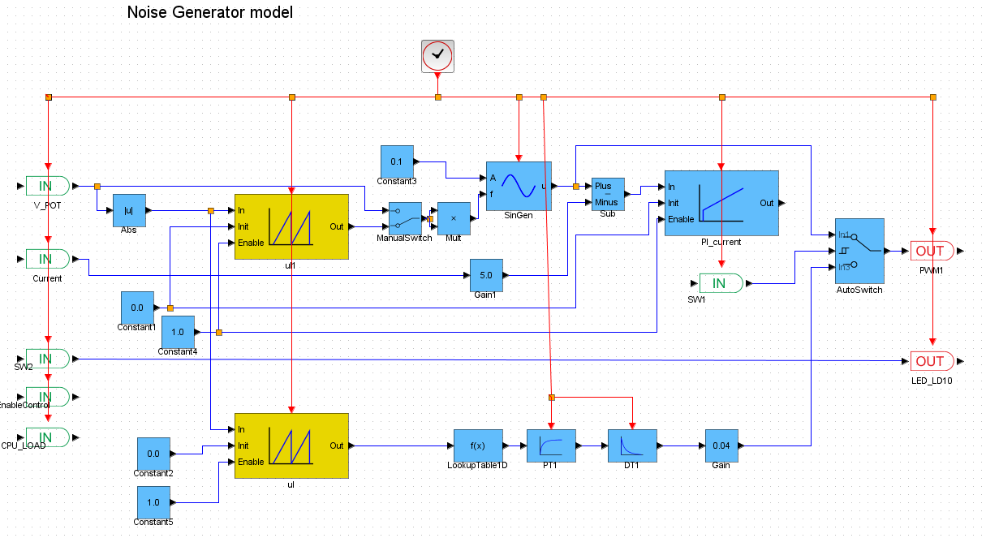
Model
Sine generator
Optional current control for experiments
Low pass
High pass
Gain control
Lookup table for car sound

Slide 5
Project tasks/ideas
Set-up HW
Set-up SW frame (X2C model?)
Create single frequency noise (feed forward Sinus voltage output based on POT value)
Playback a short wav file from a lookup table (from MCU flash)
Implement flash reading (click board)
Investigate G.726A Decoder (G.711? Or WAV) can do the job or not
Implement selected Audio decoder
Investigate audio effect features (filters)
Investigate current control feature
Verify needed LC filters (if needed)
Further optimisation for external noise immunity (LVMC capable)
and EMC
Custom board, etc…

Slide 6
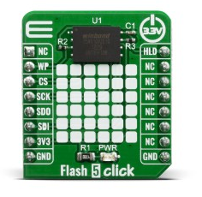
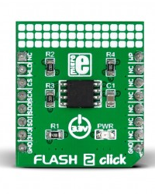
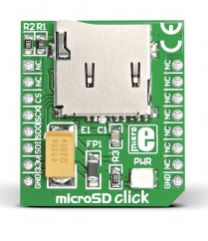
Storage click modules
FLASH 5 CLICK (1Gbit)
PID: MIKROE-3780
https://www.mikroe.com/flash-5-click
Winbond Electronics W25N01GVZEIG/IT
FLASH 2 CLICK (64Mbit) MCHP
PID: MIKROE-2267
https://www.mikroe.com/flash-2-click
Microchip Technology SST26VF064B
Compression needed (Decoder implementation)
MICROSD CLICK
PID: MIKROE-924
https://www.mikroe.com/microsd-click
Most flexible for storage size
Writing data to SD is the easiest/fastest
Probably best for fast PoC result

Slide 7
Customer interest
EMC (emission) need to be considered, so the slope compensation probably is needed. The proof of concept should already proof that as well
Maybe instead of using MOSFETs as a power transistors, maybe the bipolars should be considered instead. It would probably be easier and cheaper to drive bipolar transistor (maybe in Darlington mode)
There should be also a input voltage compensation. The sound should not be influence by the DC voltage changes and it should be operatable within 9-16V
It should be immune to the input voltage noise. There is a test where they put a AC signal with 4Vp-p on top of the DC bus (are you aware of such test?) where you should not hear anything in the loudspeaker.

Slide 8
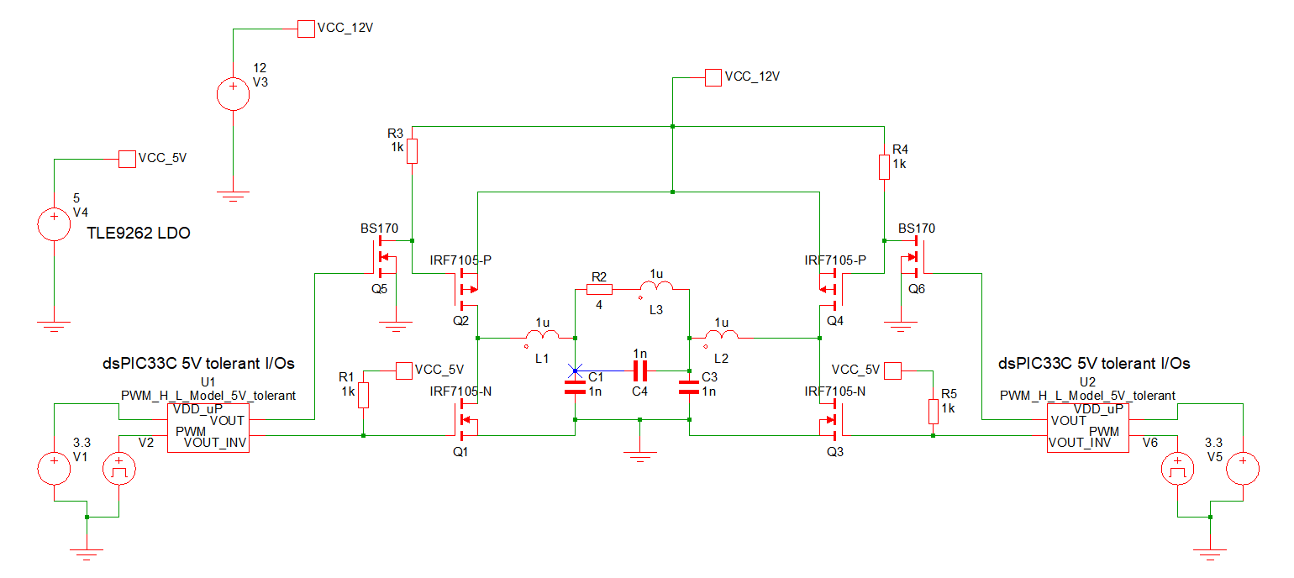
Low cost circuit idea without MOSFET driver

