Slide 1
Sound Generator PoC with dsPIC

Slide 2
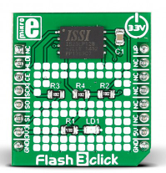
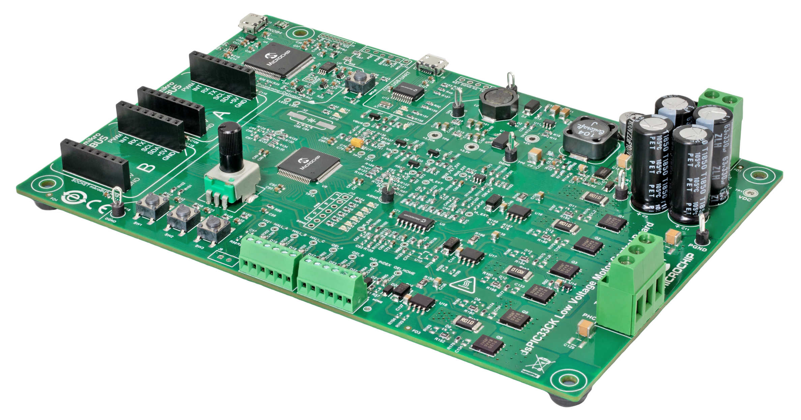
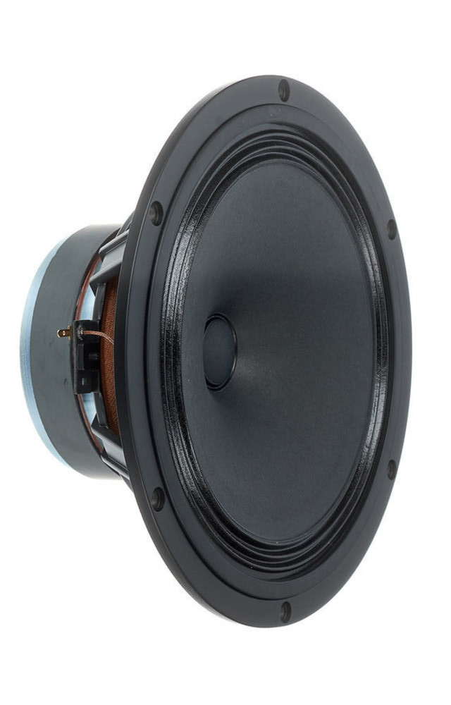
High level concept
LVMC board for start
Input DC voltage: 12V to 48V
Nominal phase RMS current: 10A at +25°C ambient temperature
LC filter
First test run video: https://microchiptechnology-my.sharepoint.com/:v:/g/personal/mark_wendler_microchip_com/ETwXsPh3MT9Ou0Anty5UnXcBujyOEAphIVYeLUMNBcvAUg?e=VeVu4F

Slide 3
Project tasks/ideas
Set-up HW
Set-up SW frame (X2C model?)
Create single frequency noise (feed forward Sinus voltage output based on POT value)
Verify needed LC filters
Investigate current control feature
Implement flash reading (click board)
Investigate G.726A Decoder (G.711? Or WAV) can do the job or not
Implement selected Audio decoder
Investigate audio effect features (filters)
Further optimisation for external noise immunity (LVMC capable)
and EMC
Custom board, etc…

Slide 4
Customer interest
EMC (emission) need to be considered, so the slope compensation probably is needed. The proof of concept should already proof that as well
Maybe instead of using MOSFETs as a power transistors, maybe the bipolars should be considered instead. It would probably be easier and cheaper to drive bipolar transistor (maybe in Darlington mode)
There should be also a input voltage compensation. The sound should not be influence by the DC voltage changes and it should be operatable within 9-16V
It should be immune to the input voltage noise. There is a test where they put a AC signal with 4Vp-p on top of the DC bus (are you aware of such test?) where you should not hear anything in the loudspeaker.

Slide 5
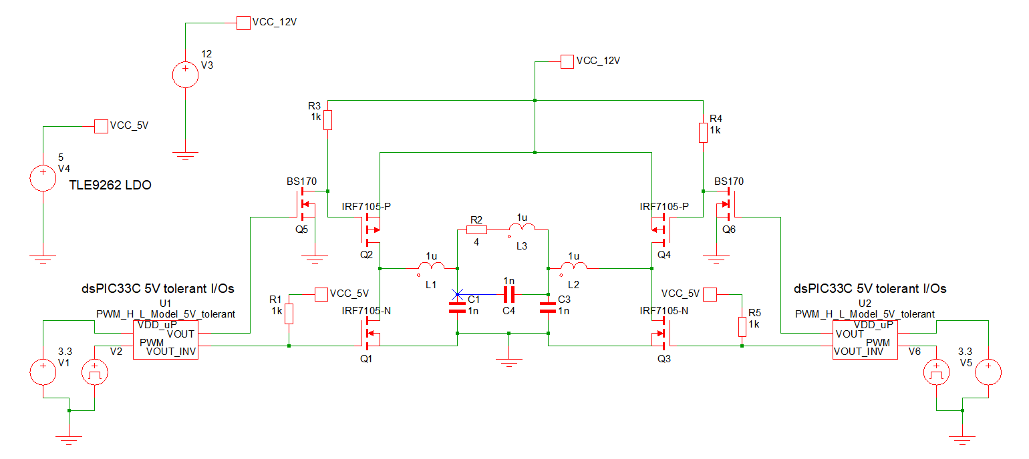
Low cost circuit idea without MOSFET driver

