Slide 1
CALIFORNIA REGIONAL APARTMENT RENTAL SURVEY

Slide 2

Siddhant & Associates
Real Estate Consulting Group

Slide 3

TEAM MEMBERS
Taji Abdullah
Christina Chau
Alex Li
Rasika Patil
Mark Werden

Slide 4
PROBLEM STATEMENT
What factors affect regional apartment monthly rental prices in California?

Slide 5
DATA SOURCES
https://www.kaggle.com/austinreese/usa-housing-listings
USA Housing Data
The dataset is derived from Craigslist, and it’s based upon the United States housing market

Slide 6
LIMITATIONS
Please consider that the data is derived from Craigslist, and its data is inputted by users who may not be real estate professionals
Data provided by traditional real estate sources, such as the California Regional Multiple Listing Service (CRMLS), LoopNet, or CoStar is usually entered by real estate professionals, such as state licensed agents/brokers who utilize state licensed real estate appraisers.
Real estate professionals utilize market data to determine rent, whereas laymen may determine rent without the necessary market data.
Therefore, Craigslist’s real estate data may be uniquely diverse compared to a database that is maintained by real estate professionals.
The focus of this project is on California due to time constraints

Slide 7
EXPLORATORY DATA ANALYSIS
Utilized statistical mode to replace missing values
Manipulated columns to only include information relevant to data analysis
Performed statistical analysis to determine outliers, then removed them from data frame
Created new data frame with California regions

Slide 8
JUPYTER NOTEBOOK
Time to transition to Jupyter Notebook

Slide 9
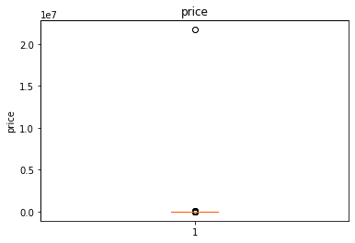
DATA ACCURACY – REMOVING OUTLIERS
Initially, the California apartment pricing data contained significant outliers as shown below
The Inland Empire, specifically, contained an apartment monthly rental price of over $2M

Slide 10
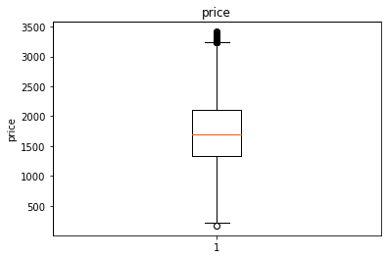
DATA ACCURACY – REMOVING OUTLIERS (CONT’D)
The Box Plot graph below shows that the normal range lies between $107 - $3419

Slide 11
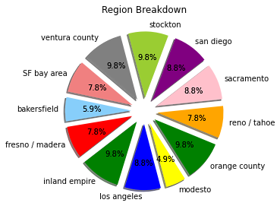
REGIONAL BREAKDOWN
The pie chart below shows that the new, cleaned data frame consists of 12 California counties
Each of these counties contained a sample size of over 1,000 data entries
Notes:
The pie chart below shows that the new, cleaned data frame consists of 12 California counties
Each of these counties contained a sample size of over 1,800 data entries
Each county contained data entries between 4.9% to 9.8% of the new, cleaned data frame’s cumulative total with Modesto as the lowest and Stockton, Ventura, Orange, and Inland Empire as the highest.

Slide 12
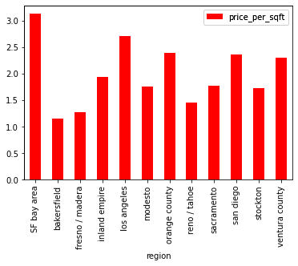
PRICE PER SF
San Francisco possesses the highest median rent per SF at over $3.00 per SF and Bakersfield possesses the lowest median rent per SF at just over $1.00 per SF.
Notes:
The bar chart below shows that San Francisco possesses the highest median rent per SF at over $3.00 per SF.
Whereas Bakersfield possesses the lowest median rent per SF at just over $1.00 per SF.
Therefore, the rent for a 1,000 SF apartment in San Francisco will be approximately $3,000, whereas the same type of apartment in Bakersfield will rent for approximately $1,000

Slide 13
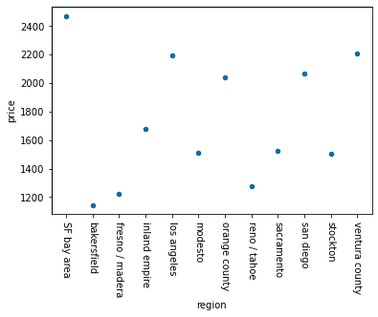
PRICE
San Francisco has the highest median rent at just under $2,500 and Bakersfield has the lowest median rent at just over $1,000.
Notes:
The bar chart below shows that San Francisco possesses the highest median rent at just under $2,500.
Whereas Bakersfield possesses the lowest median rent at just over $1,000.
Please note that Ventura’s median price is higher San Diego’s median price.
Whereas the previous slide shows the inverse for price per SF.

Slide 14
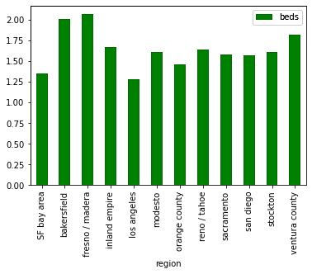
BEDS
San Francisco has the lowest median number of bedrooms with just over 1 and Bakersfield has among the highest median number of bedrooms with 2
Notes:
The bar chart below shows that, although, San Francisco possesses the highest median rent and price per SF, it possesses the lowest median amount of bedrooms.
Whereas, although, Bakersfield possesses the lowest median rent and price per SF, it possesses among the highest median amount of bedrooms.

Slide 15
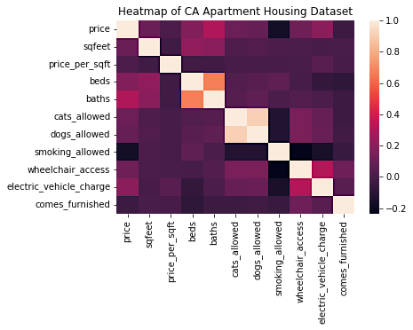
HEATMAP OF CALIFORNIA APARTMENT DATA
The heatmap below shows that price is not significantly correlated to other categories
Notes:
The heatmap below shows that price is not significantly correlated to other categories
Whereas bedrooms and bathrooms are significantly, positively correlated
Additionally, cats allowed and dogs allowed are significantly, positively correlated

Slide 16
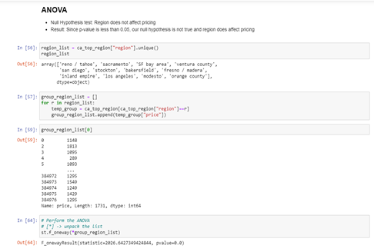
ANOVA TESTING
Null Hypothesis test on 12 regions : Region does not affect pricing
Null Hypothesis is False as P Value = 0.0 ( i.e., < 0.05 )
It was determined that region affects pricing for all 12 regions

Slide 17
ANOVA TESTING (CONT’D)
Null Hypothesis test on 2 regions (Los Angeles County and Orange County) : Region does not affect pricing
Null Hypothesis is True as P Value = 3.69 ( i.e., > 0.05 )
It was determined that if the regions are geographically close to each other then they do not affect the pricing

Slide 18
CONCLUSIONS
When analyzing the 12 California regions, price was not significantly correlated to other categories, such as SF, Beds, Baths, Cats Allowed, Dogs Allowed, Wheelchair Access, Electrical Vehicle Charging, and Furnishing
Whereas bedrooms & bathrooms and cats allowed & dogs allowed are significantly, positively correlated, respectively
When testing all 12 regions, it was determined that region affects pricing
Whereas when testing only two regions, Los Angeles County and Orange County, it was determined that region does not affecting pricing

Slide 19

THANKS!
Any questions?

