Slide 1
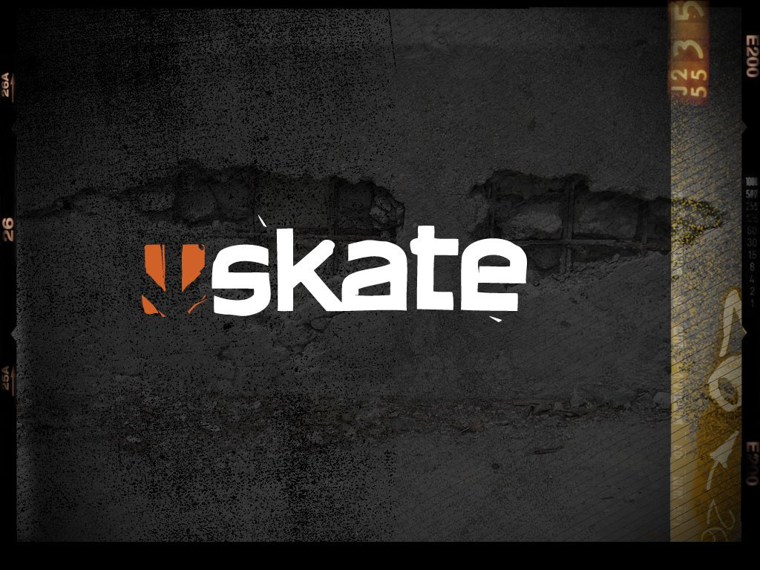
Navigating detailed worlds with a complex, physically driven locomotion:
NPC Skateboarder AI in EA’s:
Mark Wesley
Senior Software Engineer
EA Black Box

Slide 2
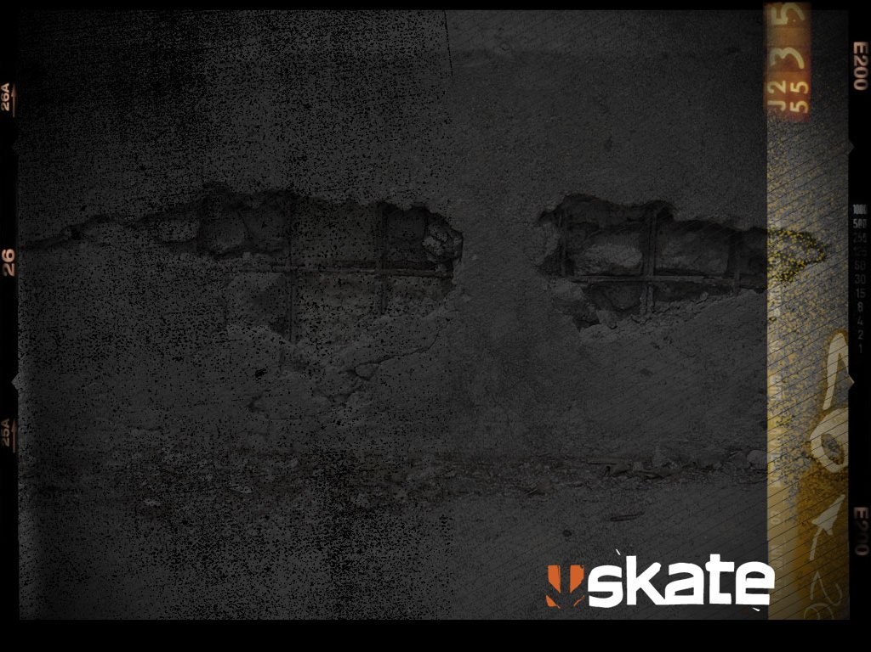
What is skate?
It’s a skateboarding game…
A brand new franchise from EA Black Box, launched in September 2007 on Xbox 360 and PS3.
Lots of fun

Slide 3
So what about the AI?
The Game Design called for:
AI competitors in challenges (Races /
Best Trick Contests / etc.)
Ambient “Living World” AI skaters for atmosphere.
(Note: There are also AI controlled pedestrians and vehicles, but that’s a separate topic.)

Slide 4
So where’s the problem?
Detailed Collision Environment
Skaters are fully physics driven (i.e. we can’t cheat)
Fully physics driven skateboarding is quite a complex form of locomotion to steer.
No ability to walk (until skate 2)
Dynamic world (vehicles, pedestrians, other skaters, etc.)
Notes:
Skaters are literally powered physics ragdolls (partially driven by animation) skating through the world.

Slide 5
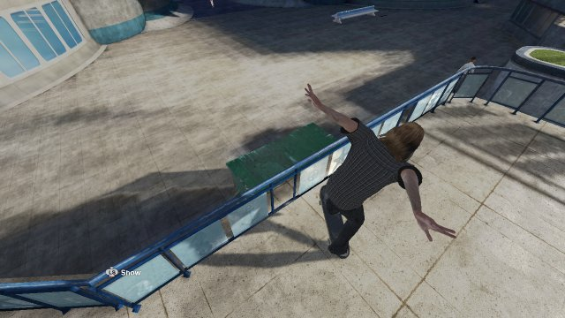
Launch a trick incorrectly
(wrong place / direction / speed / time / …)

Slide 6
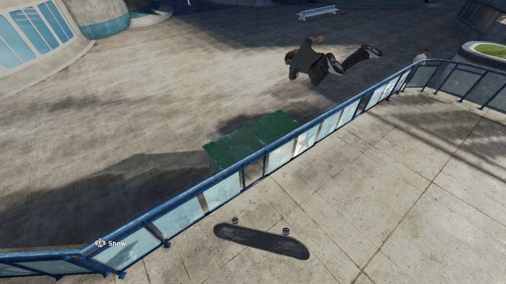
… then you’ll bail

Slide 7
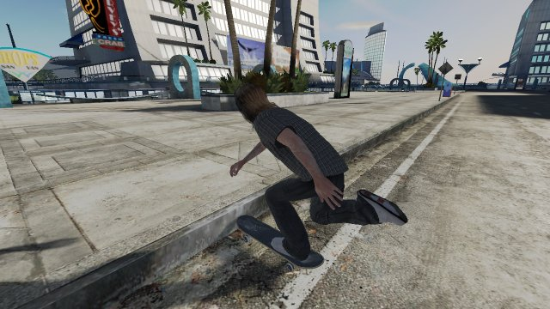
Even curbs are hard…
Notes:
Even something as simple as getting over a curb requires you to approach correctly and do the right trick at the right time.

Slide 8
Our Solution – AI Paths
Record people playing the game
  Records the “what and where”, not the “how”.
Attach metadata to the path
Save out as an XML file
Process the paths into something usable in game.

Slide 9
Path Recording
Store nodes at varying intervals whilst skating.
Path Nodes consist primarily of:
  Position
  Velocity
  Orientation
  Width (calculated by terrain analysis)

Slide 10
Runtime Path Format
Node elements are stored compressed, quantized and packed.
Path is interpolated from nodes.
  Position and velocity use a Hermite curve.
  Orientations use slerped quaternions.
  Nodes are stored whenever the interpolated data would differ from the original by more than a given threshold.

Slide 11
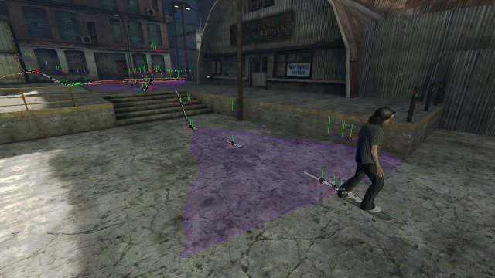
Recording A Path

Slide 12
Path Editor
All in game, allows designers to:
  View and select paths in the world
  Trim, tweak and delete paths
  Edit metadata (effectively allowing them to script who can use the paths and when)
  Quickly iterate, test and debug.

Slide 13
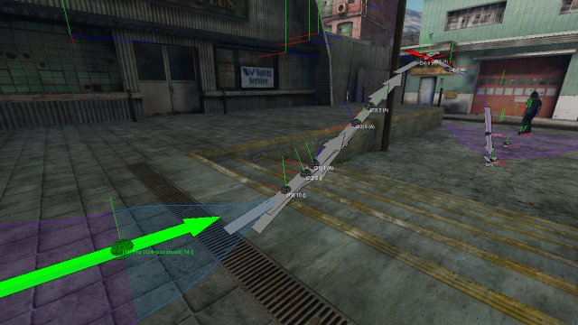
Viewing A Path

Slide 14
Path Pre-Processing
Detects branches etc.
Available in-game for rapid WYSIWYG iteration by designers
Also done offline to generate efficient binary data for the rest of the team (and the finished product)

Slide 15
Path Following
Any skater can optionally have an AI Controller attached
Looks at the skater’s current path
Evaluates dynamic obstacles
Looks at branches and other paths
Tries to pick the best route
Drives the skater with controller intents
Notes:
Controller intents are literally the button presses required if you plugged a controller in so that the underlying skater for the player and AI skaters is identical.

Slide 16
AI Profiles
Tunable by designers
Influence ability, tricks performed and style of skating for each character
AI skaters dynamically swap tricks when possible for variety.

Slide 17
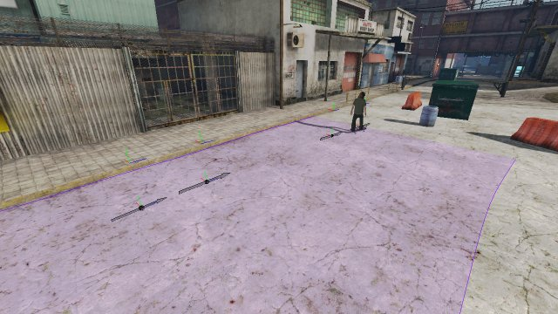
It’s easy if there’s nothing in the way…

Slide 18
Dynamic Avoidance
Evaluate all dynamic obstacles around the skater.
No static analysis of the world (all we need is already in the path)
Cut obstacles out of the paths
Look for possible speeds that would allow skater to pass in front or behind of other moving entities

Slide 19
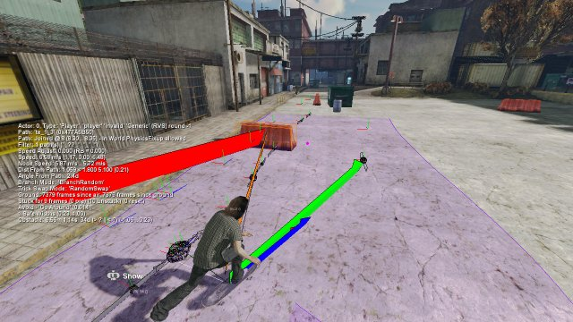
Dynamic Avoidance: Ex 1
Notes:
An obstacle has been placed to one side of the path, so the skater aims at the center of the remaining path.

Slide 20
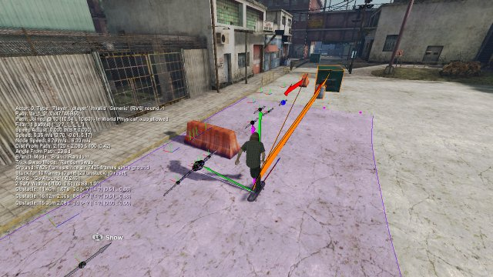
Dynamic Avoidance: Ex 1
Notes:
And correctly passes around the obstacle.

Slide 21
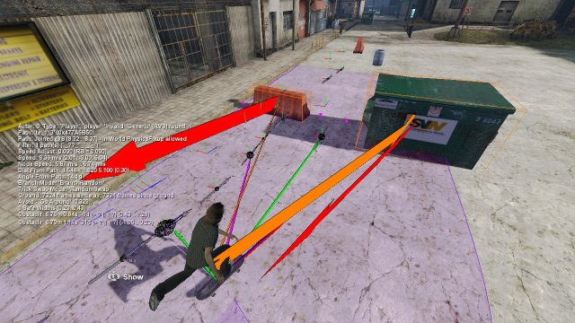
Dynamic Avoidance: Ex 2
Notes:
It also handles multiple obstacles, and picks the best gap that’s left.

Slide 22
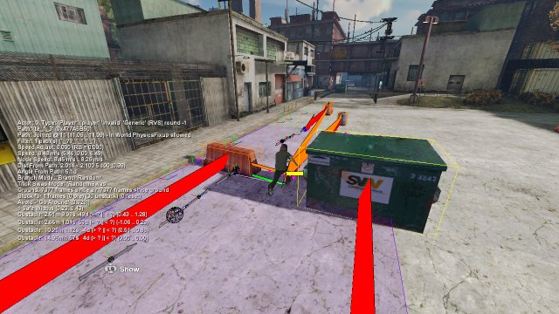
Dynamic Avoidance: Ex 2
Notes:
Allowing the skater to correctly pass between in this case.

Slide 23
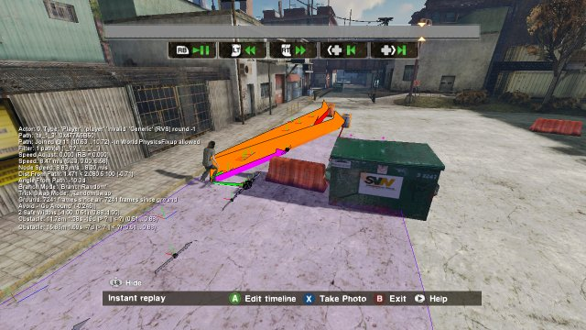
Dynamic Avoidance: Ex 3
Notes:
And with the same path again, but a different configuration of dynamic objects, the skater again is able to navigate around them.

Slide 24
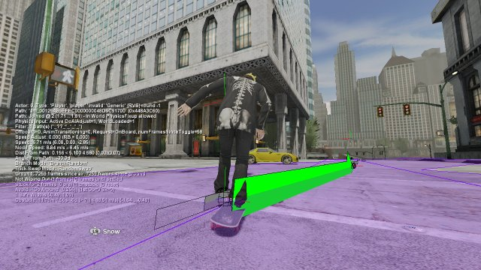
Added Bonus - Skitching
Notes:
“Skitching” or Skate-Hitching, is where a skater grabs onto the back of a car and is pulled along, as famously seen in the movie Back To The Future.

Slide 25
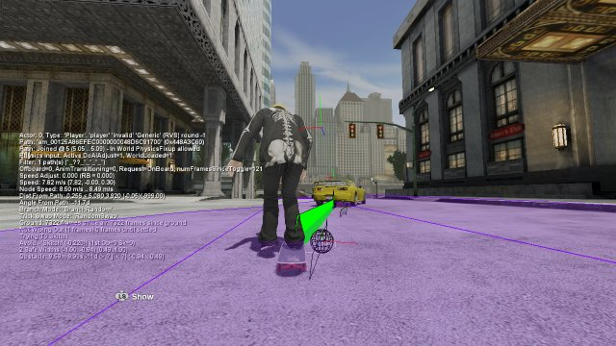
A Skitchable Obstacle
Notes:
We implemented this using an extension to the obstacle avoidance system

Slide 26
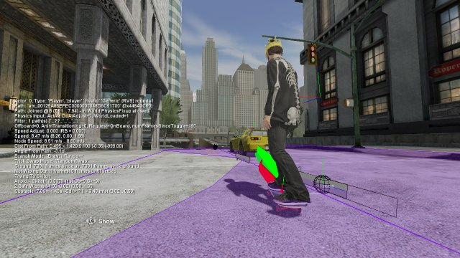
Within Path, Correct Direction
Notes:
If an obstacle on the path is worth skitching (e.g. a car travelling in the correct direction and going faster than the skater can skate), the skater will aim to grab onto the back of it.

Slide 27
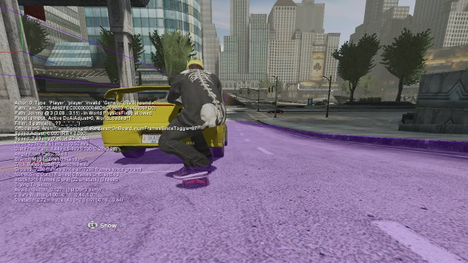
So Skitch It…
Notes:
Like so.

Slide 28
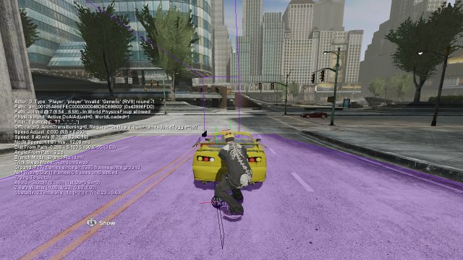
And Steer As Necessary
Notes:
They will continue to steer as necessary to stay with the car.

Slide 29
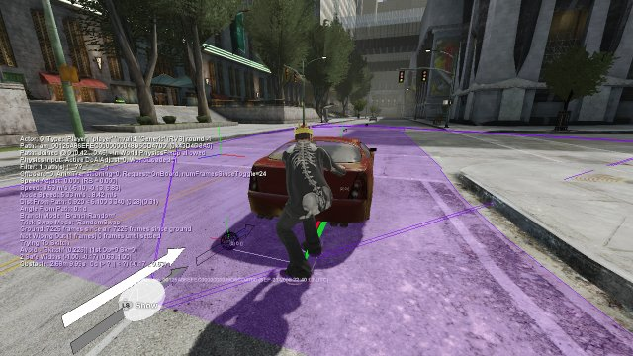
Skitching – Exit
Notes:
And as soon as the car is no longer worth skitching

Slide 30
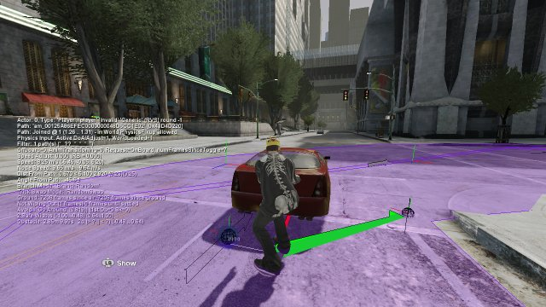
Paths Diverge
Notes:
E.g it’s heading in wrong direction, or is too slow.

Slide 31
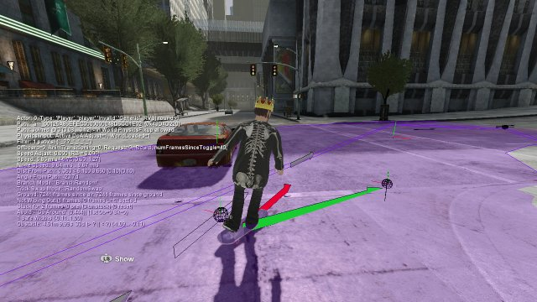
Detatch from Vehicle
Notes:
The AI will detach from the vehicle and continue as normal

Slide 32
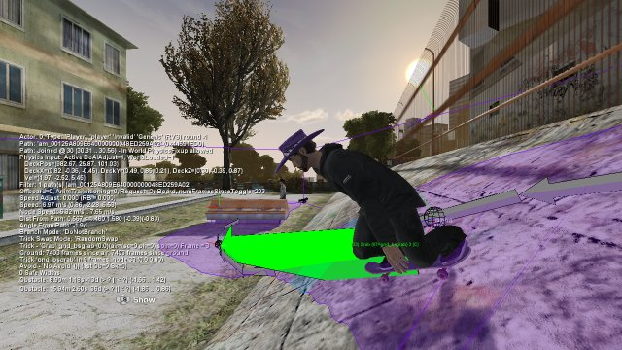
Narrow Path, Wide Object…
Notes:
Sometimes there isn’t a path left, e.g. with a narrow path, no available branch, and a large objec.

Slide 33
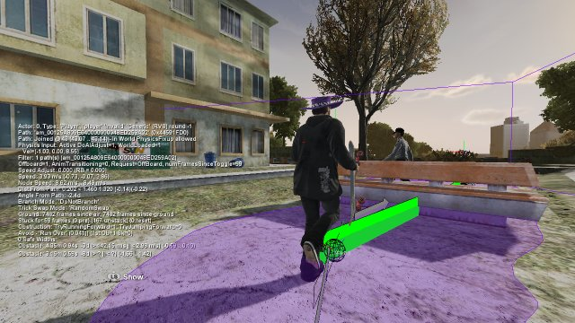
If Short Enough…
Notes:
If the object is low enough then we can run over it instead.

Slide 34
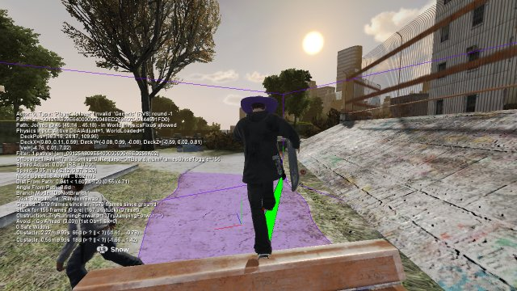
Run / Jump Over It

Slide 35
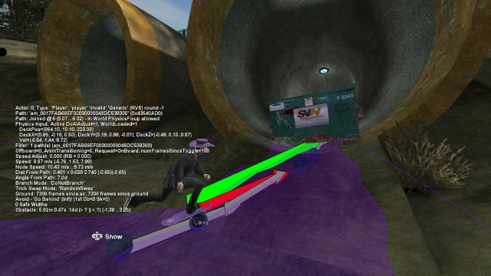
If Completely Blocked…
Notes:
But sometimes it’s not possible to do that either. If there is no other route…

Slide 36
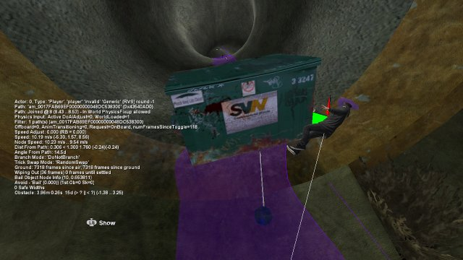
Give up and bail…
Notes:
Then we let them bail…

Slide 37
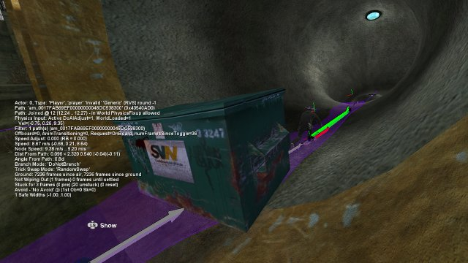
Respawn Just Past It…
Notes:
And make sure that they’re respawned after the blockage…

Slide 38
Quick Tangent…
All the above shots are from skate’s replay editor.
All debug + diagnostics drawing goes through our replay system.
Insanely helpful for debugging (for SEs and designers)

Slide 39
Automated Testing
AI Controller could be attached to any skater.
Therefore easy to make the game play itself.
Useful for overnight soak tests etc.

Slide 40
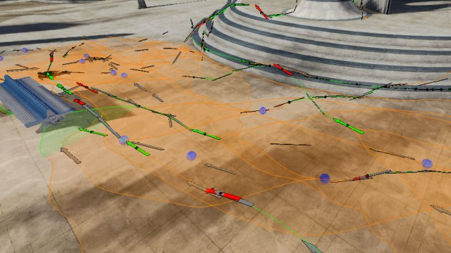
Some Paths

Slide 41
Do we need many Paths?
Large Open World
Needed lots of good path data
Our QA department helped out by generating a large amount of it for us.

Slide 42
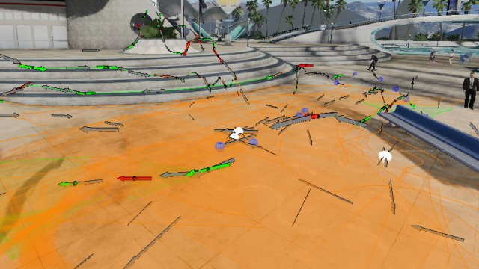
Lots of Paths

Slide 43
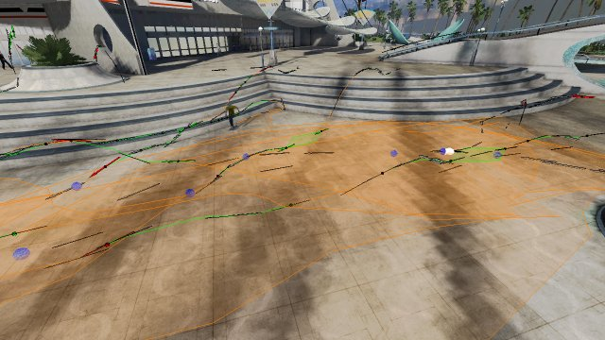
Lots and Lots of Paths

Slide 44
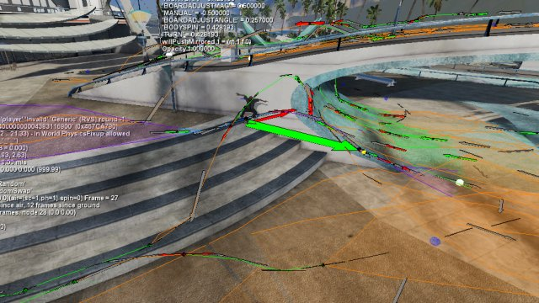
Paths, paths, everywhere

Slide 45
Some Stats from skate
Note: 465 Km (290 Miles) is the is equivalent of skating from Vancouver to Seattle and back, followed by 11 runs down Mount Everest.
Total number of Paths | 4,825
Total number of Nodes | 250,747
Total number of Tricks | 20,515
Total number of Branches | 48,500
Total length of paths | 465 Km
Total duration of paths | 17.5 Hours
Total memory (if all paths were loaded simultaneously) | 12.68 MB

Slide 46
Conclusion

Slide 47
Pros
It worked
Game Designers seem to like it
Allows some scripting “for free” by simply constraining the paths used at a particular point
A large path set combined with more random path constraints gives a nice emergent behavior

Slide 48
Review Praises AI?
"Playing solo in the career mode won't leave you feeling lonely. San Vanelona is somewhat of a haven for skaters; they flock there... You'll be doing a challenge and someone might cut in and skate your line. Or you'll be hunting for a new spot to skate and have P-Rod ride past you. These appearances are common, but not superficial. You can follow Rodriguez around town, which may lead you to a sweet spot that you didn't know about... (90%)”
(IGN Review, 2007)

Slide 49
Cons
Skaters are constrained by the path network
Requires a lot of data to be recorded
Paths are invalidated if the underlying world moves.
Notes:
Although a lot of path data was recorded, it never took over 1MB in memory at any moment for the paths loaded / streamed-in at that time.

Slide 50
Possible Extensions

Slide 51
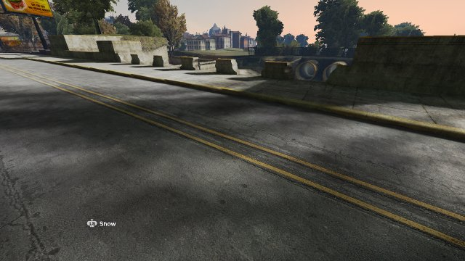
Paths on Dynamic Objects

Slide 52
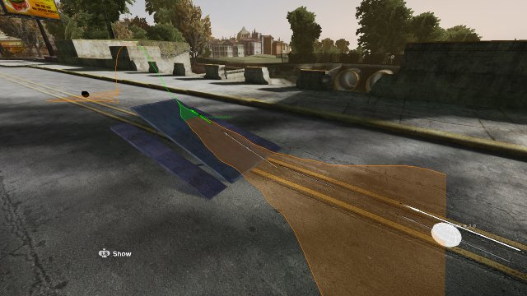
Paths on Dynamic Objects
Notes:
By attaching paths to dynamic skate-able objects, we could provide more avenues for getting past dynamic obstacles, whilst also adding more variety to skating routes in the game.

Slide 53
Record the End User
Record paths constantly, upload, process and share the data.
Easy to generate an AI profile from already captured telemetry data.
Asynchronous Online – AI equivalents of your friends appear around you!

Slide 54
Better use of NavMesh
There’s Navmesh in the world already (for the pedestrians).
Didn’t use it for skaters in Skate 1 (you couldn’t walk after all…)
Originally planned to use it as a fallback in many cases in skate 2…

Slide 55
Smarter Path Usage
Background process to weight paths based on object obstruction etc.
Thinking multiple steps ahead (we don’t do any “path-finding”, because we’ve never actually needed to).

Slide 56
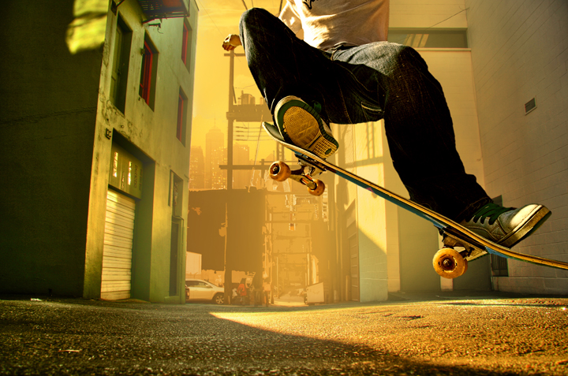
Questions?
Questions?

