Slide 1
How to install Hadoop on windows
Walid Abdelrahman
Teacher on Project part

Slide 2
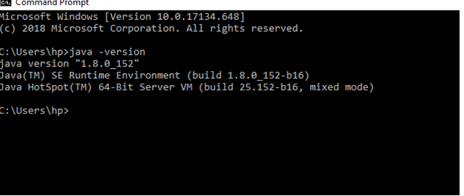
Step 1
Install Hadoop 3.x
Java version 1.8
Check your java version through this command on command prompt
java –version

Slide 3
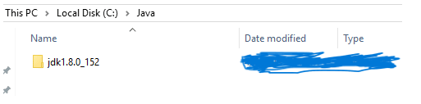
Step 2
Download the file according to your operating system. Keep the java folder directly under the local disk directory (C:\Java\jdk1.8.0_152) rather than in Program Files (C:\Program Files\Java\jdk1.8.0_152) as it can create errors afterwards.

Slide 4
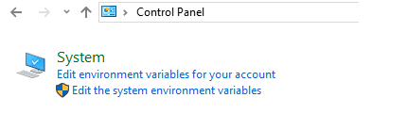
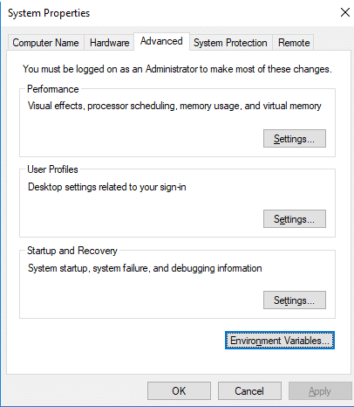
Step 3
Setup System Environment Variablers:
Open control panel to edit the system environment variable
Go to environment variable in system properties

Slide 5
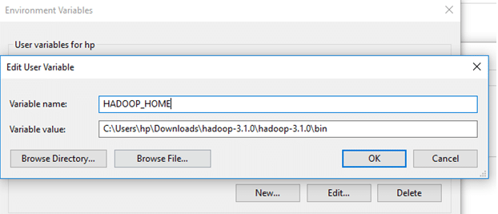
Step 3…
Create a new user variable. Put the Variable_name as HADOOP_HOME and Variable_value as the path of the bin folder where you extracted hadoop.

Slide 6
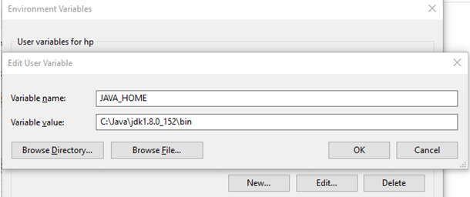
Step 3….
create a new user variable with variable name as JAVA_HOME and variable value as the path of the bin folder in the Java directory.

Slide 7
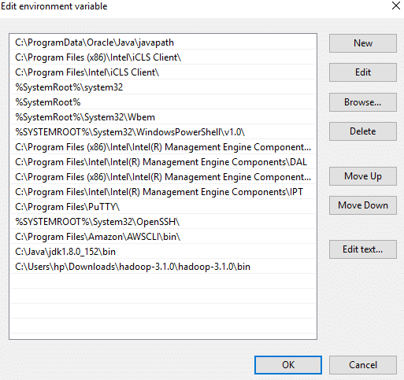
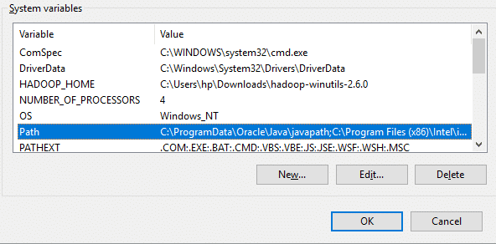
Step 3…
Now we need to set Hadoop bin directory and Java bin directory path in system variable path. Edit Path in system variable

Slide 8
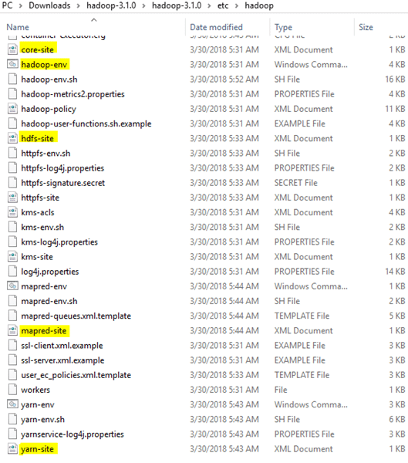
Step 3...
We need to edit some files located in the hadoop directory of the etc folder where we installed hadoop. The files that need to be edited have been highlighted.

Slide 9
Step 3…
1. Edit the file core-site.xml in the hadoop directory. Copy this xml property in the configuration in the file
<configuration>
<property>
<name>fs.defaultFS</name>
<value>hdfs://localhost:9000</value>
</property>
</configuration>

Slide 10
Step 3…
2. Edit mapred-site.xml and copy this property in the cofiguration
<configuration>
<property>
<name>mapreduce.framework.name</name>
<value>yarn</value>
</property>
</configuration>

Slide 11
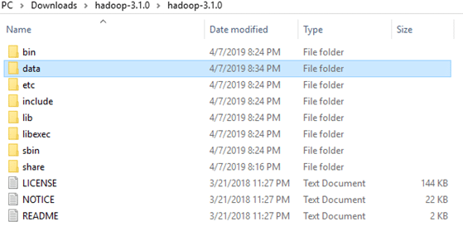
Step 3…
3. Create a folder ‘data’ in the hadoop directory

Slide 12
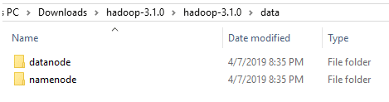
Step 3…
Create a folder with the name ‘datanode’ and a folder ‘namenode’ in this data directory

Slide 13
Step 3…
4. Edit the file hdfs-site.xml and add below property in the configuration
Note: The path of namenode and datanode across value would be the path of the datanode and namenode folders you just created.
<configuration>
<property>
<name>dfs.replication</name>
<value>1</value>
</property>
<property>
<name>dfs.namenode.name.dir</name>
<value>C:\Users\hp\Downloads\hadoop-3.1.0\hadoop-3.1.0\data\namenode</value>
</property>
<property>
<name>dfs.datanode.data.dir</name>
<value> C:\Users\hp\Downloads\hadoop-3.1.0\hadoop-3.1.0\data\datanode</value>
</property>
</configuration>

Slide 14
Step 3…
5. Edit the file yarn-site.xml and add below property in the configuration
<configuration>
<property>
<name>yarn.nodemanager.aux-services</name>
<value>mapreduce_shuffle</value>
</property>
<property>
<name>yarn.nodemanager.auxservices.mapreduce.shuffle.class</name>
<value>org.apache.hadoop.mapred.ShuffleHandler</value>
</property>
</configuration>

Slide 15
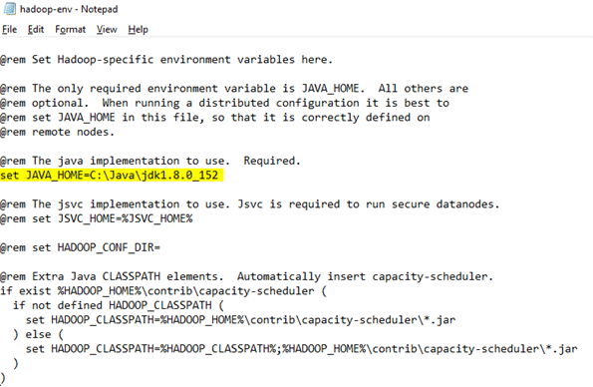
Step 3…
6. Edit hadoop-env.cmd and replace %JAVA_HOME% with the path of the java folder where your jdk 1.8 is installed

Slide 16
Step 3…
Hadoop needs windows OS specific files which does not come with default download of hadoop.
To include those files, replace the bin folder in hadoop directory with the bin folder provided in this github link.
https://github.com/s911415/apache-hadoop-3.1.0-winutils

Slide 17
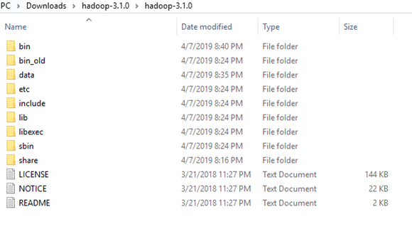
Step 3…
Download it as zip file. Extract it and copy the bin folder in it. If you want to save the old bin folder, rename it like bin_old and paste the copied bin folder in that directory.

Slide 18
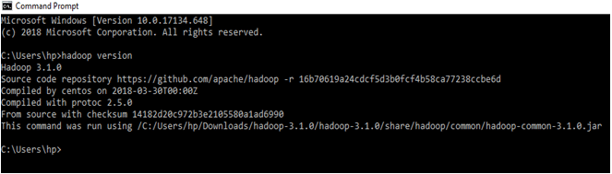
Step 3…
Check whether hadoop is successfully installed by running this command on cmd-
hadoop version

Slide 19
Step 3…
Check whether hadoop is successfully installed by running this command on cmd-
hadoop version
If it doesn’t throw error and successfully shows the hadoop version,
that means hadoop is successfully installed in the system.

Slide 20

Step 4…
Format the NameNode
Formatting the NameNode is done once when hadoop is installed and not for running hadoop filesystem, else it will delete all the data inside HDFS. Run this command-
hdfs namenode –format
It would appear something like this –

Slide 21
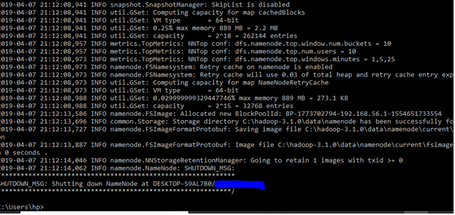
Step 4…

Slide 22

Step 4…
Now change the directory in cmd to sbin folder of hadoop directory with this command,
(Note: Make sure you are writing the path as per your system)
cd C:\Users\hp\Downloads\hadoop-3.1.0\hadoop-3.1.0\sbin
Start namenode and datanode with this command –
start-dfs.cmd

Slide 23

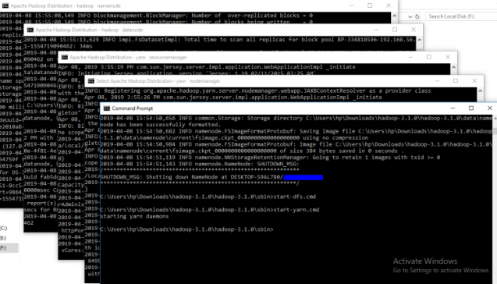
Step 4…
Two more cmd windows will open for NameNode and DataNode
Now start yarn through this command-
start-yarn.cmd
Two more windows will open, one for yarn resource manager and one for yarn node manager.

Slide 24
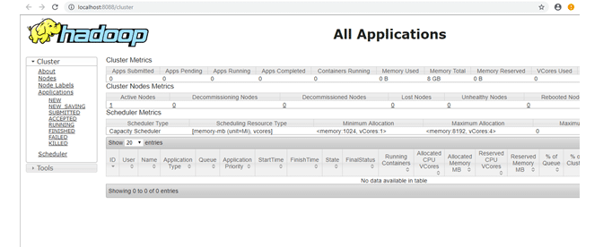
Step 4…
Note: Make sure all the 4 Apache Hadoop Distribution windows are up n running. If they are not running, you will see an error or a shutdown message. In that case, you need to debug the error.
To access information about resource manager current jobs, successful and failed jobs, go to this link in browser-
http://localhost:8088/cluster

Slide 25
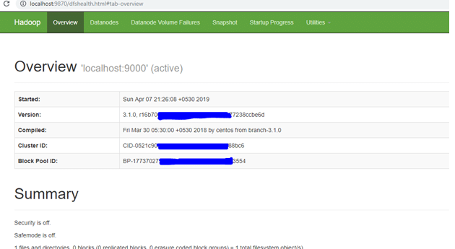
Step 4…
Note: If you are using Hadoop version prior to 3.0.0 – Alpha 1, then use port here

Slide 26
Working with HDFS…
I used a small text file in my local file system. To put it in hdfs using hdfs command line tool.
I created directory named ‘sample’ in my hadoop directory using the following command-
hdfs dfs –mkdir /sample

Slide 27

Working with HDFS…
To verify if the directory is created in hdfs, we will use ‘ls’ command which will list the files present in hdfs –
hdfs dfs –ls /

Slide 28
Working with HDFS…
Then I copy a text file named ‘potatoes’ from my local file system to this folder that I just created in hdfs using copyFromLocal command-
hdfs dfs -copyFromLocal C:\Users\hp\Downloads\potatoes.txt /sample

Slide 29

Working with HDFS…
To verify if the file is copied to the folder, I will use ‘ls’ command by specifying the folder name which will read the list of files in that folder –
hdfs dfs –ls /sample

Slide 30
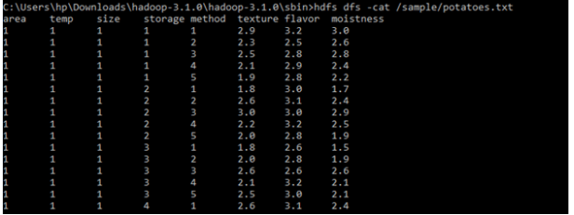
Working with HDFS…
To view the contents of the file we copied, I will use cat command-
hdfs dfs –cat /sample/potatoes.txt

Slide 31
Working with HDFS…
To Copy file from hdfs to local directory, I used get command –
hdfs dfs -get /sample/potatoes.txt C:\Users\hp\Desktop\walid
To use HDFS Command , I refer you to check and work more with Hadoop.
Commands guide
Apache Hadoop 3.1.0 – HDFS Commands Guide

Slide 32
Contact:
Contact :
walid.abdelrahman@hkr.se
Room 21-216
044-2503402
Zoomlink:
https://hkr-se.zoom.us/j/9970176462

