Slide 1
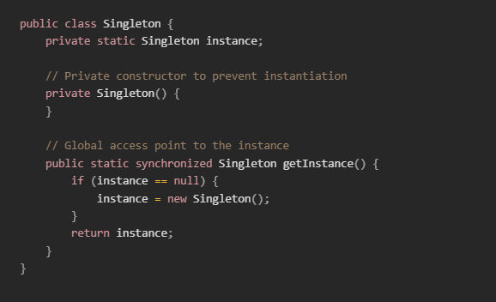
Singleton Design Pattern
Mark Harvey

Slide 2
What is the Singleton Design Pattern?
Definition: Singleton Design Pattern ensures that a class has only one instance and provides a global point of access to that instance.
Usage: Ideal for situations where a single shared resource is needed, such as a database connection or a configuration manager.
Benefits: Ensures controlled access to the single instance, reduces the potential for bugs, and improves performance by eliminating redundant object creation.

Slide 3
When to use
Logging
Configuration Management
Database Connections
Thread Pools

Slide 4
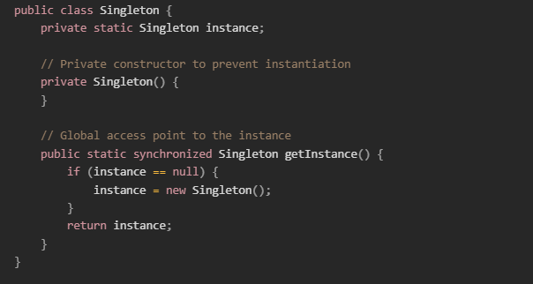
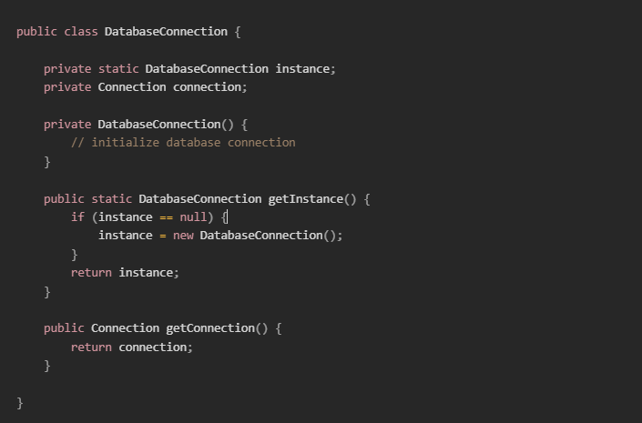
Code Example

Slide 5
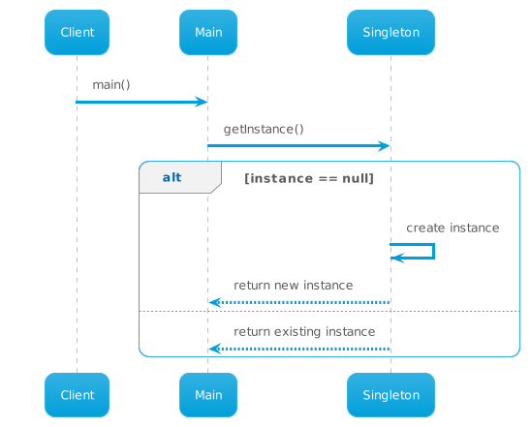
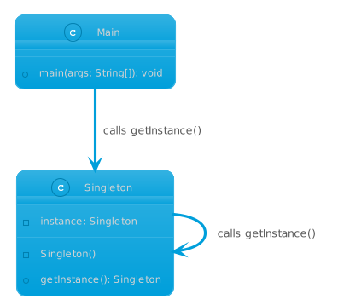
Diagrams
Notes:
Client requests the singleton instance from the Singleton class.
Participants: Client, Singleton.
The Client sends a message "getInstance()" to the Singleton class.
The Singleton class checks if an instance exists.
If no instance exists, the Singleton class creates an instance and returns it in a message back to the Client.
If an instance exists, the Singleton class returns the existing instance in a message back to the Client.
The Client receives the singleton instance.

Slide 6
Potential Drawbacks
Global State: Singleton can be considered an anti-pattern due to its global state, which can lead to issues when debugging.
Scalability: Difficult to scale in a multi-threaded environment.
Testing: Harder to unit test because of the hidden dependencies.

Slide 7
Best Practices
Ensure thread-safety.
Use the Singleton pattern judiciously and only when necessary.
Consider alternatives like dependency injection.

Slide 8
Conclusion
Ensures a single instance of a class
Provides a global point of access
Useful for managing shared resources
Be cautious of potential drawbacks and use responsibly

Slide 9
Thank you for listening :)

