Slide 1
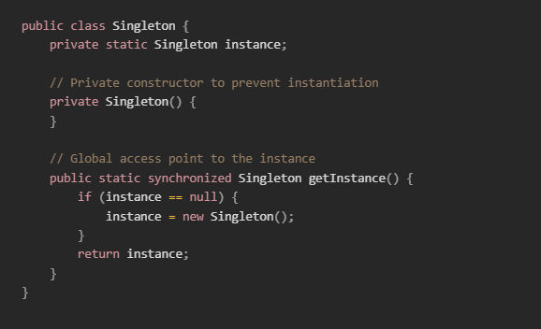
Singleton Design Pattern
Mark Harvey

Slide 2
What is the Singleton Design Pattern?
Definition: Singleton Design Pattern ensures that a class has only one instance and provides a global point of access to that instance.
Usage: Ideal for situations where a single shared resource is needed, such as a database connection or a configuration manager.
Benefits: Ensures controlled access to the single instance, reduces the potential for bugs, and improves performance by eliminating redundant object creation.

Slide 3
When to use
Logging
Configuration Management
Database Connections
Thread Pools

Slide 4
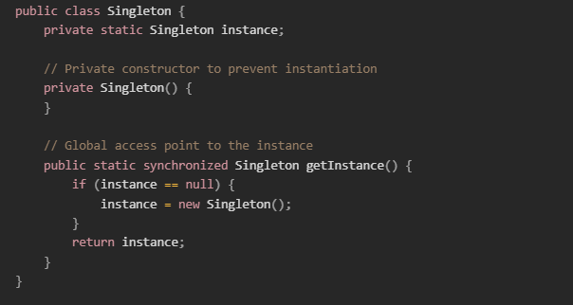
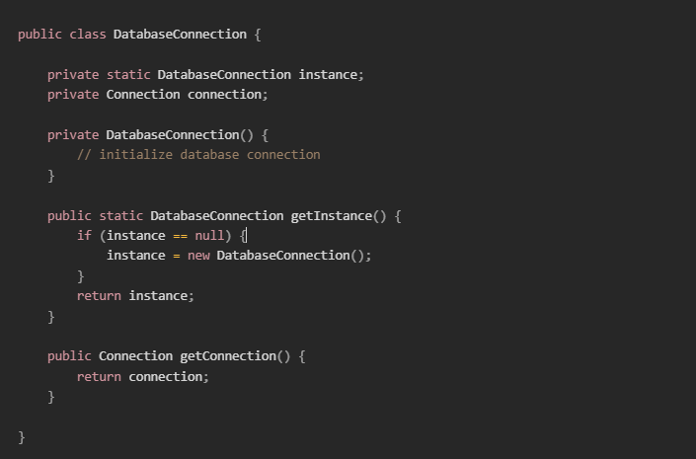
Code Example

Slide 5
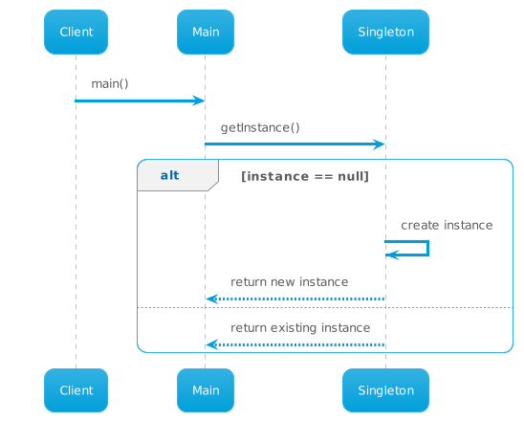
Sequence Diagram
Notes:
Client requests the singleton instance from the Singleton class.
Participants: Client, Singleton.
The Client sends a message "getInstance()" to the Singleton class.
The Singleton class checks if an instance exists.
If no instance exists, the Singleton class creates an instance and returns it in a message back to the Client.
If an instance exists, the Singleton class returns the existing instance in a message back to the Client.
The Client receives the singleton instance.

Slide 6
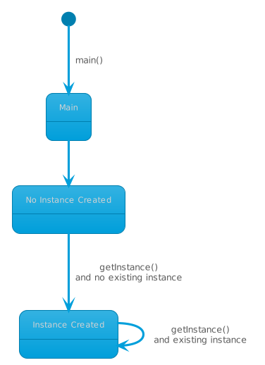
State Diagram
Notes:
States: "No Instance Created", "Instance Created".
Transitions:
"No Instance Created" -> "Instance Created": when getInstance() is called and there is no existing instance.
"Instance Created" -> "Instance Created": when getInstance() is called and there is an existing instance.

Slide 7
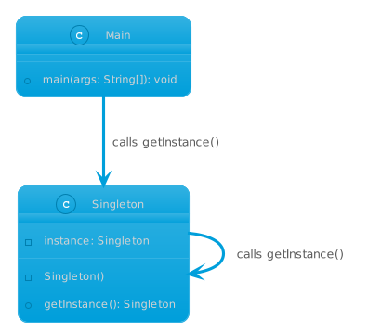
Class Diagram
Notes:
Class: Singleton
Attributes:
instance (private, static)
Methods:
getInstance() (public, static)
Singleton() (private constructor)
Class: Main
Attributes:
No Attributes
Methods:
Main method that calls getInstance

Slide 8
Potential Drawbacks
Global State: Singleton can be considered an anti-pattern due to its global state, which can lead to issues when debugging.
Scalability: Difficult to scale in a multi-threaded environment.
Testing: Harder to unit test because of the hidden dependencies.

Slide 9
Best Practices
Ensure thread-safety.
Consider alternatives like dependency injection.
Use the Singleton pattern judiciously and only when necessary.

Slide 10
Conclusion
Ensures a single instance of a class
Provides a global point of access
Useful for managing shared resources
Be cautious of potential drawbacks and use responsibly

