Slide 1
Blood Vessel Segmentation Challenge
Achieved 97% acc with U-Net and Random Patch Data Augmentation Technique

Slide 2
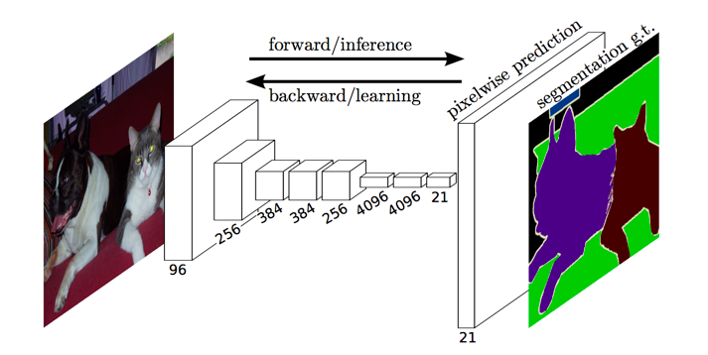
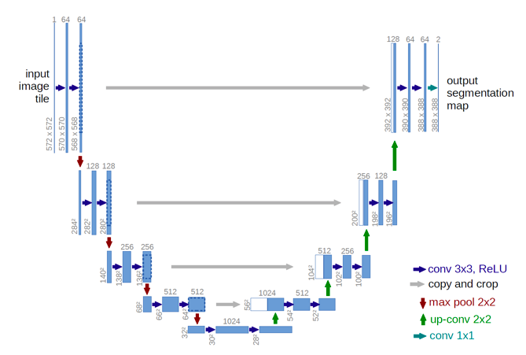
Previous Research/ Motivation
FCN
Architectures
CNN very popular for semantic segmentation tasks
CNN as feature extractor + SVM
Fully Convolutional NN
U-Net
U-Net
Yet U-Net is data hungry, but we have only 20 training images… 👀💦
https://www.jeremyjordan.me/semantic-segmentation/

Slide 3
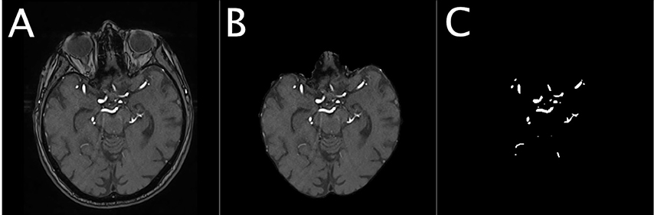
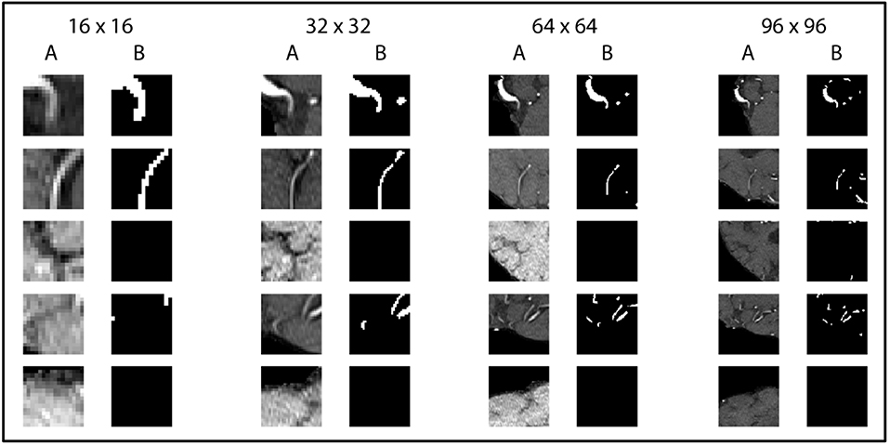
Previous Research/ Motivation
Data augmentation
– Random Patch Protocol
Livne, Michelle, et al. 2019. “A U-Net Deep Learning Framework for High Performance Vessel Segmentation in Patients with Cerebrovascular Disease.” Frontiers in Neuroscience.
Youness Mansar. 2019. “Vessel Segmentation with Python and Keras”
Notes:
Original size: 312*384, best: 96*96

Slide 4
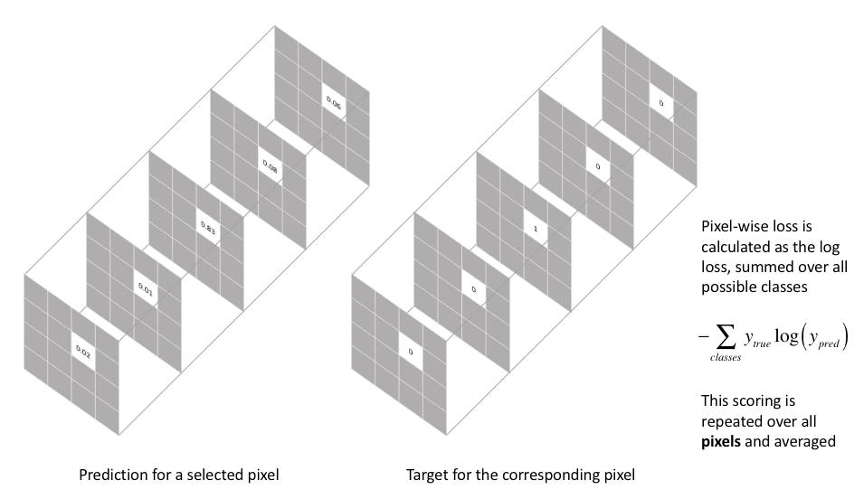
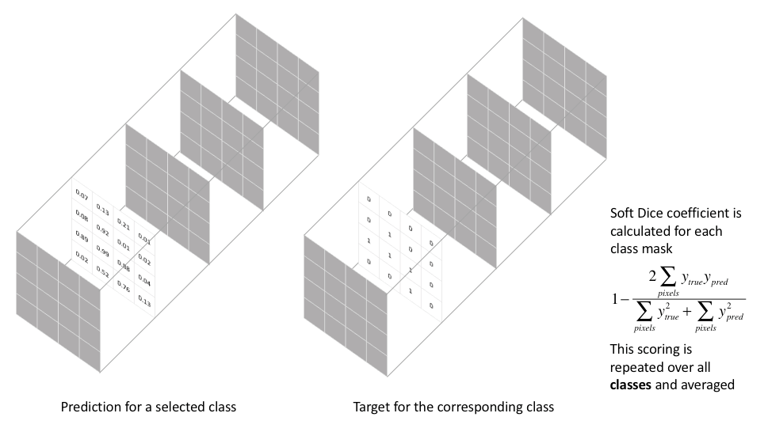
Previous Research/ Motivation
Loss Functions
Pixel-wise cross-entropy loss
Soft dice loss
https://www.jeremyjordan.me/semantic-segmentation/

Slide 5
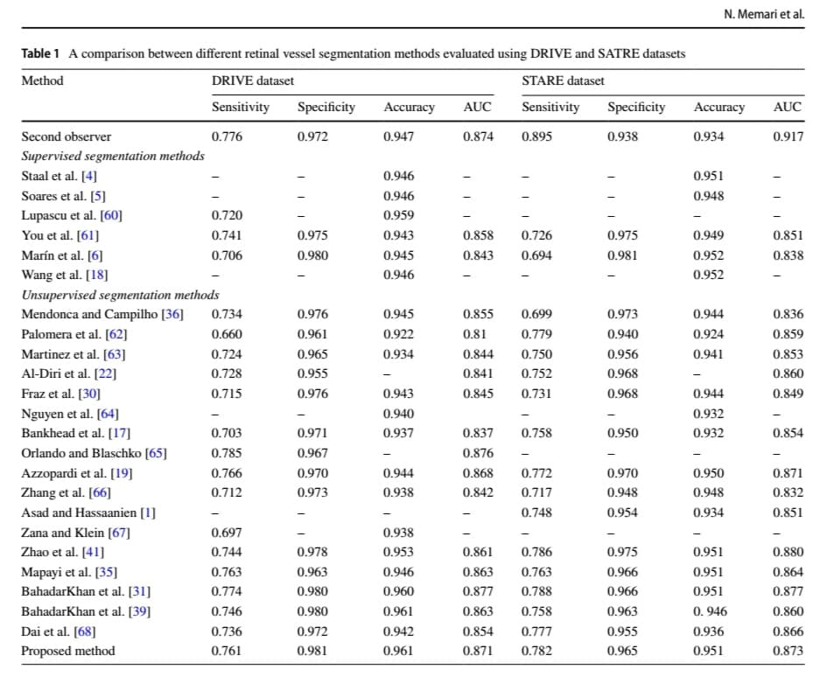
Previous Research/ Motivation
SOTA summary
Memari et al. 2018.

Slide 6
Goal
To assess the patch protocol with different patch sizes for two different loss functions (i.e. soft dice loss and cross-entropy loss).
Patch Size
64*64
128*128
256*256
512*512
Pixel-wise Cross Entropy
Loss
Soft Dice Loss

Slide 7
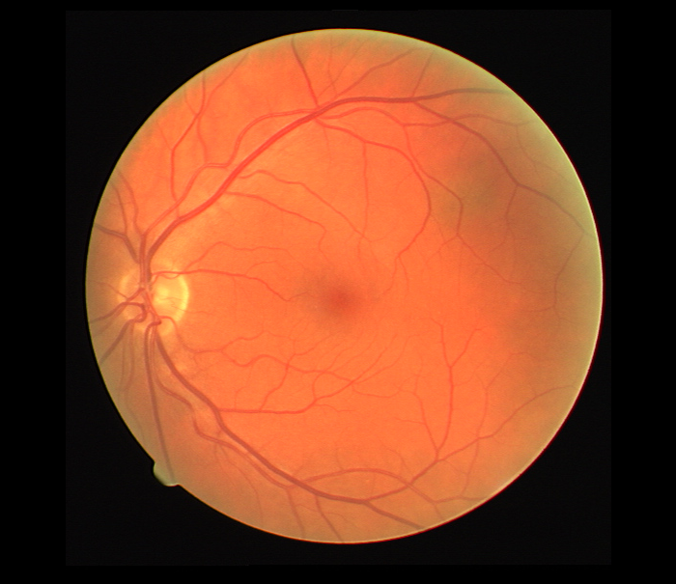
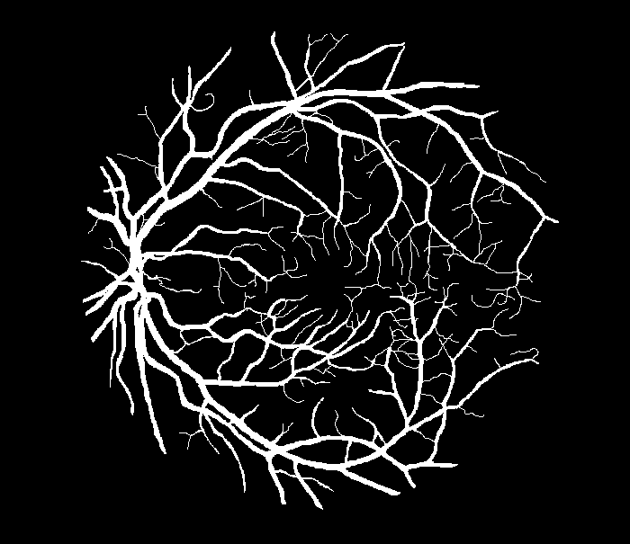
Methodology
1.1 Preprocessing and Data Augmentation
On the dataset:
- Random horizontal and vertical flips (20 => 60 training images)
On-the-fly:
- Normalization: Linearly normalize pixel values to [0,1]
Random patch protocol: Randomly select corresponding patches from the images and masks (sizes of 64*64, 128*128, 256*256, 512*512)

Slide 8
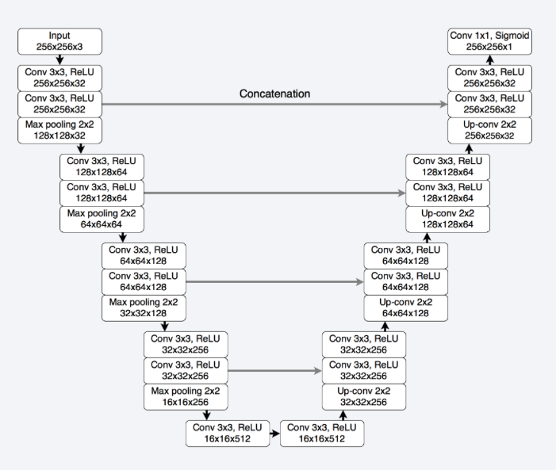
Methodology
1.2. Model Architecture
U-Net
- Encoder (4 conv blocks):
2 conv layers => max pooling
# of filters * 2 each block
Bottleneck: 2 conv layers (512 filters)
Decoder (4 deconv blocks):
transposed conv =>
feature concatenation =>
2 conv layers
# of filters / 2 each block
https://pytorch.org/hub/mateuszbuda_brain-segmentation-pytorch_unet/

Slide 9
Methodology
1.3. Loss Functions
Pixel-wise cross-entropy loss
Soft dice loss
https://www.jeremyjordan.me/semantic-segmentation/

Slide 10
Methodology
1.4. Training Details
Trained on GCP with GPU
Model optimized with optimizer RAdam (outperforms SGD, Adamw)
lr = 0.001, batch_size = 4, epoch = 250, default beta and weight decay values
Saved model weights with best val IoU for each experiment

Slide 11
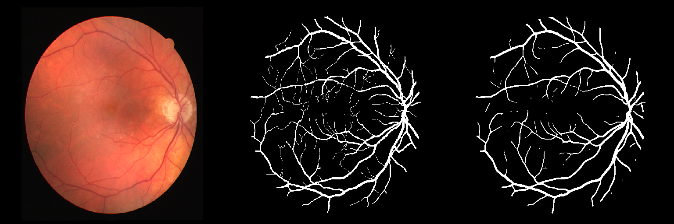
Methodology
2.1. Testing and Reconstruction
Test images resized to 512*512 (nearest neighbor interpolation)
Reconstruct predicted segmentation from patches of corresponding size used in training (i.e. 64*64, 128*128, 256*256, 512*512)
I.e. for model trained on patches of size 256*256: 1) feed the 4 256*256 sub-images from the original test image into the NN; 2) recombine the predicted patches to reconstruct the full proposed segmentation

Slide 12
Methodology
2.2 Evaluation metrics
Implemented in the pipeline:
Recall/Sensitivity = TP/ (TP + FN) as acc
IoU/Jaccard for both classes
Additional metrics to compare against SOTA:
Accuracy = (TP + TN)/ all test cases
Specificity = TN/ (TN + FP)

Slide 13
Results
Comparison of patch sizes versus loss function choices
 | Soft dice loss |  |  |  | Pixel-wise cross entropy
Patch size | Class 0 IoU | Class 1 IoU | Mean IoU | Sensitivity avg. over patches | Class 0 IoU | Class 1 IoU | Mean IoU | Sensitivity avg. over patches
512*512 | 0.9688 | 0.6564 | 0.8126 | 82.49 | To be tested
256*256 | 0.9704 | 0.6701 | 0.8203 | 83.03 | To be tested
128*128 | 0.9685 | 0.6623 | 0.8154 | 85.31 | 0.9725 | 0.6652 | 0.8189 | 75.84
64*64 | 0.9640 | 0.6280 | 0.7960 | 83.98 | 0.9699 | 0.6391 | 0.8045 | 74.21

Slide 14
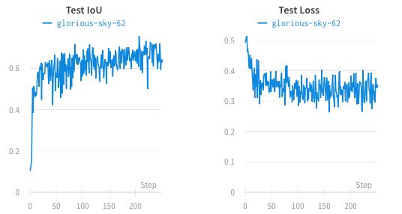
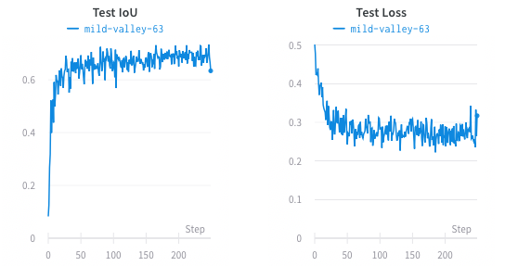
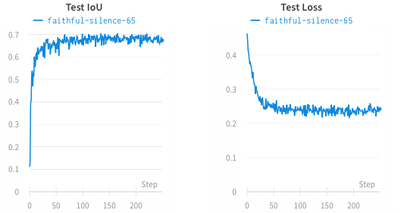
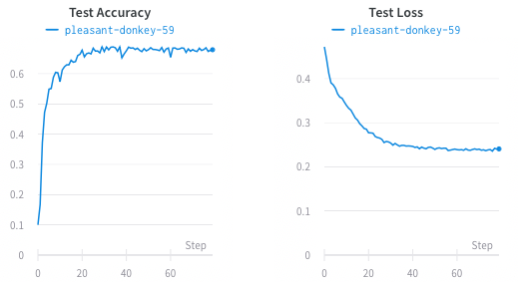
Results – Patch size
Training curves across patches for soft dice loss
64*64
128*128
256*256
512*512

Slide 15
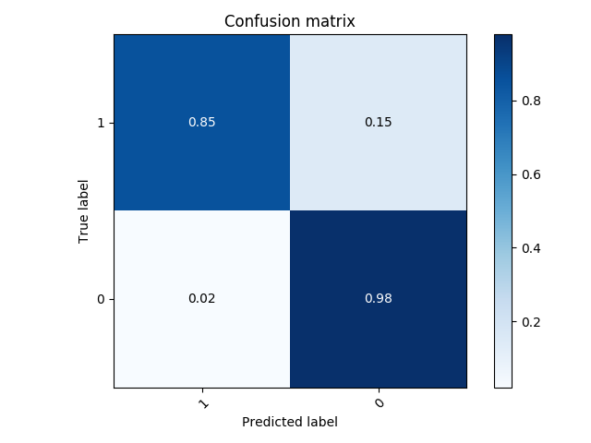
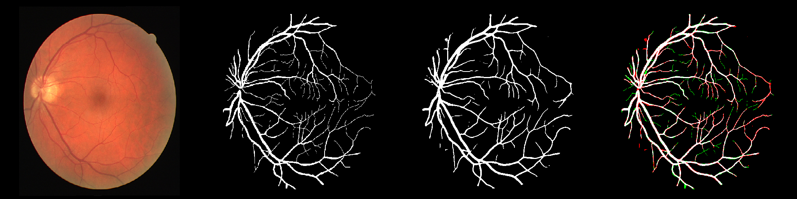
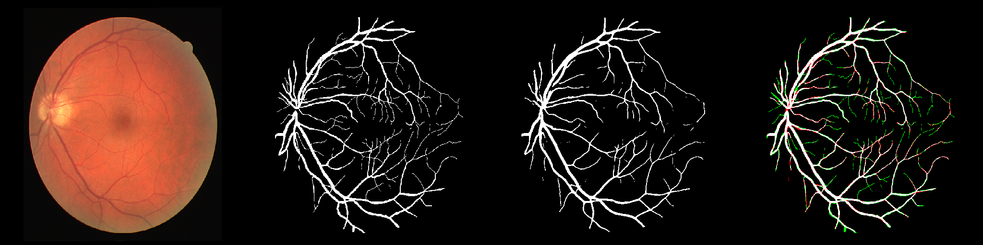
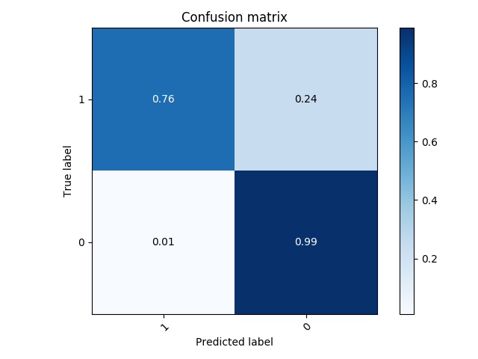
Results – Loss function
Visualization of proposed segmentation across loss function choices for patch size 128*128 (test_img_12, red = fp, green = fn)
Soft Dice
Loss
Cross-
entropy
Loss

Slide 16
Results – SOTA metrics
SOTA 2018 summary
Our result (soft dice loss, 256):
Sensitivity: 0.7764
Specificity: 0.9875
Accuracy: 0.9721

Slide 17
Discussion
Conclusions
- Soft dice loss helps address class imbalance => gives better Sensitivity
- Training on patches: training process is much faster but could be more stochastic; able to reach comparable prediction performance as training on whole image
Limitations
- Preprocessing: noise suppression, contrast enhancement, vessel enhancement approaches (filtering)
- Model trained on small uniform dataset => generalizability
Future directions
Data augmentation: shears, rotations, etc.
Yet to explore weighed pixel-wise cross-entropy loss
Whether training on patches would make model more robust in unseen datasets => transfer learning

