Slide 1
School of Computer Science & Engineering
AI Application Development – IA1
AI-Powered Discussion Monitor and Action Item Tracker

Slide 2
Team Members & Roles
Team member name | Role
Markandeshwaragouda Patil | Team Lead
Manasa K M | Customer Contact Lead
Pranathi R N | Test Lead
Pavan H K | Developer
Navaneeth S | Development Lead
Rohith L, Nikhil M | DevOps / GitHub / Product Build / Documents
Notes:
Talk about how they are managing their documents, how google docs does automatic versioning
As them what they know about Android and IoS versions

Slide 3
AI-Powered Discussion Monitor and Action Item Tracker
As virtual meetings and online collaboration environments become increasingly prevalent, maintaining structured, respectful, and outcome-oriented discussions has become a significant challenge.
Important action items and decisions are missed or not tracked properly .
Existing tools (Zoom, Teams, Meet) do not provide real-time intelligent monitoring or automation.
Notes:
Talk about how they are managing their documents, how google docs does automatic versioning
As them what they know about Android and IoS versions

Slide 4
User/ Customer Understanding
1.Do meetings often go off-topic?
Yes, discussions frequently deviate from the main agenda
2. Are important decisions or action items missed?
Yes, key points are often forgotten or not properly recorded
3. Do some participants dominate or disrupt discussions?
Yes, it affects balance and reduces meeting effectiveness
4. Is it difficult to track discussions in real-time?
Yes, manual tracking is inefficient and error-prone
5. Do existing tools solve these issues?
No, they lack real-time intelligent monitoring and guidance
6. What kind of solution would you prefer?
An AI system that keeps discussions focused and tracks key points
Notes:
Talk about how they are managing their documents, how google docs does automatic versioning
As them what they know about Android and IoS versions

Slide 5
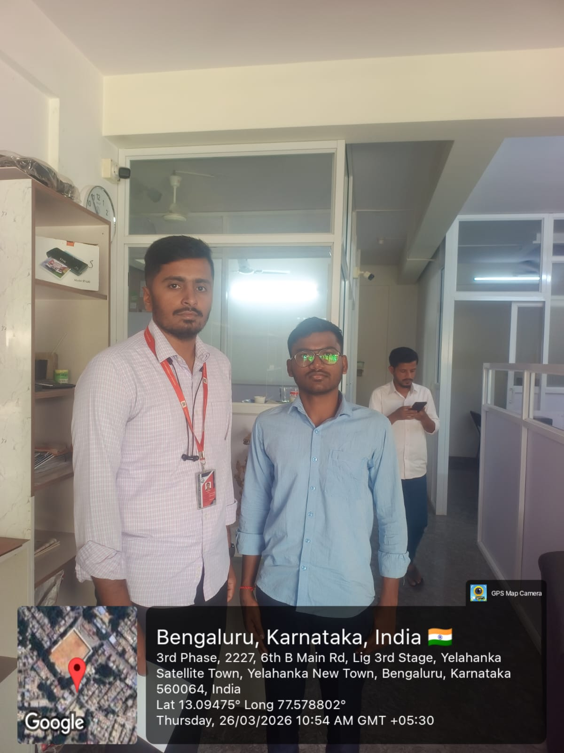
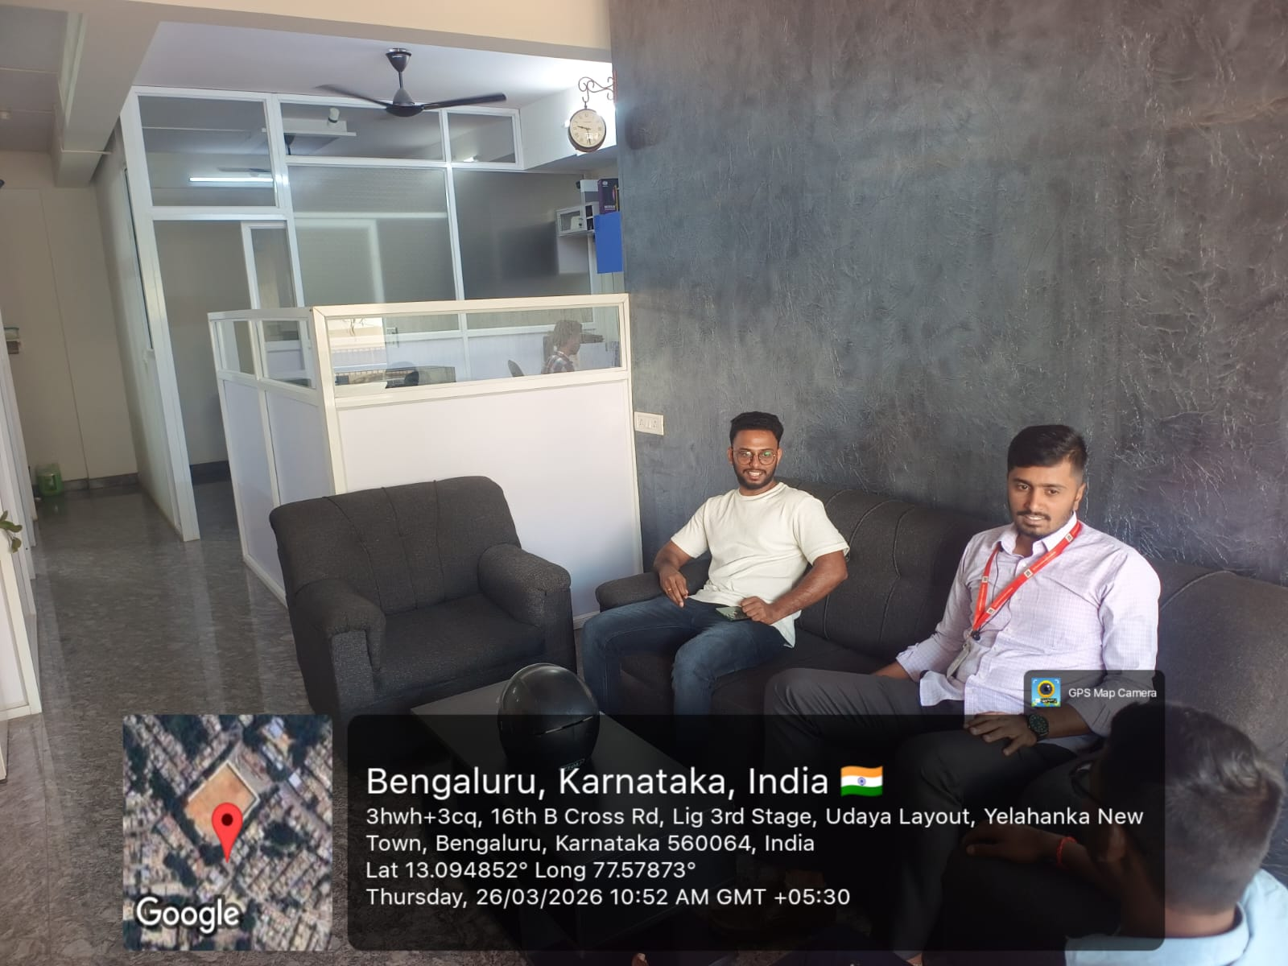
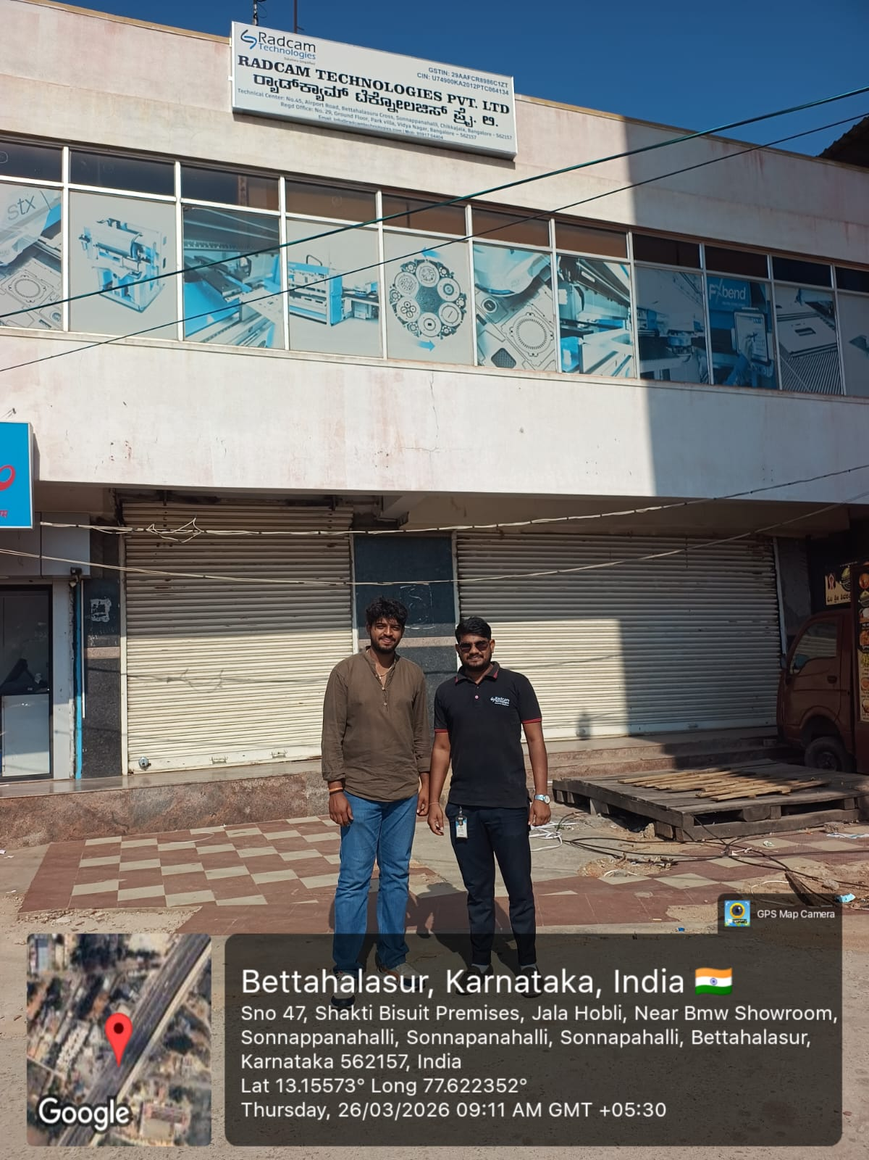
User interviews conducted to validate the problem statement

Slide 6
Ideal Customer Profile (ICP)
Demographics:
Students & professionals in frequent meetings
Use Zoom / Google Meet / Teams
Work in group discussions / collaborations
Teams of 3–10 members
Psychographics:
Prefer focused and structured discussions
Face distractions and off-topic conversations
Miss important points or action items
Find note-taking during meetings difficult
Open to AI-based tools
Key Problems:
Unstructured discussions
Missed important points
Distractions in meetings
Notes:
Only stress on the 1st sentence – the definition
Come back to the 2nd sentence in the end as part of revision

Slide 7
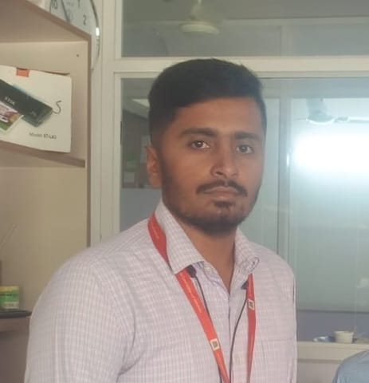
Customer Persona (CP)
Name : Puneeth
Age : 31 years
Education : BCA
Locality : Benagluru Urban
Role : HR(Team-based projects)
Device habits : Uses laptop/mobile for online meetings
Platforms used : Google Meet / Zoom / Teams
Behavior : Attends frequent online meetings, participates in group discussions and collaborations
Notes:
Only stress on the 1st sentence – the definition
Come back to the 2nd sentence in the end as part of revision

Slide 8
Product USP
Keeps meetings focused by detecting and reducing off-topic discussions.
Automatically captures key points, decisions, and action items in real-time.
Minimizes distractions by identifying unnecessary interruptions
Provides clear summaries after meetings, saving time and effort
Enhances productivity by improving meeting efficiency
Reduces manual note-taking effort for users
Works seamlessly with existing platforms like Zoom / Google Meet
Notes:
Only stress on the 1st sentence – the definition
Come back to the 2nd sentence in the end as part of revision

Slide 9
Use Cases & High Level Requirements
1.Real-Time Meeting Monitoring :
Input: Live audio/video from meeting (Zoom/Meet)
Output: Detection of off-topic discussions and alerts to stay focused
2.Automatic Note-Taking :
Input: Ongoing conversation during meeting
Output: Captured key points, decisions, and action items
3.Distraction Detection :
Input: Participant interactions and conversation flow Output: Identification of unnecessary interruptions or distractions
Notes:
Only stress on the 1st sentence – the definition
Come back to the 2nd sentence in the end as part of revision

Slide 10
Use Cases & High Level Requirements
4. Meeting Summary Generation :
Input: Complete meeting data
Output: Structured summary with key highlights and decisions
5. Smart Attendance Management :
Input: Participant list and meeting attendance data
Output: Automatically generated student attendance list (first to last) accessible by the teacher
Notes:
Only stress on the 1st sentence – the definition
Come back to the 2nd sentence in the end as part of revision

Slide 11
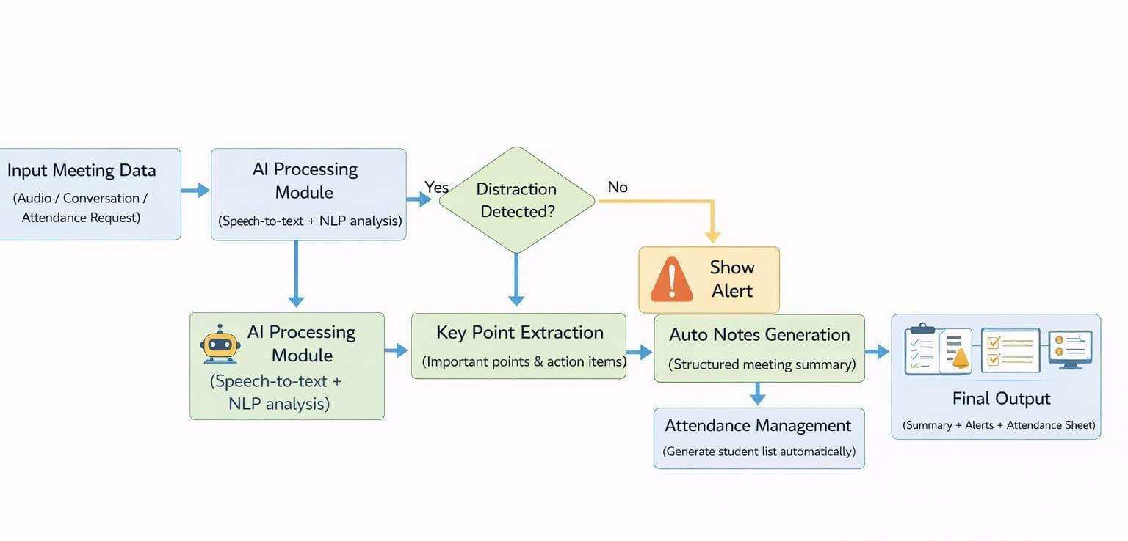
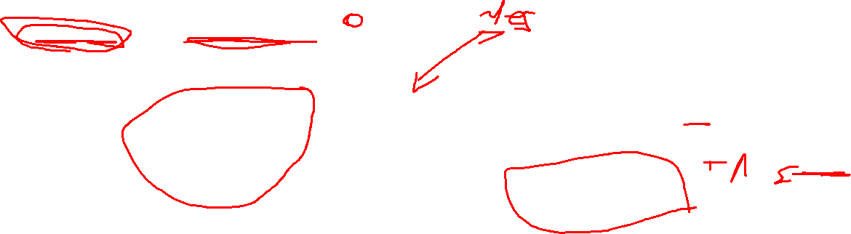
Proof of Concept (PoC) / Prototype Demo
Show demo
Notes:
Only stress on the 1st sentence – the definition
Come back to the 2nd sentence in the end as part of revision

