Slide 1
LINE CODING TECHNIQUES
Digital Data → Digital Signals
Stallings • Data and Computer Communications (8e) • Section 5.1 | Python implementation
Notes:
Introduce the topic. Line coding converts binary bits into electrical signal levels for transmission. This project implements eight techniques from Stallings Section 5.1 in Python and plots each one.

Slide 2
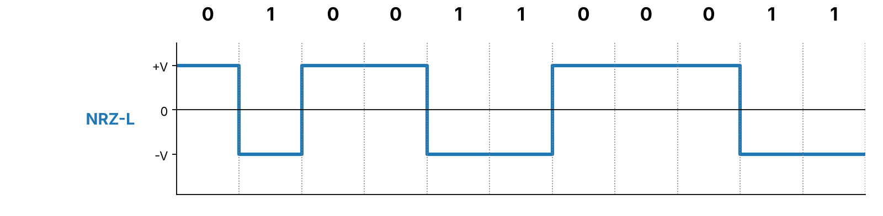
What is line coding?
Representing binary data as signal levels over time
Input: a sequence of bits, such as 01001100011
The encoder maps each bit to one or more signal levels
The receiver uses the signal changes to recover the bits
Schemes trade off synchronization, bandwidth and error behavior
2/8
Notes:
A bit carries information; the waveform is its physical representation. The example below is NRZ-L for the bits 01001100011. No single scheme is best in every situation.

Slide 3
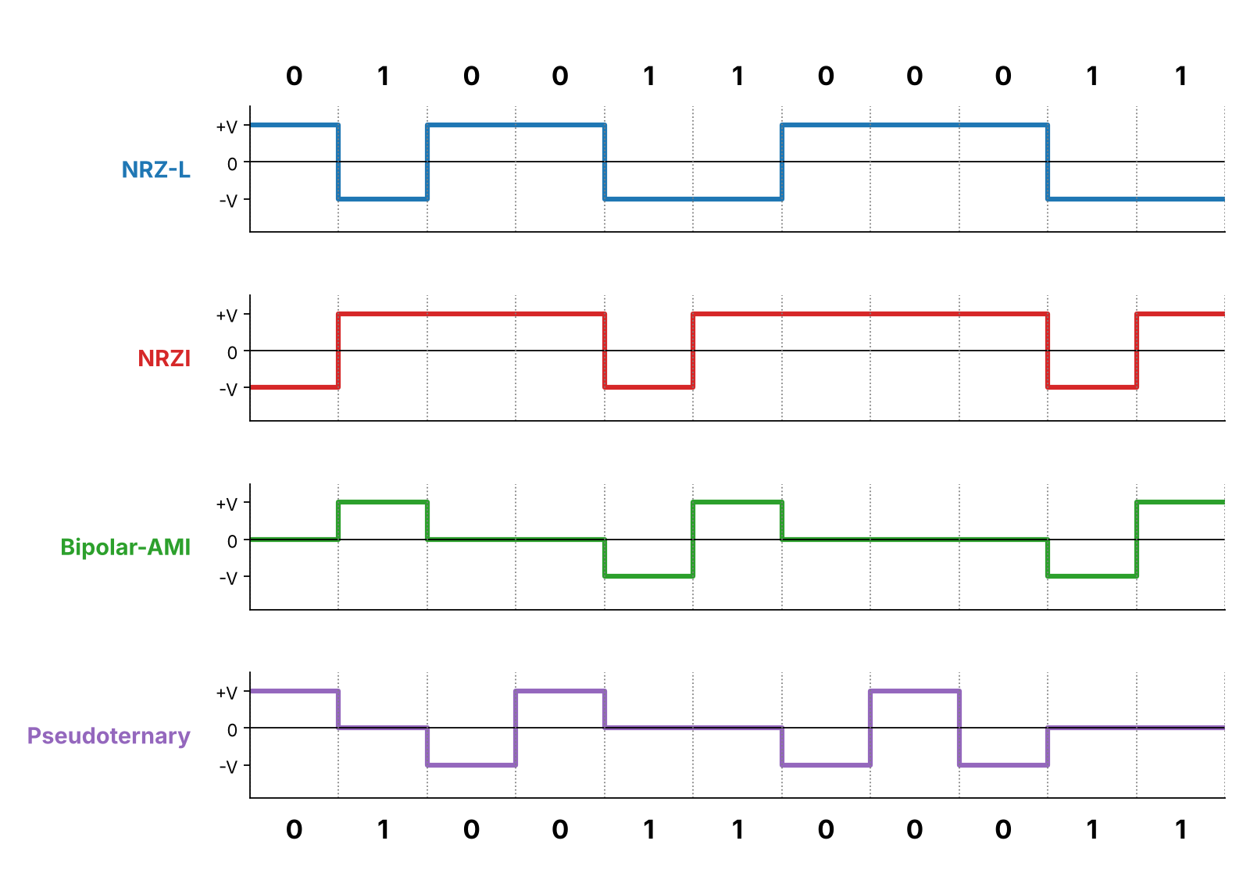
NRZ and bipolar schemes
One signal level per bit
NRZ-L: 0 = high, 1 = low
NRZI: a 1 = transition at start of bit
Bipolar-AMI: 0 = no signal; 1 alternates +V / −V
Pseudoternary: 1 = no signal; 0 alternates +V / −V
3/8
Notes:
NRZ-L maps 0 to high and 1 to low. NRZI changes level at the start of a 1. AMI alternates +/- on each 1 and sends zero for 0. Pseudoternary is the reverse: it alternates on each 0. Point at the waveforms while explaining each rule.

Slide 4
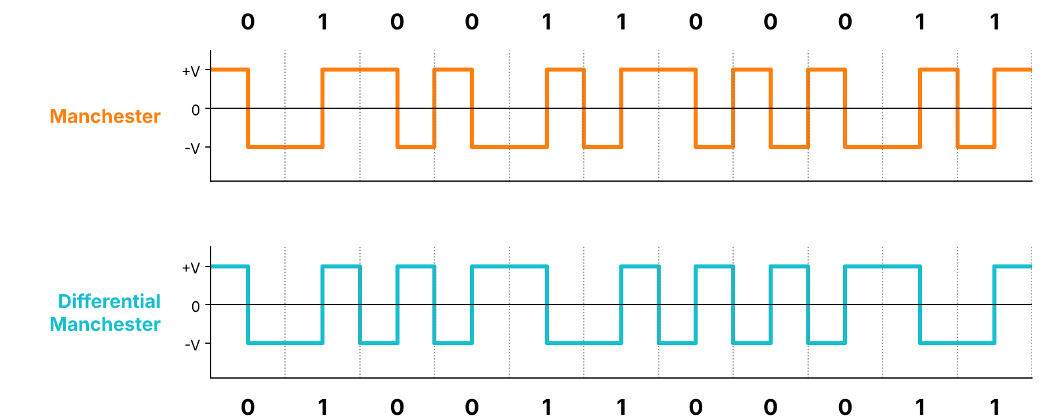
Biphase schemes
Two half-bit levels for every bit
Manchester: transition in the middle of every bit
1 = low-to-high, 0 = high-to-low
Differential Manchester: always a mid-bit transition
0 = also a transition at the start of the bit; 1 = none
4/8
Notes:
The mid-bit transition helps the receiver keep timing. Manchester: low-to-high is 1, high-to-low is 0. Differential Manchester always changes mid-bit, and a 0 also has a transition at the start of the bit. Both need more bandwidth than NRZ.

Slide 5
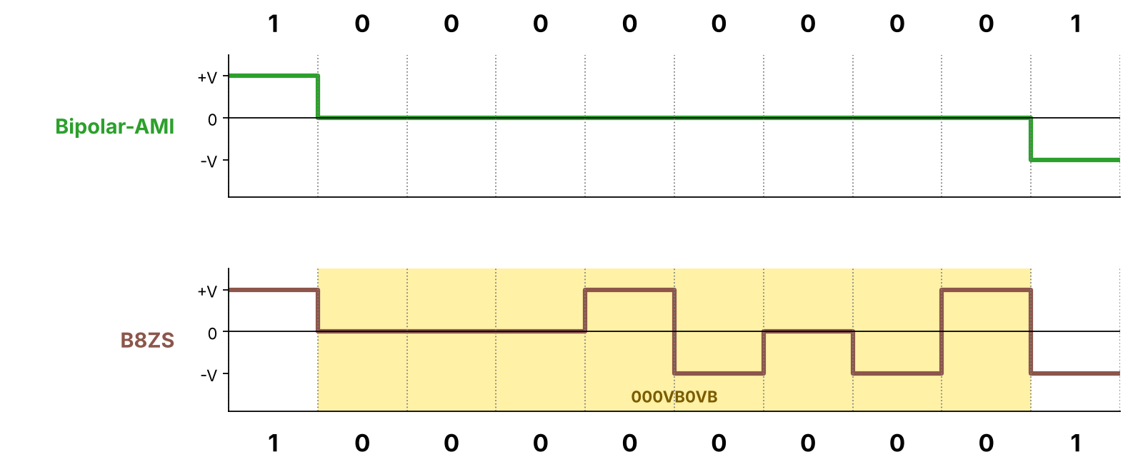
B8ZS substitution
Eight zeros are replaced by 000VB0VB
Based on Bipolar-AMI
8 zeros → 000VB0VB
V = violation (same polarity as previous pulse)
B = normal bipolar pulse
Avoids a long flat zero-voltage stretch
5/8
Notes:
B8ZS is AMI-based. Eight consecutive zeros become 000VB0VB. V is a deliberate violation of AMI alternation, B is a normal bipolar pulse. In the plot, the yellow area is the substituted pattern; compare it with plain AMI above it, which stays flat.

Slide 6
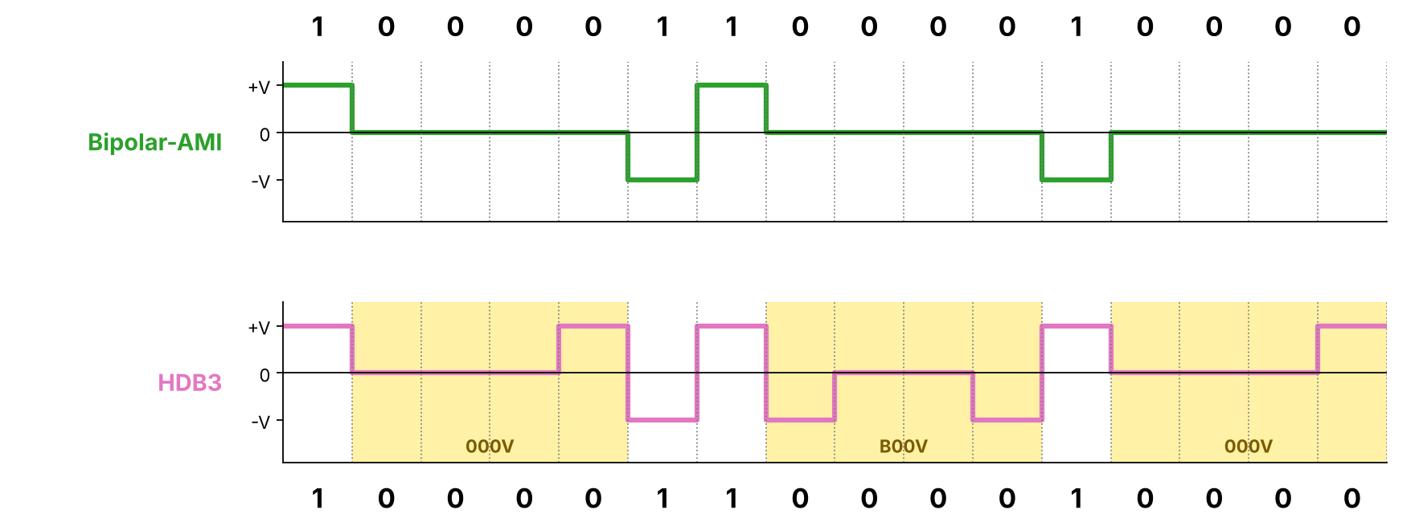
HDB3 substitution
Four zeros are replaced by 000V or B00V
Based on Bipolar-AMI
4 zeros → 000V or B00V
Odd pulse count since last substitution → 000V
Even pulse count → B00V
Keeps long zero runs from losing timing
6/8
Notes:
Count nonzero pulses since the previous substitution. An odd count gives 000V, an even count gives B00V. In this project the count starts at zero (even) and the initial AMI polarity is negative. The plot shows both cases in yellow.

Slide 7
Quick comparison
General tendencies; real performance depends on the link
Scheme | Synchronization | DC component | Bandwidth
NRZ-L / NRZI | Weak on long runs | Present | Low
Bipolar-AMI / Pseudoternary | Weak on long zero runs | Reduced | Low
Manchester / Differential | Strong (mid-bit transition) | Balanced | Higher
B8ZS / HDB3 | Good (zero runs substituted) | Reduced | Low
7/8
Notes:
Compare as general tendencies, not guarantees. NRZ is simple but long runs hurt timing and can carry DC. AMI-family schemes reduce DC. Manchester-family schemes give a transition every bit but use more bandwidth. B8ZS and HDB3 fix the long-zero-run problem of AMI.

Slide 8
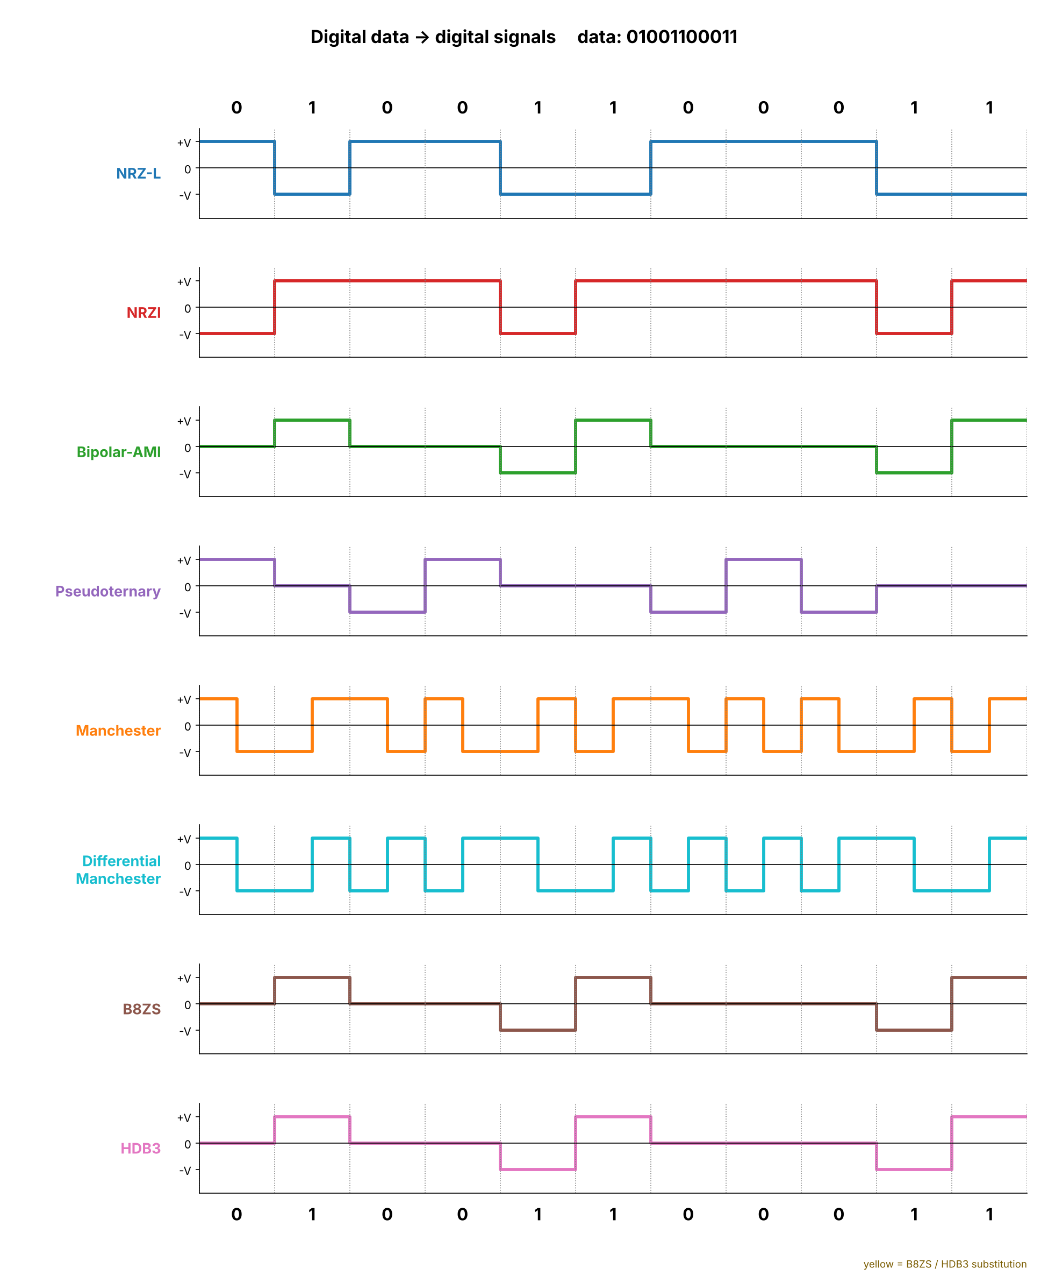
Demo and summary
Eight schemes • text output • waveform plots
Interactive menu or command line
Signal levels printed as +, 0, −
Yellow = B8ZS / HDB3 substitution
Automated tests check sample outputs
python encoding_techniques.py 01001100011
8/8
Notes:
Close by running the sample command. The CLI prints the encoded levels and the menu draws the waveforms. Show the combined plot, then try 1000000001 for B8ZS and 1000011000010000 for HDB3. Automated tests protect the encoding conventions.

