Slide 1
6.1 Network Security
Computer Security

Slide 2
Contents
Introduction
IPSec
TLS/SSL
SSH
WEP/WPA2
Firewalls

Slide 3
ISO OSI Reference Model
TCP/IP Protocol Stack
Application
Presentation
Session
Network
Transport
Link
Physical
Application
Transport
Internet
Network Access

Slide 4
Reminder: TCP/IP (Internet) Protocol Stack
User
Application
e.g. HTTP, FTP, Email
Transport
e.g. TCP, UDP
Internetwork
e.g. IP
Network Access (link)
e.g. Ethernet, WiFi, PPP (modem)
Physical
e.g. copper cable, radio spectrum

Slide 5
So do you secure network traffic
at the Application layer?
e.g. PGP, SET
at the Transport layer?
e.g. SSL/TLS
at the Internetwork layer
e.g. IPsec
at lower layers?
e.g. WEP/WPA (for wireless access points)
at all layers?
for maximum security

Slide 6
It depends…
on users
Do you want it all to be transparent to users?
Application layer security normally involves the user
on the importance of speed
Encrypting the same data multiple times slows things down
on security needs
Hide traffic pattern, etc.
on network topology
Is the network trusted or not?
Are there wireless links?

Slide 7
IPSec

Slide 8
Why secure at the IP layer?
Can put security in place once, in a consistent manner, for multiple applications
All applications are secured, without the need for the user to be involved
Central management of security, including access policy, keys, algorithms, etc.

Slide 9
IPv4 IPv6
IPv4 – packets transmitted in the clear
IPv6 – allows for security (but not deployed yet)
IPSec - Suite of protocols from Internet Engineering Task Force (IETF) providing encryption and authentication at the IP layer
http://datatracker.ietf.org/wg/ipsecme/charter/
IPv4 plus IPsec = IPv6

Slide 10
IPsec
Provides security at the network layer.
Secures datagrams between any two network-layer entities including hosts and routers.
Used by organisations to create Virtual Private Networks (VPNs).

Slide 11
VPN
Institutions often want private networks for security.
Costly - Separate routers, links, DNS infrastructure.
With a VPN, institution’s inter-office traffic is sent over public Internet instead.
But inter-office traffic is encrypted before entering public Internet.

Slide 12
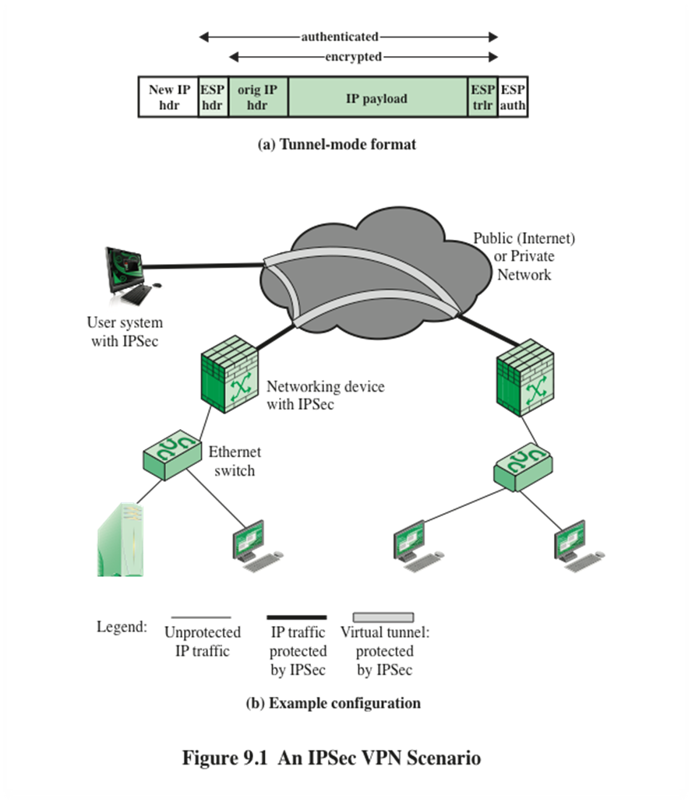

Slide 13
IPSec
Provides mechanisms for :
Confidentiality
Source Authentication
Data Integrity
Replay-attack Prevention

Slide 14
Confidentiality
Network layer confidentiality between a pair of network entities (e.g. between 2 routers, 2 host or a router and a host).
The sender encrypts the payload of all datagrams sent to the receiving entity.
The encrypted payload could be a TCP segment, a UDP segment etc.
So data is hidden from any 3rd party that might be sniffing the network.

Slide 15
Confidentiality
Not only the data is encrypted so too is:
Protocol number
Source IP address
Destination IP address

Slide 16
Source Authentication
To allow the receiving entity to verify the source of the secured datagram.
Achieved through using the authentication key (part of the SA information).

Slide 17
Data Integrity
To allow the receiving entity to check for any tampering of the datagram while in transit.
Integrity check provided by MAC will spot a datagram which has been tampered with.
And the same integrity check will spot if a 3rd party attempts to masquerade and create a false datagram.

Slide 18
Replay-attack Prevention
To allow the receiving entity to detect any duplicate datagrams inserted by an attacker.
IPsec includes sequence numbers and so replay attacks are thwarted.

Slide 19
Secure Sockets Layer (SSL) / Transport Layer Security (TLS)

Slide 20
Securing Web content
Communication on the web means web browsers talking to web servers using HTTP
Web Server (e.g. apache)
HTTP Request (GET, POST, form data, …)
HTTP Response (HTML & other content)
Web Browser (e.g. Firefox)

Slide 21
Securing Web content
HTTP by itself doesn’t provide any security
The approach to securing web content is to:
Leave HTTP as it is
Add security just above the transport layer
This has been variously known as
Secure Socket Layer (SSL)
Originated by Netscape
Transport Layer Security (TLS)
Vendor-neutral standard (IETF – RFC 5246)

Slide 22
Reminder: TCP/IP (Internet) Protocol Stack
User
Application
Transport Layer Security
Transport
Internetwork
Network Access (link)
Physical

Slide 23
Uses of TLS
Encrypting
Encrypting sensitive data sent between browser and web server
Authenticating
Authenticating participants
To verify that web server is genuine
To verify that user/browser is genuine (optional)

Slide 24
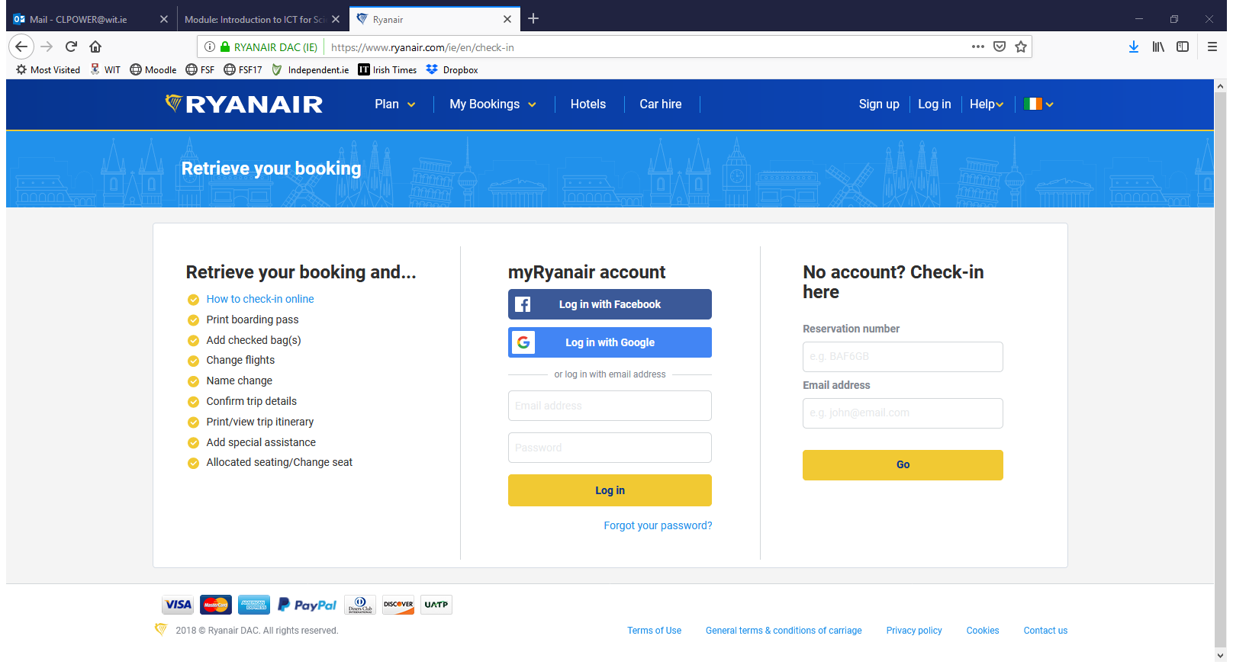
Recognising a TLS (SSL) page
URL begins with https: rather than http:
(Possibly) pop-up letting you know
Closed lock symbol on browser

Slide 25

TLS (SSL) Protocol Overview
TLS (SSL) has 2 layers of protocols:
One layer is a set of protocols for setting up a session, changing parameters, etc
TLS Handshake Protocol
TLS Change Cipher Spec Protocol
TLS Alert Protocol
The other is the “workhorse”, doing the encryption and authentication
TLS Record Protocol

Slide 26
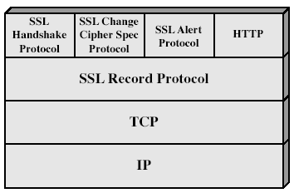
TLS Architecture

Slide 27
TLS (SSL) Handshake Protocol – summary
Agree TLS version
Select algorithms
Authenticate each other using certificates
Client generates shared secret session key (K_{S}) and sends to server encrypted with its public key (from its cert)
Client and server now communicate using generated shared secret keys (symmetric encryption)
1,2
3
4
5

Slide 28
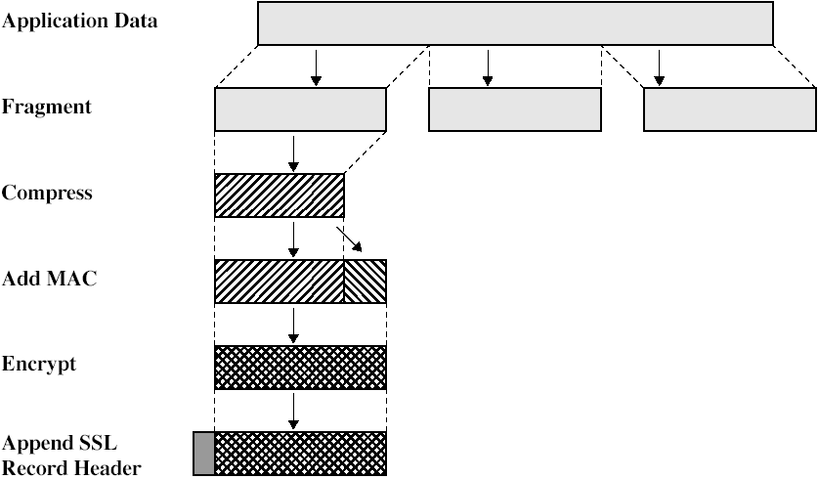
TLS Record Protocol

Slide 29
TLS Record Protocol
Fragmentation
Upper-layer message fragmented into blocks of 2¹⁴ (16384) bytes or less
Compression
This just makes sense if done before encryption
Add MAC
Based on cryptographic hash function and shared secret key (exchanged using handshake protocol)
Encrypt
Using symmetric encryption using shared secret key. May use block or stream cipher, as specified in agreed CipherSpec
Add TLS Record Protocol Header
Contains version number, content length, etc

Slide 30
Change Cipher Spec & Alert Protocol
TLS Change Cipher Spec Protocol
Updates cipher specification (algorithms, keys, etc) for current connection
TLS Alert Protocol
Signals warning or fatal alerts
Examples:
unexpected_message
no_certificate
bad_certificate (e.g. signature does not verify)
certificate revoked
certificate expired

Slide 31


Is TLS secure?
So much relies on TLS nowadays that it’s fair to ask whether it can be considered secure
The answer is yes and no
Yes, the protocol seems to be secure if used correctly
However it is very fragile – any of a large number of conditions can break it (completely)
Lots of recent issues, such as
POODLE (Padding Oracle On Downgraded Legacy Encryption) – Oct 2014
Heartbleed bug – April 2014

Slide 32
Is TLS secure?
TLS fails if:
One “bad” certificate authority is added to the client’s list of trusted CAs
One of the “good” CAs is careless or unlucky
Weak algorithms are used
Key generation is weak (often due to bad pseudo-random number generator)
One side tricks the other into “stepping down” to use a weak algorithm or key length (e.g. MD5, 512 bit RSA). This is possible as TLS allows the two sides to negotiate these.
Client doesn’t check for certificate revocation

Slide 33
Is TLS secure?
TLS fails if (continued):
Client or server is modified by malware
Client or server is “owned” by someone else
Client or server has software bugs (e.g. Heartbleed)
Client is modified by system administrator to use company’s CA list
Pages contain a mix of secure and insecure content (frames, images, etc)
Users fail to understand security warnings and/or are conditioned to ignore them
Server fails to renew certificates

Slide 34
HTTPS
HTTP over TLS/SSL
combination of HTTP & SSL/TLS to secure
The HTTPS capability is built into all modern Web browsers.
Its use depends on the Web server supporting HTTPS communication.
The user will notice
https://
rather than http://
A normal HTTP connection uses port 80. If HTTPS is specified, port 443 is specified, which invokes SSL.

Slide 35
HTTPS
When used it encrypts:
URL of requested document,
Document contents,
Contents of browser forms (filled in by browser user),
Cookies sent between browser and server and vice versa,
Contents of HTTP headers.

Slide 36
Wireshark Demo

Slide 37
Secure Shell (SSH)

Slide 38
Secure Shell (SSH)
A protocol for secure network communications designed to be relatively simple and inexpensive to implement
Allows data to be exchanged using a secure channel between two networked devices.
It is widely used by network administrators to control Web and other kinds of servers remotely for both Windows and UNIX.

Slide 39
Secure Shell (SSH)
SSH client and server applications are widely available for most operating systems
Has become the method of choice for remote login
Is rapidly becoming one of the most pervasive applications for encryption technology outside of embedded systems
Designed as a replacement for telnet
SSH also provides a more general client/server capability and can be used for such network functions as file transfer and e-mail

Slide 40
Secure Shell (SSH)
SSH commands are encrypted and secure in several ways.
Both ends of the client/server connection are authenticated using a digital certificate.
Passwords are protected through encryption.
SSH uses RSA public key cryptography for both connection and authentication.
Encryption algorithms include Blowfish, DES, and IDEA(default).

Slide 41
SSH
Allows for:
Remote command execution
File Transfer (SCP – Secure Copy)
Port Forwarding
To provide transport for insecure TCP/IP applications (email, DB access etc.)
To bypass firewalls

Slide 42
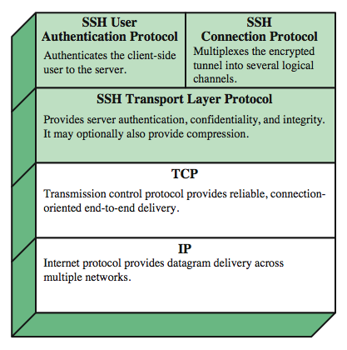
SSH Protocol Stack

Slide 43
Port Forwarding
One of the most useful features of SSH
Provides the ability to convert any insecure TCP connection into a secure SSH connection (also referred to as SSH tunneling)
Incoming TCP traffic is delivered to the appropriate application on the basis of the port number (a port is an identifier of a user of TCP)
An application may employ multiple port numbers

Slide 44
SSH Port Forwarding – the problem
Consider the following problem:
You work for a company but you are currently away from the office
You want to connect from outside to an internal host on the corporate network to access IMAP email
The IMAP port (143) is blocked by the corporate firewall
Normally, attempts to read your email would be blocked

Slide 45
SSH Port Forwarding – the solution
But say the following is the case:
The SSH port (22) is open on the firewall
You have an account on some machine (not necessarily the mail server) inside the network that runs an SSH server
With SSH, you can set up a “SSH tunnel” from a local port on your client PC, through the SSH server within the company network, and on to the desired application (in this case the mail server, port 143).
Then you get your mail client to connect to the local port on your client (from which you have set up an SSH tunnel to port 22) and that connection is forwarded to the desired application (the mail server)

Slide 46
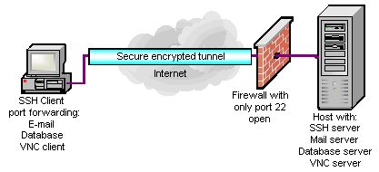
SSH Port Forwarding
In the diagram shown, the SSH server is on the same machine as other application servers, though this need not necessarily be the case.

