Slide 1
6.2 Wireless Network Security

Slide 2
Wireless Security
Securing a wireless network is more complex than an wired network.
Due to the nature of wireless technology (physical boundaries etc)
As wireless networks became more popular more security problem arose
Wireless encryption methods were originally flawed
Hacking methods have increased in sophistication

Slide 3
Threats in Mobile/Wireless Networks
Eavesdropping by a third party
Someone else listens in on communication
Bogus user
Masquerading as genuine customer to gain illegitimate access or perpetrate fraud
Bogus network
Base station presenting itself as network to the user, for example to collect user data
Denial of service
e.g. by signal jamming

Slide 4
Wireless Security
Organizations that have no wireless access points installed often feel that they don’t need to address wireless security concerns.
Issues can arise in a supposedly non-wireless organization when a wireless laptop is plugged into the corporate network.
A cracker could sit out in the parking lot and gather info from the organization through laptops and/or other devices, or even break in through this wireless card-equipped laptop and gain access to the wired network.
Further problems can also be created when employees plug in their own unauthorised APs.

Slide 5
Wireless Security
WLANs are vulnerable to specialized attacks.
Many of these attacks exploit technology weaknesses since 802.11 WLAN security is relatively new (or recently changed) and persistently attacked.
There are also many configuration weaknesses since some companies are not using the security features of WLANs on all their equipment.
Many devices are shipped with default administrator passwords.
Finally, there are policy weaknesses.
When a company does not have a clear wireless policy on wireless usage, employees may set up their own APs.
An employee setup AP is known as a rogue AP, which is rarely secure.

Slide 6
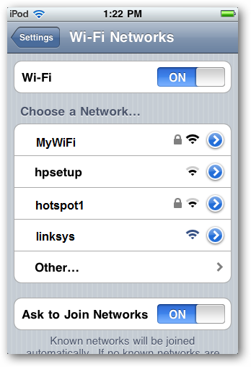
SSID
By disabling this broadcast, users either have to know the network name or have some kind of wireless packet capture software to derive this information.
There is no significant reason to broadcast the SSID, unless you want outsiders to know about your network.

Slide 7
Access Lists / MAC ID Filtering
The access list defines the MAC addresses of the wireless NICs you allow to associate or prevent from associating with your access point.
An access list creates management overhead, as you need to enter the MAC address of each card that needs access.
Unfortunately, MAC addresses are easy to discover with a sniffer since they are transmitted in clear text.
MAC IDs over a network can be faked. Cracking utilities such as SMAC are widely available
By configuring a wireless NIC with a known good MAC address that was sniffed out of the air, an attacker can gain access to the network to which they should not have access.

Slide 8
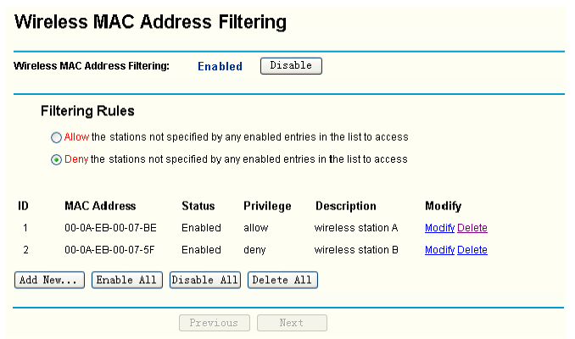

Slide 9
WEP (Wired-Equivalent Privacy)
As its name implies, this standard was intended to make wireless networks as secure as wired networks.
Aimed to provide:
Confidentiality
Authentication
Integrity

Slide 10
WEP (Wired-Equivalent Privacy)
Key shared by access point and all stations
Key entered manually into
Access point
Stations (by individual users)
Key management nightmare
What happens when someone leaves company?
How about visitors, temporary workers, etc?
Key update difficult as everyone required to change

Slide 11
WEP Design Goals
Symmetric key cryptography
Confidentiality
Station Authorisation
Data integrity
Self synchronising: each packet separately encrypted
Given encrypted packet and key, can decrypt; can continue to decrypt packets when preceding packet was lost
Unlike Cipher Block Chaining (CBC) in block ciphers

Slide 12
WEP weaknesses
Insufficient key size, but main problem is IV size.
RC4 seed is made up of IV combined with key. If key never changes, need to be sure IV is never repeated
But IV has just 24 bits, so will repeat eventually
802.11b even says that changing IV with each packet is optional!!!
If the IV keys are chosen randomly, the probability of having chosen the same IV value and therefore the same key is more than 99% after only 12000 frames

Slide 13
WEP (Wired-Equivalent Privacy)
There are several open source utilities that can be used by crackers to break in by examining packets and looking for patterns in the encryption.
WEP comes in different key sizes. The longer the better as it will increase the difficulty for crackers however this difficulty only increases linearly.
In 2005 a group from the FBI held a demonstration where they used publicly available tools to break a WEP encrypted network in three minutes.
Once the attacker has extracted the key, they have complete access to all transmitted information.
This type of encryption is considered outdated and seriously flawed.
WEP was deprecated by the IEEE in 2004.

Slide 14
Solution: WPA (Wi-Fi Protected Access)
Introduced by the Wi-Fi Alliance as a solution to WEP insecurities in 2003.
WPA as an intermediate measure pending the availability of the full IEEE 802.11i standard known as WPA2.
WPA could be implemented on wireless network interface cards designed for WEP.
Temporal Key Integrity Protocol (TKIP), was adopted for WPA.
TKIP employs a per-packet key, meaning that it dynamically generates a new 128-bit key for each packet and thus prevents the types of attacks that compromised WEP.
WPA also includes a message integrity check (called MIC/Michael). This is designed to prevent an attacker from capturing, altering and/or resending data packets.
This replaces the cyclic redundancy check (CRC) that was used by the WEP standard.
WPA also includes 802.1X, which allows the system to check who’s logging in against a central database of known users.
Researchers have since discovered a flaw in WPA that relied on older weaknesses in WEP and the limitations of Michael to retrieve the keystream from short packets to use for re-injection and spoofing.

Slide 15
Further Solution : 802.11i/WPA2
The 802.11i architecture contains the following components:
RSN (Robust Security Network): negotiates algorithms between access points and user stations
Counter Mode CBC MAC Protocol (CCMP): new protocol for encrypting data, based on the Advanced Encryption Standard (AES)
802.1X authentication based on EAP. EAP provides flexibility to choose type of authentication.
Requires new network card hardware.
Robust Security Network (RSN) is an element of 802.11i authentication and encryption algorithms to be used for communications between Access Points and clients. This means that as new threats are discovered, new algorithms can be added.
Mandatory for Wi-Fi–certified devices since 2006.

