Slide 1
6.3 Firewalls

Slide 2
What is a Firewall?
An alternative, or at least complement, to host-based security services
Is inserted between the premises network and the Internet to establish a controlled link and to erect an outer security wall or perimeter
The aim of this perimeter is to protect the premises network from Internet-based attacks and to provide a single choke point where security and auditing can be imposed
May be a single computer system or a set of two or more systems that cooperate to perform the firewall function

Slide 3
Firewall Design Goals
Design goals for a firewall:
All traffic from inside to outside, and vice versa, must pass through the firewall
Only authorized traffic, as defined by the local security policy, will be allowed to pass
The firewall itself is immune to penetration

Slide 4
Firewall Characteristics
IP Address and Protocol Values
Controls access based on the source or destination addresses and port numbers, direction of flow being inbound or outbound, and other network and transport layer characteristics
Application Protocol
Controls access on the basis of authorized application protocol data
User Identity
Controls access based on the user’s identity, typically for inside users who identify themselves using some form of secure authentication technology, such as IPSec
Network Activity
Controls access based on considerations such as the time or request

Slide 5
Firewall expectations
A firewall
Single choke point that :
1. keeps unauthorized users out of the network
2. prohibits vulnerable services from entering/leaving the network
3. provides protection from various kinds of IP spoofing & routing attacks
Provides a location for monitoring
security-related events
Convenient platform for several Internet functions that are not security related
Can serve as the platform for IPsec

Slide 6
Firewall limitations
Cannot protect against attacks that bypass the firewall
May not protect fully against internal threats, such as a disgruntled employee or an employee who unwittingly cooperates with an external attacker
Cannot guard against wireless communications between local systems on different sides of the internal firewall
A laptop, PDA, or portable storage device may be used and infected outside the corporate network, and then attached and used internally
A Firewall

Slide 7
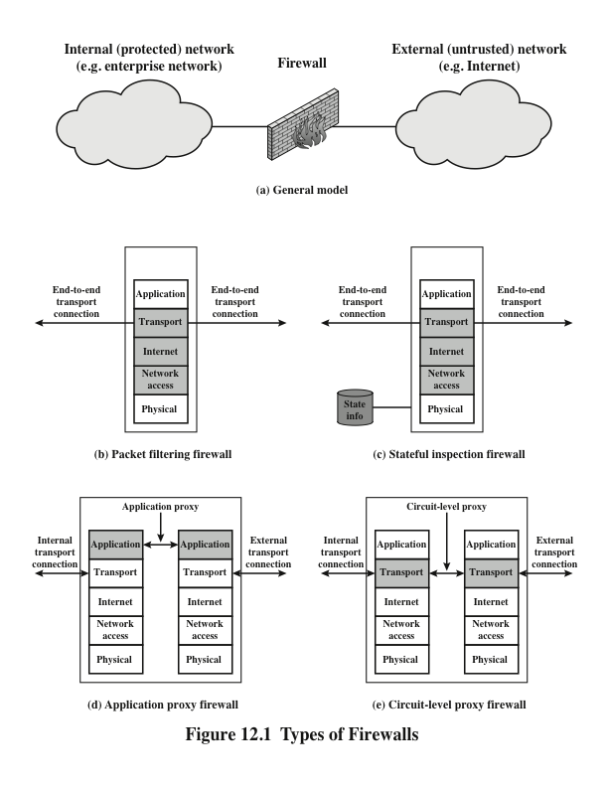

Slide 8
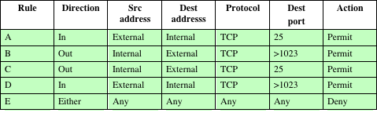
Table 12.1
Packet-Filtering Example Example

Slide 9
Packet Filtering firewalls
Weaknesses
Its simplicity
Transparent to users and are very fast
Because packet filter firewalls do not examine upper-layer data, they cannot prevent attacks that employ application-specific vulnerabilities or functions
Because of the limited information available to the firewall, the logging functionality present in packet filter firewalls is limited
Most packet filter firewalls do not support advanced user authentication schemes
Packet filter firewalls are generally vulnerable to attacks and exploits that take advantage of problems within the TCP/IP specification and protocol stack
Due to the small number of variables used in access control decisions, packet filter firewalls are susceptible to security breaches caused by improper configurations
Strengths

Slide 10
Attacks and countermeasures
IP address spoofing
The intruder transmits packets from the outside with a source IP address field containing an address of an internal host
Countermeasure is to discard packets with an inside source address if the packet arrives on an external interface
Source routing attacks
The source station specifies the route that a packet should take as it crosses the internet, in the hopes that this will bypass security measures that do not analyze the source routing information
Countermeasure is to discard all packets that use this option
Tiny fragment attacks
The intruder uses the IP fragmentation option to create extremely small fragments and force the TCP header information into a separate packet fragment
Countermeasure is to enforce a rule that the first fragment of a packet must contain a predefined minimum amount of the transport header

Slide 11
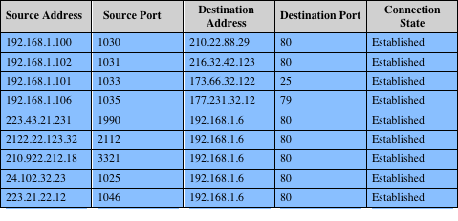
]

Slide 12
Application Level Gateway
Also called an application proxy
Acts as a relay of application-level traffic
If the gateway does not implement the proxy code for a specific application, the service is not supported and cannot be forwarded across the firewall
The gateway can be configured to support only specific features of an application that the network administrator considers acceptable while denying all other features
Tend to be more secure than packet filters
Disadvantage:
The additional processing overhead on each connection

Slide 13
Bastion Host
A system identified by the firewall administrator as a critical strong point in the network’s security
Typically serves as a platform for an application-level or circuit-level gateway

Slide 14
Common Characteristics
Executes a secure version of its operating system, making it a hardened system
Only the services that the network administrator considers essential are installed
May require additional authentication before a user is allowed access to the proxy services
Each proxy is configured to support only a subset of the standard application’s command set
Each proxy is configured to allow access only to specific host systems
Each proxy maintains detailed audit information by logging all traffic, each connection, and the duration of each connection
Each proxy module is a very small software package specifically designed for network security
Each proxy is independent of other proxies on the bastion host
A proxy generally performs no disk access other than to read its initial configuration file
Each proxy runs as a nonprivileged user in a private and secured directory on the bastion host

Slide 15
Host-Based Firewall
A software module used to secure an individual host
Is available in many operating systems or can be provided as an add-on package
Filters and restricts the flow of packets
Common location is a server
Advantages:
Filtering rules can be tailored to the host environment
Protection is provided independent of topology
Used in conjunction with stand-alone firewalls, provides an additional layer of protection

Slide 16
Personal Firewall
Controls the traffic between a personal computer or workstation on one side and the Internet or enterprise network on the other side
Can be used in the home environment and on corporate intranets
Typically is a software module on the personal computer
Primary role is to deny unauthorized remote access to the computer
Can also monitor outgoing activity in an attempt to detect and block worms and other malware

Slide 17
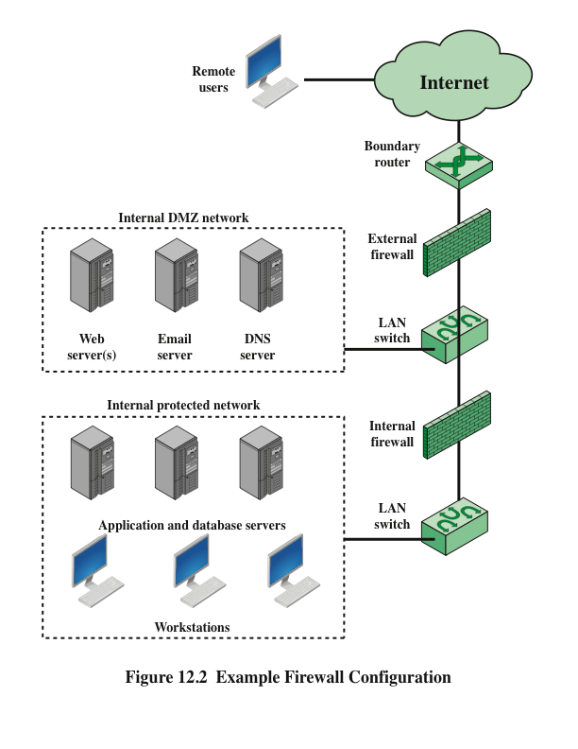

Slide 18
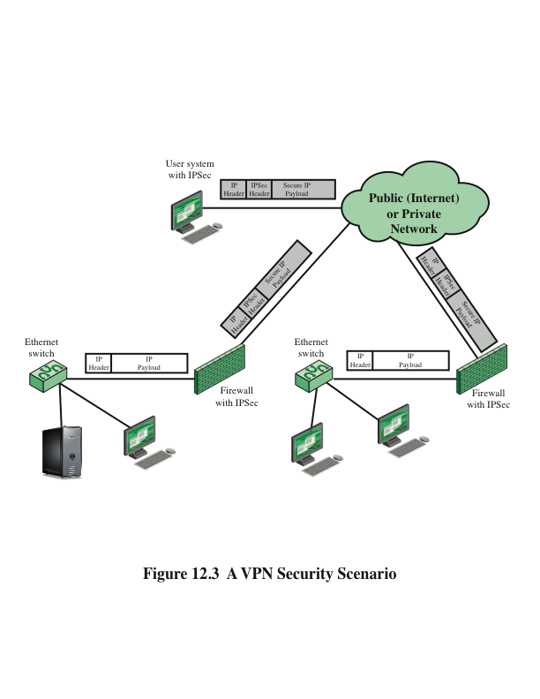

Slide 19
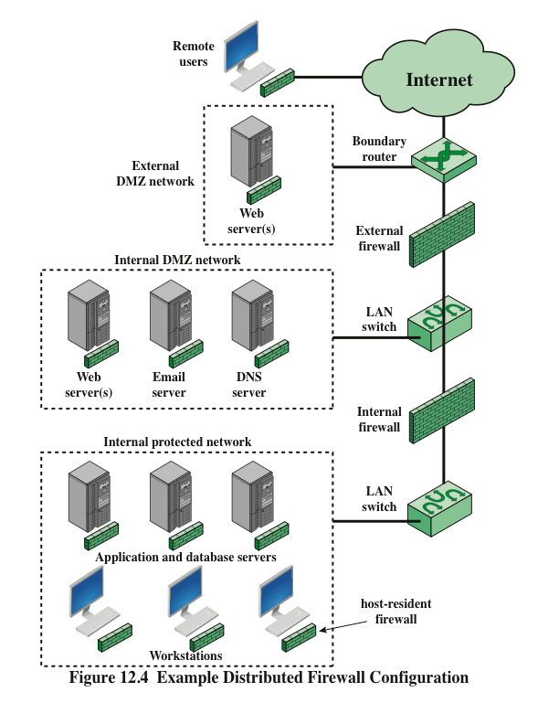

Slide 20
Summary of Firewall Locations and Topologies
Host-resident firewall
This category includes personal firewall software and firewall software on servers
Can be used alone or as part of an in-depth firewall deployment
Screening router
A single router between internal and external networks with stateless or full packet filtering
This arrangement is typical for small office/home office (SOHO) applications
Single bastion inline
A single firewall device between an internal and external router
This is the typical firewall appliance configuration for small-to-medium sized organizations
Single bastion T
Similar to single bastion inline but has a third network interface on bastion to a DMZ where externally visible servers are placed
Double bastion inline
DMZ is sandwiched between bastion firewalls
Double bastion T
DMZ is on a separate network interface on the bastion firewall
Distributed firewall configuration
Used by some large businesses and government organizations

