Slide 1
7 D-DoS Distributed Denial of Service Attacks
Chapter 10, Stallings Network Security Essentials 6th Edition

Slide 2
Contents
Introduction
SYN Flood Attack
Distributed ICMP Attack
Direct DDoS
Reflector DDoS
Constructing the attack network
Countermeasures

Slide 3
Introduction
Attacks that make computer systems inaccessible by flooding servers, networks, or even end-user systems with useless traffic so that legitimate users can no longer gain access to those resources
One way to classify DDoS attacks is in terms of the type of resources that are consumed
The resource consumed is either an internal host resource on the target system or data transmission capacity in the local network in which the target is attacked

Slide 4
SYN flood attack
Stallings shows an example of an internal resource attack - the SYN flood attack.
The attacker takes control of multiple hosts over the Internet
The slave hosts begin sending TCP/IP SYN (synchronize/initialization) packets, with erroneous return IP address information, to the target
For each such packet, the Web server responds with a SYN/ACK (synchronize/acknowledge) packet. The Web server maintains a data structure for each SYN request waiting for a response back and becomes bogged down as more traffic floods in.

Slide 5
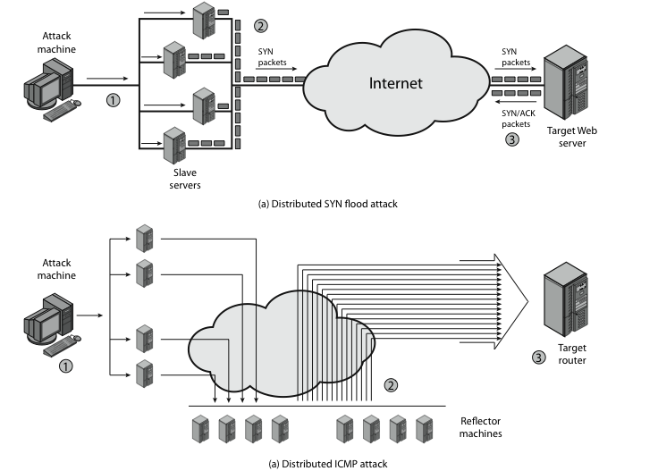
SYN flood attack
Notes:
.

Slide 6
Distributed ICMP Attack
Stallings illustrates an example of an attack that consumes data transmission resources.
The attacker takes control of multiple hosts over the Internet, instructing them to send ICMP ECHO packets with the target’s spoofed IP address to a group of hosts that act as reflectors
Nodes at the bounce site receive multiple spoofed requests and respond by sending echo reply packets to the target site.
The target’s router is flooded with packets from the bounce site, leaving no data transmission capacity for legitimate traffic

Slide 7
Distributed ICMP Attack
Notes:
.

Slide 8
Direct DDoS attacks
Attacker can implant zombie software on a number of sites distributed throughout the Internet.
Often, the DDoS attack involves two levels of zombie machines: master zombies and slave zombies.
The hosts of both machines have been infected with malicious code.
The attacker coordinates and triggers the master zombies, which in turn coordinate and trigger the slave zombies.
The use of two levels of zombies makes it more difficult to trace the attack back to its source and provides for a more resilient network of attackers.

Slide 9
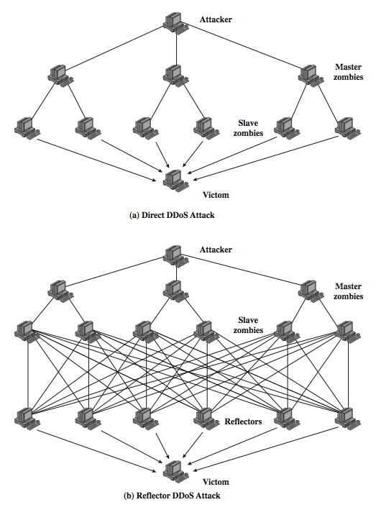
DDoS Flood Types

Slide 10
Reflector DDoS attacks
Adds another layer of machines.
In this type of attack, the slave zombies construct packets requiring a response that contain the target's IP address as the source IP address in the packet's IP header.
These packets are sent to uninfected machines known as reflectors.
The uninfected machines respond with packets directed at the target machine.
More machines and more traffic than a direct DDoS attack and hence be more damaging.
Further, tracing back the attack is more difficult because the attack comes from widely dispersed uninfected machines.

Slide 11
DDoS Flood Types

Slide 12
Constructing the attack network
The first step in a DDoS attack is for the attacker to infect a number of machines with zombie software that will ultimately be used to carry out the attack
Essential ingredients:
Software that can carry out the DDoS attack
A vulnerability in a large number of systems
A strategy for locating vulnerable machines (scanning strategies)

Slide 13
Scanning Strategies
Random
Each compromised host probes random addresses in the IP address space, using a different seed
Hit list
The attacker first compiles a long list of potential vulnerable machines
Topological
This method uses information contained on an infected victim machine to find more hosts to scan
Local subnet
If a host is infected behind a firewall, that host then looks for targets in its own local network

Slide 14
DDoS Countermeasures
In general, there are three lines of defense against DDoS attacks:
Attack prevention and pre-emption (before the attack)
These mechanisms enable the victim to endure attack attempts without denying service to legitimate clients
Attack detection and filtering (during the attack)
These mechanisms attempt to detect the attack as it begins and respond immediately
Attack source traceback and identification (during and after the attack)
This is an attempt to identify the source of the attack as a first step in preventing future attacks

Slide 15
Summary
Introduction
SYN Flood Attack
Distributed ICMP Attack
Direct DDoS
Reflector DDoS
Constructing the attack network
Countermeasures

