Slide 1
Secure Software Development

Slide 2
Contents
Introduction
Infrastructure Security v’s Application Security
Software Development Process
Best practice
OWASP, SANS
Secure UML
Use Case, Mis Use, Abuse
Security by Design Principles OWASP
Secure Coding

Slide 3
Introduction
Software processes are inter-leaved sequences of:
technical,
collaborative and
managerial activities
with the overall goal of
specifying,
designing,
implementing and
testing
a software system.

Slide 4
Introduction
What are the
tools,
techniques and
methods
to support the
development and
maintenance
of systems that can resist malicious attacks ?

Slide 5
Infrastructure Security
Infrastructure security, which is concerned with maintaining the security of all systems and networks that provide an infrastructure and a set of shared services to the organization.
Infrastructure security is a systems management problem where the infrastructure is configured to resist attacks.

Slide 6
Application Security
Application security, which is concerned with the security of individual application systems or related groups of systems.
Application security is a software engineering problem where the system is designed to resist attacks.
Design security in…..

Slide 7
Software process activities (Sommerville)
Software specification, where customers and engineers define the software that is to be produced and the constraints on its operation.
Software development, where the software is designed and programmed.
Software validation, where the software is checked to ensure that it is what the customer requires.
Software evolution, where the software is modified to reflect changing customer and market requirements.

Slide 8
Software Development Process
Many different software processes but all involve:
Specification – defining what the system should do;
Design and implementation – defining the organization of the system and implementing the system;
Validation – checking that it does what the customer wants;
Evolution – changing the system in response to changing customer needs.

Slide 9
Software Development Process
How can security be designed in at all these stages ?
Specification
Design and Implementation
Validation
Evolution

Slide 10
Building Secure Software
Building Security In Maturity Model https://www.bsimm.com/
Microsoft’s SDL Security Development Lifecycle https://www.microsoft.com/en-us/sdl
Software Assurance Forum for Excellence in Code SAFECode https://www.safecode.org/
Oracle Cyber Security initiatives and solutions https://www.oracle.com/security/index.html
OWASP Software Assurance Maturity Model SAMM https://www.owasp.org/index.php/OWASP_SAMM_Project

Slide 11
Best practice
SANS
Secure Coding Standards
Training
Policy templates
OWASP projects for :
Tools
Code
Documentation
CERT Secure Coding

Slide 12
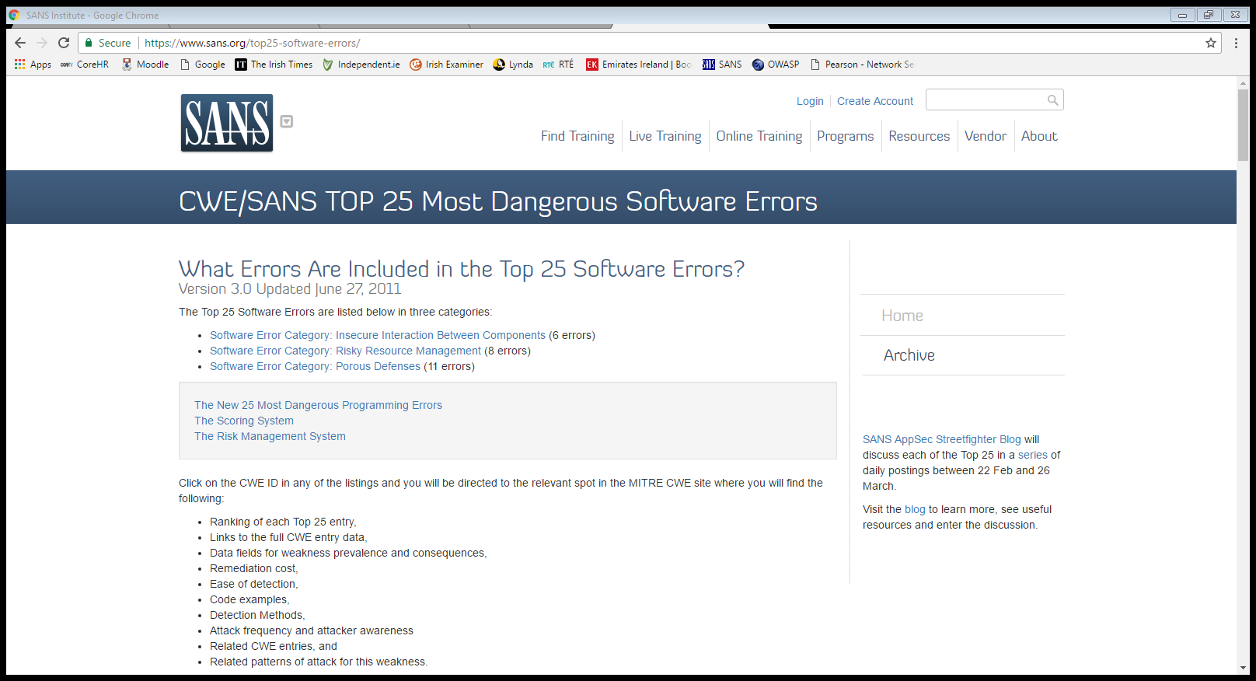
SANS Top 25
https://www.sans.org/top25-software-errors/

Slide 13
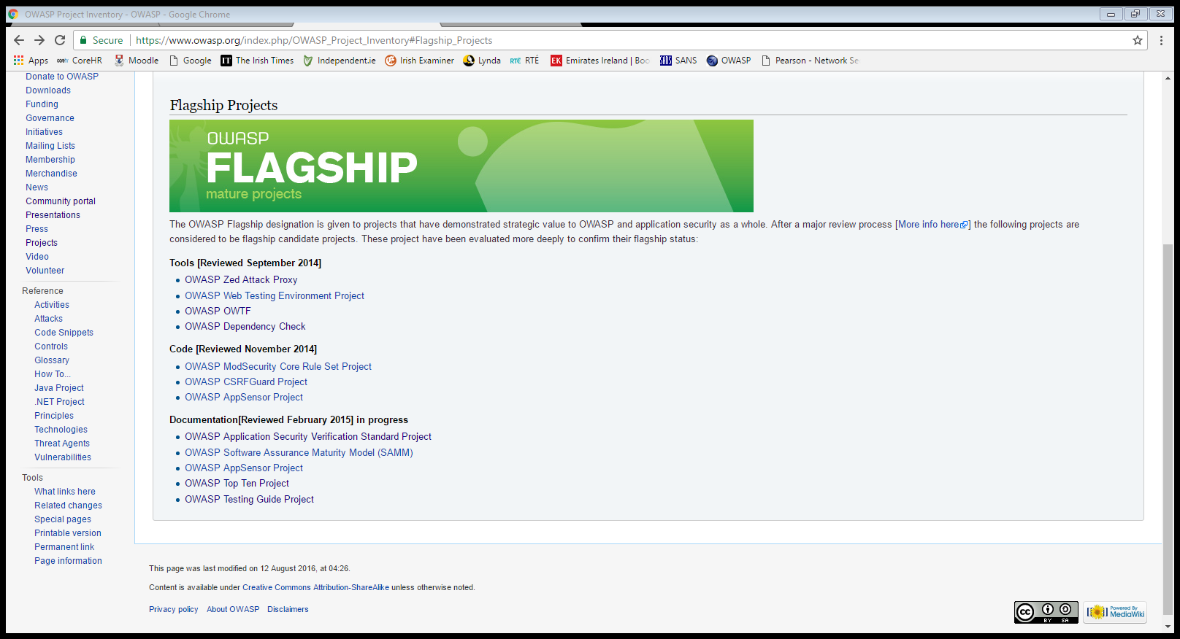
OWASP Flagship Projects
https://www.owasp.org/index.php/OWASP_Project_Inventory#Flagship_Projects

Slide 14
OWASP
OWASP Software Assurance Maturity Model
“The Software Assurance Maturity Model (SAMM) is an open framework to help organizations formulate and implement a strategy for software security that is tailored to the specific risks facing the organization. SAMM helps you:
Evaluate an organization’s existing software security practices
Build a balanced software security assurance program in well-defined iterations
Demonstrate concrete improvements to a security assurance program
Define and measure security-related activities throughout an organization”
OWASP Application Security Verification Standard Project
“The OWASP Application Security Verification Standard (ASVS) Project provides a basis for testing web application technical security controls and also provides developers with a list of requirements for secure development.”

Slide 15
Software Development Process
How can security be designed in at all these stages ?
Specification (OWASP SAMM)
Design (Secure UML) and Implementation (Secure Coding)
Validation (OWASP ASVS)
Evolution

Slide 16
Secure UML
Use Case
Misuse Case
Abuse Case

Slide 17
Misuse cases (Sommerville)
Misuse cases are instances of threats to a system
Interception threats
Attacker gains access to an asset
Interruption threats
Attacker makes part of a system unavailable
Modification threats
A system asset if tampered with
Fabrication threats
False information is added to a system

Slide 18
Misuse cases (Sommerville)

Slide 19
Mentcare use case – Transfer data
Mentcare system: Transfer data
Actors | Medical receptionist, Patient records system (PRS)
Description | A receptionist may transfer data from the Mentcare system to a general patient record database that is maintained by a health authority. The information transferred may either be updated personal information (address, phone number, etc.) or a summary of the patient’s diagnosis and treatment.
Data | Patient’s personal information, treatment summary.
Stimulus | User command issued by medical receptionist.
Response | Confirmation that PRS has been updated.
Comments | The receptionist must have appropriate security permissions to access the patient information and the PRS.

Slide 20
Mentcare misuse case: Intercept transfer
Mentcare system: Intercept transfer (Misuse case)
Actors | Medical receptionist, Patient records system (PRS), Attacker
Description | A receptionist transfers data from his or her PC to the Mentcare system on the server. An attacker intercepts the data transfer and takes a copy of that data.
Data (assets) | Patient’s personal information, treatment summary
Attacks | A network monitor is added to the system and packets from the receptionist to the server are intercepted. A spoof server is set up between the receptionist and the database server so that receptionist believes they are interacting with the real system.

Slide 21
Misuse case: Intercept transfer
Mentcare system: Intercept transfer (Misuse case)
Mitigations | All networking equipment must be maintained in a locked room. Engineers accessing the equipment must be accredited. All data transfers between the client and server must be encrypted. Certificate-based client-server communication must be used
Requirements | All communications between the client and the server must use the Secure Socket Layer (SSL). The https protocol uses certificate based authentication and encryption.

Slide 22
Use Cases – key ideas
A use case illustrates the activities that are performed by users of a system.
It identifies the Actors involved in an interaction and names the type of interaction.
It illustrates the functionality of the system.
Use cases are logical models -- they describe the activities of a system without specifying how the activities are implemented.

Slide 23
UML model of functional requirements

Slide 24
What are Use Case descriptions?
Describe basic functions of the system
What the user can do
How the system responds
Use cases are building blocks for continued design activities.

Slide 25
How Are Use Cases Created?
Two steps:
Write text-based case descriptions
Translate descriptions into diagrams
Describes one and only one function, but may have multiple paths.
Developed working with users for content.

Slide 26
UML Syntax

Slide 27
Appointment System

Slide 28
Extends and Includes relationships

Slide 29
Use Cases do not cover
Implementation
How functions are implemented
Non-functional requirements
Performance
Scalability
Security
Price
Sequencing
State modelling

Slide 30
Misuse Cases
UML does not cater specifically for misuse/abuse cases
Extending use cases to include misuse cases can be very useful for threat modelling
A number of different styles are used for misuse cases
New keywords introduced e.g.
<<threaten>> and <<mitigate>

Slide 31
Adapted from: Eliciting security requirements with misuse cases, Sindre & Opdahl

Slide 32
Adapted from: Eliciting security requirements with misuse cases, Sindre & Opdahl

Slide 33
Adapted from: Eliciting security requirements with misuse cases, Sindre & Opdahl

Slide 34
Adapted from: Eliciting security requirements with misuse cases, Sindre & Opdahl

Slide 35
Adapted from: Eliciting security requirements with misuse cases, Sindre & Opdahl

Slide 36
Adapted from: Eliciting security requirements with misuse cases, Sindre & Opdahl

Slide 37
Adapted from: Eliciting security requirements with misuse cases, Sindre & Opdahl

Slide 38
OWASP Security by Design Principles
Minimize attack surface area
Establish secure defaults
Principle of Least privilege
Principle of Defense in depth
Fail securely
Don’t trust services
Separation of duties
Avoid security by obscurity
Keep security simple
Fix security issues correctly

Slide 39
1. Minimize attack surface area
The aim for secure development is to reduce the overall risk by reducing the attack surface area.
For example, a web application implements online help with a search function. The search function may be vulnerable to SQL injection attacks.
If the help feature was limited to authorized users, the attack likelihood is reduced.
If the help feature’s search function was gated through centralized data validation routines, the ability to perform SQL injection is dramatically reduced.
However, if the help feature was re-written to eliminate the search function this almost eliminates the attack surface area.

Slide 40
2. Establish secure defaults
Security mechanisms and policies should be ON by default.
If allowed it should be use to the user to turn these mechanisms and policies OFF.
For example, by default, password aging and complexity should be enabled.
Users might be allowed to turn these two features off to simplify their use of the application and increase their risk.

Slide 41
3. Principle of Least privilege
Accounts should have the least amount of privilege required to perform their business processes.
user rights, resource permissions such as CPU limits, memory, network, and file system permissions.
For example, if a middleware server only requires access to the network, read access to a database table, and the ability to write to a log, this is the only privilege it should have.
Under no circumstances should the middleware be granted administrative privileges

Slide 42
4. Principle of Defense in depth
If one control is reasonable, more controls that approach risks in different ways is better.
With secure coding, this may take the form of tier-based validation, centralized auditing controls, and requiring users to be logged on all pages.
For example, a flawed admin interface is unlikely to be vulnerable to attack if it correctly gates access to internal networks, checks user authorization, and logs all access.

Slide 43
5. Fail Securely
Applications regularly fail to process transactions for many reasons. How they fail can determine if an application is secure or not.
For example:
isAdmin = true;
try {
codeWhichMayFail();
isAdmin = isUserInRole( “Administrator” );
}
catch (Exception ex) {
log.write(ex.toString());
}
If either codeWhichMayFail() or isUserInRole() fails or throws an exception, the user is an admin by default.

Slide 44
6. Don’t trust services
Organisations use the processing capabilities of third party partners, who more than likely have differing security policies than them.
Implicit trust of externally run systems is not warranted.
For example, a loyalty program provider provides data that is used by Internet Banking, providing the number of reward points and a small list of potential redemption items. However, the data should be checked to ensure that it is safe to display to end users, and that the reward points are a positive number, and not improbably large.

Slide 45
7. Separation of duties
A key fraud control is separation of duties.
For example, someone who requests a computer cannot also sign for it, nor should they directly receive the computer. This prevents the user from requesting many computers, and claiming they never arrived.
Certain roles have different levels of trust than normal users. In particular, administrators are different to normal users. In general, administrators should not be users of the application.
For example, an administrator should be able to turn the system on or off, set password policy but shouldn’t be able to log on to the storefront as a super privileged user, such as being able to “buy” goods on behalf of other users.

Slide 46
8. Avoid security by obscurity
Security through obscurity is a weak security control, and nearly always fails when it is the only control.
This is not to say that keeping secrets is a bad idea, it simply means that the security of key systems should not be reliant upon keeping details hidden.
For example, the security of an application should not rely upon knowledge of the source code being kept secret.
The security should rely upon many other factors, including reasonable password policies, defense in depth, business transaction limits, solid network architecture, and fraud and audit controls.
A practical example is Linux.
Linux’s source code is widely available, and yet when properly secured, Linux is a hardy, secure and robust operating system.

Slide 47
9. Keep security simple
Attack surface area and simplicity go hand in hand.
Certain software engineering fads prefer overly complex approaches to what would otherwise be relatively straightforward and simple code.
Developers should avoid the use of complex architectures when a simpler approach would be faster and simpler.

Slide 48
10. Fix security issues correctly
Once a security issue has been identified, it is important to develop a test for it, and to understand the root cause of the issue.
For example, a user has found that they can see another user’s balance by adjusting their cookie. The fix seems to be relatively straightforward, but as the cookie handling code is shared among all applications, a change to just one application will trickle through to all other applications. The fix must therefore be tested on all affected applications.

Slide 49
Secure coding
Easily avoided software defects
primary cause of commonly exploited software vulnerabilities.
By identifying insecure coding practices and developing secure alternatives,
software developers can take practical steps to reduce or eliminate vulnerabilities before deployment

Slide 50
Cert secure coding initiative
Secure Coding standards
CERT Program working with software developers to develop standards for commonly used programming languages.
Development Tools and Libraries
The CERT Program has developed tools and libraries that help software developers reduce the number of vulnerabilities in their code.

