Slide 1
Computer Security
2.1 Classical Encryption

Slide 2
Contents of this section
Classical Encryption
Caesar Cipher
Monoalphabetic substitution
Vigenere Cipher
One-time pad techniques
Transposition Cipher

Slide 3
Classical Encryption
Before the advent of modern computer systems, cryptosystems tended to be based on natural languages (e.g. English text)
Two major techniques
  Substitution
    Maps each plaintext element onto corresponding element of ciphertext
  Transposition
    Rearranges the plaintext (same as permutation)

Slide 4
Caesar Cipher
Early substitution cipher for text
Alphabetic circular shift
For each letter i of text:
let p_{i}=0 if letter is a, p_{i}=1 if letter is b, etc
let key k be the size of the shift
Encryption: c_{i} = E_{k}(p_{i}) = (p_{i} + k) mod 26
Decryption: p_{i} = D_{k}(c_{i})= (c_{i} – k) mod 26
Example (setting k = 3)
attack at dawn
DWWDFN DW GDZQ

Slide 5
Caesar Cipher
C_{i =} E_{k} (p_{i}) = (p_{i}+k) mod 26
(A + 3) mod 26
0+3
3
A = D
attack at dawn
DWWDFN DW GDZQ

Slide 6
Caesar Cipher
Example (setting k = 3)
attack at dawn
DWWDFN DW GDZQ
Encryption
Decryption
0 | 1 | 2 | 3 | 4 | 5 | 6 | 7 | 8 | 9 | 10 | 11 | 12 | 13 | 14 | 15 | 16 | 17 | 18 | 19 | 20 | 21 | 22 | 23 | 24 | 25
A | B | C | D | E | F | G | H | I | J | K | L | M | N | O | P | Q | R | S | T | U | V | W | X | Y | Z
X | Y | Z | A | B | C | D | E | F | G | H | I | J | K | L | M | N | O | P | Q | R | S | T | U | V | W

Slide 7
Exercises
Decrypt the following English Texts, which were encrypted with a Caesar Cipher:
  GVCTXEREPCWMW
  YURBKJ
Encrypt the following English text using a Caesar Cipher and a key = 3.
  BOMB THE PALACE
Encrypt the following English text using a Caesar Cipher and a key = 10.
  ATTACK AT MIDNIGHT
Encrypt a message of your own using a key of your choice. Swop with a colleague and attempt to decrypt their message.

Slide 8
Attacking Caesar Cipher
Brute force
  Key is just one letter (or number between 1 and 25)
  Try all 25 keys
  Easy!

Slide 9
Monoalphabetic substitution
Use arbitrary mapping of plaintext letters onto ciphertext
  e.g.
Example:
attack at dawn
XCCXQJ XC MXBF

Slide 10
Attacking Monoalphabetic substitution
Brute force
  Very difficult; Key is 26 letters long
  No. of possible keys = 26! = 4 x 10²⁶
Algorithm weaknesses:
  Frequency of letters in English language is well known
    Can deduce plaintext->ciphertext mapping by analysing frequency of occurrence
    e.g. on analysing plenty of ciphertext, most frequent letter probably corresponds to ‘E’
  Can spot digrams and trigrams
    Digram: common 2-letter sequence; e.g. ‘th’, ‘an’, ‘ed’
    Trigram: common 3-letter sequence: e.g. ‘ing’, ‘the’, ‘est’

Slide 11

English Letter Frequencies

Slide 12
Attacking Monoalphabetic substitution
Given ciphertext:
  UZQSOVUOHXMOPVGPOZPEVSGZWSZOPFPESXUDBMETSXAIZVUEPHZHMDZSHZOWSFPAPPDTSVPQUZWYMXUZUHSXEPYEPOPDZSZUFPOMBZWPFUPZHMDJUDTMOHMQ
Count relative letter frequencies

Slide 13
Letter Frequencies
A: 2
B: 2
C: 0
D: 6
E: 6
F: 4
G: 2
H: 7
I: 1
J: 1
K: 0
L: 0
M: 8
N: 0
O: 9
P: 16
Q: 3
R: 0
S: 10
T: 3
U: 10
V: 5
W: 4
X: 5
Y: 2
Z: 14

Slide 14
Attacking Monoalphabetic substitution
Given ciphertext:
  UZQSOVUOHXMOPVGPOZPEVSGZWSZOPFPESXUDBMETSXAIZVUEPHZHMDZSHZOWSFPAPPDTSVPQUZWYMXUZUHSXEPYEPOPDZSZUFPOMBZWPFUPZHMDJUDTMOHMQ
Count relative letter frequencies
Guess P & Z are e and t

Slide 15
Attacking Monoalphabetic substitution
Given ciphertext:
  UZQSOVUOHXMOPVGPOZPEVSGZWSZOPFPESXUDBMETSXAIZVUEPHZHMDZSHZOWSFPAPPDTSVPQUZWYMXUZUHSXEPYEPOPDZSZUFPOMBZWPFUPZHMDJUDTMOHMQ
Guess ZW is th and hence ZWP is the
Proceeding with trial and error, we finally get:
  it was disclosed yesterday that several informal but direct contacts have been made with political representatives of the viet cong in moscow

Slide 16
Vigenère Cipher
Polyalphabetic Substitution Cipher
“Add” repeating keyword to plaintext (using tabula recta)
Example:
key: witwitwitwitwitwitwitwitwit
plaintext: wearediscoveredsaveyourself
ciphertext: SMTNMWEAVKDXNMWOIOAGHQZLATY
http://www.counton.org/explorer/codebreaking/vigenere-cipher.php

Slide 17
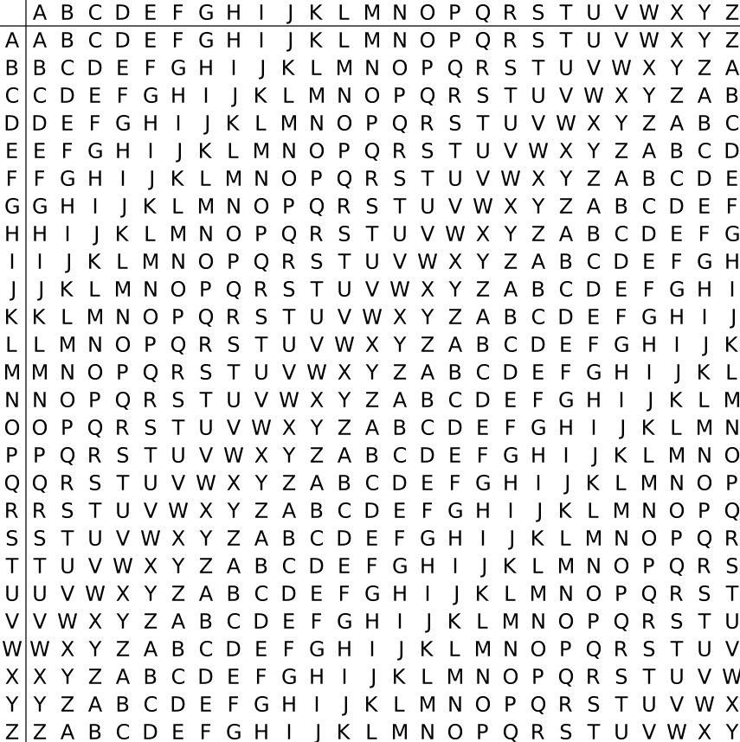
Vigenère Cipher: tabula recta

Slide 18
Attacking Vigenère Cipher
Brute force
  Very difficult; like password cracking
  The longer the key the harder brute force is
  Having a sufficiently long key means this scheme is effectively unbreakable by brute force (alone)

Slide 19
Attacking Vigenère Cipher
Algorithm weaknesses
  Trick is to find key length
    If key length is known, then we effectively have that many monoalphabetic ciphers
    Can then do frequency analysis on each of these
    e.g. if ciphertext is SMTNMWEAVKDXNMWOIOAGHQZLATY and key length is 3, then we have 3 monoalphabetic ciphers to crack:
    SNEKNOAQA, MMADMIGZT, TWVXWOHLY
  Key length can be found by Kasiski examination:
    Based on the fact that commonly repeated words will eventually be encrypted using the same key letters. The period between these repetitions will be a multiple of the key length

Slide 20
One-Time Pad
Unbreakable substitution cipher
Uses random key that is at least as long as the message
Can use key only once

Slide 21
Transposition Ciphers
Involve some kind of permutation of plaintext letters
Example – rail fence technique
  write message “attack at midnight” out as:
    a t c a m d i h
    t a k t i n g t
  giving ciphertext
    ATCAMDIHTAKTINGT
Modern techniques use product ciphers, that combine transposition and substitution

