Slide 1
Computer
Security
      2.2 Modern Encryption

Slide 2
Contents of this section
Modern Encryption
  Feistal Cipher
Algorithms
  DES
  3DES
  AES
  Others
Stream Ciphers
Random Number Generation

Slide 3
XOR
Modern techniques use bits rather than text letters
Most transformations use eXclusive OR
Speed is the main benefit of using XOR
XOR truth table:
XOR properties:
  A ⊕ A = 0
  A ⊕ 0 = A
  (A ⊕ B) ⊕ B = A
A | B | A ⊕ B
0 | 0 | 0
0 | 1 | 1
1 | 0 | 1
1 | 1 | 0

Slide 4
Feistel Cipher
Partitions block into two halves, L₀ and R₀
Processes through n rounds
Divide key into n subkeys, one per round
At each round i:
  Perform substitution on current left half L_{i–1} by XORing it with F(K_{i}, R_{i–1})
  F is known as the round function.
  Swap halves (this is a permutation)
Basis of most modern block ciphers

Slide 5
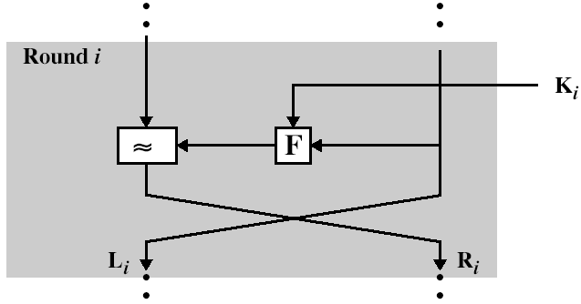
⊕
R_{i} = L_{i-1} ⊕ F(K_{i}, R_{i–1})
L_{i} = R_{i-1}
K_{i} is subkey derived from the overall key

Slide 6
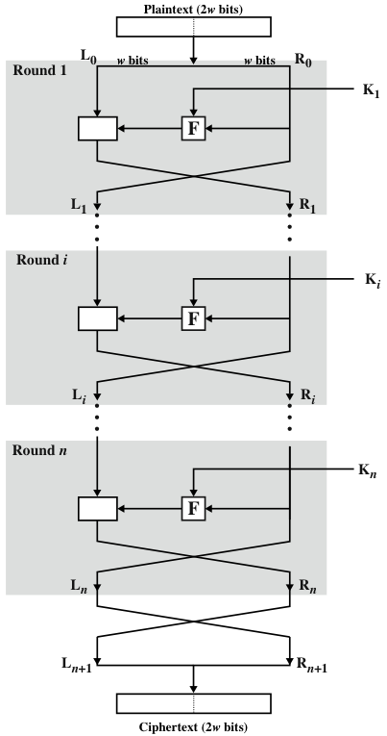
Feistel Network
⊕
n rounds
Decryption same as encryption, except subkeys are supplied in reverse order
⊕
⊕

Slide 7
Algorithms
Algorithms based on Feistel structure can vary in:
  Block size
  Key size
  Subkey generation algorithm
  No. of rounds
  The round function, F

Slide 8
Algorithm | Key Size (bits) | Block Size (bits) | No. of Rounds | Applications
DES | 56 | 64 | 16 | SET, Kerberos
Triple DES | 168 | 64 | 48 | Financial key management, PGP, S/MIME
IDEA | 128 | 64 | 8 | PGP
Blowfish | variable to 448 | 64 | 16 | Various software packages
RC5 | variable to 2048 | 64 | variable to 255 | Various software packages
AES | 128, 192, or 256 | 128 | 10, 12, or 14 | Intended to replace DES and 3DES
AES is not a Feistel Cipher, but is included here for comparison

Slide 9
DES
Data Encryption Standard (1976)
Block size: 64 bits
Key size: 56 bits
No. of rounds: 16
Feistel cipher with additional Initial and Final Permutations

Slide 10
Triple DES (3DES)
Motivated by concerns over security of DES
  56-bit key felt to be insufficient
3DES uses three keys and three executions of DES
Effective key length is 168 bits

Slide 11
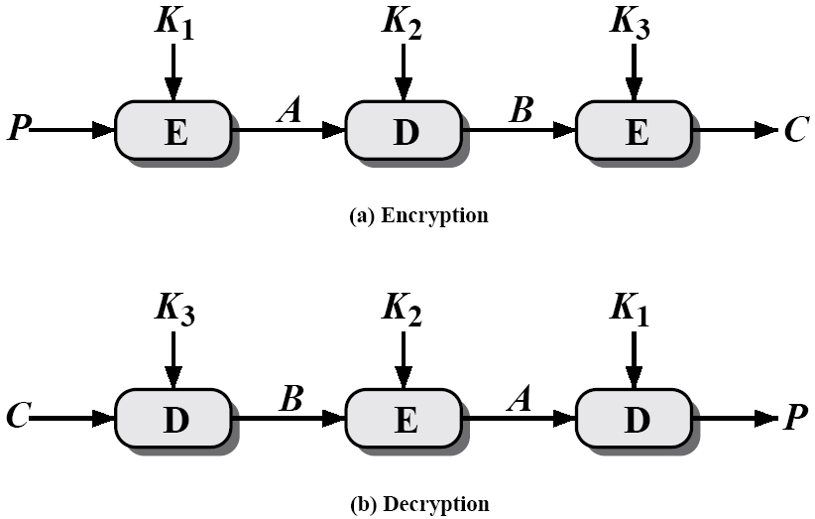
Triple DES (3DES)
Encryption
C = E_{K3}[D_{K2}[E_{K1}[P]]]
Decryption
P = D_{K1}[E_{K2}[D_{K3}[C]]]

Slide 12
AES
Advanced Encryption Standard (2001)
Chosen by design competition
Requirements:
  Algorithm in public domain
  Royalty-free
  Block size: 128 bits
  Key sizes: 128, 192, 256

Slide 13
AES
Other Criteria
  Speed – on different types of processor
  Small memory requirement (e.g. for smart cards)
  Security
  Simplicity
  Suitability for both hardware and software
  Flexibility in key size, etc
Winner: Rijndael (Belgium)

Slide 14
Other Notable Algorithms
IDEA (International Data Encryption Algorithm)
  128-bit key
  Considered very safe
  Used in PGP
Blowfish
  Schneier, 1994
  Fast and fairly compact (5K)
  Key size: 32, 64, 96, 128, …, 448 bits
RC5
  Adaptable to processors of different word sizes
  Variable number of rounds

Slide 15
Stream Ciphers
Process message bit by bit* (or a few bits at a time)
Have a pseudo random keystream which is combined (XOR) with plaintext bit by bit
Randomness of stream key completely destroys statistically properties in message
  C_{i} = P_{i} XOR StreamKey_{i}
But must never reuse stream key
  otherwise can recover messages

Slide 16
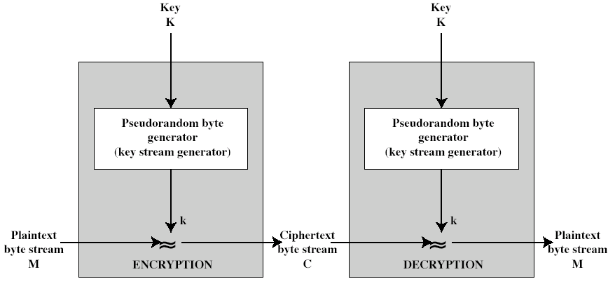
Stream Cipher Structure
⊕
⊕
C_{i} = P_{i} ⊕ k_{i}
P_{i} = C_{i} ⊕ k_{i}

Slide 17
Stream Cipher Properties
Some design considerations for stream cipher:
  Pseudorandom number generators are deterministic and eventually repeat. The period should be large
  Keystream should be statistically random
  Large enough key to prevent brute force attack
Properly designed, can be as secure as a block cipher with same size key
But usually simpler & faster

Slide 18
RC4: a stream cipher
Proprietary cipher, owned by RSA Inc
Developed in 1987, but not published until 1994
Variable key size, byte-oriented stream cipher
Widely used (e.g. WEP)

Slide 19
RC4 Security
Claimed to be secure
  Some theoretical methods of attack
Since RC4 is a stream cipher, must never reuse a key
Concerns with the way it is used in WEP. This is due to key handling rather than RC4 itself

Slide 20
Random Number Generation

Slide 21
Uses of random numbers
In cryptography
  Selection of symmetric session keys
  Generation of keys for public-key algorithms such as RSA
  Generation of nonces and IVs required for some protocols
In many other applications
  lotteries, gambling, simulation, statistical sampling, jury selection, sports, …
  even in nature: genetic mutation
It is important that numbers used are close to truly random

Slide 22
Requirements
There are two main requirements for random numbers:
Randomness
  The following two criteria are used to validate that a sequence of numbers is random:
    Uniform distribution – that the numbers chosen are evenly spread over the range
    Interdependence – no one value of a sequence of random numbers can be inferred from the others
Unpredictability
  Given the beginning of a sequence of random numbers generated from some source, it must be impossible to predict any future elements of the sequence

Slide 23
True random number generation
Numbers that are close to truly random
  may be available from the physical environment
    based on naturally random phenomena, such as Brownian motion of particles of a fluid
  or may be generated by triggering a physical process
    This is done by hardware random number generators
    that generate physical noise (e.g. electromagnetic or thermal)
    and convert this noise into a digital signal
Attempts to use these in general purpose network security applications have largely failed.

Slide 24
Pseudorandom number generation
Cryptographic algorithms prefer algorithmic techniques.
Pseudo-random number generators (PRNGs) rely on a short seed. The seed should be close to truly random.
These algorithmic techniques are deterministic and therefore produce sequence of numbers that are not truly random.
  Deterministic: will repeatedly give the same result for the same input (seed)
It is possible to produce sequences of numbers that pass all reasonable tests for randomness, if a suitable algorithm is chosen

Slide 25
Blum Blum Shub (BBS)
Most commonly used
  Simple
  Fast
  Secure

Slide 26
Randomness Requirements for Security
RFC 4086
  From IETF (Internet Engineering Task Force)
  June 2005

Slide 27
Random numbers vulnerabilities are a real problem
Large number of vulnerabilities caused by bad random number generation
  e.g. Debian (Linux distribution) 2008 OpenSSL release used 15-bit process ID as seed for PRNG. Result: only 32,768 possible TLS (SSL) keys.
Early 2012 survey of millions of public keys found significant duplication of keys – i.e. same key used twice in different places
  This strongly suggests poor RNG seeding
  Chance of collision should be impossibly tiny

